Slide 1
The visual interpretation of decision trees
(How to lead a fulfilling life by being dissatisfied)
Terence Parr University of San Francisco
Work done with Prince Grover
manifold.ai

Slide 2
Topics
How regression and classification decision trees work
Visualizing key elements of decision trees
Lessons learned about visualization
How to lead a fulfilling life by being dissatisfied

Slide 3
Decision trees

Slide 4
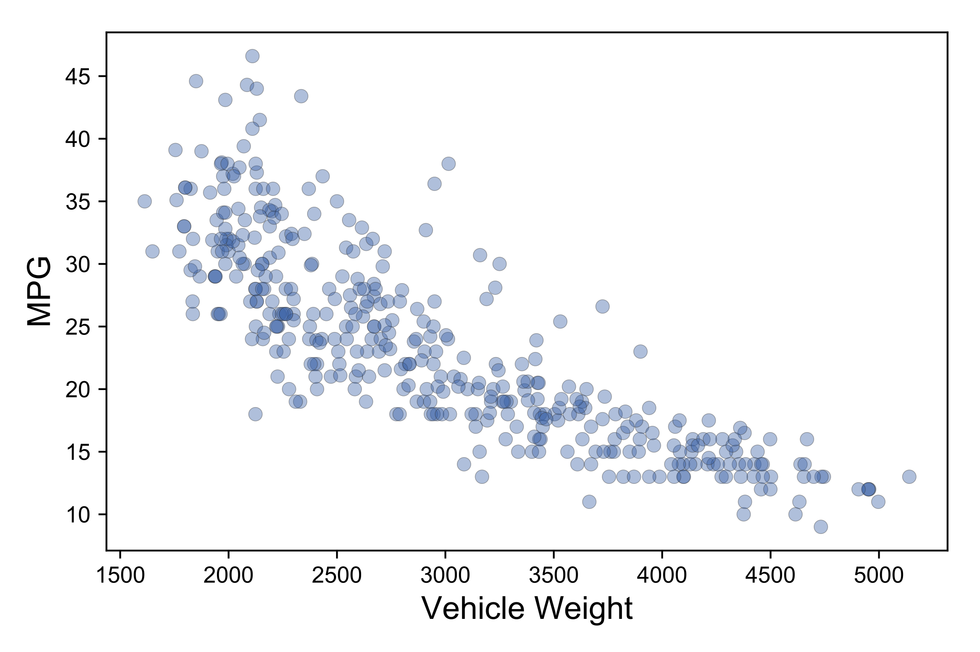
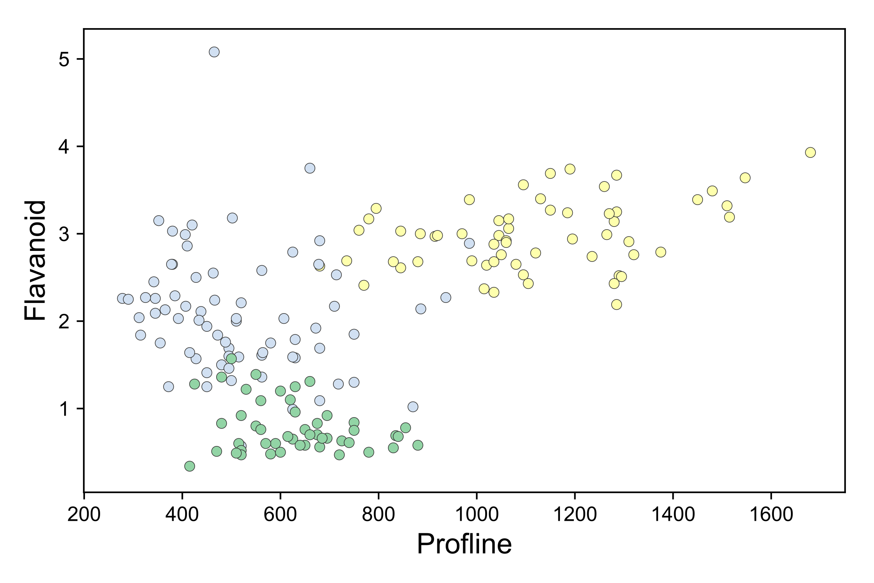
Regression versus classification
Regressors draw through data
Classifiers draw between data clusters

Slide 5
Different models have different surfaces

Slide 6
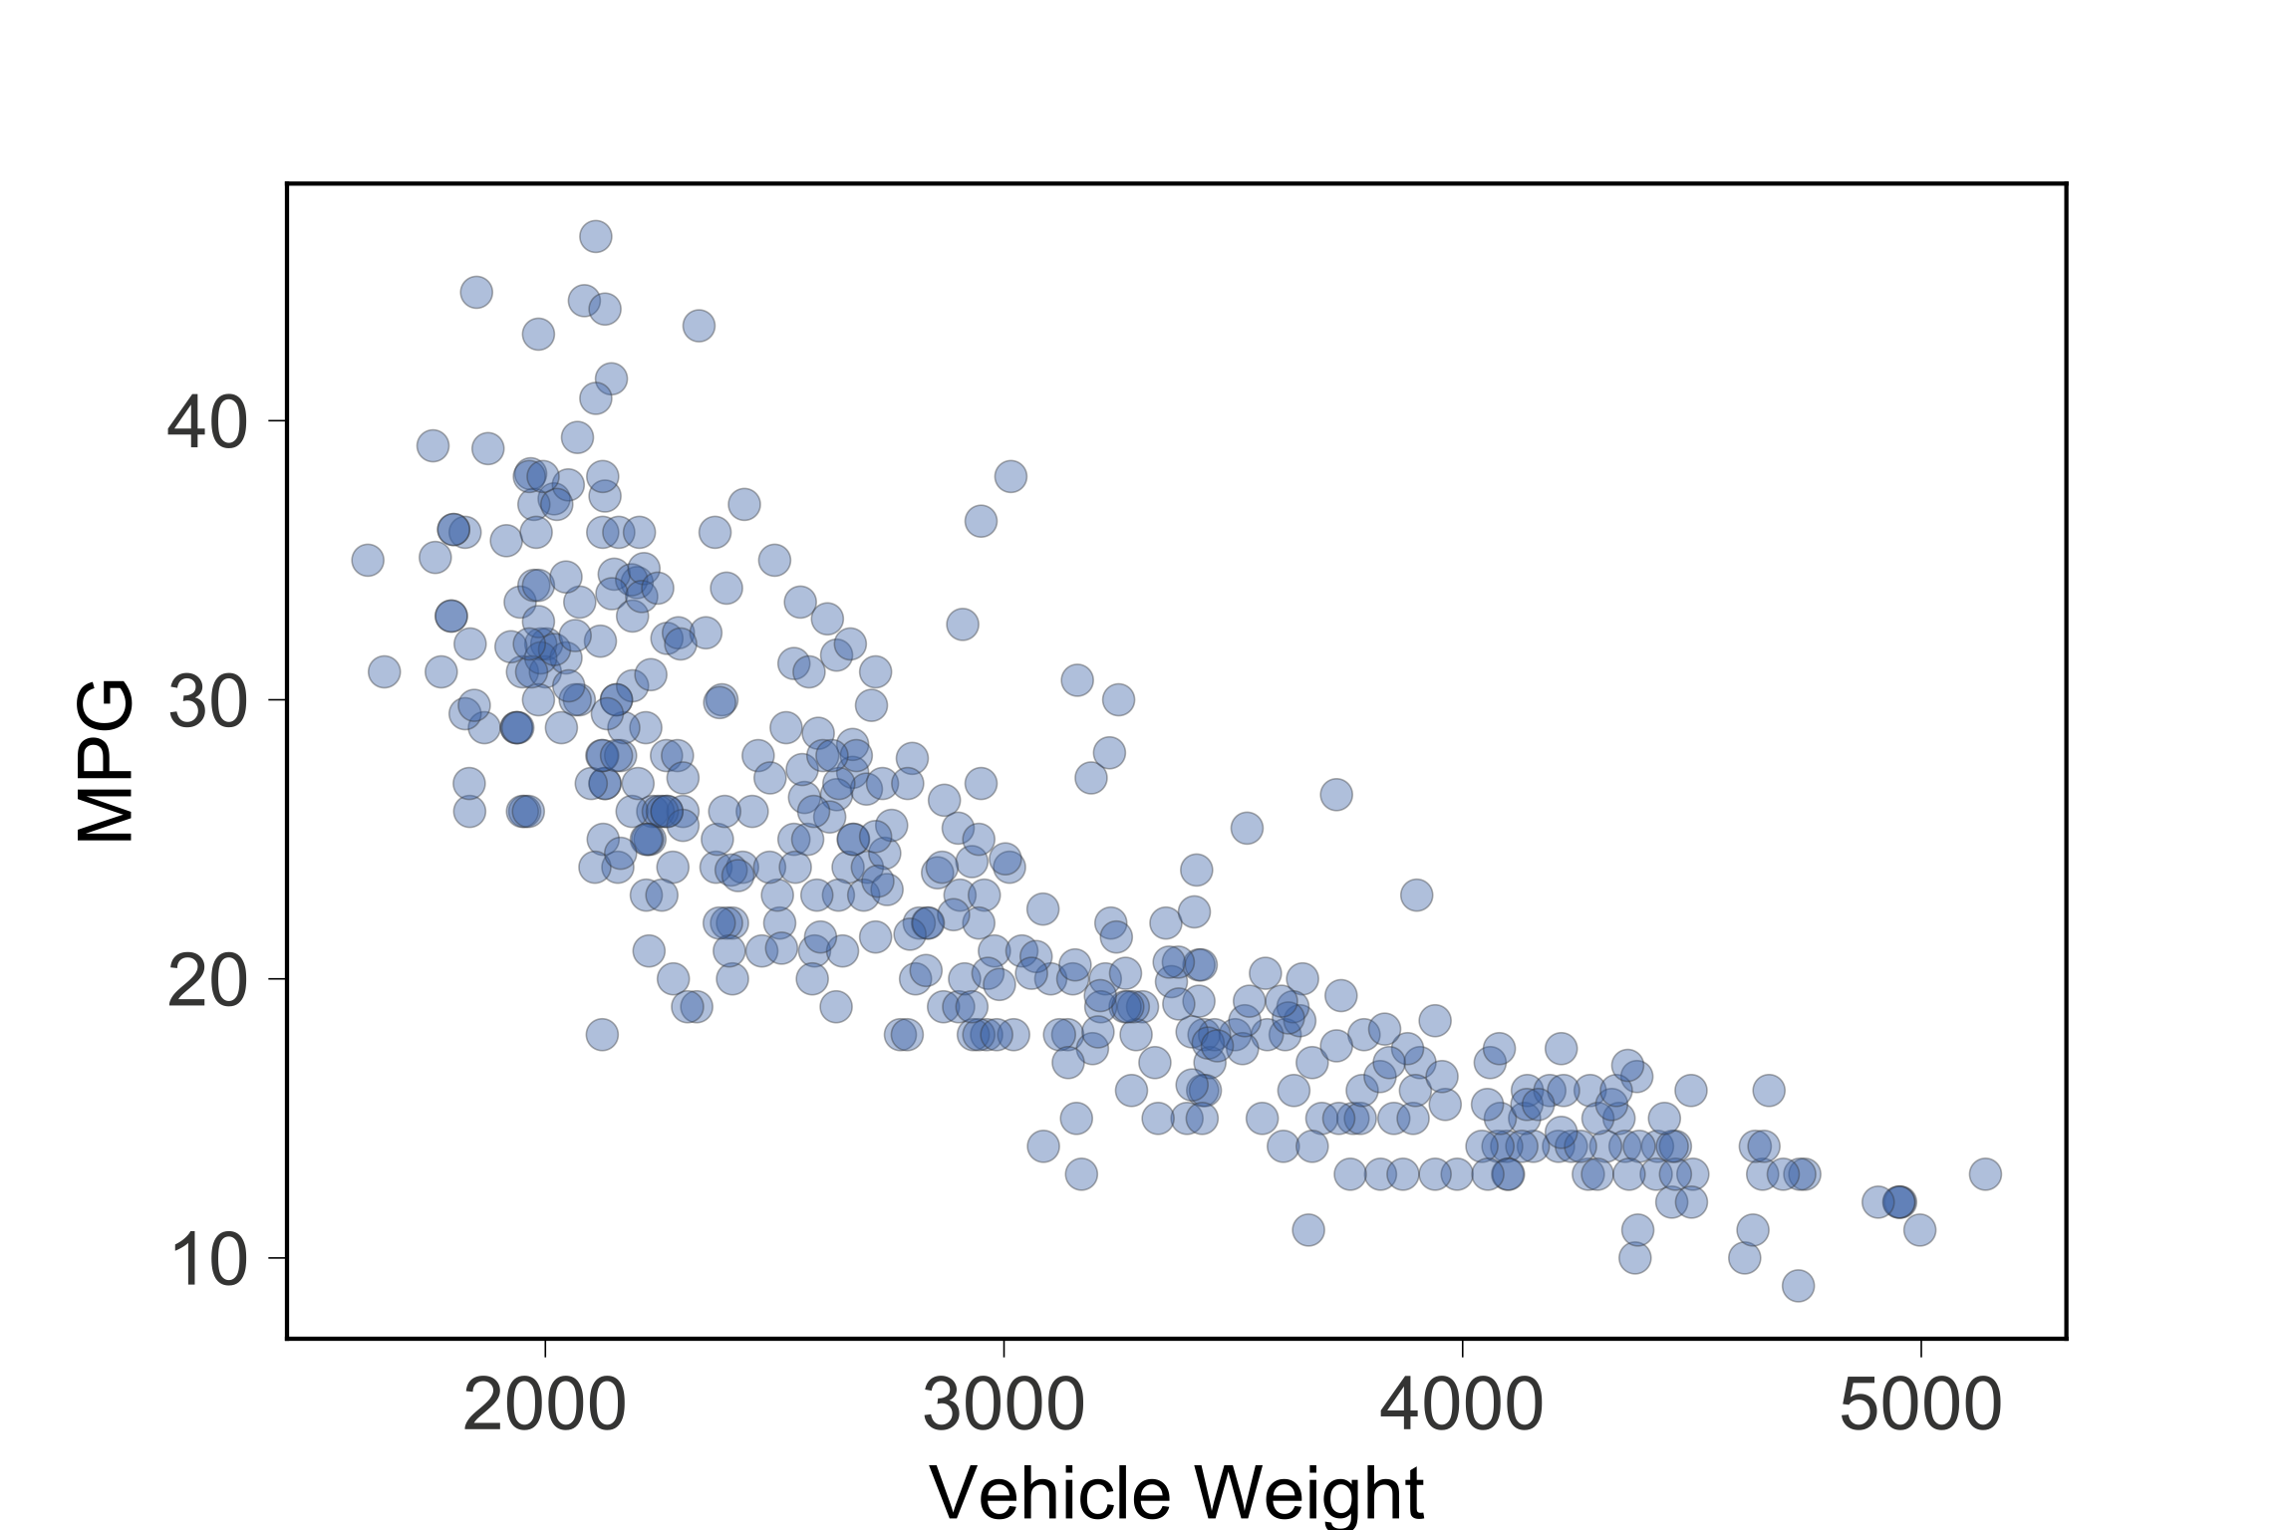
Let’s invent a simple regressor
Predict a single
constant for
entire range
(the mean)

Slide 7
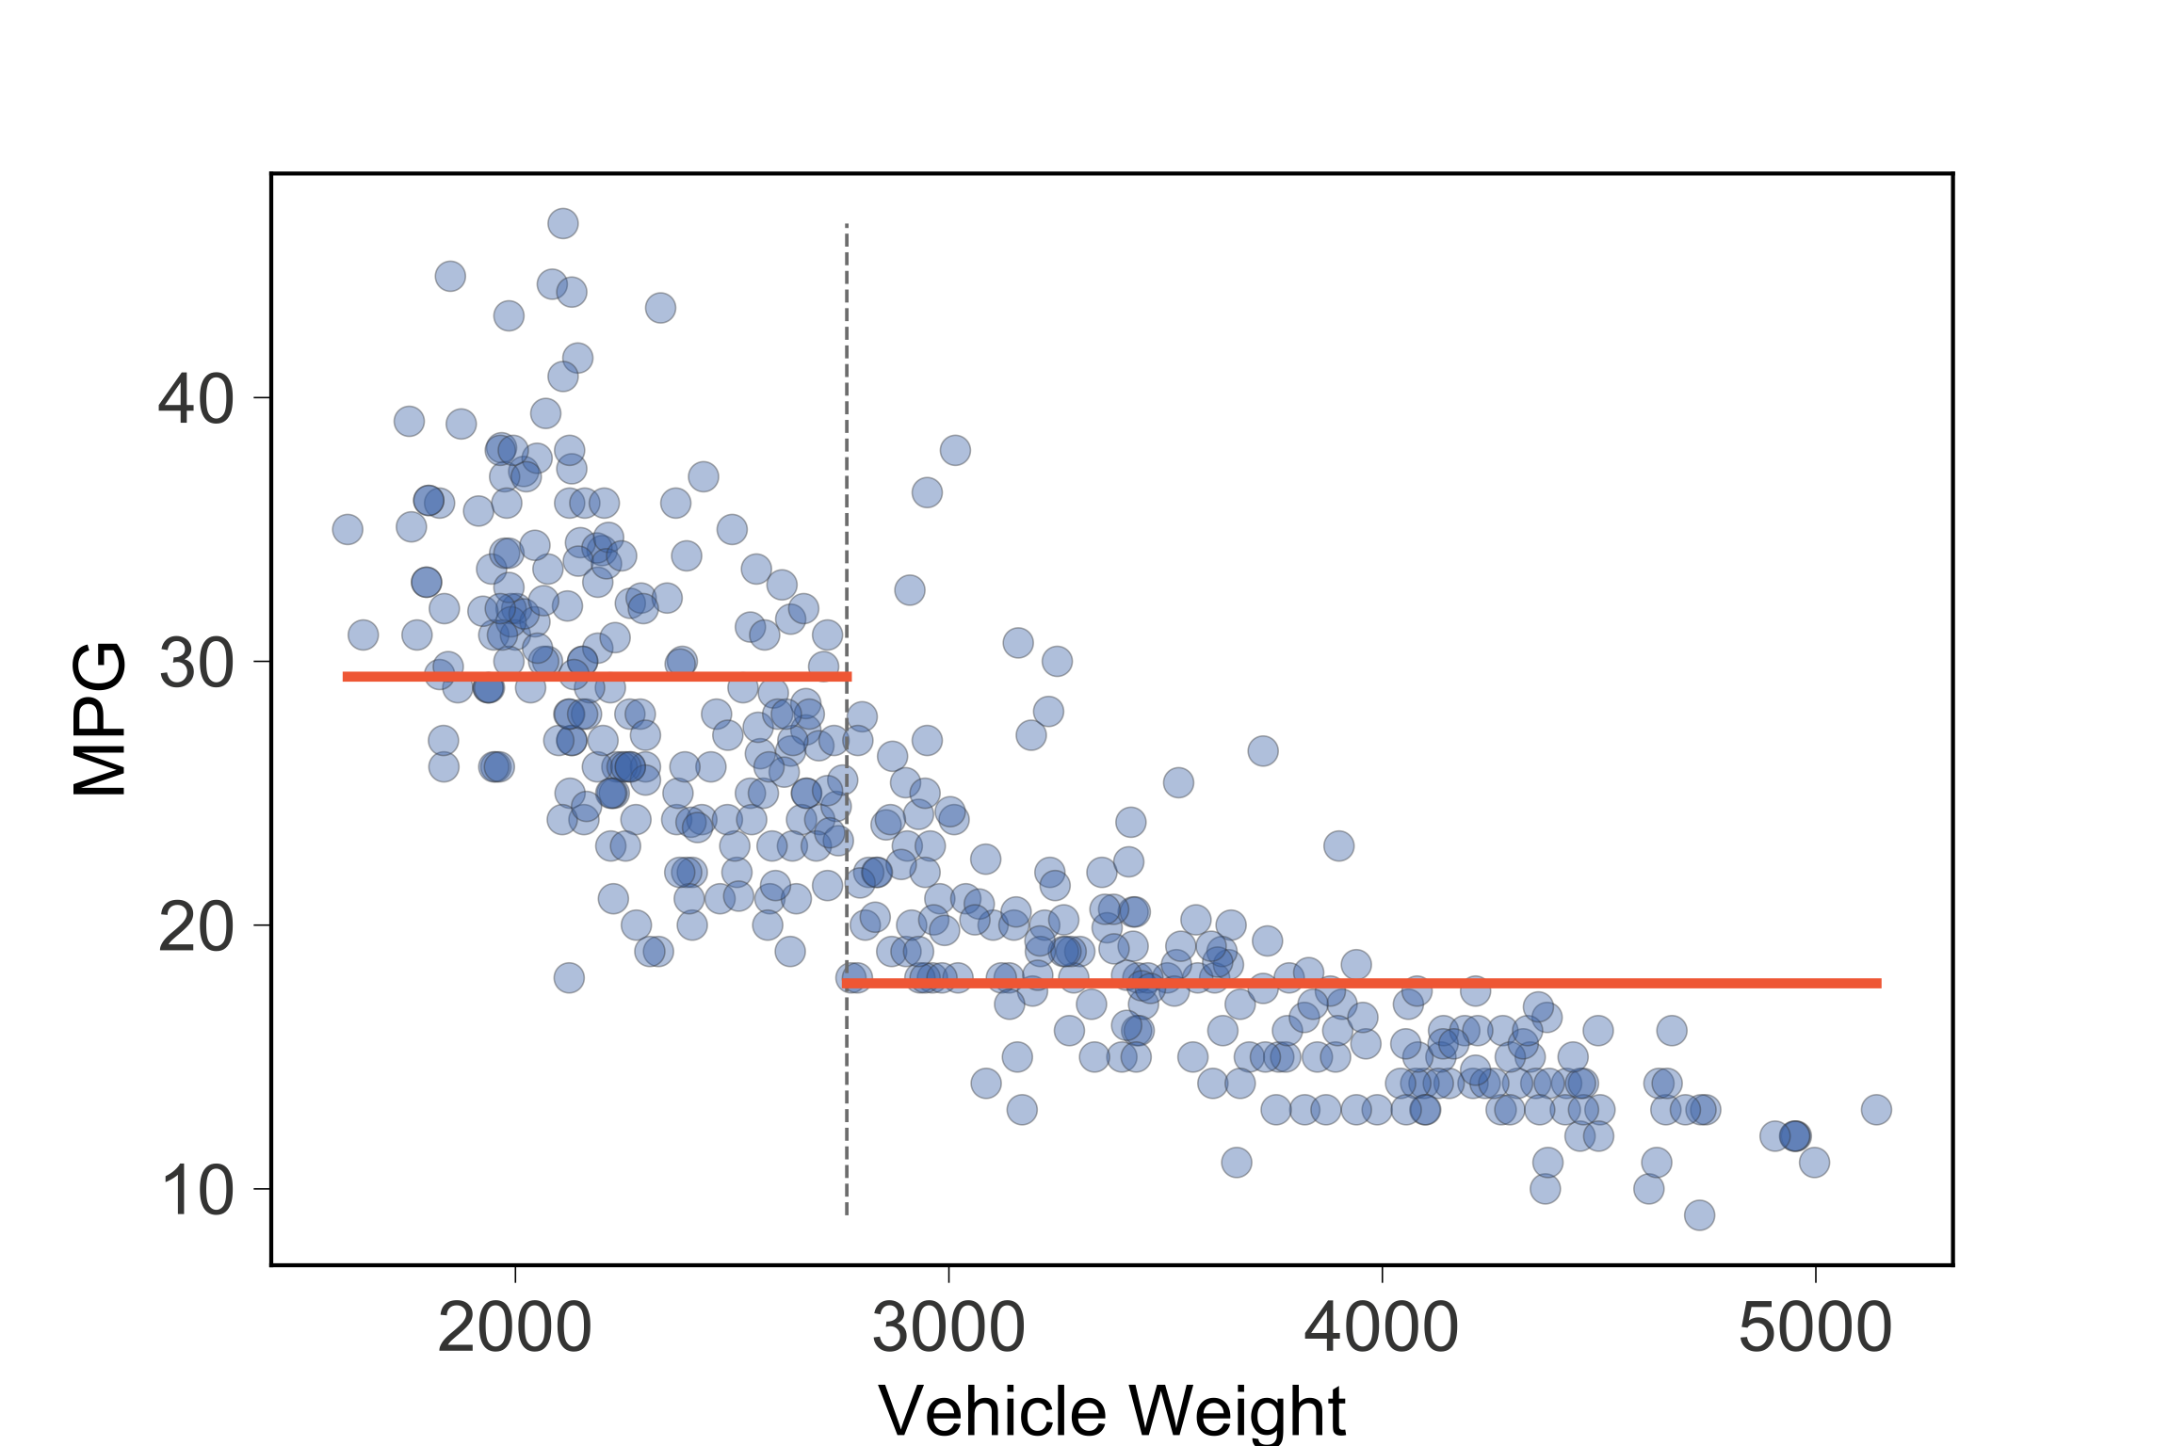
Improve by splitting into two regions
Predict mean
of training values
in each region
s1

Slide 8
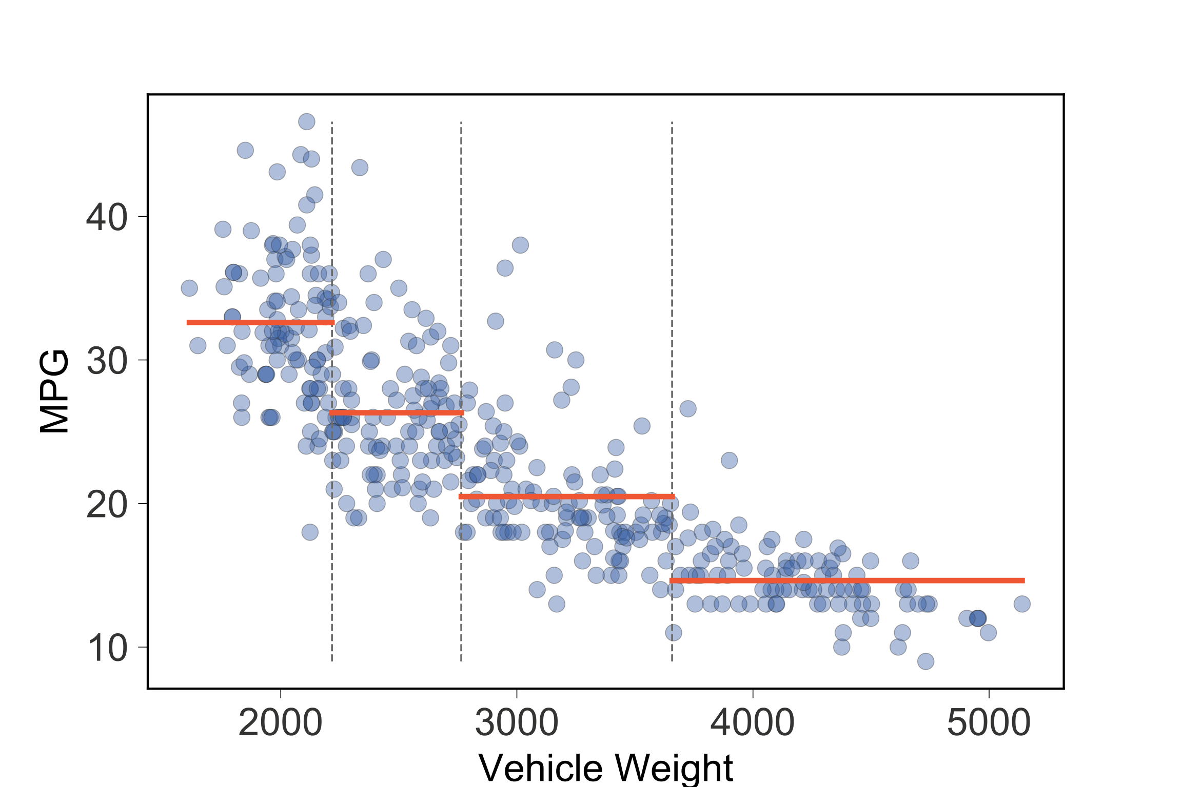
Improve by splitting into four regions
Technique:
Split into regions
of similar values
Split s1 stays,
recursively split
left/right to get
splits s2, s3
s2
s1
s3

Slide 9
Model implementation
Identify regions in split order:
if x<s1 and x<s2: predict 32.6
if x<s1 and x>=s2: predict 26.3
if x>=s1 and x<s3: predict 20.5
if x>=s1 and x>=s3: predict 14.6
s2
s1
s3

Slide 10
Factor split comparisons for efficiency
s2
s1
s3
if x<s1:
if x<s2: predict 32.6
if x>=s2: predict 26.3
elif x>=s1
if x<s3: predict 20.5
if x>=s3: predict 14.6

Slide 11
Represent nested conditionals as regression decision tree
s1
s2
s1
s3
<
>=
s2
s3
<
>=
<
>=
32.6
26.3
20.5
14.6
Internal nodes test features
Leaves make predictions

Slide 12
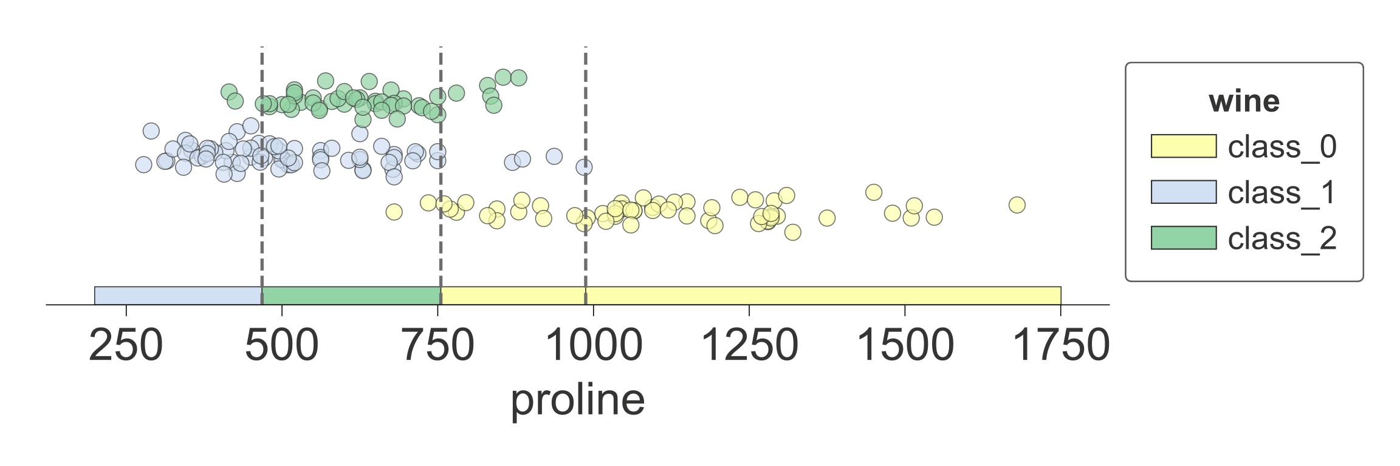
Classifiers work same way
s2
s1
s3
s1
<
>=
s2
s3
<
>=
<
>=
Internal nodes test features
Leaves predict most common target category

Slide 13
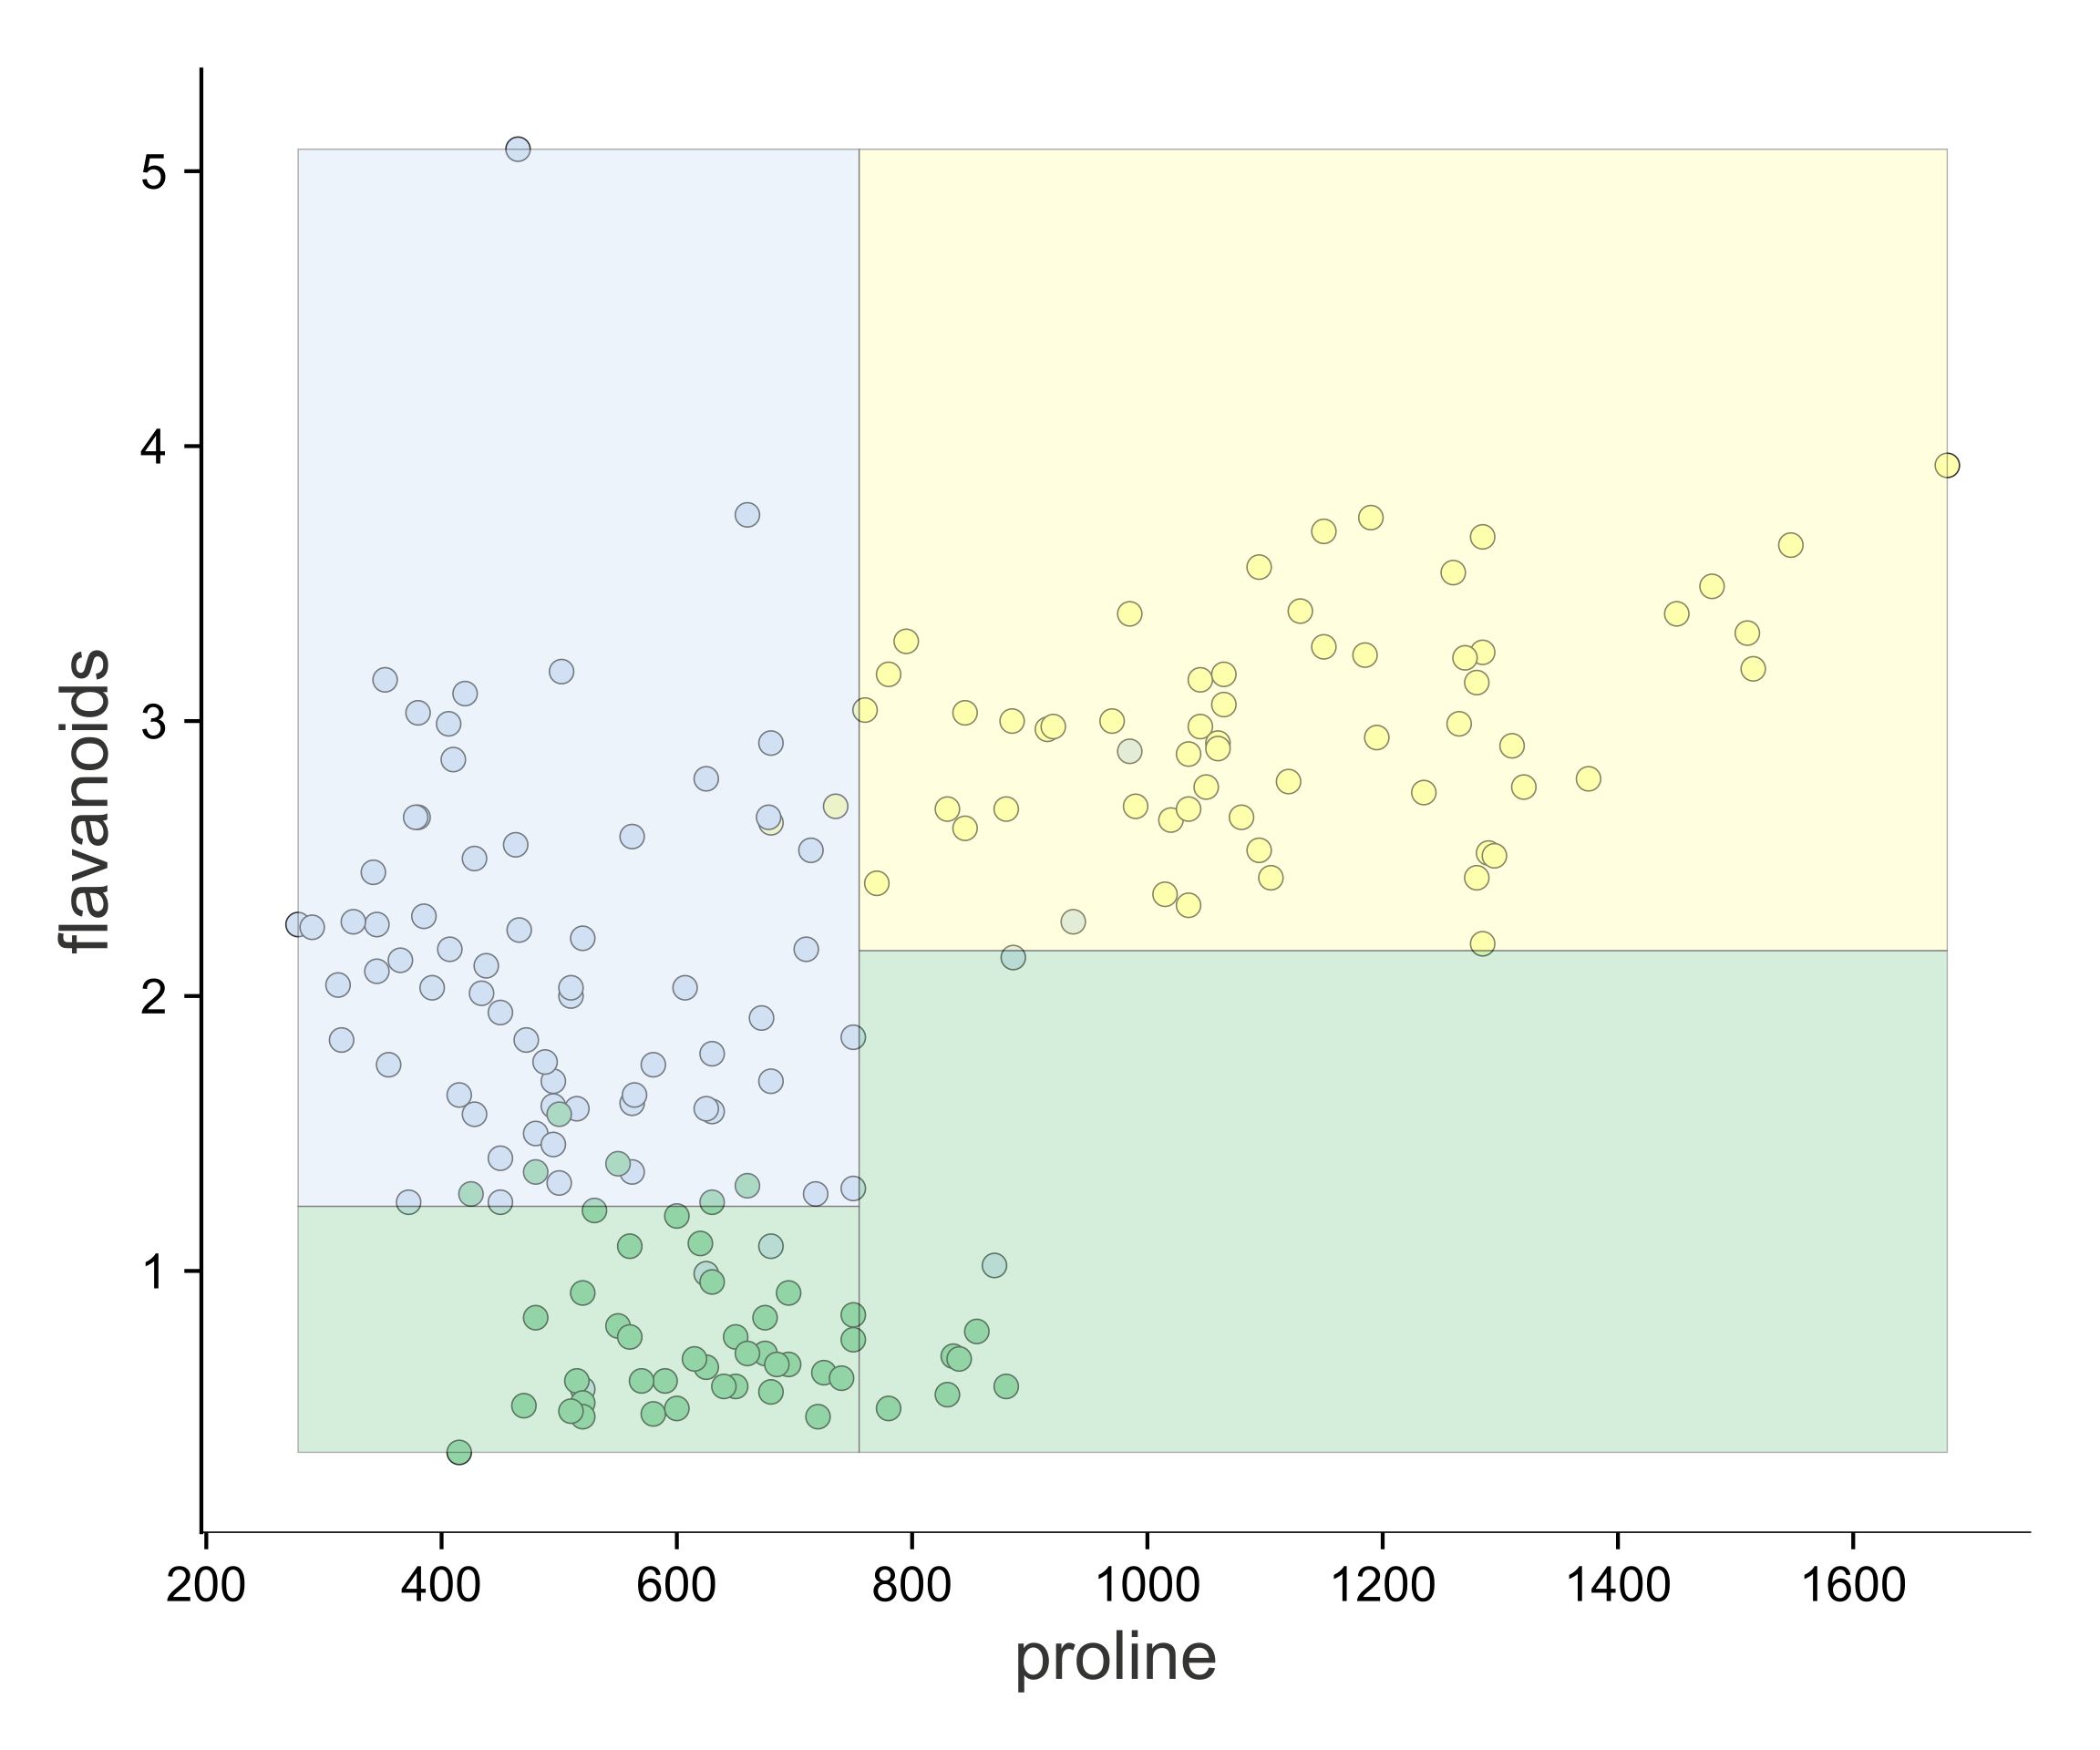
Improve predictions: Use 2 features and split 2D feature space into regions
x1
<
>=
y2
y1
y2
>=
>=
y1
<
<
x1

Slide 14
We can also split regressor 2D feature space into regions to improve accuracy
<insert awesome 3D visualization here>

Slide 15
Visualizing the key elements

Slide 16
How to lead a fulfilling life by being dissatisfied

Slide 17
Be dissatisfied
Be offended by bad software or unsatisfying experiences
Crave beauty
Make the world a better place for others
Obsess about the details (pick colors, outline of planes,boxes)
Cost: high on you and those in “blast radius”, but awesome for everyone else

Slide 18
Be tenacious
Reagan
“Why program by hand in five days, …”
Matplotlib mashup
SVG not png

Slide 19
Be a finisher
Tension between perfection and finishing

Slide 20
Be courageous
Slap it up on github
Write articles or blog entries
You might think you don’t know anything
(might be true at the beginning)
Building code and writing articles exposes holes in your understanding
Face that fear; it is so valuable to identify your weakness because then you can fix it. Don’t hide from it

Slide 21
How to contribute and make a difference
Look for the pain
Look for a hole in the market
Erase the pain with reusable and general code
Learn tactics from existing successful projects
Website
doc
API design
consistent style
Give it pizzazz or flash

Slide 22
“The reasonable [wo]man adapts [her|him]self to the world: the unreasonable one persists in trying to adapt the world to [her|him]self. Therefore all progress depends on the unreasonable [wo]man.”
Be unreasonable
― George Bernard Shaw

