Slide 1
The visual interpretation of decision trees
(How to lead a fulfilling life by being dissatisfied)
Terence Parr University of San Francisco
Work done with Prince Grover
manifold.ai

Slide 2
Topics
How regression and classification decision trees work
Visualizing key elements of decision trees
Lessons learned about visualization
How to lead a fulfilling life by being dissatisfied

Slide 3
Decision trees

Slide 4
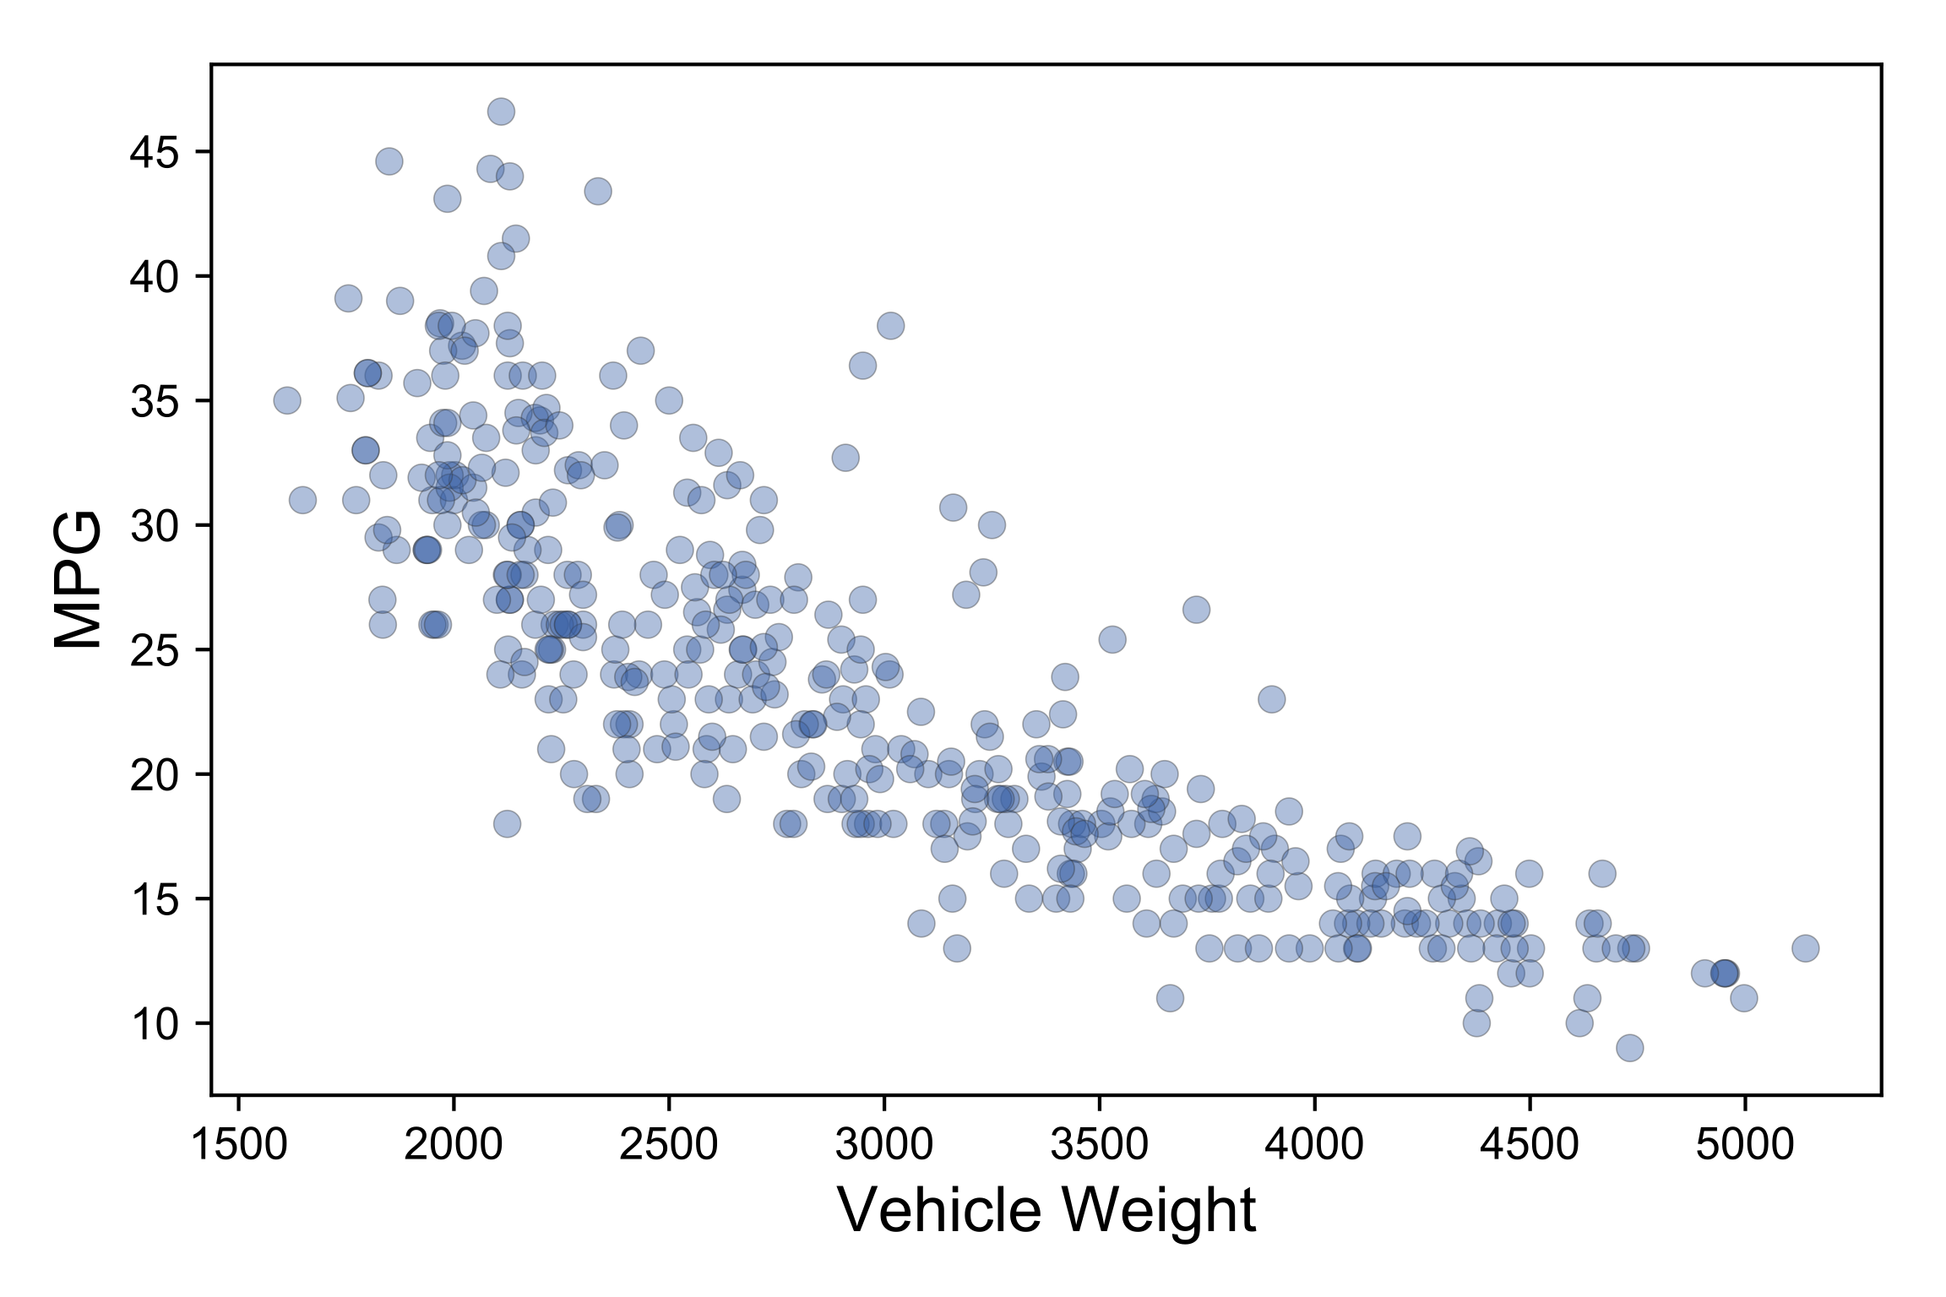
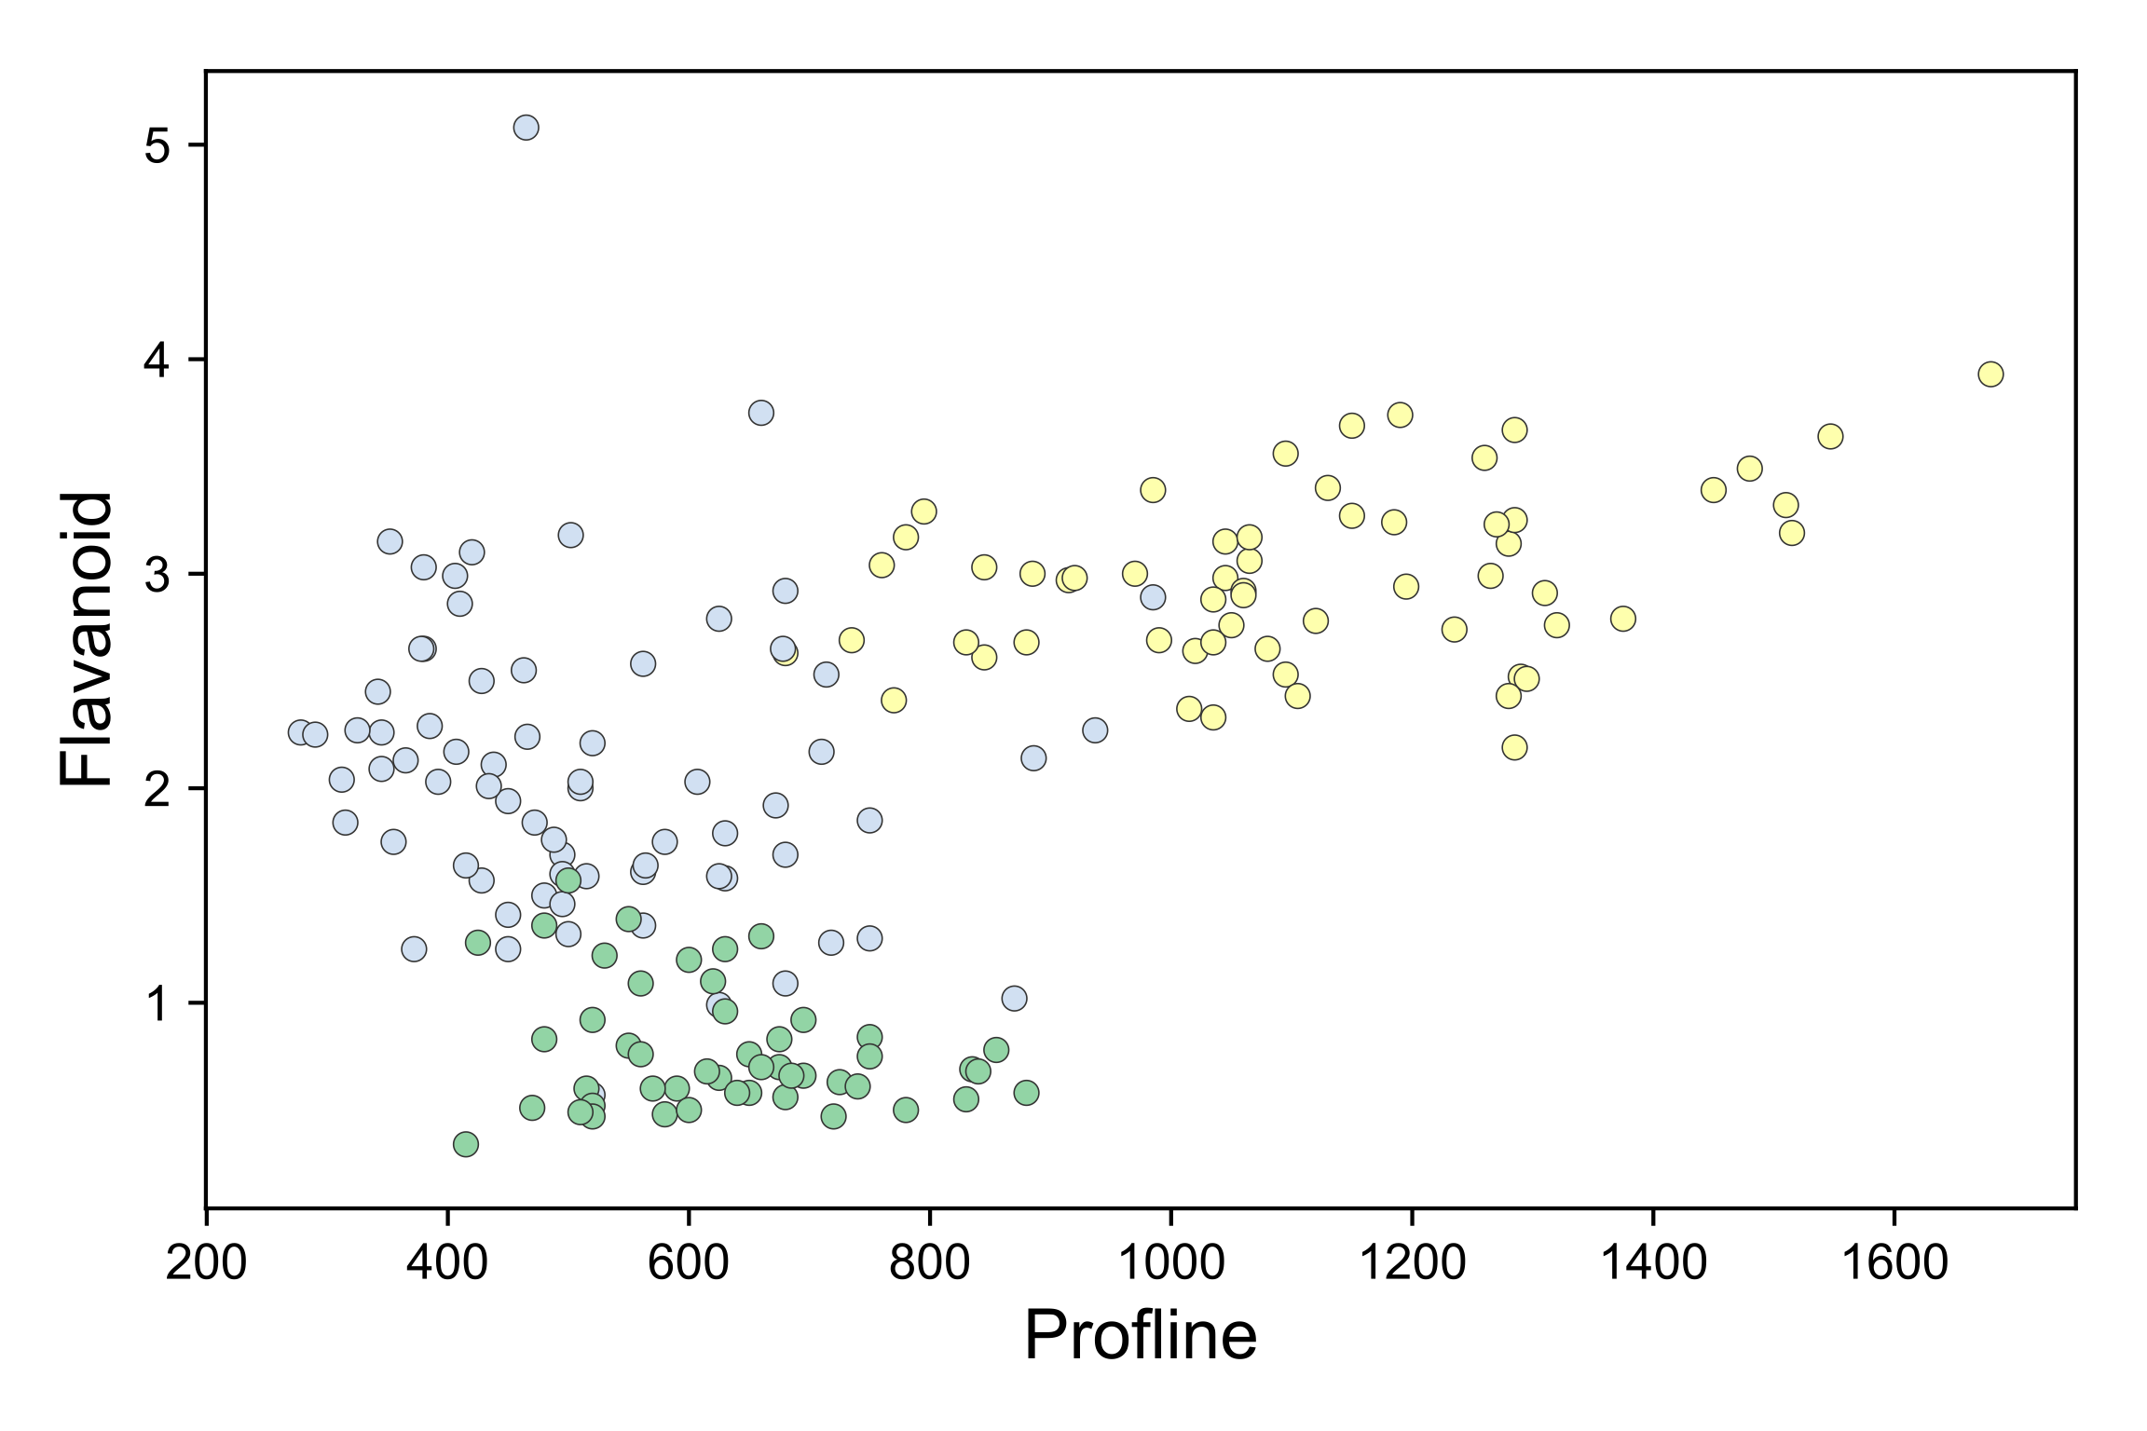
Regression versus classification
Regressors draw through data
Classifiers draw between data clusters

Slide 5
Different models have different surfaces

Slide 6
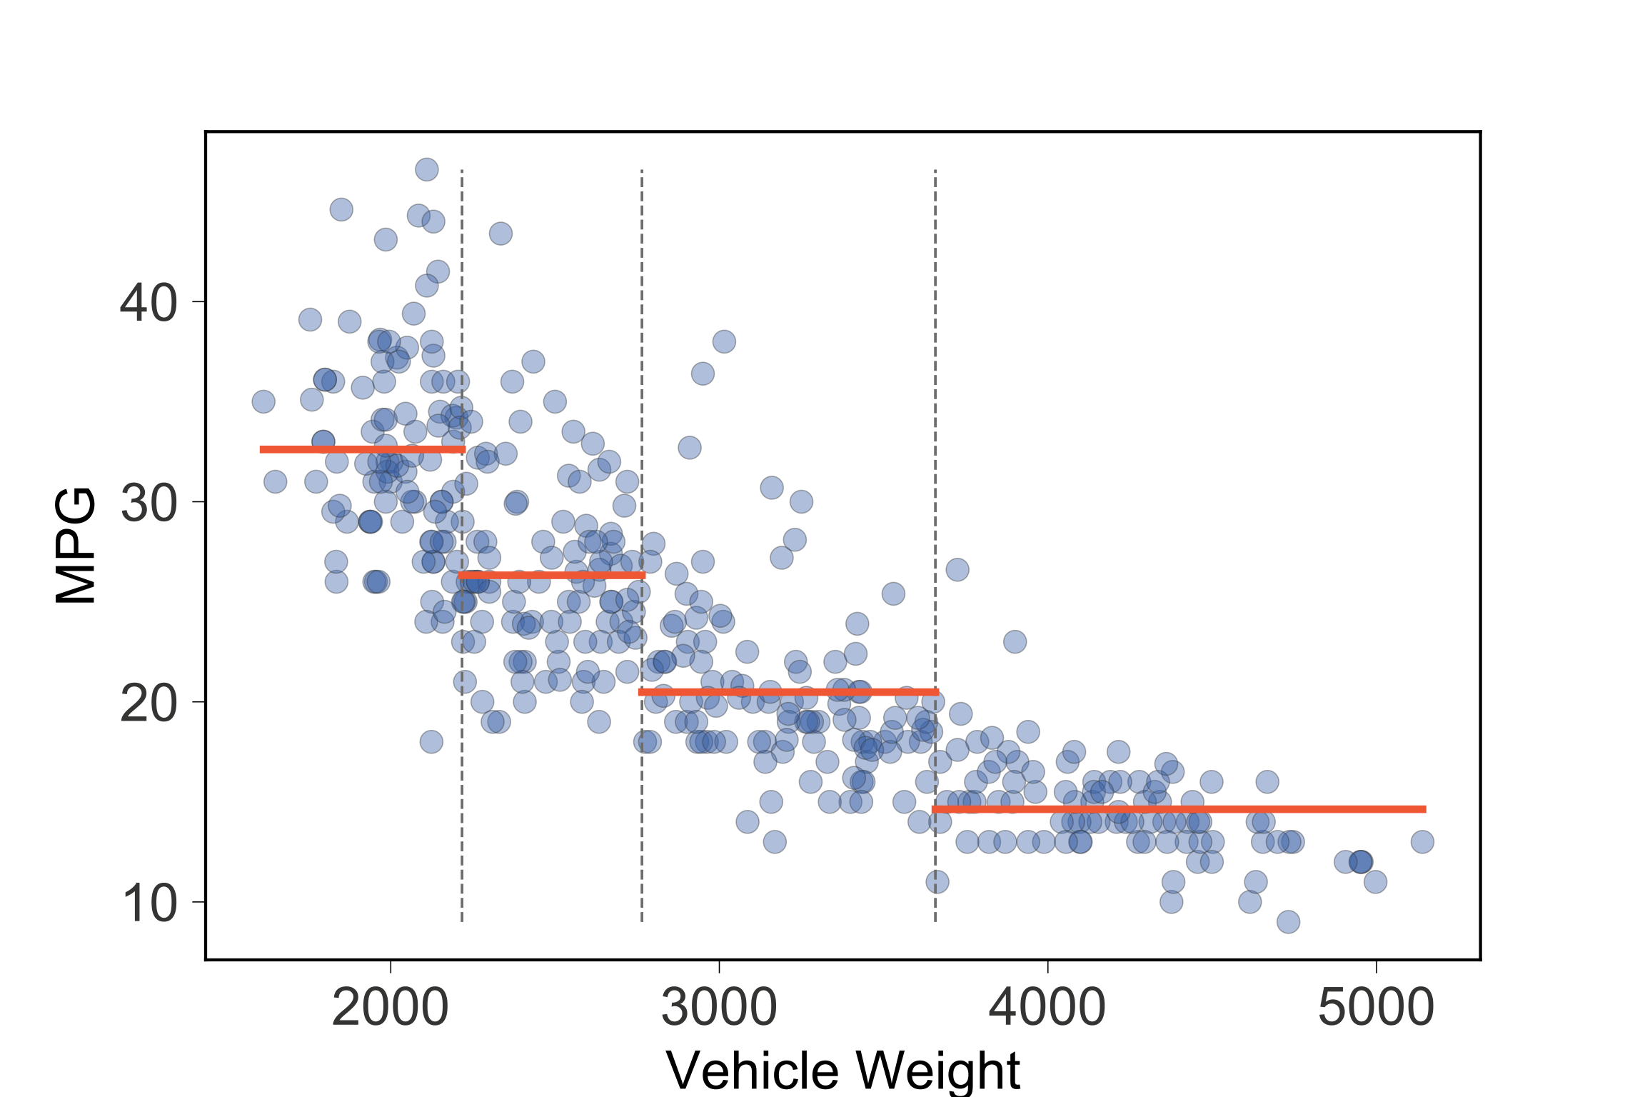
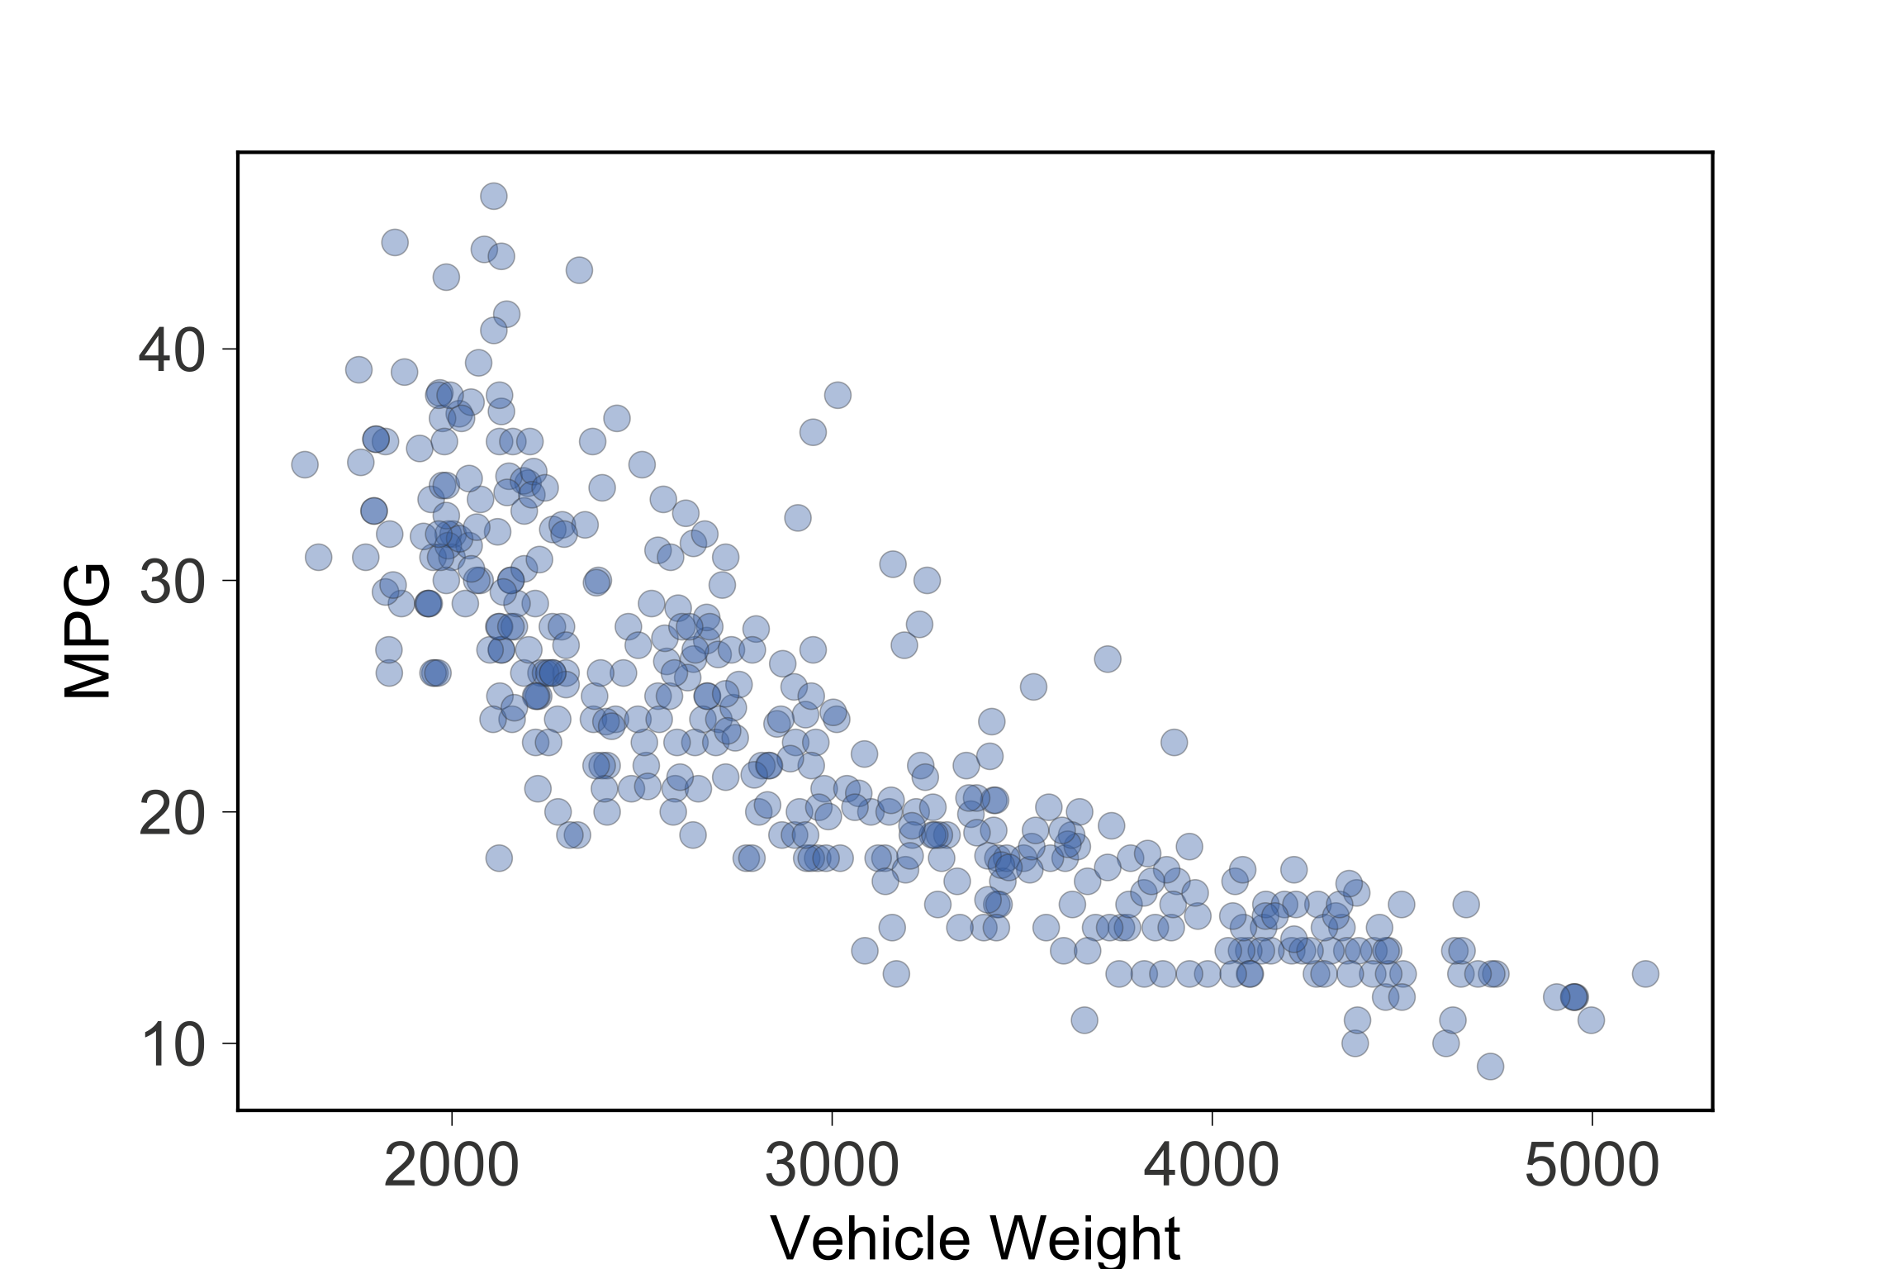
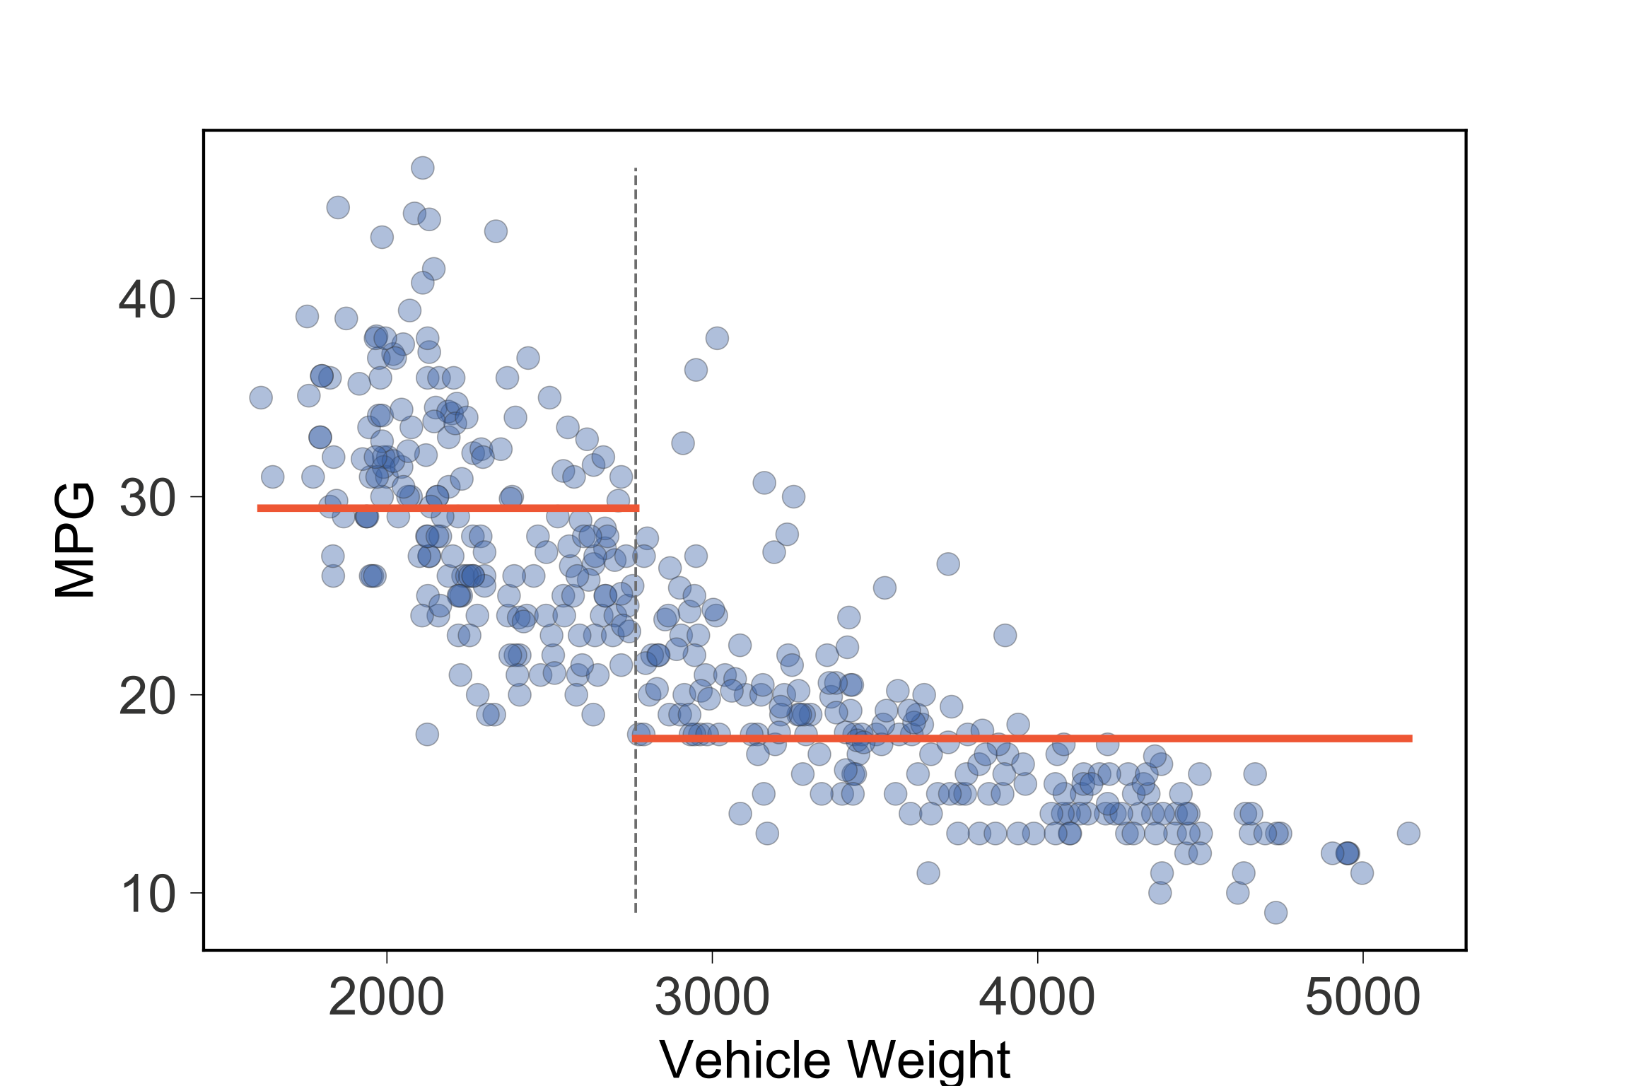

Slide 7
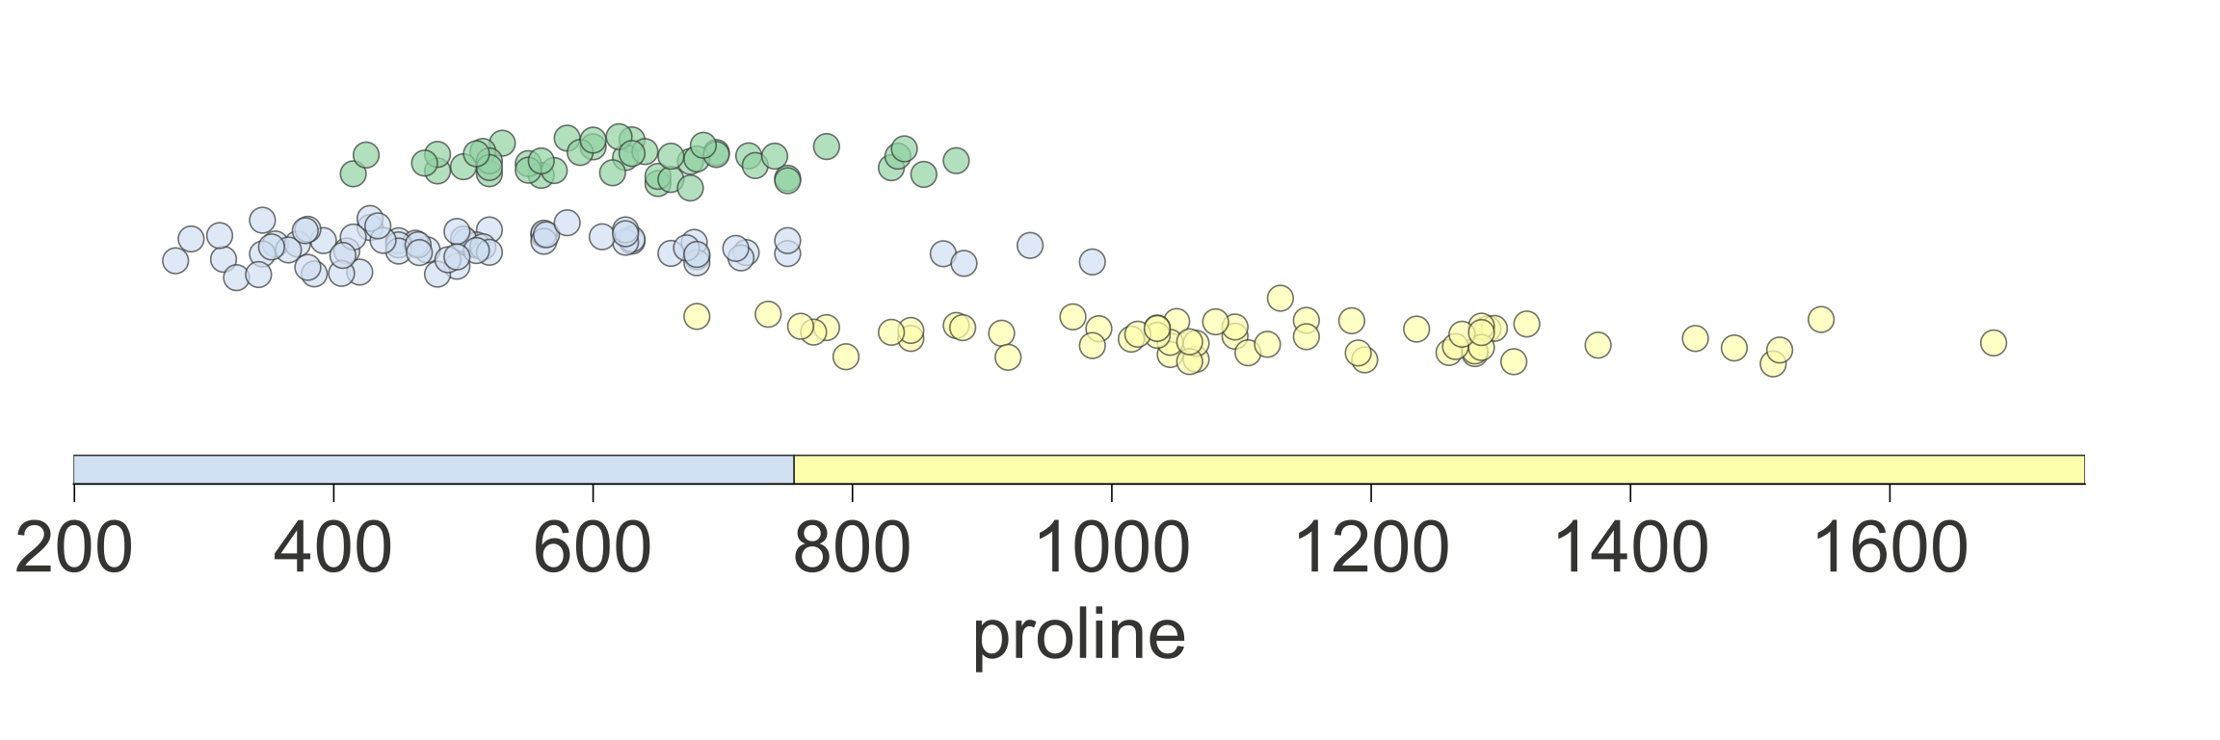

Slide 8
Visualizing the key elements

Slide 9
How to lead a fulfilling life by being dissatisfied

Slide 10
“The reasonable [wo]man adapts [her|him]self to the world: the unreasonable one persists in trying to adapt the world to [her|him]self. Therefore all progress depends on the unreasonable [wo]man.”
― George Bernard Shaw

Slide 11
Be unreasonably dissatisfied
Be offended by bad software or unsatisfying experiences
Crave beauty
Make the world a better place for others
Obsess about the details (pick colors, outline of planes,boxes)
Cost: high on you and those in “blast radius”, but awesome for everyone else

Slide 12
Be unreasonably tenacious
Reagan
“Why program by hand in five days, …”
Matplotlib mashup
SVG not png

Slide 13
How to contribute and make a difference
Look for the pain
Look for a hole in the market
Erase the pain with reusable and general code
Learn tactics from existing successful projects
Website
doc
API design
consistent style
Give it pizzazz or flash

Slide 14
Be courageous
Slap it up on github
Write articles or blog entries
You might think you don’t know anything
(might be true at the beginning)
Building code and writing articles exposes holes in your understanding
Face that fear; it is so valuable to identify your weakness because then you can fix it. Don’t hide from it

