Slide 1

Penguins in Antarctica
Ryan Spake – Final Exam

Slide 2
The Problem
When data is collected each year about penguins in Antarctica, it is difficult to draw insights from the raw data and compare data over time.
Our goal is to make it easier to identify clusters and characteristics of these penguins from the data so that insights can be made more efficiently as we continue to sample these penguins in the future.

Slide 3
The approach
Our approach to this problem is to create a clustering algorithm that will make it easier to organize data and visualize the clusters and characteristics of the penguins.
To do this we use:
K-means clustering to organize and illustrate the clusters.
Hierarchical clustering to visualize the characteristics of the penguins in these clusters.
This approach will make it easier to compare characteristics and clusters over time.

Slide 4
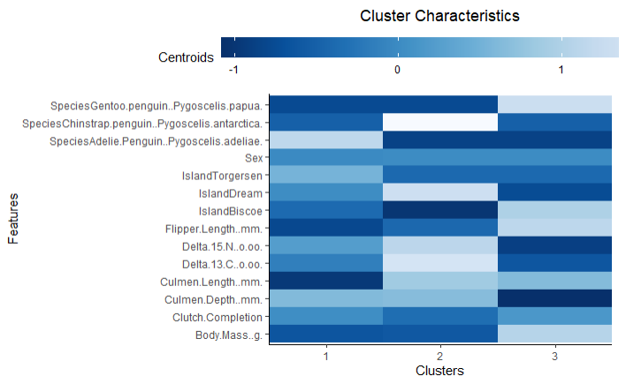
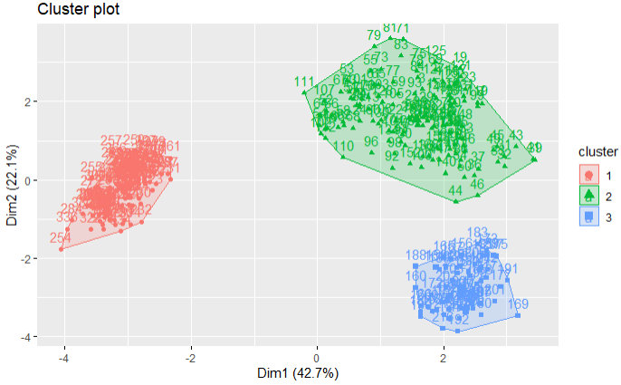
The Results
The algorithm generates two main graphs that are easy to comprehend and can be used to compare results over time.

