Slide 1
Options
Kevin

Slide 2
Overview
User Interface
Access custom functions
Access flight controller functions
Easily plan missions using a combination of custom and flight controller functions
Configuration Management/Continuous Integration
Repeatable and reproducible build chain
Track and maintain versions
Easy interaction during testing/operation (using standard services, configuration, streaming, etc.)
ICD configuration, access to flight controller, image streaming location, etc.
Mission Management
Integrates custom modules
Manages mission workflow between custom modules and flight controller functions
ICD MAVlink overrides & extensions, waypoint types, UI hooks, etc.

Slide 3
User Interface
Mission Planner
Supports plugins - not well documented, only add menu options
Could make custom UI and launch a “CAT UI” from within Mission Planner
Lots of configuration options (motor test, esp8266, etc.)
Supports APM
APM Planner 2.0
No plugin framework
Cross platform
Supports APM
QGroundControl
Supports plugins - decent documentation, add custom widgets via QML
Cross Platform
Supports PX4 and APM
Tower, UGCS, Custom, etc.

Slide 4
Companion Computer CM/CI
Manual (Build Log)
Time consuming
Small differences, not as well documented
Maverick
Well organized
Poorly optimized
Questionable maintenance practices
APSync
Not actively developed
Limited features
FlytOS
Lots of proprietary modules
Developer SDKs
Script-based
Repeatable, reproducable, runnable in web-based tools
Maintenance required
Very customizable/portable

Slide 5
Flight Controller Interface
MAVProxy
Resource intensive
Easy to use
MAVlink-router
Basic features
Very fast
MAVROS
ROS environment opens up lots of possibilities
Limited GCS connections
MAVProxy or MAVlink-router combined with MAVROS

Slide 6
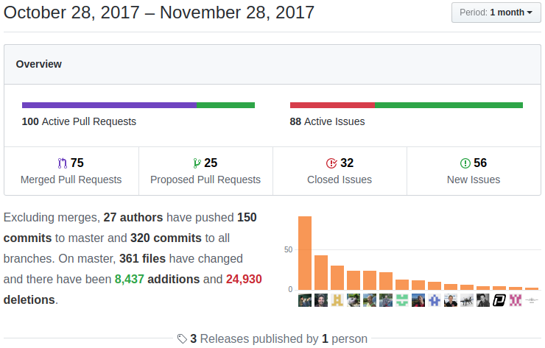
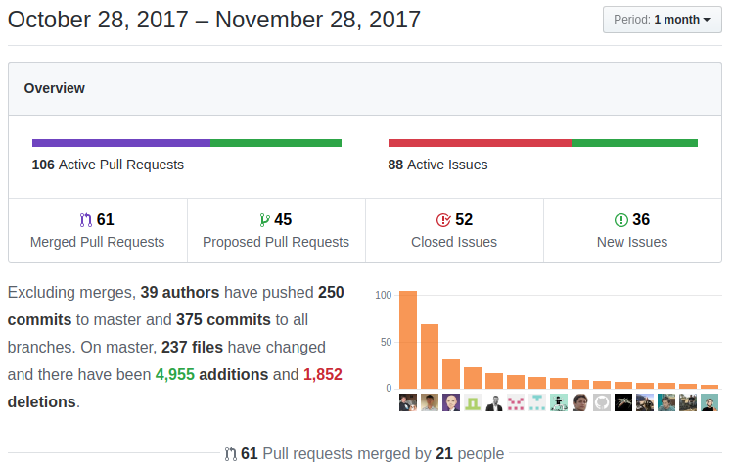
Firmware Comparison
PX4
Ardupilot

Slide 7
Firmware Comparison
PX4
Better developer docs
Easy to use 3d simulation
BSD license
Better integration with MAVROS
Ardupilot
Better user docs
3d simulation limited
GPL license
Better integration with Dronekit
Both
Support more advanced navigation/stabilization (terrain following, optical flow, weathervane, VTOL, etc.)
Support similar range of lidar, sonar, rtk gps, airspeed sensors

Slide 8
Way Ahead Strategy
Companion Computer CM/CI
Continue developing scripts, goal is to get to a point where everyone can create an image from a web page with various options, then add features/supported CCs from there
Document package versions and service definitions and keep them updated, come up with convention so we always know what is installed and how it’s configured
Mission Management
For now, make sure our custom solutions use the same methods for reconfiguration, video streaming, etc. so we can more easily integrate later
Flight Controller Interface
Document standard UDP ports for services, choose MAVProxy/MAVlink-router based on CC, use MAVROS in conjunction with a mavlink proxy
User Interface
More research needs to be done, this will be influenced by Mission Management framework
Firmware
Install PX4 on a quad and a plane and test

Slide 9
Ingesting Solutions
There are many open source ROS solutions available and it is not much work to wrap code in a ROS node
Most of our Govt. solutions already use ROS nodes
In the future, a more formalized ICD would be beneficial, so that we can include custom commands and UI elements in planning autonomous missions
ICD specifies topic for streaming video artifacts
ICD specifies configuration scheme
ICD specifies any new commands the custom nodes make available

