Slide 1
H.P. WILLIAMS
LONDON SCHOOL OF ECONOMICS
MODELS FOR SOLVING
THE
TRAVELLING SALESMAN PROBLEM
h.p.williams@lse.ac.uk

Slide 2

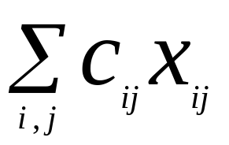
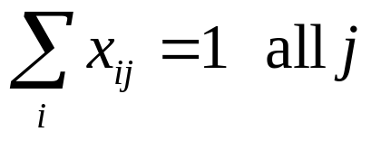
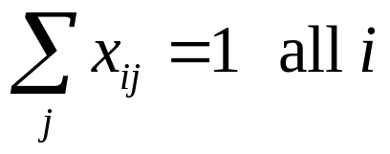
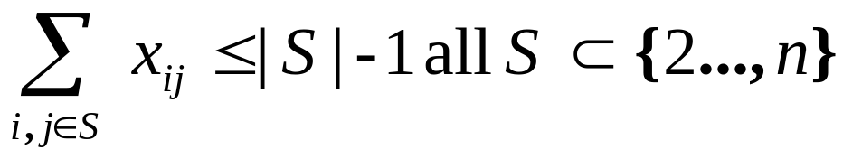
STANDARD FORMULATION OF THE (ASYMMETRIC) TRAVELLING SALESMAN PROBLEM
Conventional Formulation:
(cities 1,2, …, n) (Dantzig, Fulkerson, Johnson) (1954). is a link in tour
Minimise:
subject to:

Slide 3
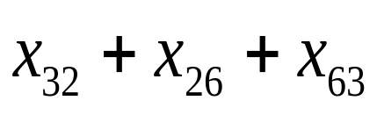
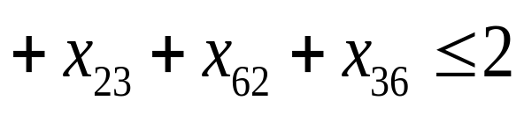
e.g.
2
6
3
0(2^{n}) Constraints = (2^{n-1} + n –2)
0(n²) Variables = n(n – 1)

Slide 4
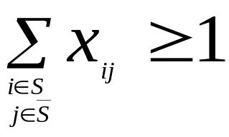
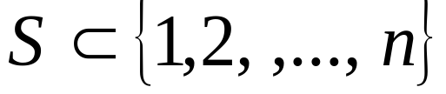
EQUIVALENT FORMULATION
Replace subtour elimination constraints with
all
____
S
S
Add second set of constraints for all i in S and
subtract from subtour elimination constraints for S

Slide 5
OPTIMAL SOLUTON TO A 10 CITY TRAVELLING SALESMAN PROBLEM
8
6
3
1
2
10
5
7
4
9
Cost = 881

Slide 6
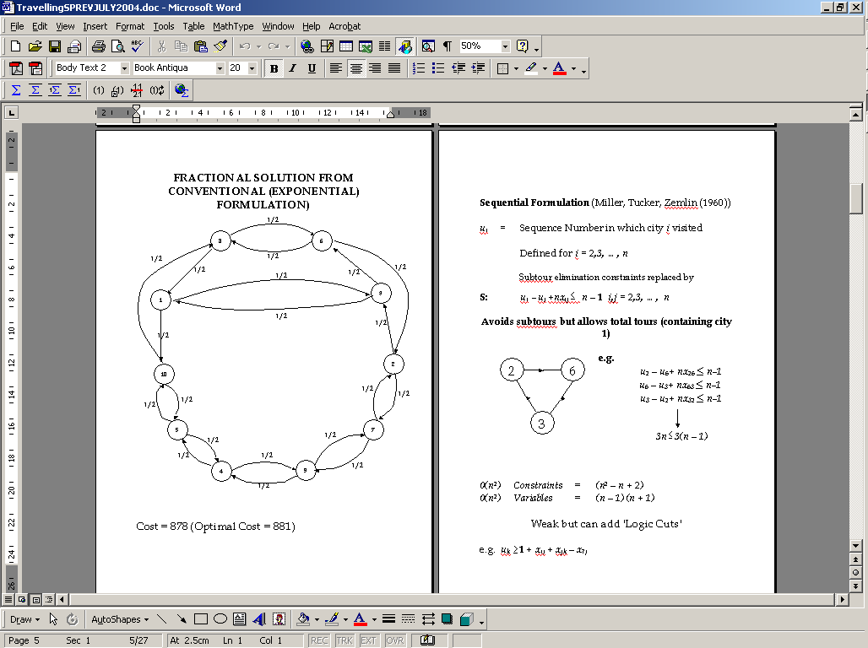
FRACTIONAL SOLUTION FROM CONVENTIONAL (EXPONENTIAL) FORMULATION)
Cost = 878 (Optimal Cost = 881)

Slide 7


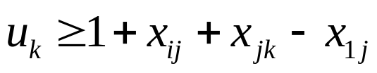
Sequential Formulation (Miller, Tucker, Zemlin (1960))
u_{i} = Sequence Number in which city i visited
Defined for i = 2,3, …, n
Subtour elimination constraints replaced by
S: u_{i} - u_{j} +nx_{ij} n – 1 i,j = 2,3, …, n
Avoids subtours
but allows total tours (containing city 1)
u₂ – u₆+ nx₂₆ n-1
u₆ – u₃+ nx₆₃ n-1
u₃ – u₂+ nx₃₂ n-1
2
6
3
3n 3(n – 1)
0(n²) Constraints = (n² – n + 2)
0(n²) Variables = (n – 1) (n + 1)
Weak but can add 'Logic Cuts'
e.g.

Slide 8
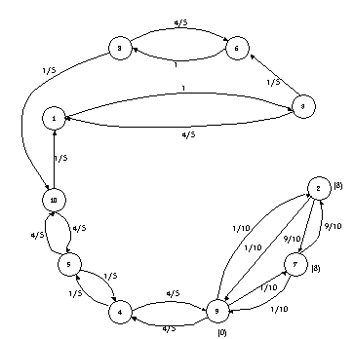


FRACTIONAL SOLUTION FROM SEQUENTIAL FORMULATION
Subtour Constraints Violated : e.g.
Logic Cuts Violated: e.g.
Cost = 773 ³/₅ (Optimal Cost = 881)

Slide 9
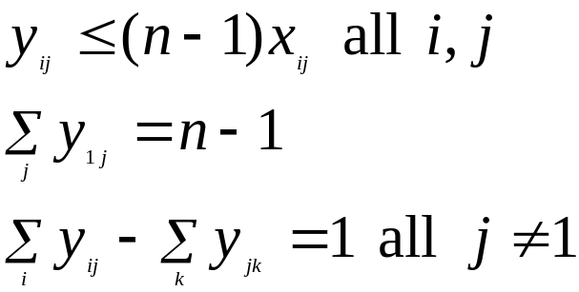


Flow Formulations
Single Commodity (Gavish & Graves (1978))
Introduce extra variables (‘Flow’ in an arc)
Replace subtour elimination constraints by
F1:
Can improve (F1’) by amended constraints:
all

Slide 10




Network Flow formulation in variables over
complete graph
1
4
1
2
1
n-1
3
1
Graph must be connected. Hence no subtours possible.
Constraints
Variables

Slide 11
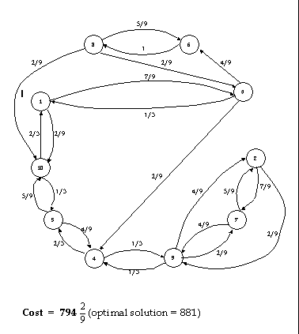

FRACTIONAL SOLUTION FROM SINGLE COMMODITY FLOW FORMULATION
Cost = 794 (Optimal solution = 881)

Slide 12
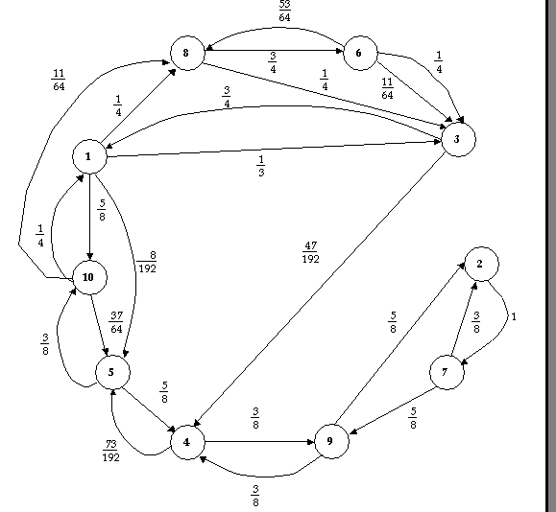
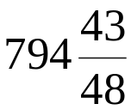
FRACTIONAL SOLUTION FROM MODIFIED SINGLE COMMODITY FLOW FORMULATION
Cost = (Optimal solution = 881) (192=3x64)

Slide 13
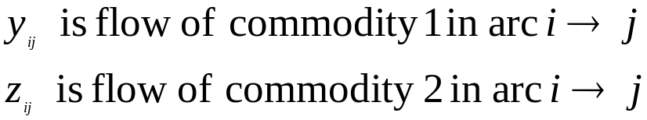
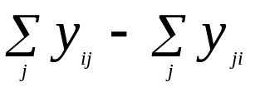
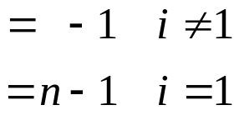

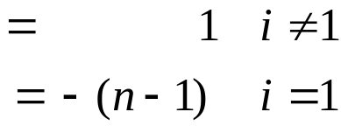





Two Commodity Flow (Finke, Claus Gunn (1983))
F2:
=
=
1
1
Commodity 1
2
3
1
1 Commodity 2 1
n-1
n-1
Commodity 2
Commodity 1
Constraints
Variables

Slide 14







Multi-Commodity (Wong (1980) Claus (1984))
“Dissaggregate” variables
is flow in arc destined for
F3
Constraints
Variables
LP Relaxation of equal strength to Conventional Formulation.
But of polynomial size.
Tight Formulation of Min Cost Spanning Tree
+ (Tight) Assignment Problem

Slide 15
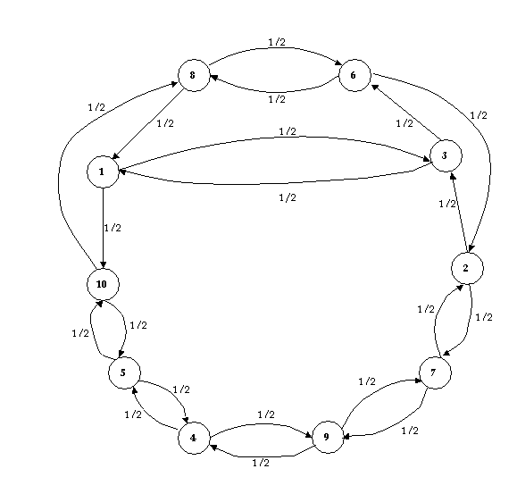
FRACTIONAL SOLUTION FROM MULTI COMMODITY FLOW FORMULATION (= FRACTIONAL SOLUTION FROM CONVENTIONAL (EXPONENTIAL) FORMULATION)
Cost = 878 (Optimal Cost = 881)

Slide 16

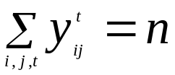
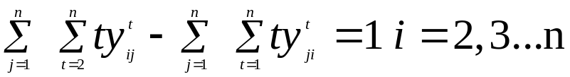
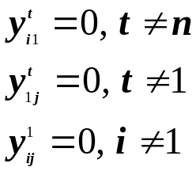
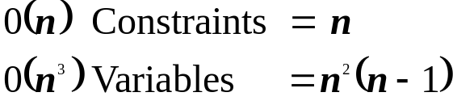


Stage Dependent Formulations
First (Fox, Gavish, Graves (1980))
= 1 if arc traversed at stage t
= 0 otherwise
T1:
(Stage at which i left 1 more than stage at which entered)
Also convenient to introduce
variables with constraints

Slide 17
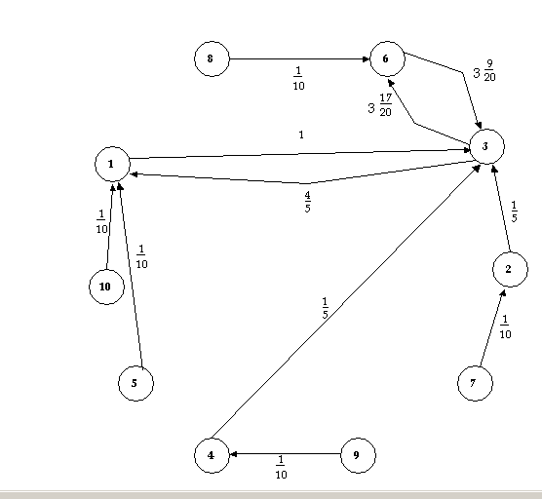
FRACTIONAL SOLUTION FROM 1ST
(AGGREGATED) TIME-STAGED FORMULATION
Cost = 364.5 (Optimal solution = 881)
NB ‘Lengths’ of Arcs can be > 1

Slide 18
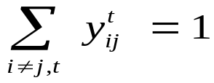
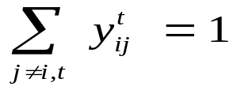
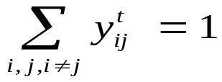
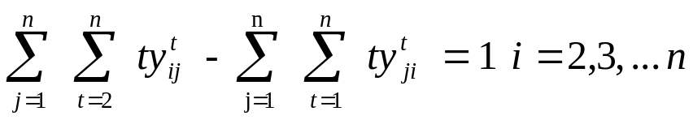
Second (Fox, Gavish, Graves (1980))
T2: Disaggregate to give
all j
all i
all t
Initial conditions no longer necessary
0(n) Constraints = 4 n – 1
0(n³) Variables = n² (n – 1)

Slide 19
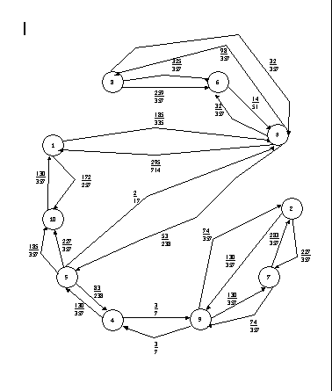
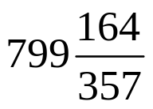
FRACTIONAL SOLUTION FROM 2nd TIME-STAGED FORMULATION
Cost =
(optimal solution = 881)
(714 = 2 x 3 x 7 x 17)

Slide 20
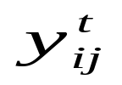
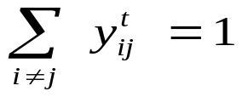
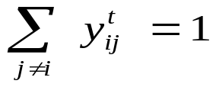
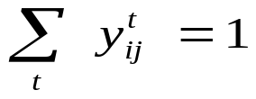
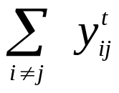
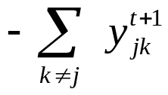
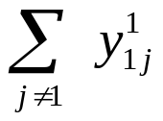
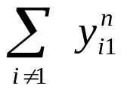
Third (Vajda/Hadley (1960))
T3:
interpreted as before
all j
all i
all t
= 0 all j, t
= 1
= 1
0 (n²) Constraints = (2n²+ 3)
0 (n³) Variables = n²(n-1)

Slide 21
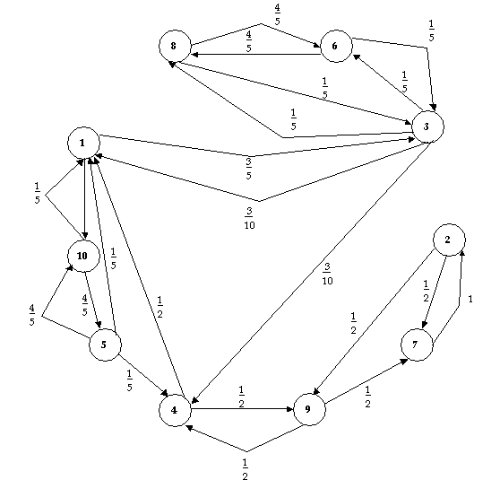

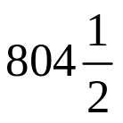
FRACTIONAL SOLUTION FROM 2nd TIME 2nd TIME-STAGED FORMULATION
Optimal solution = 881
Cost =

Slide 22
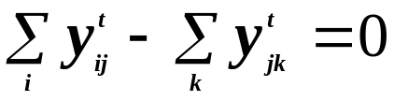

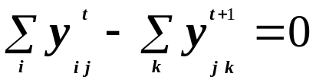


OBSERVATION
Multicommodity Flow Formulation
is flow destined for node t
Time Staged Formulation
Are these formulations related?
Can extra variables , introduced syntactically, be given different semantic interpretations?

Slide 23







COMPARING FORMULATIONS
Minimise:
Subject to:
W forms a cone which can be characterised by its extreme rays giving matrix Q such that
Hence
This is the projection of formulation into space of original variables

Slide 24


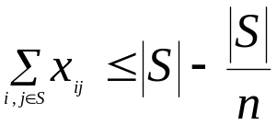

COMPARING FORMULATIONS
Project out variables by Fourier-Motzkin elimination to reduce to space of conventional formulation.
P (r) is polytope of LP relaxation of projection of formulation r.
Formulation S (Sequential)
Project out around each directed cycle S by summing
ie
weaker than |S|-1 (for S a
subset of nodes)
Hence

Slide 25
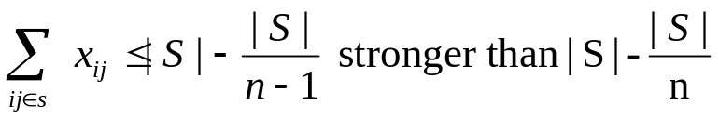

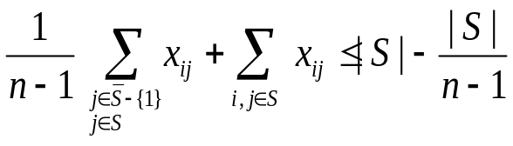
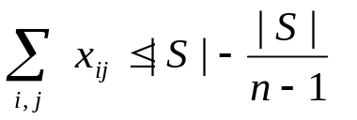
Formulation F1 (1 Commodity Network Flow)
Projects to
Hence
Formulation F1' (Amended 1 Commodity Network Flow)
Projects to
Hence
Formulation F2 (2 Commodity Network Flow)
Projects to
Hence
P(F2) = P(F1)

Slide 26
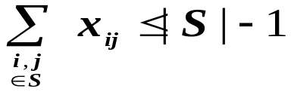
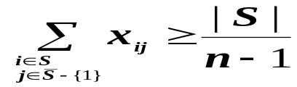


Formulation F3 (Multi Commodity Network
Flow)
Projects to
Hence P(F3) = P(C)
Formulation T1 (First Stage Dependant)
Projects to
(Cannot convert 1st constraint to ‘
‘form since
Assignment Constraints not present)

Slide 27

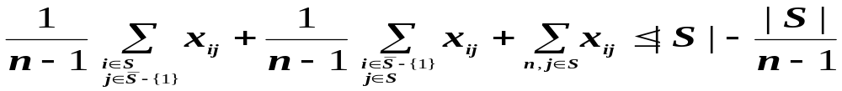
Formulation T2 (Second Stage Dependant)
Projects to
+ others
Hence P(T2) P(F1')
Formulation T3 (Third Stage Dependant)
Projects to
+ others
Can show stronger than T2
Hence P(T3) P(T2)

Slide 28

Computational Results of a 10-City TSP in order to compare sizes and strengths of LP Relaxations
Solutions obtained using NEW MAGIC and EMSOL

Slide 29

P(TSP) TSP Polytope – not fully known
P(X) Polytope of Projected LP relaxations

Slide 30
Reference
AJ Orman and HP Williams,
A Survey of Different Formulations of the Travelling Salesman Problem,
in C Gatu and E Kontoghiorghes (Eds), Advances in Computational Management Science 9 Optimisation, Econometric and Financial Analysis (2006) Springer

