Slide 1
What's F#
A .NET language from Microsoft
Another alternative to VB.NET, C#
Part of the ML family of languages

Slide 2
How can you use it?
Can have F# and C#/VB.NET projects in the same Visual Studio solution
Can call code between them – it's all .NET
Caveat: Some APIs designed for F# are awkward to use from C# and vice versa

Slide 3
Getting familiar with F#
Not going to cover the language in detail
But we need to be able to read the simple stuff to understand the interesting stuff

Slide 4
Whitespace sensitive
F# is whitespace sensitive
Block structure is inferred from indentation
for user in users do
// these lines are in the loop
Console.WriteLine(user.Name)
Console.WriteLine("^ that's a user")
Console.WriteLine("loop done")

Slide 5
Type inferred
Statically typed like C# – code won't compile with a type error
But types can be inferred by the compiler in most cases (like C#'s var on steroids)
let fullName(user : User) = // explicitly annotated argument type
user.FirstName + " " + user.LastName
// a function taking an IEnumerable<User>
let showFullNames(users) =
for user in users do
// type of user is inferred since
// we use the fullName function
Console.WriteLine(fullName(user))

Slide 6
Expressions, not statements
Almost everything is an expression, not a statement
This means you can use code in the place of a value
Console.WriteLine(
let mutable x = 1
while x * 2 < 1000 do
x <- x * 2
x)

Slide 7
The unit type
If everything is an expression, what about void functions?
// what is the type of x?
// a variable can't be void, can it?
let x = Console.WriteLine("hello world")
// F# models void with a type called "unit"
// which has only one value
let (y : unit) = () // the "unit" value
// Makes a lot of sense for generics:
// avoids Task<T> vs Task, Func<T> vs Action, etc.
// in favor of Task<unit>, Func<unit>

Slide 8
Classes
F# supports object oriented programming
Odd-looking to C# developers: classes must have a "primary constructor"
type Point(x : int, y : int) =
member this.X = x
member this.Y = y
override this.ToString() =
x.ToString() + "," + y.ToString()
type IShape =
abstract member Area : float
type Rectangle(corner1 : Point, corner2 : Point) =
member this.Width = abs(corner2.X - corner1.X)
member this.Height = abs(corner2.Y - corner1.Y)
interface IShape with
member this.Area = float(this.Width * this.Height)

Slide 9
The good part
Now we have a general idea of how to read F# code
But why bother?
Let's find out.

Slide 10
Modeling data
All software ultimately has inputs and outputs, usually with some structure to them
What's legal to type into this form on a UI?
What possible things might we display on an invoice line item?
What JSON do I get from calling a web API?

Slide 11


Example: Stripe API
Stripe does payment processing
They have a web API that talks JSON
Look through documentation for their API and it's easy to find language like this:

Slide 12
Not singling out Stripe
"or" is a fact of life
Sometimes the data just naturally has a fixed set of mutually exclusive possible formats
Other APIs exhibit this too
  Quickbooks line items
    Sales | Discount | Subtotal | Group
  Box.com file share links

Slide 13
Modeling JSON itself
Discriminated unions are perfect for modeling the structure of JSON
Transformations of JSON data are very easy to accomplish
type JValue =
| JString of string
| JNumber of decimal
| JBoolean of bool
| JNull
type JToken =
| JValue of JValue
| JArray of JToken list
| JObject of (string * JToken) list

Slide 14
Built-in DUs
Many of the applications for DUs are satisfied by the generic types Option<'a> and Result<'ok, 'err>
type Option<'a> =
  | Some of 'a
  | None
Idiomatic F# code always uses Option, never null
Nulls handled only when interacting with external code
type Result<'ok, 'err> =
  | Ok of 'ok
  | Error of 'err
Good for validation; calls that are expected to fail

Slide 15
When to use OO vs DUs
DUs do not replace classes
DUs model data, classes model behavior
Many examples of great classes and interfaces
  Stream
  Control
  TextWriter
  IEnumerable<T>
  IDictionary<TKey, TValue>

Slide 16
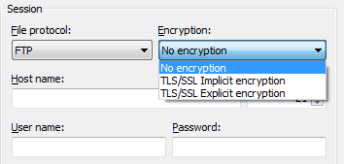
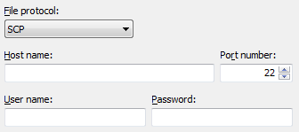
Example use of DUs
WinSCP connection dialog
type FTPEncryption =
| ImplicitTLSEncryption
| ExplicitTLSEncryption
type Protocol =
| SCP
| FTP of FTPEncryption option
type ConnectionParameters =
{
Protocol : Protocol
HostName : string
PortNumber : int
UserName : string
Password : string
}

Slide 17
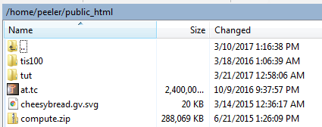
Example use of OO
WinSCP connection
Lists files, lets you browse/upload/download
Same capabilities regardless of how it's done
type IConnection =
inherit IDisposable
abstract member CurrentDirectory : string
abstract member ChangeDirectory : string -> unit
abstract member ListDirectoryEntries : unit -> DirectoryEntry list
abstract member OpenFile : string -> Stream

Slide 18
Putting it together
Just need some glue code to create a connection given the data
type IConnectionFactory =
abstract member GetConnection : ConnectionParameters -> IConnection

Slide 19
Inline functions
Some standard library methods in .NET have many overloads – usually to deal with numeric types.
  Enumerable.Sum
  Math.Abs
Interfaces aren't suitable for math, for both performance and type safety (what would return type be?)
Is there a better way?

Slide 20
Units of measure
Compile-time type information attached to numeric types (int, decimal, double, etc.)
Compiler can check that units match up and will "calculate" the units of a formula:
  10<meter> / 2<second> = 5<meter/second>
No runtime representation, so no overhead (but you also can't, say, print the units of a number)
Better than a comment for documentation

Slide 21
Units of Measure: why?
May seem like this is a scientific computing feature – don't write many apps that deal with meters or kilograms
What about…
  Money
  Time
  Quantities of products sold (is cost <dollar/package> or <dollar/pound>?)
  Percentages (is 2% represented as 2 or .02 in this variable?)

