Slide 1
Using Regression Techniques to Predict Weather Signals from Image Sequences
Richard Speyer
Master of Science Thesis Defense
April 22nd, 2009

Slide 2
Overview
Background Information
AMOS Dataset
Weather Data
Algorithms
Canonical Correlation Analysis (CCA)
Principal Coefficient Analysis (PCA)
Putting everything together
Results
Wind Velocity
Vapor Pressure
Training set analysis
Conclusion
Future Work

Slide 3
Webcam Data

Slide 4
AMOS Dataset

Slide 5
AMOS Dataset

Slide 6
Weather Data

Slide 7
Canonical Correlation Analysis (CCA)
Given…Find…

Slide 8
Canonical Correlation Analysis (CCA)
How it works

Slide 9
Canonical Correlation Analysis (CCA)
Why it is cool, works for us, image size problem

Slide 10
Principal Coefficient Analysis (PCA)
What PCA is, example?

Slide 11
Principal Coefficient Analysis (PCA)
Benefits for us

Slide 12
Bringing it together - Algorithms
English explanation of steps

Slide 13
Predicting the Weather
Predict from CCA, etc.

Slide 14
Results & Analysis

Slide 15
Wind Velocity
Goals, challenges

Slide 16
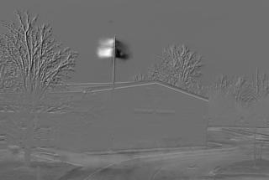
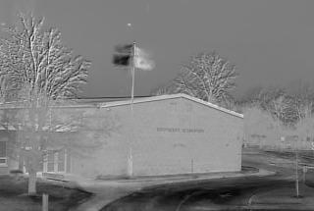
Wind Velocity

Slide 17
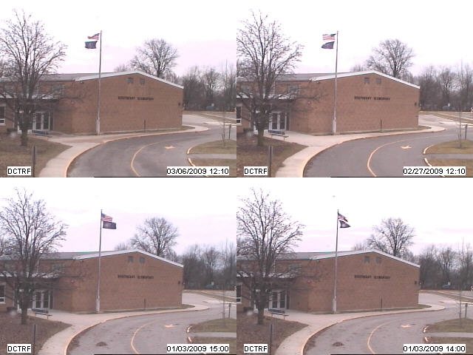
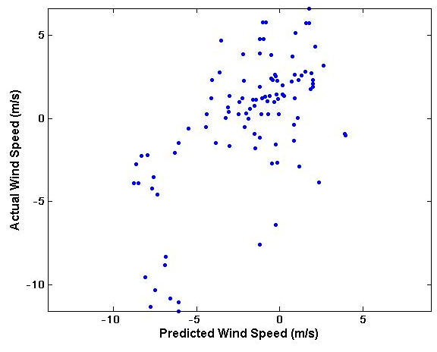
Wind Velocity

Slide 18
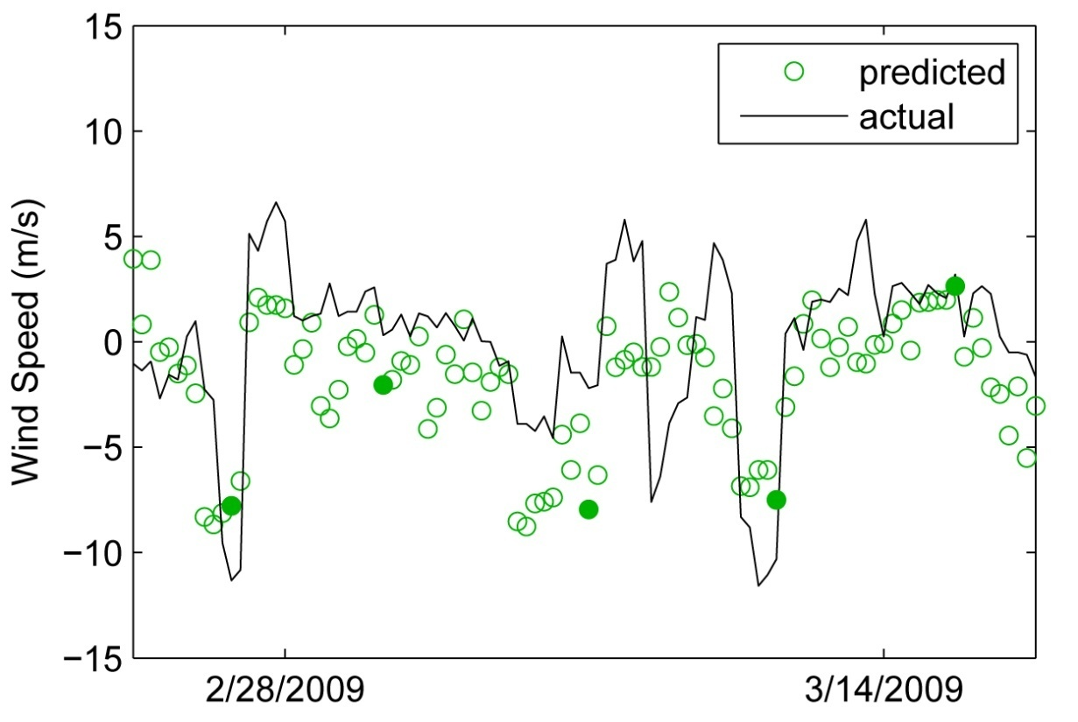
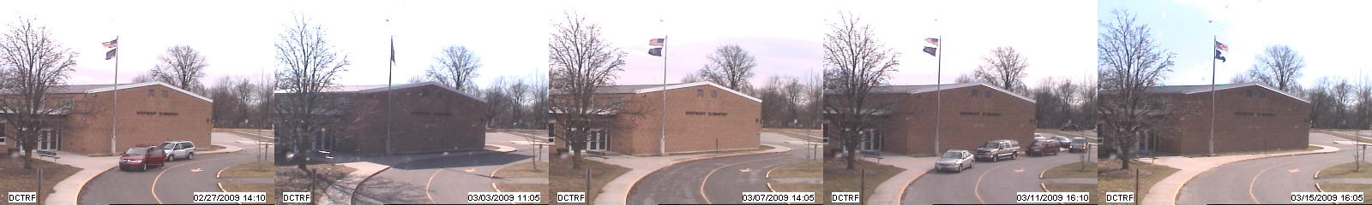
Wind Velocity

Slide 19
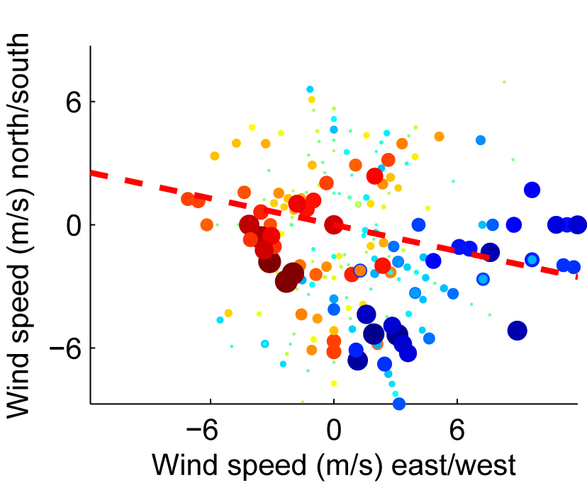
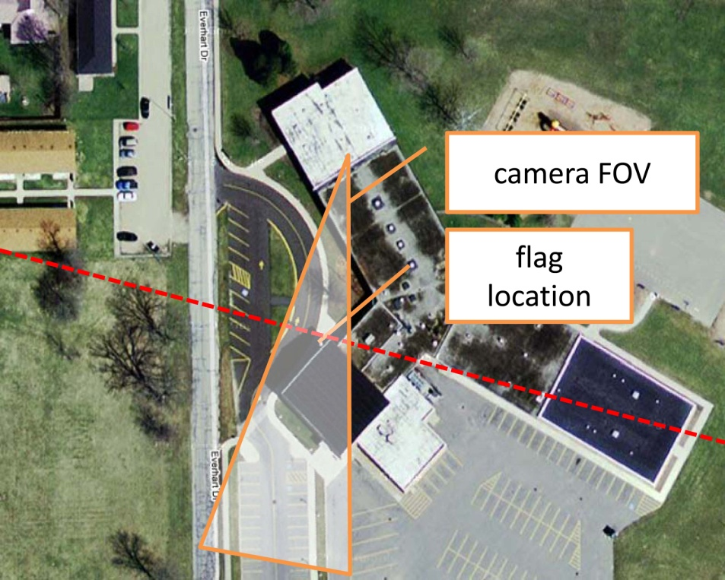
Wind Velocity

Slide 20
Vapor Pressure
Goals, challenges, gradient image

Slide 21


Vapor Pressure

Slide 22
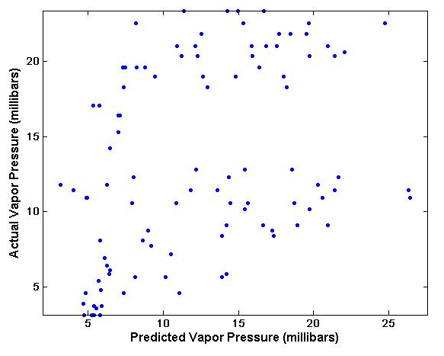
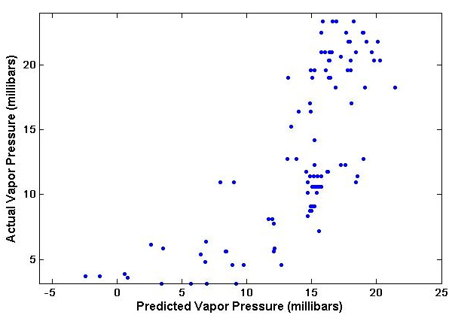
Vapor Pressure

Slide 23
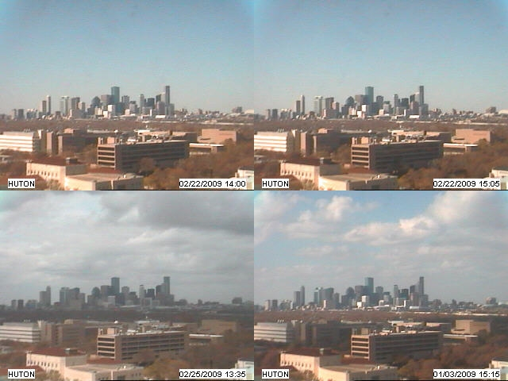
Vapor Pressure

Slide 24
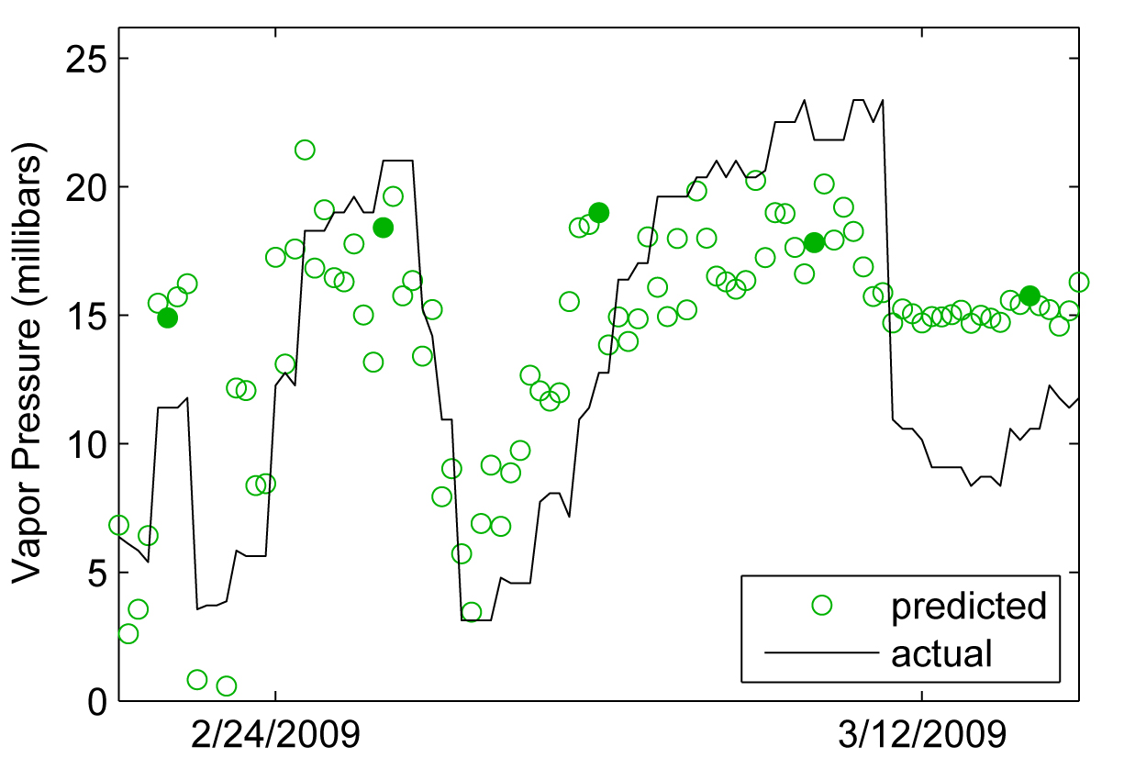
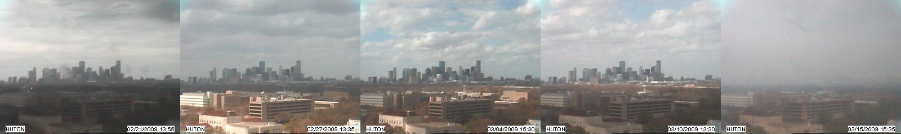
Vapor Pressure

Slide 25
Training Set Analysis
What we want to do, why it is valuable, background?

Slide 26
Training Set Analysis
Method used to predict

Slide 27
Training Set Analysis
charts

Slide 28
Conclusion

Slide 29
Future Work

Slide 30
Acknowledgements
Dr. Robert Pless
Nathan Jacobs
Thesis Examination Committee
Dr. Ron Cytron
Dr. Tao Ju
Dr. Robert Pless

Slide 31
Questions?

