Slide 1
Using Regression Techniques to Predict Weather Signals from Image Sequences
Richard Speyer
Master of Science Thesis Defense
April 22nd, 2009
with slides from Nathan Jacobs and Robert Pless
Notes:
Hello, my name is Richard Speyer and the title of my thesis is…..

Slide 2
Overview
Introduction
Background Information
AMOS Dataset
Weather Data
Related Work
Methods & Algorithms
Canonical Correlation Analysis (CCA)
Principal Coefficient Analysis (PCA)
Putting everything together
Results & Analysis
Wind Velocity
Vapor Pressure
Training set analysis
Conclusion
Future Work
Notes:
Go through what to expect, please interrupt with questions whenever you like

Slide 3
Introduction
Given a set of images collected from a static webcam and the associated ground truth weather data, can we build a model to predict the weather at a given time by just looking at the associated image?
If so, why should we bother?
Help us gain a better understanding of local weather patterns
Fill in missing data from weather stations
Uses cheap sensors already in place as opposed to setting up an expensive weather station
We will use regression and correlation techniques such as Canonical Correlation Analysis (CCA) to achieve this goal
Notes:
Overarching goal, how we do this

Slide 4
Background Information & Related Work

Slide 5
Images & Webcam Data
Images inherently contain large amounts of information beyond just pixel colors
Our job as researchers is to develop methods to extract this information to gain a better understanding what is going on in a given scene
Thousands of webcams are already installed all over the world and are constantly collecting data
Provides a vast resource of “real world” data for us to test our methods
Notes:
What makes webcams cool, motivation for using them

Slide 6
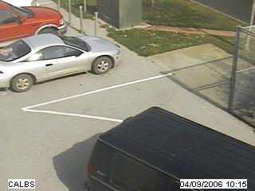
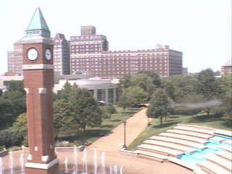
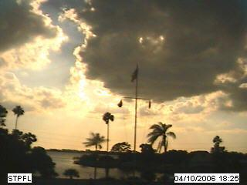
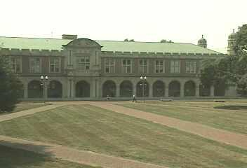
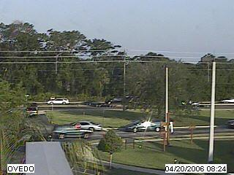
AMOS Dataset
The Archive of Many Outdoor Scenes (AMOS)
Images from ~1000 static webcams,
Every 30 minutes since March 2006.
www.cs.wustl.edu/amos
Capture variations from fixed cameras
Due to lighting (time of day), and
Seasonal and weather variations (over a year).
Collected from cameras mostly in the USA (a few elsewhere)
Notes:
Largest known dataset of its type, provides vast number of cameras to work with, lots of opportunities

Slide 7
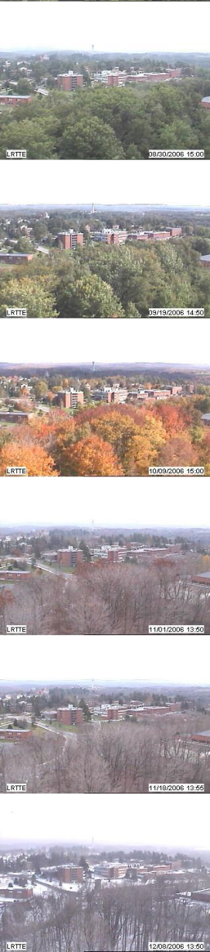
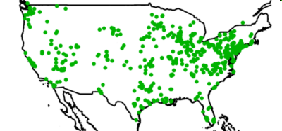
AMOS Dataset
1000 webcams
x 3 years
30 million images
Variations
over a year and over a day
Notes:
More info, variations

Slide 8
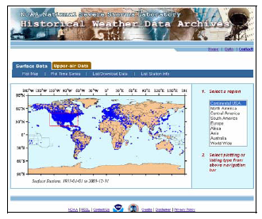
Weather Data
Historical Weather Data Archives (HWDA) maintained by the National Oceanic and Atmospheric Administration (NOAA)
Maintains hourly weather data from about 6,000 weather stations across the country from January 1, 1933 to present
But, there are segments of
missing data due to broken
equipment, failure to report, etc.
Notes:
Government collected data
Vapor pressure
Relative humidity
Cloud cover
Wind speed
Precipitation
Etc.

Slide 9
Related Work
Inferring information from large webcam datasets
S.G. Narasimhan, C. Wang, and S.K. Nayar. All the Images of an Outdoor Scene.
James Hays and Alexei A. Efros. im2gps: estimating geographic information from a single image.
Jean-Francois Lalonde, Srinivasa G. Narasimhan, and Alexei A. Efros. What does the sky tell us about the camera?
CCA and multimedia
Dongge Li, Nevenka Dimitrova, Mingkun Li, and Ishwar K. Sethi. Multimedia content processing through cross-modal association.
Notes:
WILD database – variations due to weather, etc. Can use known variations to de-fog, de-haze bad images
Single image inference of location using distributions across world
Use sky appearance and sun position to determine camera calibration variables
Sound-image retrieval using CCA

Slide 10
Methods & Algorithms

Slide 11

Canonical Correlation Analysis (CCA)
Measures the linear relationship between two multi-dimensional variables
Given two data matrices X and Y finds two matrices A and B to maximize the correlation:
Finds two sets of basis vectors such that the correlation between the projections of the variables onto these basis vectors is maximized
Iteratively finds vectors which maximize the correlation between the two datasets and minimize the correlation between previously measured vectors
Vectors are not necessarily orthogonal
Notes:
Projects variables into unique space, allows us to relate multidimensional variables

Slide 12
Canonical Correlation Analysis (CCA)
Not dependent on the coordinate system of the variables
Can find correlations regardless of measurement system used, which is important since images and weather data use different forms of measurement
Invariant to affine transformations of the variables
It is important that each data entry in X has a corresponding entry in Y, and vice versa (same number of rows)
Notes:
Why it is cool, good for our uses. Important things to note

Slide 13
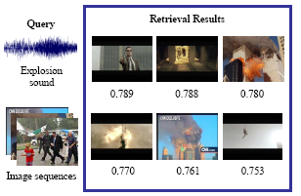
Canonical Correlation Analysis (CCA)
One common application of CCA in multimedia is content-based image and video retrieval
Text-based retrieval
Sound-based retrieval
Notes:
Text-based retrieval
400 records of JPEG images for each class with associated text and a total of 3 classes
Data was split randomly into 2 parts for training and test
Features
Image – HSV Color, Gabor texture
Text – Term frequencies
Results were taken for an average of 10 runs

Slide 14
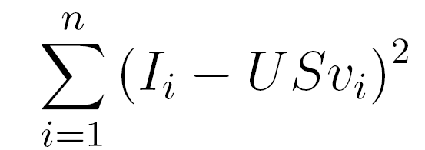
Principal Coefficient Analysis (PCA)
PCA is a method used to extract the most significant features from given dataset
Given a set of images I and a number k>0, finds the k most important features in the set of images
[U S V] = PCA(I,k)
U contains the k feature, or basis, images, all of which are orthogonal to each other
S is a diagonal matrix which contains the weights of each feature vector
V contains the coefficients of each basis image for each actual image
Will extract the most significant features to minimize
Notes:
Another correlation technique used is PCA…
Decomposes images into U,S,V
Can represent each image by a few numbers

Slide 15
Principal Coefficient Analysis
D
U
S
V
coefficients
=
Images
Basis Images
We can reconstruct image x as a linear combination of the basis images: i_{x}=USv_{x}
Reconstructed images will not exactly match the original images
Similarity increases as we increase the number of coefficients k
Notes:
Further explanation

Slide 16
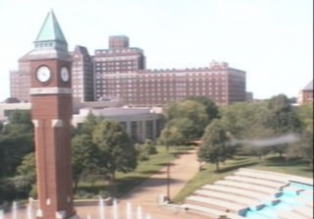
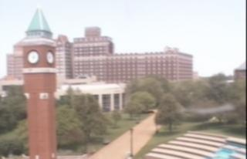
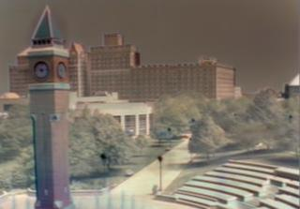
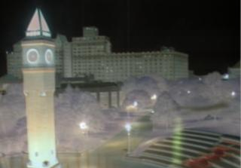
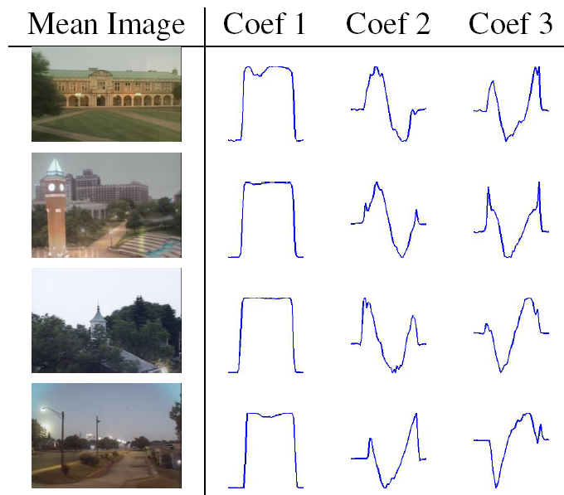
= + f₁(t) + f₂(t) + ...
mean Image
component 1
component 2
Camera 1
Camera 2
Camera 3
Camera 4
Notes:
Visual example. See day/night, dawn/dusk. Keep?? Shows why we cannot use images from entire day, localize to certain range of hours

Slide 17
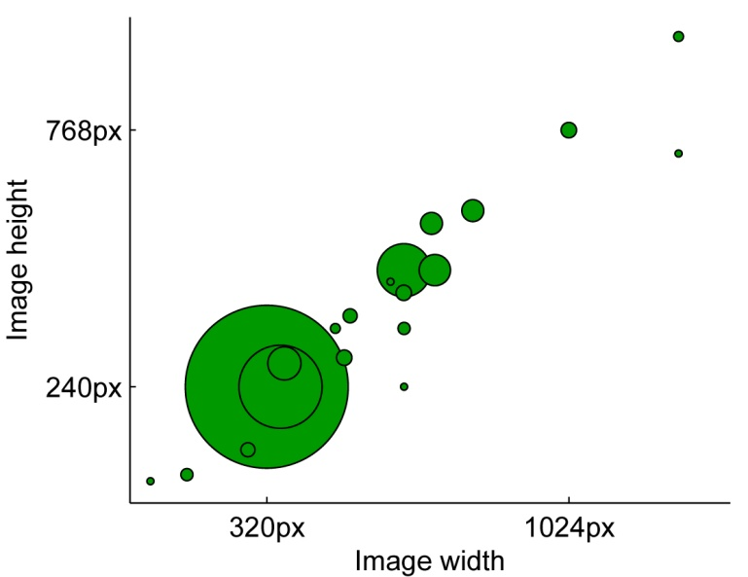
Why use PCA components?
Most of the images in the AMOS dataset are 320 x 240 pixels = 76,800 pixels
Lots of dimensions for CCA, will greatly hurt the runtime of our algorithms
We can reduce this number dramatically by instead using the PCA components of each image (k=10)
Notes:
Why PCA is necessary, reduces computation time
CCA clearly dependent on # of variables

Slide 18
Bringing it together - Algorithms
Given set of timestamped images I = i₁,…,i_{x} and weather data entries W = w₁,…,w_{y}
Concurrently iterate through both sets and remove entries which do not have corresponding entries in opposite set. Both sets now have n entries
Run PCA on images; V = v₁,…,v_{n} are vectors of length k containing the principal coefficients for each image, U = u₁,…u_{k} are the basis images
Run CCA using V and W as input matrices
[A B] = CCA(V, W)
Notes:
This is the big deal. How it all comes together to form a coherent algorithm

Slide 19

Predicting the Weather
Given a new image i and CCA projection matrices A and B, we can predict the value of the weather signal in the following way:
Find the PCA coefficients of the new image I on our existing basis vectors U (v)
Value of weather signal w is:
Notes:
How to predict weather given CCA matrices A and B. This converts images into some value in the measurement system of the weather signal. Ie: millibars, m/s

Slide 20
Results & Analysis

Slide 21
Results & Analysis
Predict two signals which present unique challenges
Wind Velocity
Vapor Pressure
Analyze effect of training set size on performance
Find minimum amount of data needed to build a good predictor
Notes:
Time to show how it works. Chose two diverse examples to show robustness of algorithm
Determine size of training set; how little data is needed

Slide 22
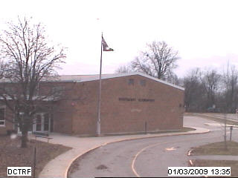
Wind Velocity
Wind velocity is made up of 2 components: north/south and east/west
Effects are only noticeable on very local regions of the image
Trees
Flags
In order to ignore changes due
to time of day, all images are
captured between 10 AM and
2 PM
204 training images, 102 test
images
(Left). A sample image from AMOS camera #194 in Decatur, IN

Slide 23
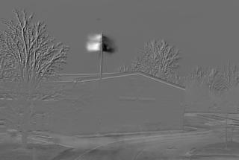
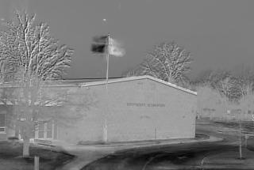
Wind Velocity
Can visualize the derived CCA bases by projecting back onto the image space using the basis images U (U×A)
Analysis of CCA basis images shows only one accurate dimension
Makes sense since webcam captures in 2D so we can only see the flag blowing along one direction
First CCA basis vector projected onto the image space
Second CCA basis vector projected onto the image space
Notes:
This means we will only be able to predict the magnitude of wind velocity along some unknown vector = camera orientation

Slide 24
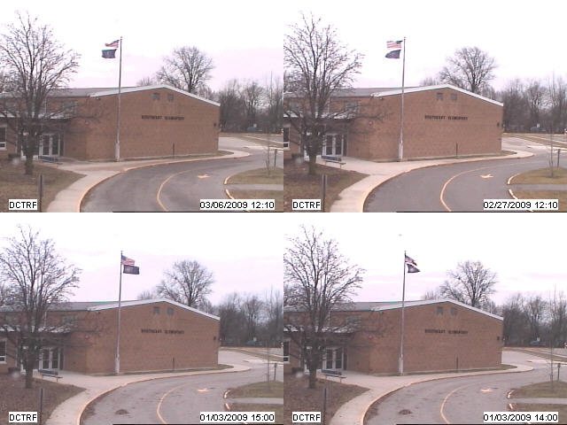
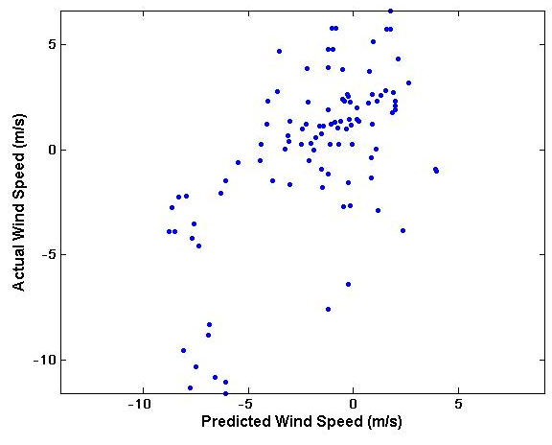
Wind Velocity
If we sort images by the value of the first CCA coefficient, it is clear that the direction of the flag is a key feature
Sample images sorted by the value of the first CCA coefficient
Predicted vs. actual wind speeds (r=0.61759)
Notes:
To compare, second CCA component yields r=0.3523

Slide 25
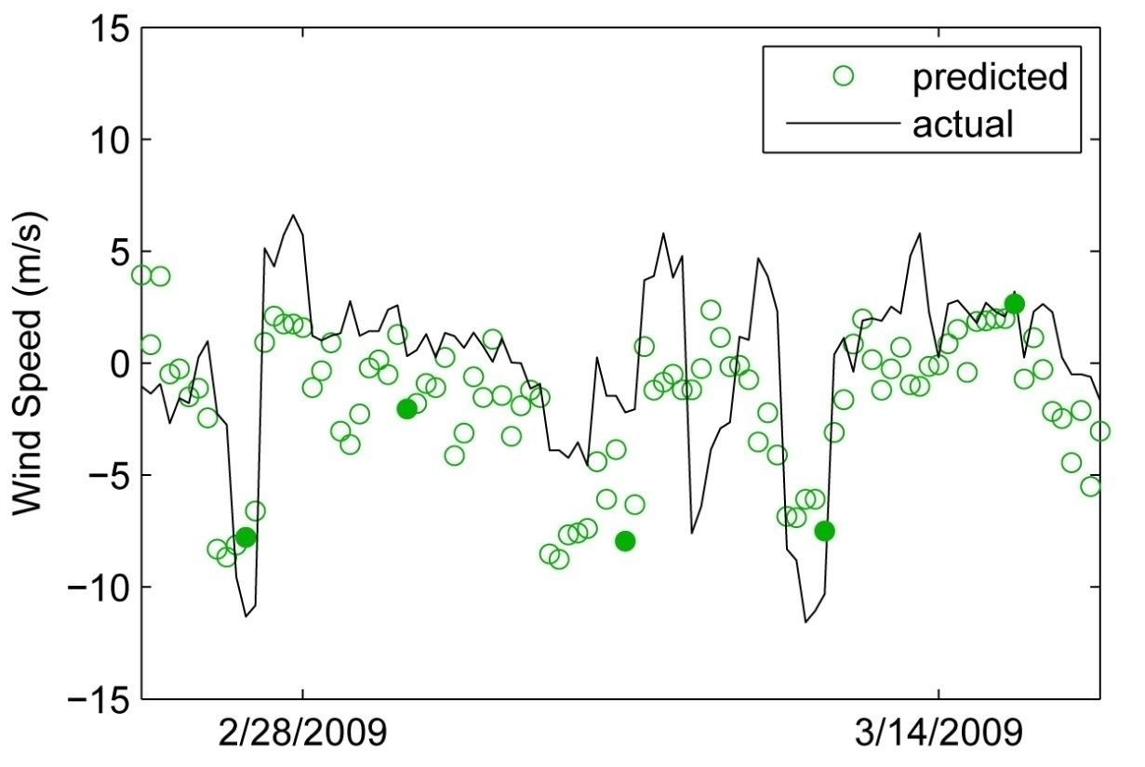
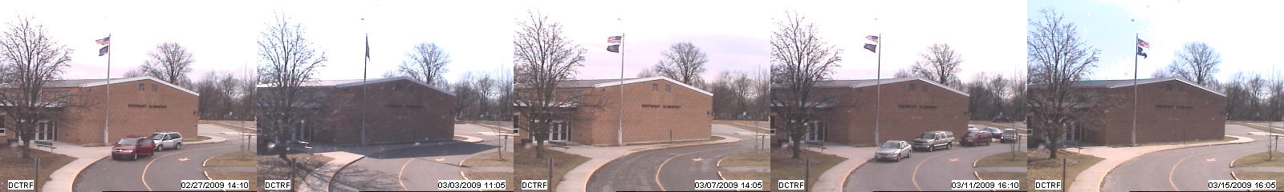
Wind Velocity
Notes:
Since we only have one good CCA dimension, we can only predict wind magnitude along an unknown vector

Slide 26
Wind Velocity
Since flag can only be viewed in 2D, we only predicted the magnitude along some unknown vector
Use this information to compute this unknown vector, which will tell us the orientation of the camera
Let A = n×2 matrix containing actual wind velocity, let b = n×1 vector containing predicted wind magnitudes
By solving Ax = b for x, we will find the orientation vector of the camera
Notes:
Now we can use the information we have to determine the direction of the unknown vector = camera orientation. In my opinion one of the coolest byproducts of this method.

Slide 27
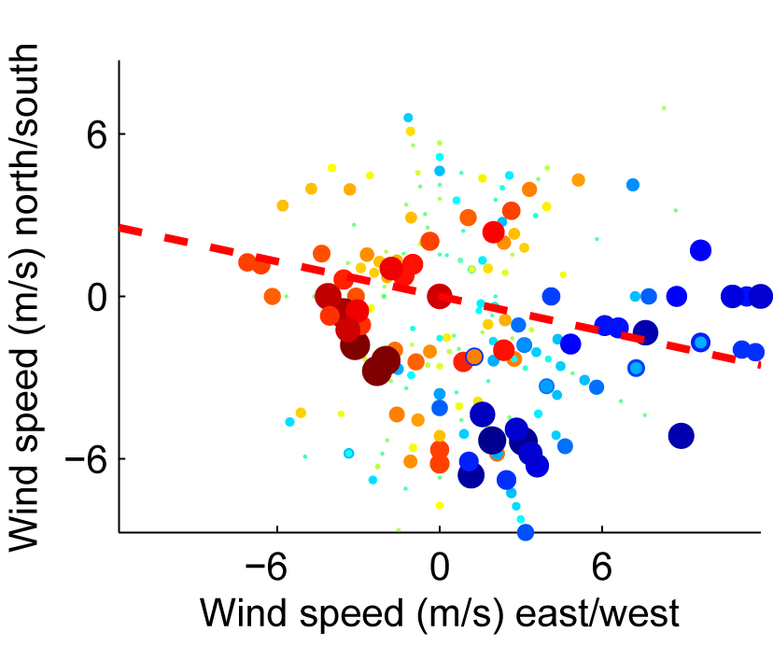
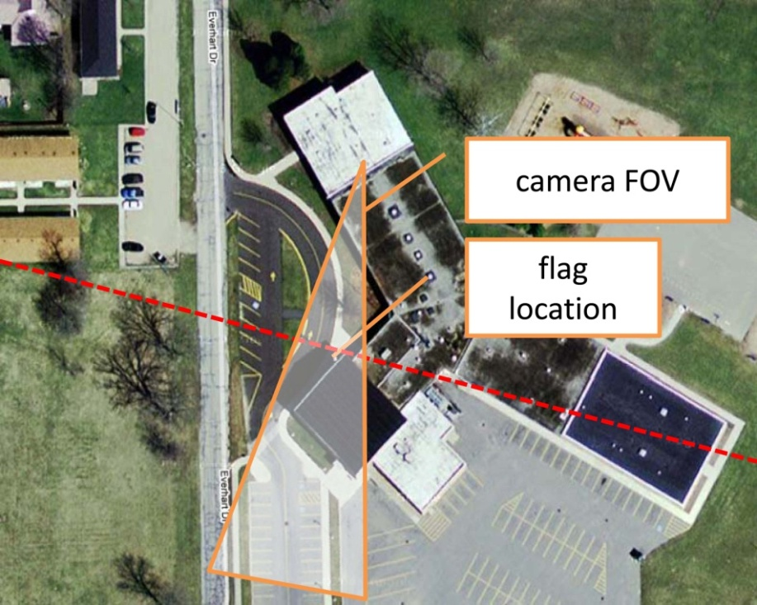
Wind Velocity
On the left, the size and color of each marker is determined by the predicted wind speed and the location of each marker is determined by the north/south and east/west components of the actual wind speed at the same time. The dashed red line is the normal to the projection axis determined by running linear regression between the predicted and actual values.
On the right, we show this axis overlaid on a Google Maps image with the field of view crudely estimated by hand.

Slide 28
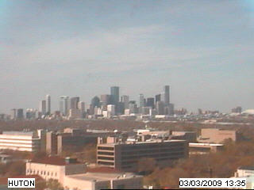
Vapor Pressure
Contribution of water vapor to overall atmospheric pressure (millibars)
As opposed to wind velocity, vapor pressure will likely have a more universal effect on the image
Expect to see the cloud cover increase as vapor pressure increases
Images captured between
10 AM and 2 PM
198 training images, 99 test
images
(Left). A sample image from AMOS camera #619 in Houston, TX
Notes:
Very different challenge. Not as easy for humans to visualize, determine.

Slide 29


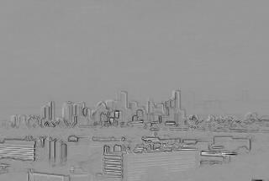
Vapor Pressure
CCA projection image when original images are used (left) is not very compelling. Seems to be identifying sunlight as a key indicator of vapor pressure
When gradient images are used (right), the image is far more compelling
Appears to be identifying the clarity/visibility of building outlines as an important indicator of vapor pressure
CCA basis vector projected onto the image space (original images)
CCA basis vector projected onto the image space (gradient images)
Notes:
Gradient images highlight edges and changes in images, so helps us find building edges as a key changing part of the image.

Slide 30
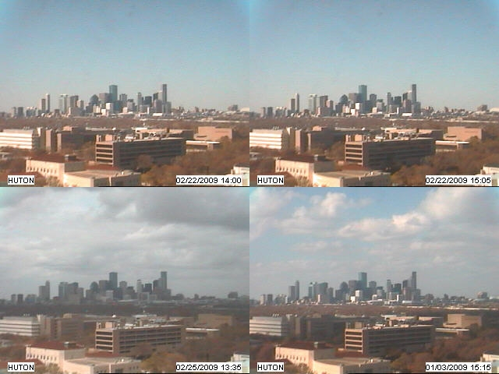
Vapor Pressure
If we sort images by the value of the CCA coefficients, it is clear that the cloud cover and resulting visibility of the buildings is a key feature
Sample images sorted by the value of their CCA coefficient
Notes:
Clouds effect visibility, etc.

Slide 31
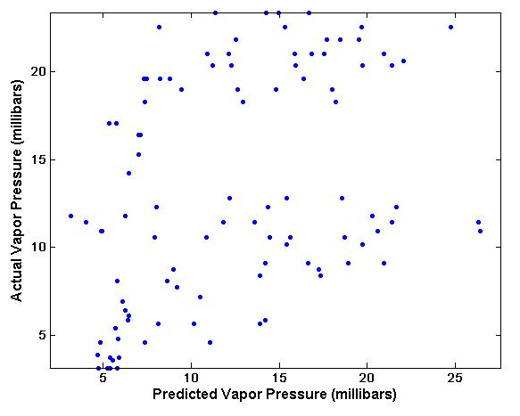
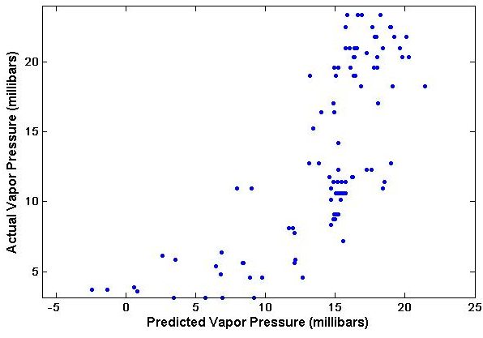
Vapor Pressure
Scatter plots of predicted vs. actual vapor pressures (millibars) further verify the improvement with gradient images
Agrees with expectations from CCA projection images
Original images (r=0.3894)
Gradient images (r=0.73684)
Notes:
Outliers will be explained in next slide

Slide 32
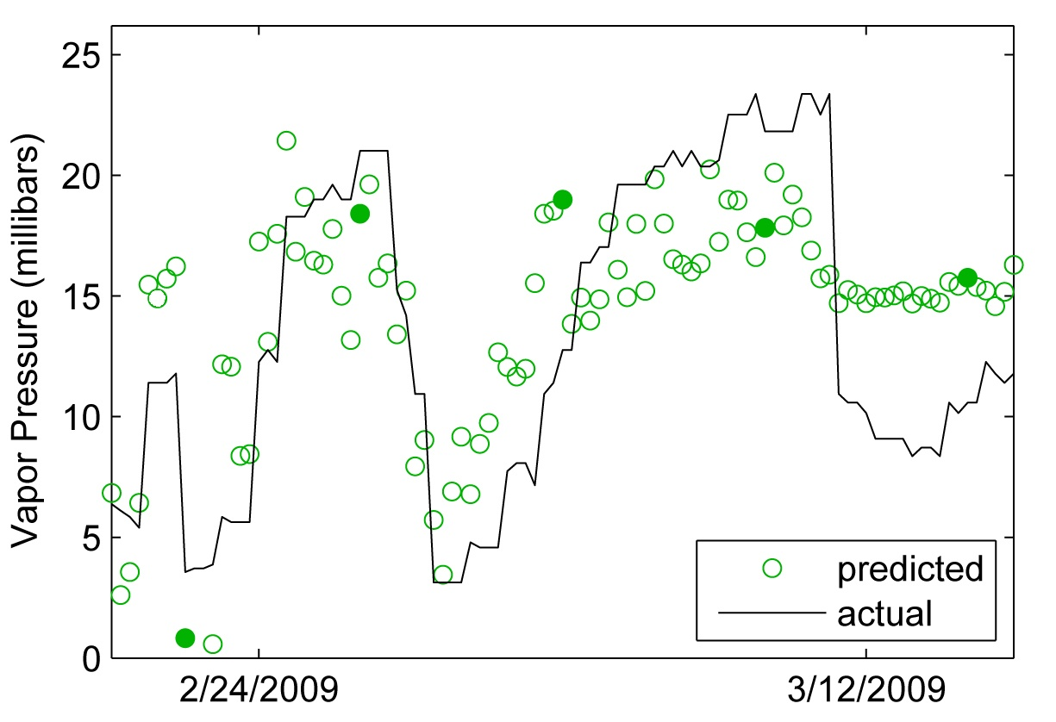
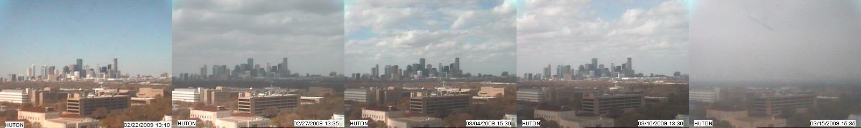
Vapor Pressure
Notes:
March 12 – so hazy we cannot make a clear prediction

Slide 33
Training Set Analysis
How many images does it take to build a good weather predictor?
Want to find out what the minimum amount of data is required to build an accurate and precise predictor of a given weather signal
Previous studies (Barcikowski & Stevens, 1975) indicates that CCA requires between 40 and 60 times the number of variables in training data
Might less if data variations are limited and samples sufficiently cover possible range

Slide 34
Training Set Analysis
Vary training size between 10 and 200 images
Run PCA, CCA on images
Take new set of 100 test images, get PCA components on existing basis vectors U
Predict value of weather signal, compute correlation coefficient r with known actual values
Repeat 10 times at each training size with different training sets
Reduces effect of lucky/unlucky selections of training data

Slide 35
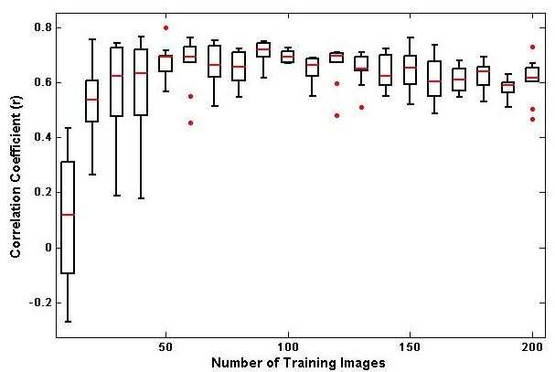
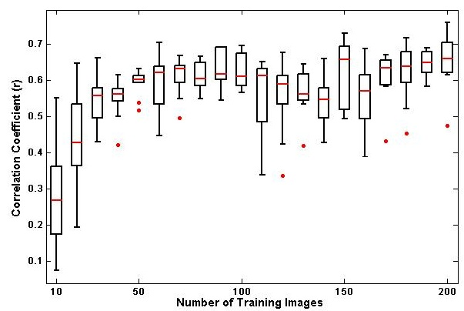
Training Set Analysis
Average correlation coefficient (red lines) steadily increase as training set size increases
Stop rising rapidly around 80 images, amount of variation in coefficients decreases as well
80 images = 2 weeks of data
Wind Velocity (m/s)
Vapor Pressure (millibars)
Notes:
Error bars in vapor pressure example do not reduce as much, due to bad data on March 12?? Notice lots of outliers on the bottom

Slide 36
Conclusion & Future Work

Slide 37
Conclusion
Images carry with them lots of higher level information
Develop methods to extract this information to gain a better understanding of what is going on at a given location
Using regression and correlation techniques, we can predict weather signals simply by observing a given webcam
Only 2 weeks of data is required to build an accurate model
Notes:
Why what we did is cool, interesting, compelling

Slide 38
Future Work
Take greater advantage of AMOS dataset
Further automate the methods used in order to apply to many cameras
Begin to gain a better understanding of local weather variations by combining predicted weather data with locations of cameras
Build models to work at all times of day
Notes:
This is really a proof-of-concept, major payoff comes when we can apply this to large number of cameras

Slide 39
Acknowledgements
Dr. Robert Pless
Nathan Jacobs
Thesis Examination Committee
Dr. Ron Cytron
Dr. Tao Ju
Dr. Robert Pless
Media & Machines Lab

Slide 40
Questions?

