Slide 1
Using Regression Techniques to Predict Weather Signals from Image Sequences
Richard Speyer
Master of Science Thesis Defense
April 22nd, 2009
with slides from Nathan Jacobs and Robert Pless

Slide 2
Overview
Introduction
Background Information
AMOS Dataset
Weather Data
Related Work
Algorithms
Canonical Correlation Analysis (CCA)
Principal Coefficient Analysis (PCA)
Putting everything together
Results
Wind Velocity
Vapor Pressure
Training set analysis
Conclusion
Future Work

Slide 3
Introduction
Given a set of images collected from a static webcam and the associated ground truth weather data, can we build a model to predict the weather at a given time by just looking at the associated image?
If so, why should we bother?
Help us gain a better understanding of local weather patterns
Fill in missing data from weather stations
Uses cheap sensors already in place as opposed to setting up an expensive weather station

Slide 4
Webcam Data
Thousands of webcams are already installed all over the world and are constantly collecting data
Provides a vast resource of “real world” data for us to test our methods
Images inherently contain large amounts of information beyond just pixel colors
Our job as researchers is to develop methods to extract this information to gain a better understanding what is going on in a given scene

Slide 5
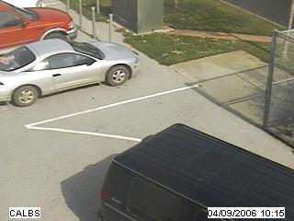
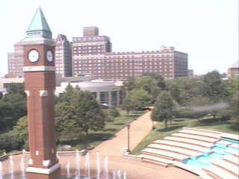
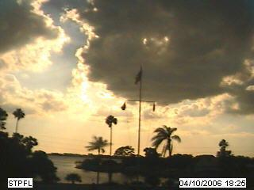
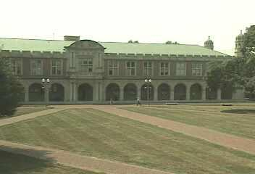
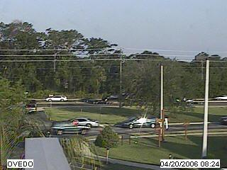
AMOS Dataset
The Archive of Many Outdoor Scenes (AMOS)
Images from ~1000 static webcams,
Every 30 minutes since March 2006.
www.cs.wustl.edu/amos
Capture variations from fixed cameras
Due to lighting (time of day), and
Seasonal and weather variations (over a year).
From cameras mostly in the USA (a few elsewhere).

Slide 6
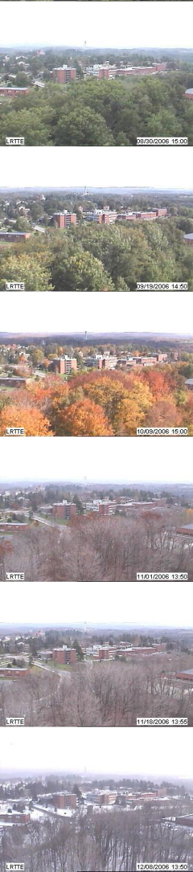
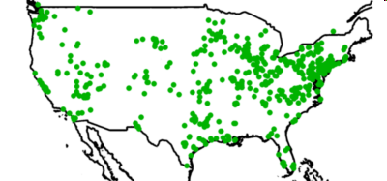
AMOS Dataset
1000 webcams
x 3 years
30 million images
Variations
over a year and over a day

Slide 7
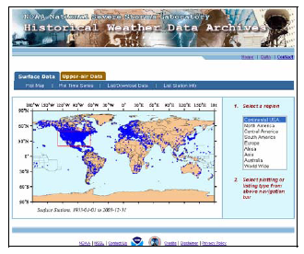
Weather Data
Historical Weather Data Archives (HWDA) maintained by the National Oceanic and Atmospheric Administration (NOAA)
Maintains hourly weather data from about 6,000 weather stations across the country from January 1, 1933 to present
But, there are segments of missing
data due to broken equipment,
failure to report, etc.

Slide 8
Related Work
Inferring information from large webcam datasets
S.G. Narasimhan, C. Wang, and S.K. Nayar. All the Images of an Outdoor Scene.
James Hays and Alexei A. Efros. im2gps: estimating geographic information from a single image.
Jean-Francois Lalonde, Srinivasa G. Narasimhan, and Alexei A. Efros. What does the sky tell us about the camera?
CCA and multimedia
Dongge Li, Nevenka Dimitrova, Mingkun Li, and Ishwar K. Sethi. Multimedia content processing through cross-modal association.

Slide 9

Canonical Correlation Analysis (CCA)
Measures the linear relationship between two multi-dimensional variables
Finds two sets of basis vectors such that the correlation between the projections of the variables onto these basis vectors is maximized
Given two data matrices X and Y finds projection matrices A and B to maximize the correlation:

Slide 10
Canonical Correlation Analysis (CCA)
Iteratively finds vectors which maximize the correlation between the two datasets and minimize the correlation between previously measured vectors
Vectors are not necessarily orthogonal
Used in content-based image retrieval systems

Slide 11
Canonical Correlation Analysis (CCA)
Not dependent on the coordinate system of the variables
Can find correlations regardless of measurement system used, which is important since images and weather data use different forms of measurement
Invariant to affine transformations of the variables
It is important that each data entry in X has a corresponding entry in Y, and vice versa (same number of rows)

Slide 12
Principal Coefficient Analysis (PCA)
PCA is a method used to extract the most significant features from given dataset
Given a set of images I and a number k>0, finds the k most important features in the set of images
[U S V] = PCA(I,k)
U contains the k feature vectors, all of which are orthogonal
S is a diagonal matrix which contains the weights of each feature vector
V contains the coefficients of each vector for each image
We can reconstruct image x: i_{x}=USv_{x}

Slide 13
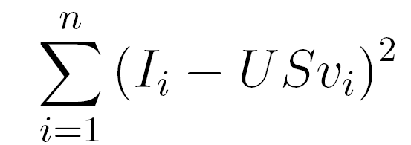
Principal Coefficient Analysis
D
U
S
V
coefficients
=
Images
Basis Images
Images will not be exact reconstructions of original images
Similarity increases as we increase the number of coefficients k
Will extract the most significant features to minimize

Slide 14
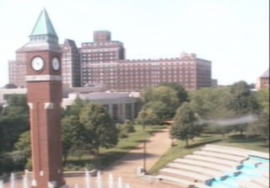
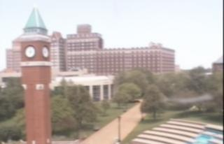
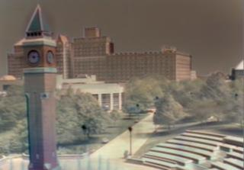
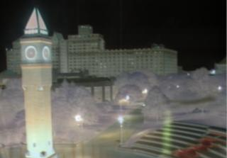
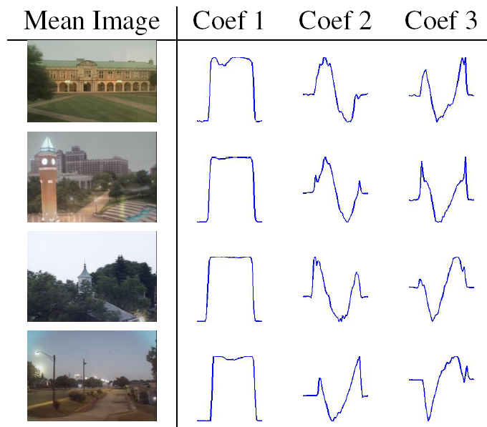
= + f₁(t) + f₂(t) + ...
mean Image
component 1
component 2
Camera 1
Camera 2
Camera 3
Camera 4

Slide 15
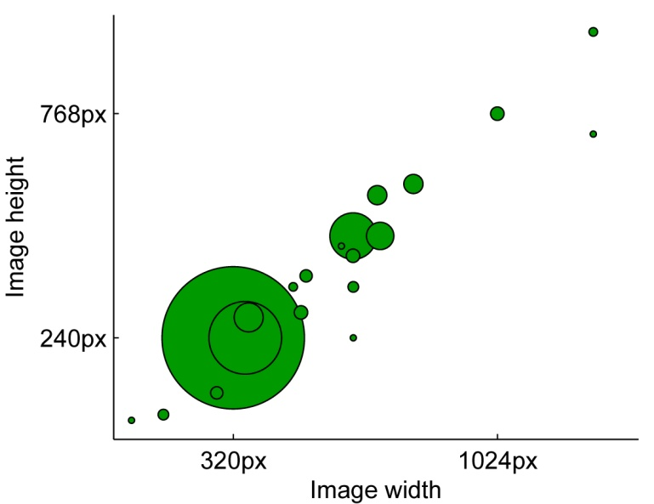
Principal Coefficient Analysis (PCA)
Most of the images in the AMOS dataset are 320 x 240 pixels = 76800 pixels
Lots of dimensions for CCA, will greatly hurt the runtime of our algorithms
We can reduce this number dramatically by instead using the PCA components of each image (k=10)

Slide 16
Bringing it together - Algorithms
Given set of timestamped images I = i₁,…,i_{x} and weather data entries W = w₁,…,w_{y}
Concurrently iterate through both sets and remove entries which do not have corresponding entries in opposite set. Both sets now have n entries
Run PCA on images; V = v₁,…,v_{n} are vectors of length k containing the principal coefficients for each image, U = u₁,…u_{k} are the basis vectors
Run CCA using V and W as input matrices
[A B] = CCA(V, W)

Slide 17
Predicting the Weather
Given a new image i and CCA projection matrices A and B, we can predict the value of the weather signal in the following way:
Find the PCA coefficients of the new image I on our existing basis vectors U (v_{i})
Value of weather signal is w_{i} = Av_{i}B⁻¹

Slide 18
Results & Analysis
Predict two signals which present unique challenges
Wind Velocity
Vapor Pressure
Analyze effect of training set size on performance
Find minimum amount of data needed to build a good predictor

Slide 19
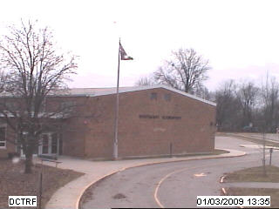
Wind Velocity
Effects are only noticeable on very local regions of the image
Trees
Flags
In order to ignore changes due to time of day, all images are captured between 10 AM and 2 PM
204 training images, 102 test
images
(Left). A sample image from AMOS camera #194 in Decatur, IN

Slide 20
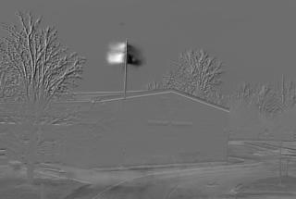
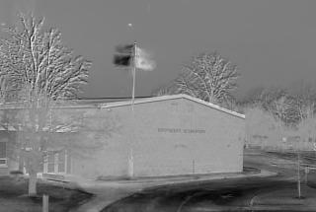
Wind Velocity
Analysis of CCA basis images shows only one accurate dimension
Makes sense since webcam captures in 2D so we can only see the flag blowing along one direction
First CCA basis vector projected onto the image space
Second CCA basis vector projected onto the image space

Slide 21
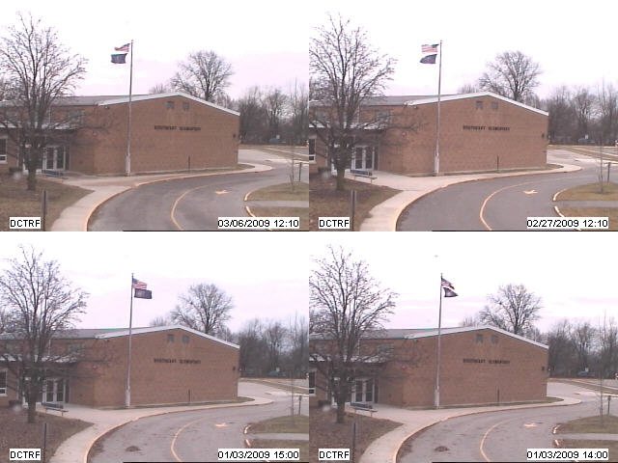
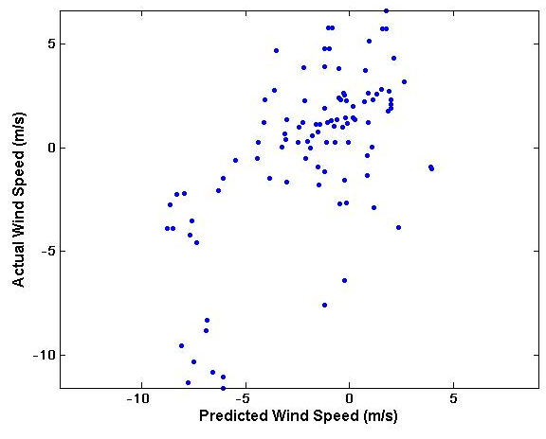
Wind Velocity
If we sort images by the value of the first CCA coefficient, it is clear that the direction of the flag is a key feature
Sample images sorted by the value of the first CCA coefficient
Predicted vs. actual wind speeds (r=0.61759)

Slide 22
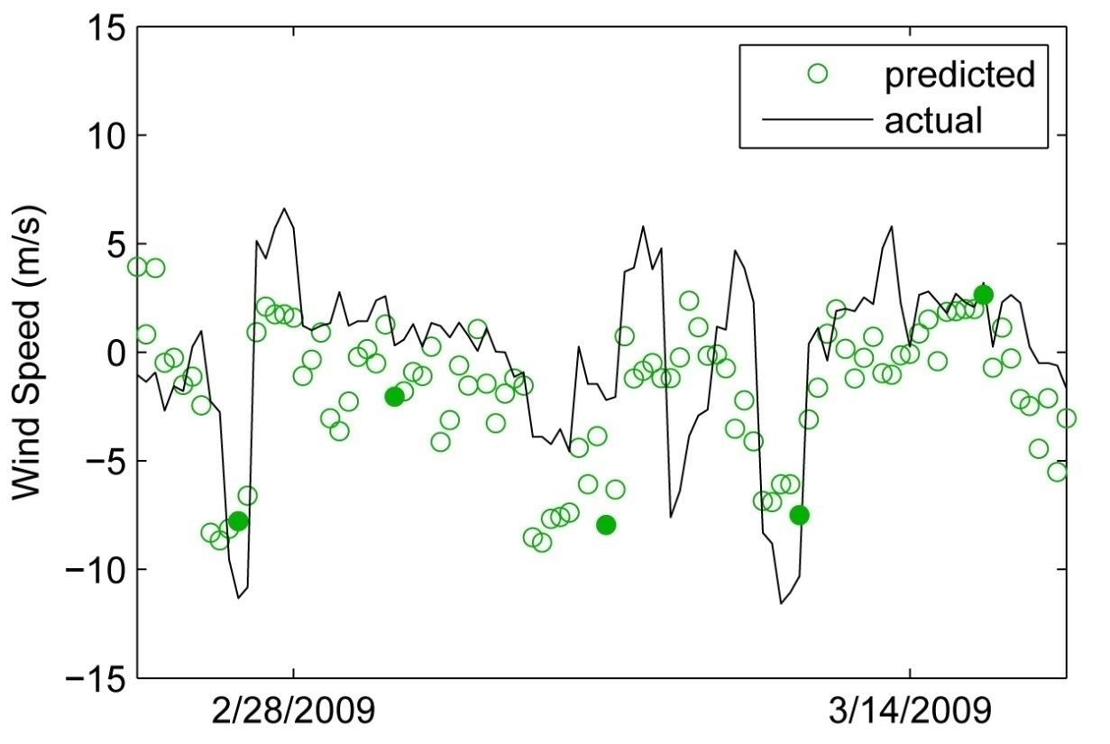
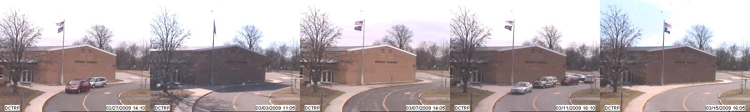
Wind Velocity

Slide 23
Wind Velocity
Wind velocity is made up of 2 components: north/south and east/west
Since flag can only be viewed in 2D, we only predicted the magnitude along some unknown vector
Use this information to compute this unknown vector, which will tell us the orientation of the camera
Let A = nx2 matrix containing actual wind velocity, let b = nx1 vector containing predicted wind magnitudes
By solving Ax = b for x, we will find the orientation vector of the camera

Slide 24
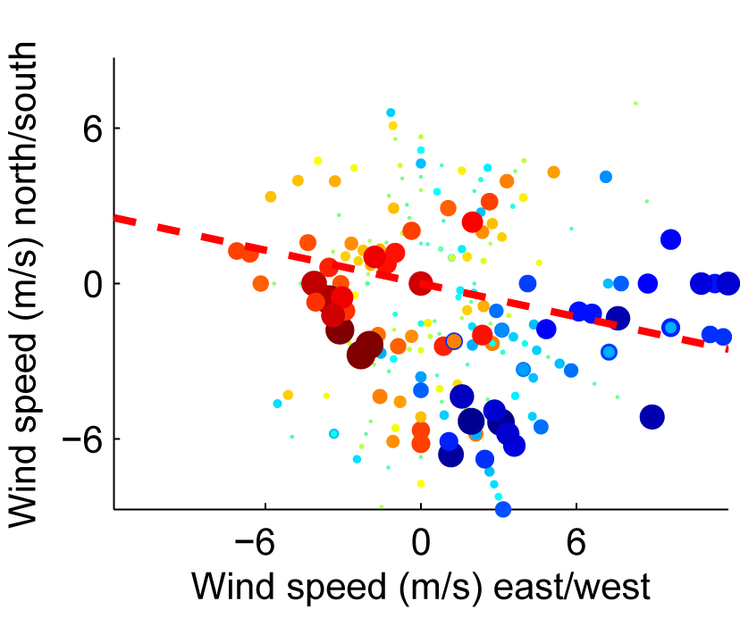
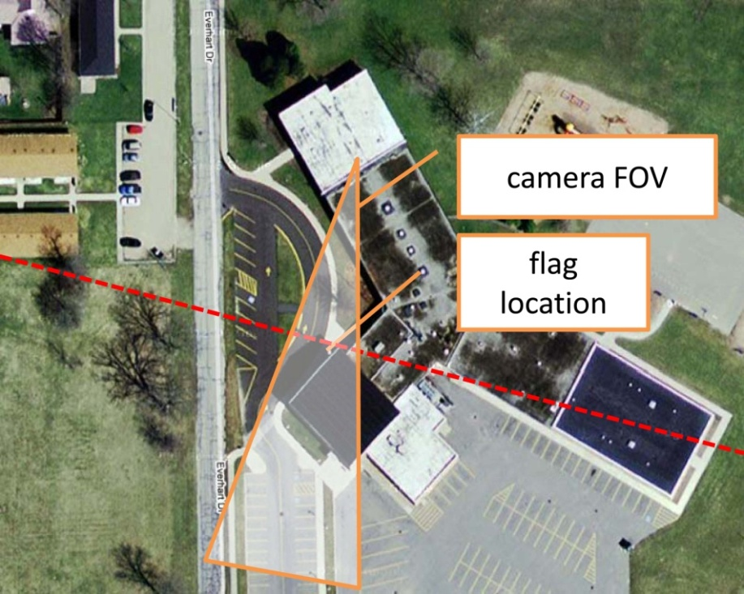
Wind Velocity
On the left, the size and color of each marker is determined by the predicted wind speed and the location of each marker is determined by the north/south and east/west components of the actual wind speed at the same time. The dashed red line is the normal to the projection axis determined by running linear regression between the predicted and actual values.
On the right, we show this axis overlaid on a Google Maps image with the field of view crudely estimated by hand.

Slide 25
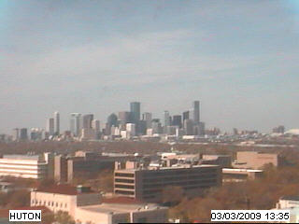
Vapor Pressure
Contribution of water vapor to overall atmospheric pressure (millibars)
As opposed to wind velocity, vapor pressure will likely have a more universal effect on the image
Expect to see the cloud cover increase as vapor pressure increases
Images captured between
10 AM and 2 PM
198 training images, 99 test
images
(Left). A sample image from AMOS camera #619 in Houston, TX

Slide 26

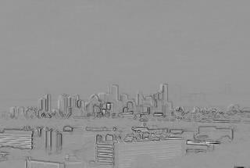
Vapor Pressure
CCA projection image when original images are used (left) is not very compelling
Seems to be identifying sunlight as a key indicator of vapor pressure
When gradient images are used (right), the image is far more compelling
Appears to be identifying the clarity/visibility of building outlines as an important indicator of vapor pressure
CCA basis vector projected onto the image space (original images)
CCA basis vector projected onto the image space (gradient images)

Slide 27
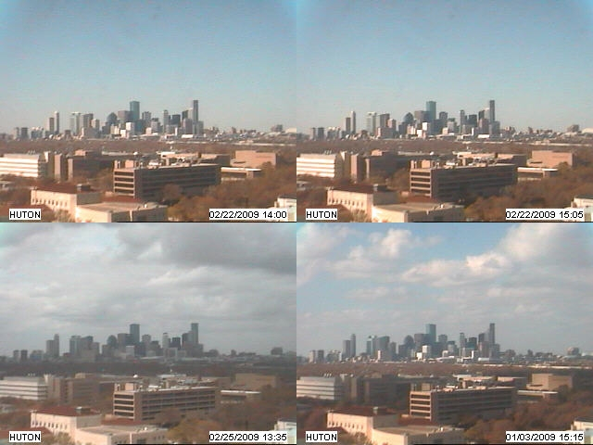
Vapor Pressure
If we sort images by the value of the CCA coefficients, it is clear that the cloud cover and resulting visibility of the buildings is a key feature
Sample images sorted by the value of their CCA coefficient

Slide 28
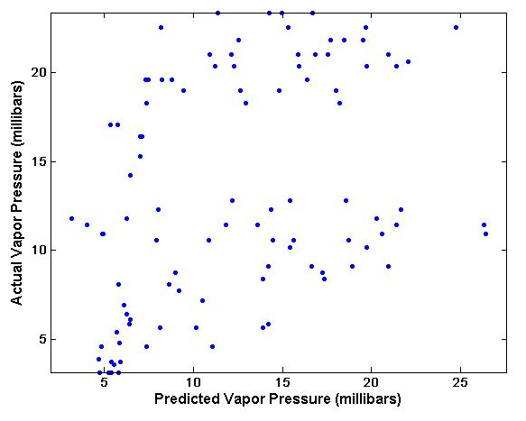
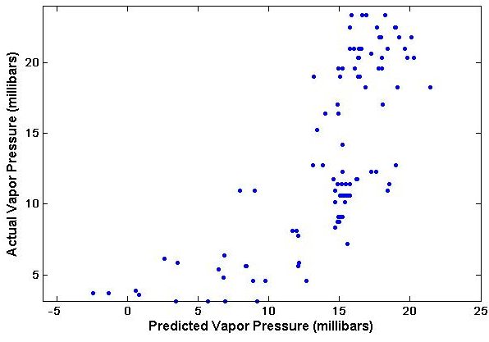
Vapor Pressure
Scatter plots of predicted vs. actual vapor pressures (millibars) further verify the improvement with gradient images
Agrees with expectations from CCA projection images
Original images (r=0.3894)
Gradient images (r=0.73684)

Slide 29
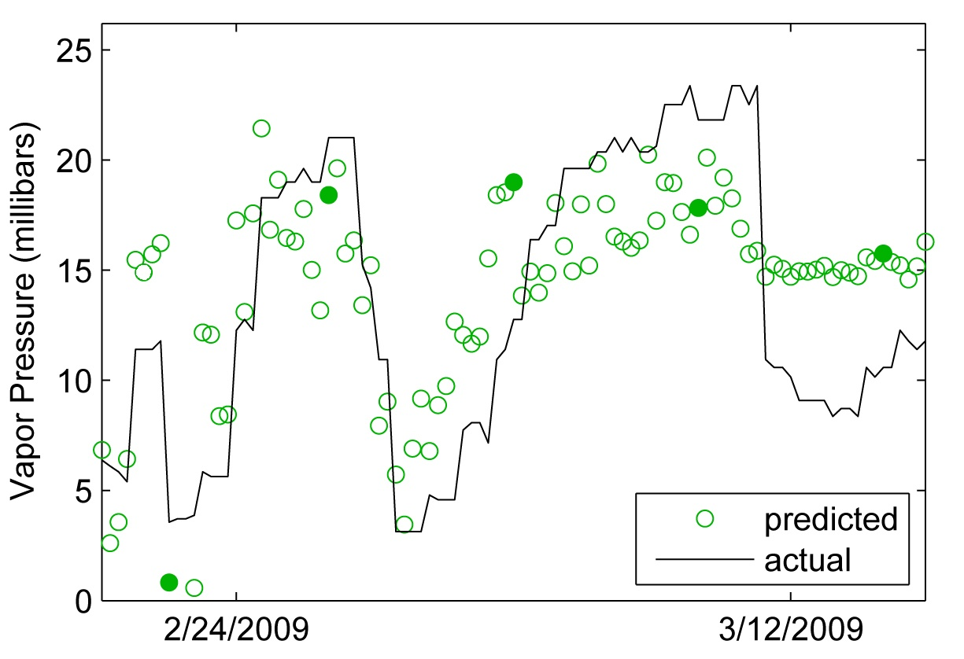
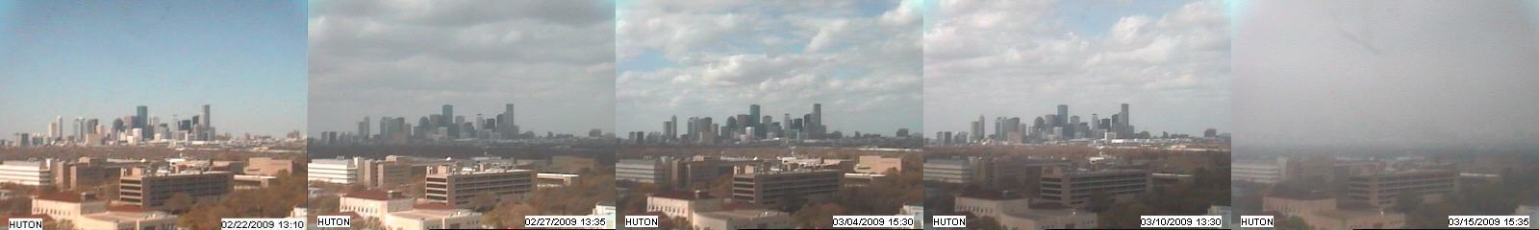
Vapor Pressure

Slide 30
Training Set Analysis
How many images does it take to build a good weather predictor?
Want to find out what the minimum amount of data is required to build an accurate and precise predictor of a given weather signal
Previous studies (Barcikowski & Stevens, 1975) indicates that CCA requires between 40 and 60 times the number of variables in training data
Might less if data variations are limited and samples sufficiently cover possible range

Slide 31
Training Set Analysis
Vary training size between 10 and 200 images
Run PCA, CCA on images
Take new set of 100 test images, get PCA components on existing basis vectors U
Predict value of weather signal, compute correlation coefficient r with known actual values
Repeat 10 times at each training size with different training sets
Reduces effect of lucky/unlucky selections of training data

Slide 32
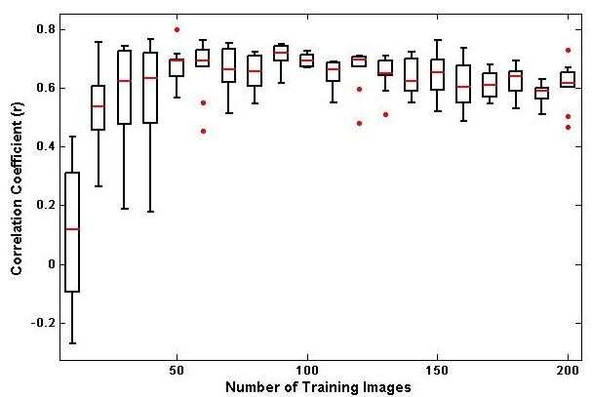
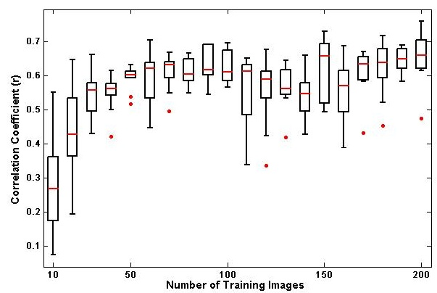
Training Set Analysis
Average correlation coefficient (red lines) steadily increase as training set size increases
Stop rising rapidly around 80 images, amount of variation in coefficients decreases as well
80 images = 2 weeks of data
Wind Velocity (m/s)
Vapor Pressure (millibars)

Slide 33
Conclusion
Images carry with them lots of higher level information
Develop methods to extract this information to gain a better understanding of what is going on at a given location
Using regression and correlation techniques, we can predict weather signals simply by observing a given webcam
Only 2 weeks of data is required to build an accurate model

Slide 34
Future Work
Take greater advantage of AMOS dataset
Further automate the methods used in order to apply to many cameras
Begin to gain a better understanding of local weather variations by combining predicted weather data with locations of cameras

Slide 35
Acknowledgements
Dr. Robert Pless
Nathan Jacobs
Thesis Examination Committee
Dr. Ron Cytron
Dr. Tao Ju
Dr. Robert Pless
Media & Machines Lab

Slide 36
Questions?

