Slide 1
Using Regression Techniques to Predict Weather Signals from Image Sequences
Richard Speyer
Master of Science Thesis Defense
April 22nd, 2009

Slide 2
Overview
Background Information
AMOS Dataset
Weather Data
Algorithms
Canonical Correlation Analysis (CCA)
Principal Coefficient Analysis (PCA)
Putting everything together
Results
Wind Velocity
Vapor Pressure
Training set analysis
Conclusion
Future Work

Slide 3
Webcam Data

Slide 4
AMOS Dataset

Slide 5
AMOS Dataset

Slide 6
Weather Data

Slide 7
Canonical Correlation Analysis (CCA)
Given…Find…

Slide 8
Canonical Correlation Analysis (CCA)
How it works

Slide 9
Canonical Correlation Analysis (CCA)
Why it is cool, works for us, image size problem

Slide 10
Principal Coefficient Analysis (PCA)
What PCA is, example?

Slide 11
Principal Coefficient Analysis (PCA)
Benefits for us

Slide 12
Bringing it together - Algorithms
English explanation of steps

Slide 13
Predicting the Weather
Predict from CCA, etc.

Slide 14
Results & Analysis
Predict two signals which present unique challenges
Wind Velocity
Vapor Pressure
Analyze effect of training set size on performance
Find minimum amount of data needed to build a good predictor

Slide 15
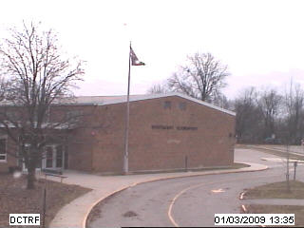
Wind Velocity
Effects are only noticeable on very local regions of the image
Trees
Flags
In order to ignore changes due to time of day, all images are captured between 10 AM and 2 PM

Slide 16
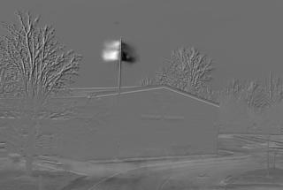
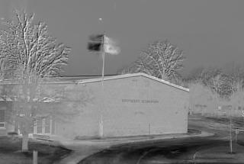
Wind Velocity
Analysis of CCA basis images shows only one accurate dimension
Makes sense since webcam captures in 2D so we can only see the flag blowing along one direction

Slide 17
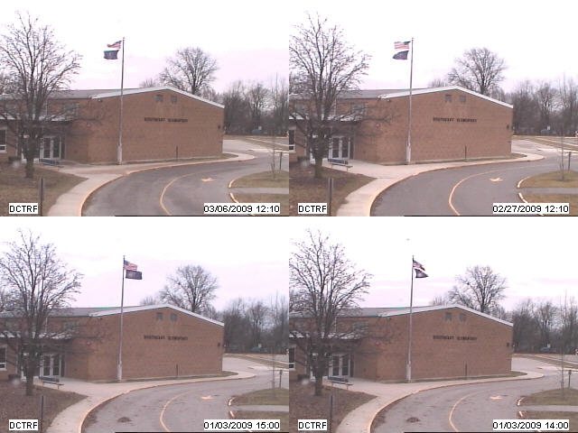
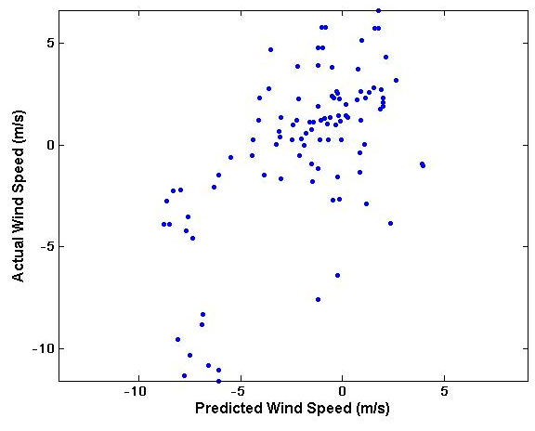
Wind Velocity

Slide 18
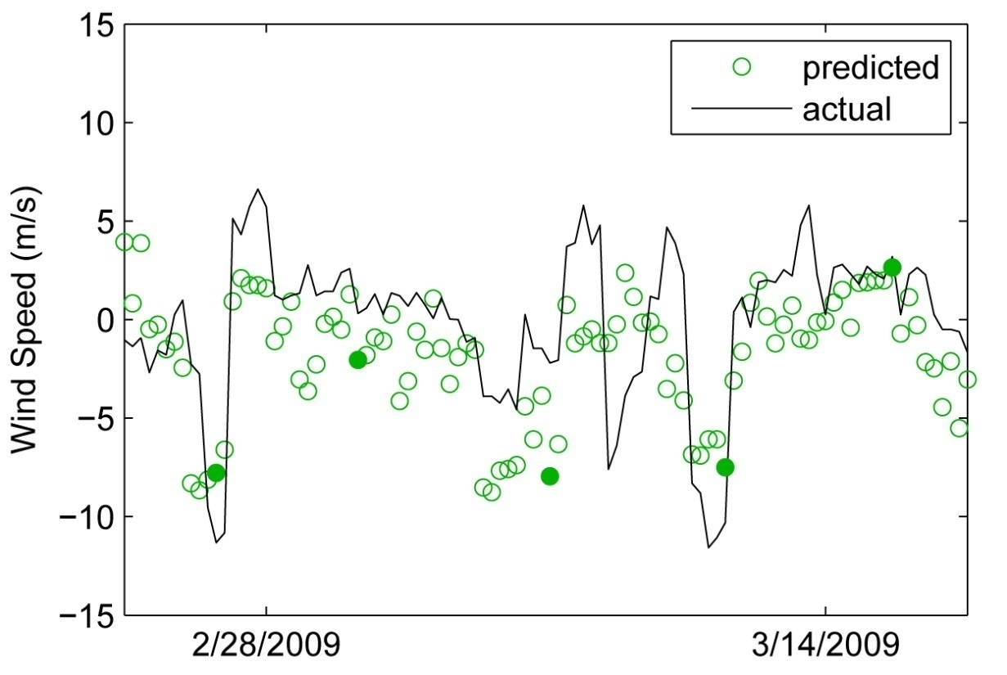
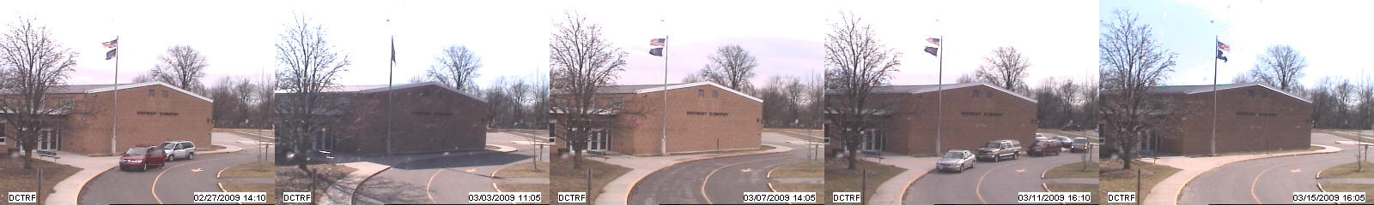
Wind Velocity

Slide 19
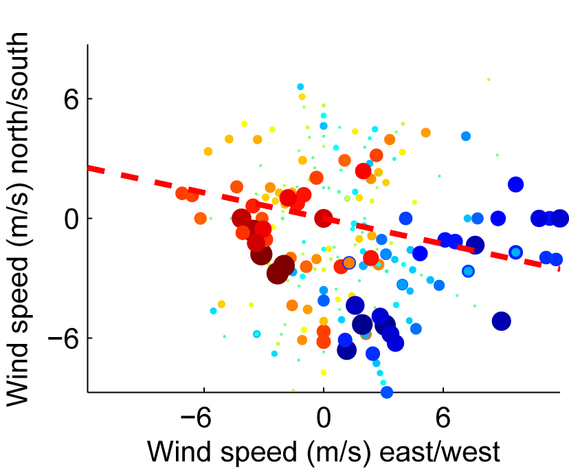
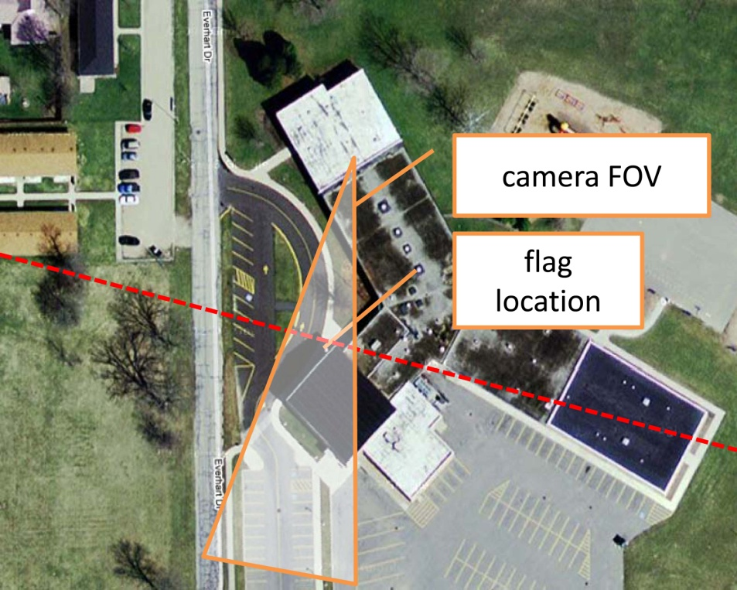
Wind Velocity

Slide 20
Vapor Pressure
Goals, challenges, gradient image

Slide 21

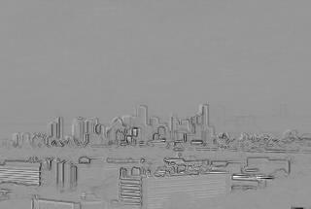
Vapor Pressure

Slide 22
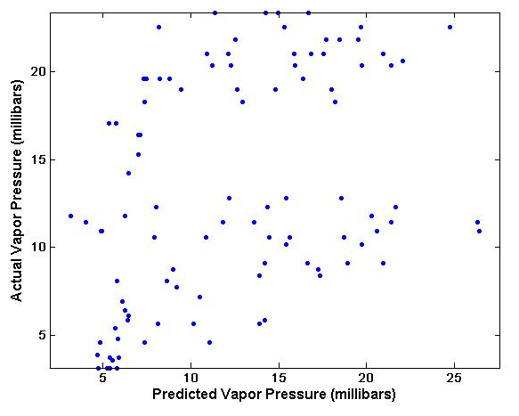
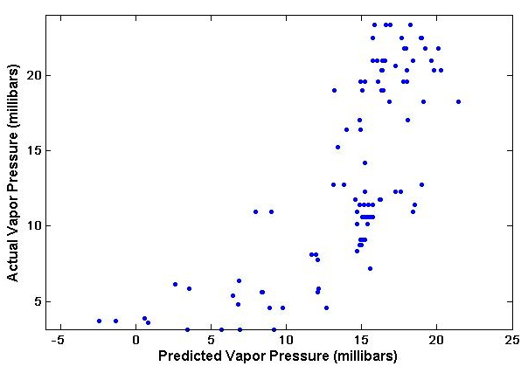
Vapor Pressure

Slide 23
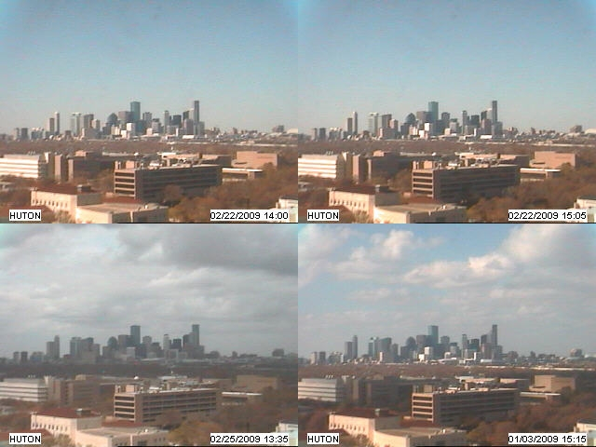
Vapor Pressure

Slide 24
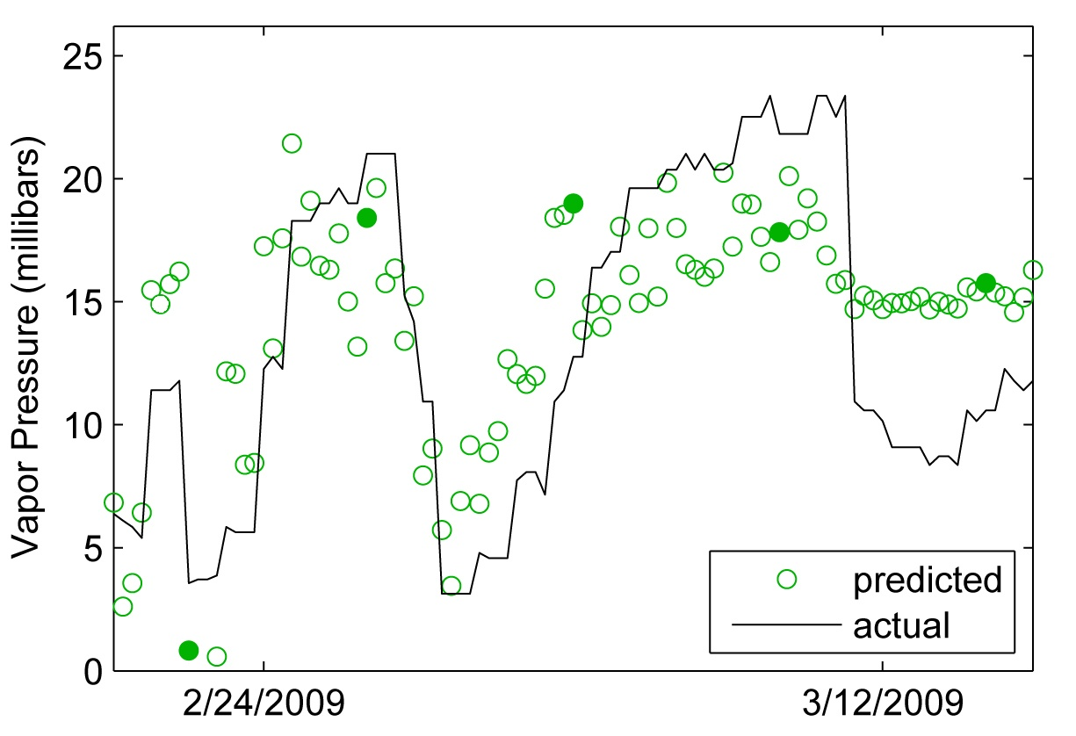
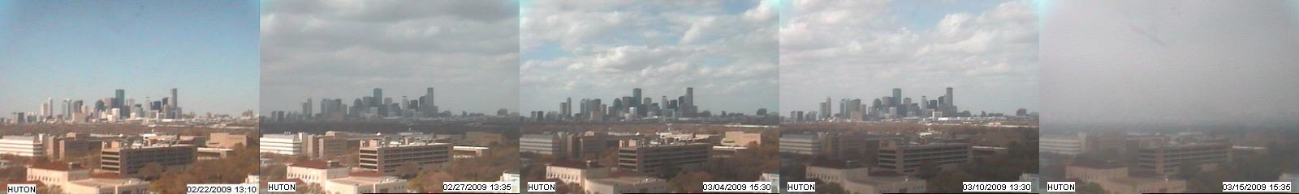
Vapor Pressure

Slide 25
Training Set Analysis
What we want to do, why it is valuable, background?

Slide 26
Training Set Analysis
Method used to predict

Slide 27
Training Set Analysis
charts

Slide 28
Conclusion

Slide 29
Future Work
Take better advantage of AMOS dataset
Further automate the methods used in order to apply to many cameras
Begin to gain a better understanding of local weather variations by combining predicted weather data with locations of cameras

Slide 30
Acknowledgements
Dr. Robert Pless
Nathan Jacobs
Thesis Examination Committee
Dr. Ron Cytron
Dr. Tao Ju
Dr. Robert Pless

Slide 31
Questions?

