Slide 1
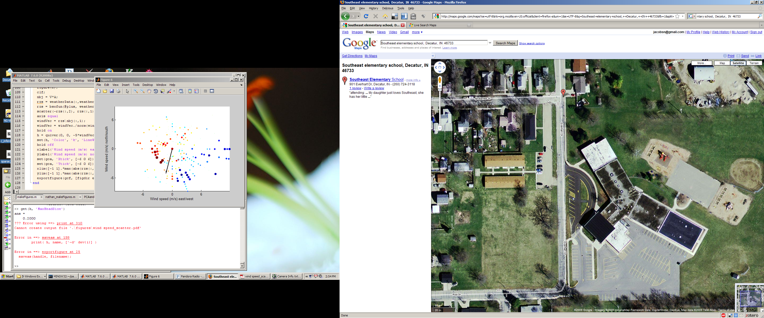
camera FOV
flag location

