Slide 1
Using Regression Techniques to Predict Weather Signals from Image Sequences
Richard Speyer
Master of Science Thesis Defense
April 22nd, 2009

Slide 2
Overview
Background Information
AMOS Dataset
Weather Data
Algorithms
Canonical Correlation Analysis (CCA)
Principal Coefficient Analysis (PCA)
Putting everything together
Results
Wind Velocity
Vapor Pressure
Training set analysis
Conclusion
Future Work

Slide 3
Webcam Data

Slide 4
AMOS Dataset

Slide 5
AMOS Dataset

Slide 6
Weather Data
Historical Weather Data Archives (HWDA) maintained by the National Oceanic and Atmospheric Administration (NOAA)
Maintains hourly weather data from about 6,000 weather stations across the country from January 1, 1933 to present
But, there are segments of missing data due to broken equipment, failure to report, etc.

Slide 7

Canonical Correlation Analysis (CCA)
Measures the linear relationship between two multi-dimensional variables
Finds two sets of basis vectors such that the correlation between the projections of the variables onto these basis vectors is maximized
Given two data matrices X and Y finds projection matrices A and B to maximize:

Slide 8
Canonical Correlation Analysis (CCA)
Iteratively finds vectors which maximize the correlation between the two datasets and minimize the correlation between previously measured vectors
Used in content-based image retrieval systems

Slide 9
Canonical Correlation Analysis (CCA)
Not dependent on the coordinate system of the variables
Can find correlations regardless of measurement system used, which is important since images and weather data use different forms of measurement
It is important that each data entry in X has a corresponding entry in Y, and vice versa (same number of rows)

Slide 10
Principal Coefficient Analysis (PCA)
PCA is a method used to extract the most significant scene variations from a set of images
Given a set of images I and a number k>0, finds the k most important features in the set of images
[U S V] = PCA(I,k)
U contains the k feature vectors
S is a diagonal matrix which contains the weights of each feature vector
V contains the coefficients of each vector for each image
We can reconstruct image x: i_{x}=U*S*v_{x}

Slide 11
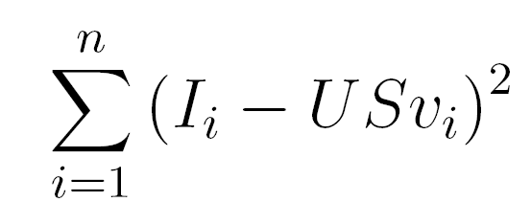
Principal Coefficient Analysis
D
U
S
V
coefficients
=
Images
Basis Images
Images will not be exact reconstructions of original images
Similarity increases as we increase the number of coefficients k
Will extract the most significant features to minimize

Slide 12
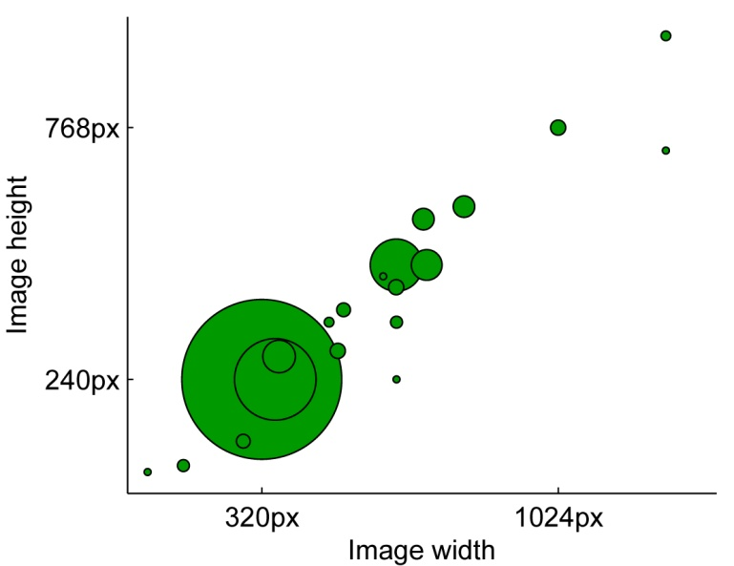
Principal Coefficient Analysis (PCA)
Most of the images in the AMOS dataset are 320 x 240 pixels = 76800 pixels
Lots of dimensions for CCA, will greatly hurt the runtime of our algorithms
We can reduce this number dramatically by instead using the PCA components of each image (k=10)
PCA will still find the most
significant features of the
image

Slide 13
Bringing it together - Algorithms
Given set of timestamped images I = i₁,…,i_{x} and weather data entries W = w₁,…,w_{y}
Concurrently iterate through both sets and remove entries which do not have corresponding entries in opposite set so both sets now have n entries
Run PCA on images; V = v₁,…,v_{n} are vectors of length k containing the coefficients for each image, U = u₁,…u_{k} are the basis vectors
Run CCA using V and W as input matrices

Slide 14
Predicting the Weather
Given a new image i and CCA projection matrices A and B, we can predict the value of the weather signal in the following way:
Find the PCA coefficients of the new image I on our existing basis vectors U (v_{i})
Value of weather signal w = Av_{i}B⁻¹

Slide 15
Results & Analysis
Predict two signals which present unique challenges
Wind Velocity
Vapor Pressure
Analyze effect of training set size on performance
Find minimum amount of data needed to build a good predictor

Slide 16
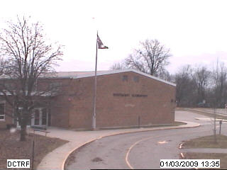
Wind Velocity
Effects are only noticeable on very local regions of the image
Trees
Flags
In order to ignore changes due to time of day, all images are captured between 10 AM and 2 PM
204 training images, 102 test
images

Slide 17
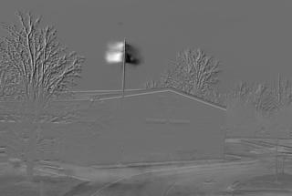
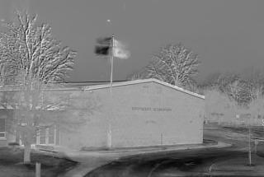
Wind Velocity
Analysis of CCA basis images shows only one accurate dimension
Makes sense since webcam captures in 2D so we can only see the flag blowing along one direction

Slide 18
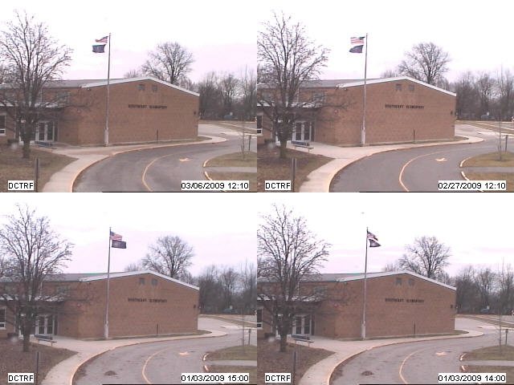
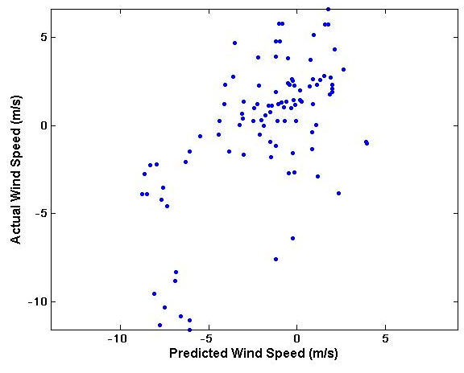
Wind Velocity
If we sort images by the value of the first CCA coefficient, it is clear that the direction of the flag is a key feature
Predicted vs. actual wind speeds (r=0.61759)

Slide 19
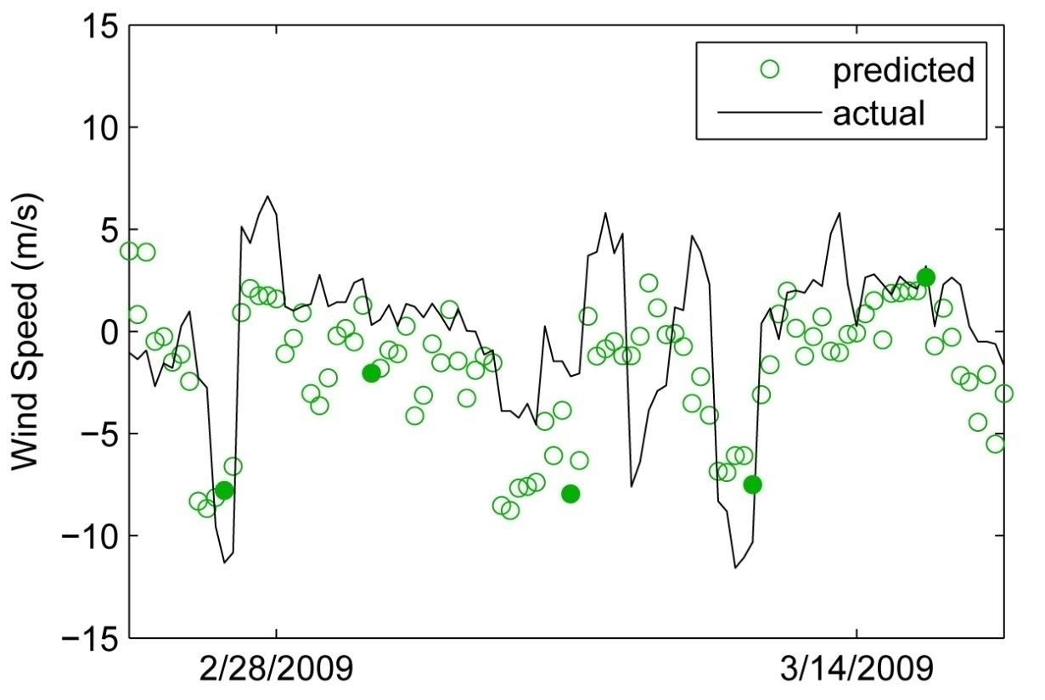
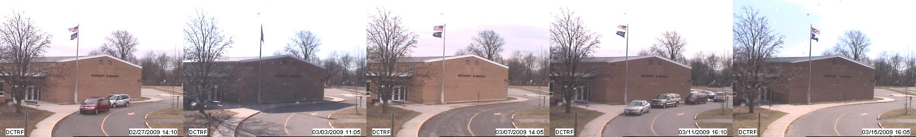
Wind Velocity

Slide 20
Wind Velocity
Explanation of camera orientation

Slide 21
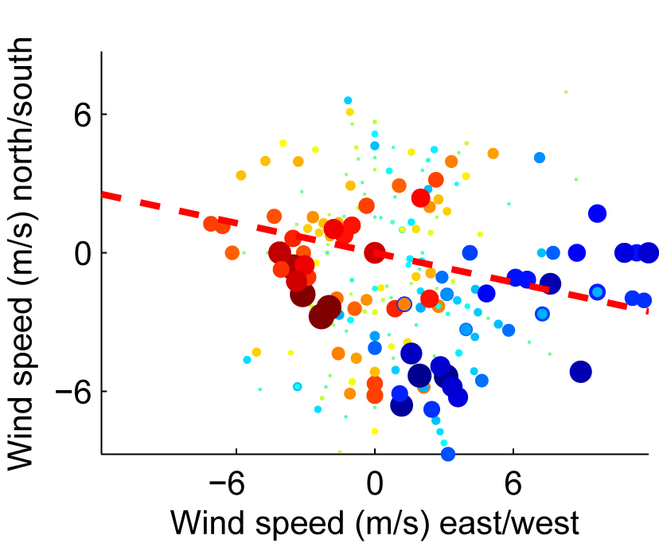
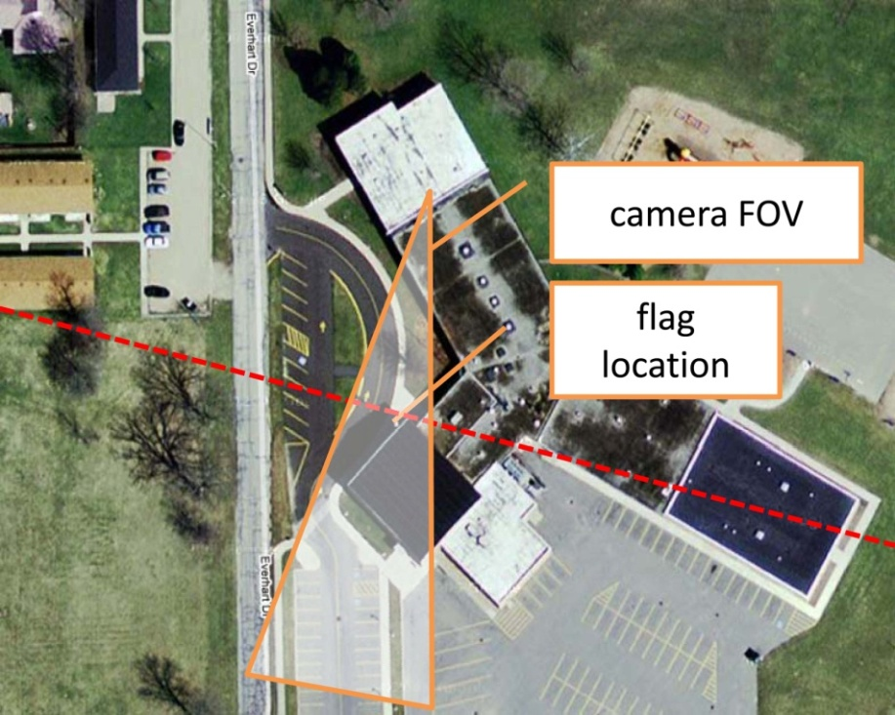
Wind Velocity

Slide 22
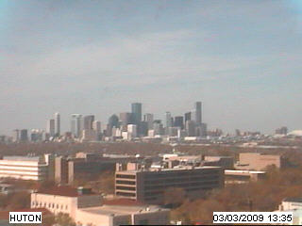
Vapor Pressure
Contribution of water vapor to overall atmospheric pressure (millibars)
As opposed to wind velocity, vapor pressure will likely have a more universal effect on the image
Expect to see the cloud cover increase as vapor pressure increases
Images captured between
10 AM and 2 PM
198 training images, 99 test
images

Slide 23


Vapor Pressure
CCA projection image when original images are used (left) is not very compelling
Seems to be identifying sunlight as a key indicator of vapor pressure
When gradient images are used (right) image is far more compelling
Appears to be identifying the clarity/visibility of building outlines as an important indicator of vapor pressure, which makes sense

Slide 24
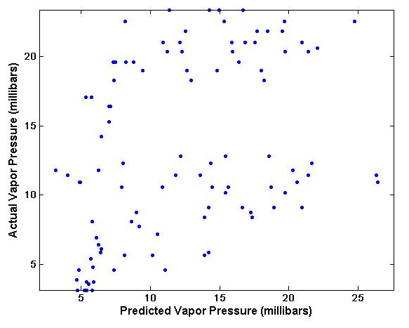
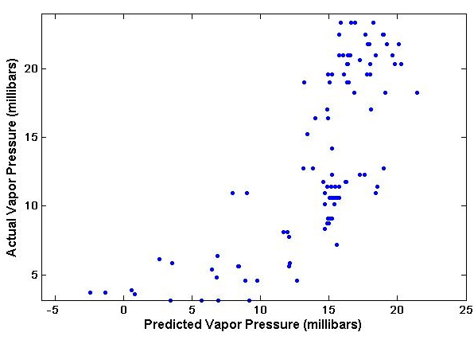
Vapor Pressure
Scatter plots of predicted vs. actual vapor pressures further verify the improvement with gradient images
Agrees with expectations from CCA projection images
Original images (r=0.3894)
Gradient images (r=0.73684)

Slide 25
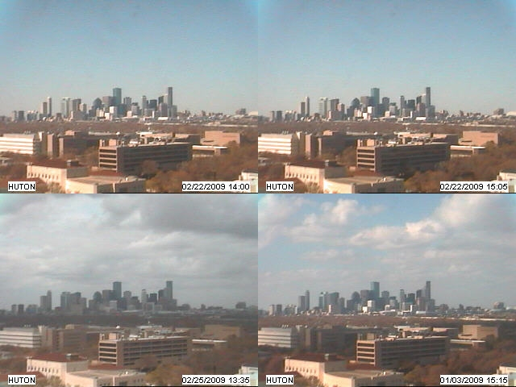
Vapor Pressure

Slide 26
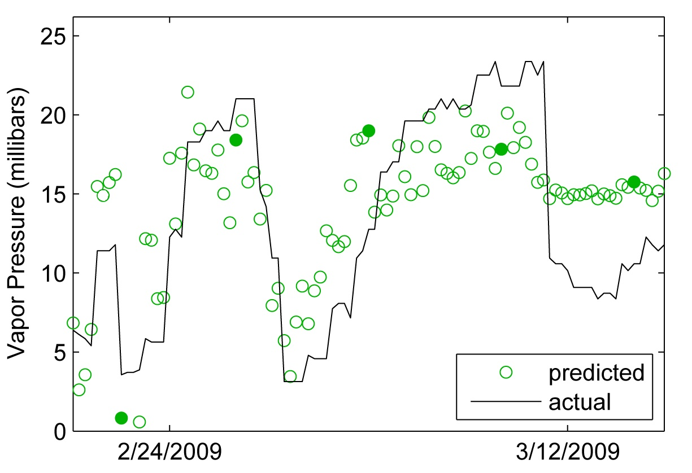
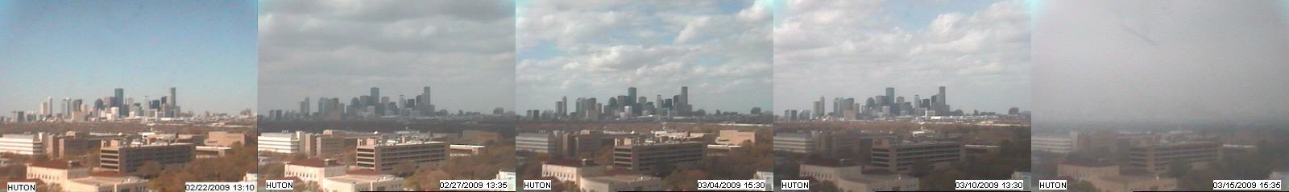
Vapor Pressure

Slide 27
Training Set Analysis
How many images does it take to build a good weather predictor?
Want to find out what the minimum amount of data is required to build an accurate and precise predictor of a given weather signal
Previous studies (Barcikowski & Stevens, 1975) indicates that CCA requires between 40 and 60 times the number of variables in training data
May be less if data variations are limited and samples sufficiently cover possible range

Slide 28
Training Set Analysis
Vary training size between 10 and 200 images
Run PCA, CCA on images
Take new set of test images, get PCA components on existing basis vectors U
Predict value of weather signal, compute correlation coefficient r
Repeat 10 times at each training size with different training sets
Reduces effect of lucky/unlucky selections, biases

Slide 29
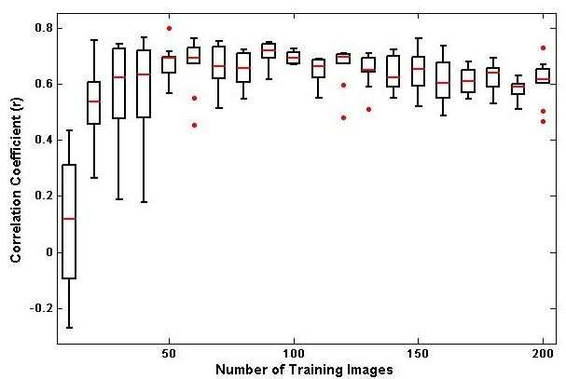
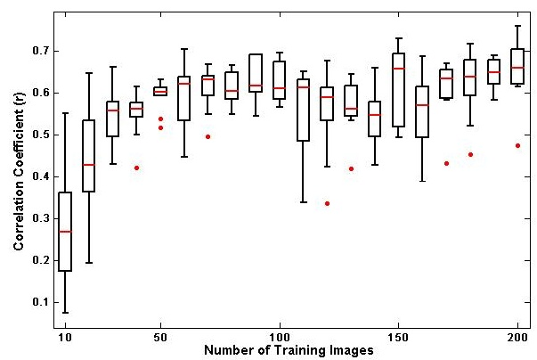
Training Set Analysis
Average correlation coefficient (red lines) steadily increase as training set size increases
Stops rising rapidly around 80 images, amount of variation in coefficients decreases as well
80 images = 2 weeks of data
Wind Velocity (m/s)
Vapor Pressure (millibars)

Slide 30
Conclusion
Images carry with them lots of higher level information
Develop methods to extract this information to gain a better understanding of what is going on at a given location
Using regression and correlation techniques, we can predict weather signals simply by observing a given webcam
Only 2 weeks of data is required to build an accurate model

Slide 31
Future Work
Take better advantage of AMOS dataset
Further automate the methods used in order to apply to many cameras
Begin to gain a better understanding of local weather variations by combining predicted weather data with locations of cameras

Slide 32
Acknowledgements
Dr. Robert Pless
Nathan Jacobs
Thesis Examination Committee
Dr. Ron Cytron
Dr. Tao Ju
Dr. Robert Pless

Slide 33
Questions?

