Slide 1
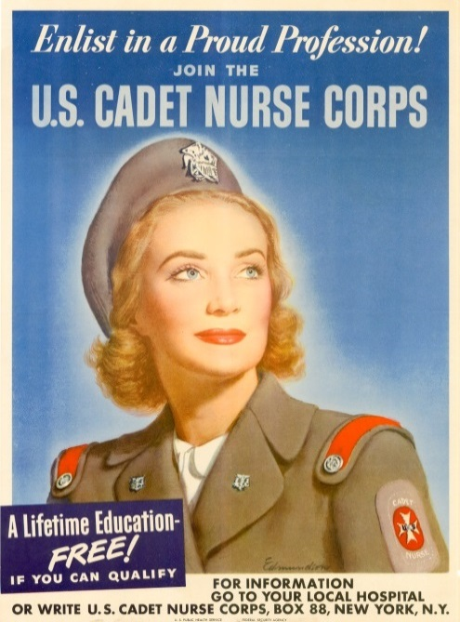
The U. S. Cadet Nurse Corps: Commemorating 70 Years of Service Elsie M. Szecsy, EdD Thelma Robinson, RN, MS, PNP Elizabeth Yeznach, RN, BS, MS
Recruitment poster by Carolyn Moorhead Edmundson 1943
Nurse Recognition Day | U.S. Public Health Service, Bethesda, Maryland | May 5, 2014
Notes:
2 minutes
Thank you…
Rear Admiral Sylvia Trent- Adams and the U.S. Public Health Service for making this opportunity available
Senator Jeanne Shaheen, who worked with Nancy Richards-Stower to make this presentation possible.
Shirley Harrow, a younger nurse who first introduced me to Cadet Nurses and their history. I know the story as well as I do because of her.
The many Cadet Nurses and their families and friends whose interest in our loved ones’ story infected me with the curiosity to find out more. You know who you are, and many of you are here now.
I am also honored to be with two Cadet Nurses, Thelma Robinson and Elizabeth Yeznach, whose reflections will amplify the importance of the U.S. Cadet Nurse Corps in a critical period in U.S. and nursing history.
Both my parents were nurses. My mother was a Cadet Nurse, and I am an educator. I study the US Cadet Nurse Corps as a massive curriculum and program development project. This project began as early as 1917 with the development of a standard curriculum and in 1923 with the call to move from an apprenticeship to academic model for nurse education. The U.S. Cadet Nurse Corps was the catalyst for the advancement of this process during World War II.
Hopefully we are successful in summarizing what the US Cadet Nurse Corps was and why it is important to remember it today.
Notes:
This is a huge story that could take weeks to tell, but we have only a few minutes.
Images throughout the slide presentation include recruitment posters and news photos from World War II.
This presentation will be available on uscadetnurse.org website.
We will try to keep to about 20 minutes for the presentation and about 10 minutes Q&A.

Slide 2
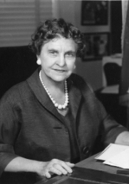
Public Law 74 The Bolton Act – Nurse Training Act
Milestone | When
H.R. 2326: Nurse Training Act introduced | March 29, 1943
H.R. 2326: hearings held | May 7-8, 1943
H.R. 2664: Nurse Training Act (The Bolton Act) passed | May 12, 1943
President of the United States approved the Bolton Act | June 15, 1943
First meeting of Advisory Committee on Training for Nurses | June 25-26, 1943
Public Law 74 (The Bolton Act) enacted | July 1, 1943
Rules and regulations governing the program approved | July 5, 1943
Rules and regulations governing the program published in the Federal Register | July 9, 1943
Rep. Frances Payne Bolton (Rep.), Ohio
Source: Frances Payne Bolton School of Nursing, Case Western Reserve University
Notes:
1 minute
How did the U.S. Cadet Nurse Corps come to be? In this slide we see the legislative chronology of the development of Public Law 74 from its introduction by Rep. Frances Payne Bolton, Republican from Ohio, to the beginning of the U.S. Cadet Nurse Corps’ operation some three months later.
The U.S. Cadet Nurse Corps attracted 180,000 students, and 124,000 graduated and became R.N.s. Their average length of service in nursing was 28 years.
There were 1,125 participating schools, including 10 schools in Puerto Rico.
Eighty percent of U.S. hospitals’ nursing staff were Cadet Nurses during World War II.
The majority of participating schools were in the Northeast and Upper Midwest, with Pennsylvania, New York, Illinois, and Ohio leading in the number of participating schools of nursing.
Pennsylvania (110), New York (105), Illinois (86), and Ohio (61) had the largest numbers of participating schools of nursing.

Slide 3
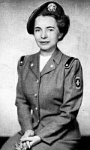
Program Features
For high school graduates age 17-35
Accelerated curriculum with Senior Cadet Nurse supervised clinical practice during last 6 months of training
Scholarships for tuition, books and supplies, uniforms, housing
Monthly stipend
Pledge to be available for military, or other Federal, governmental, or essential civilian services for the duration of World War II
Available to all, regardless of gender, race, ethnicity, or marital status
Funding support for curriculum and program development
Lucile Petry, R.N., Director, Division of Nurse Education, U.S. Public Health Service
Notes:
1 minute
What was the U.S. Cadet Nurse Corps? The program was open to high school graduates, age 17-35, regardless of gender, race, ethnicity, or marital status. In exchange for the promise to be available for essential nursing service for the duration of the war, Cadet Nurses received scholarships to cover tuition, books, uniforms, and housing; and a monthly stipend. The program also provided funding for curriculum and program development, and additional funding was available for facilities improvements at nursing schools.

Slide 4
Context and Outcomes
Concurrent Streams
Accomplishments
Address a critical shortage of nurses
Redefine nursing as a profession
Migrate from apprenticeship to academic model for nurse education
Expand the nurse’s role
Prevented the collapse of the U.S. healthcare system during World War II and post-war years.
Standardized nurse education curricula according to guidelines so that all Cadet Nurses received similar training experiences, regardless of race or ethnicity.
Advanced an agenda begun before World War II to improve the quality of nurse education and to balance supply and demand for nurses.
Notes:
1 minute
Why was the U.S. Cadet Nurse Corps important? Four concurrent streams were at play at this time. The most transparent was the need to address a critical shortage of nurses. This came at a time when nursing was also redefining itself as a profession, and nurse education was moving from an apprenticeship to academic model. Also, the nurse’s role was changing from caregiver to a caregiver who also educates.
What did the U.S. Cadet Nurse Corps accomplish? The U.S. Cadet Nurse Corps addressed all of these streams. Of all of the recruitment efforts during World War II, the U.S. Cadet Nurse Corps was most successful. It met all of its recruitment targets. The program prevented the collapse of the U.S. healthcare system. It also improved nurse education through a standardized curriculum to ensure that that all nurses received similar training. It also advanced an agenda to improve the quality of nurse education and to balance supply and demand for nurses during Wartime.

Slide 5
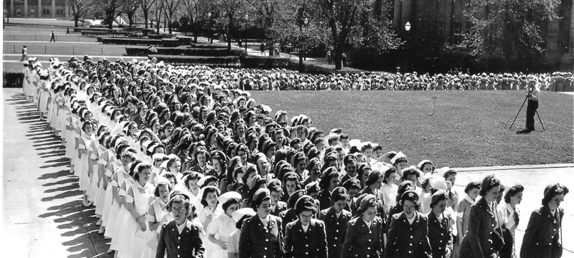
Cadet Nurse Experiences
National Cadet Nurse Corps Induction Day
May 13, 1944
Photo courtesy of cadetnurse.com
Thelma Robinson, RN, MS, PNP
Elizabeth Yeznach, RN, BS, MS
Notes:
2 minutes
Now to the next part, Thelma Robinson and Elizabeth Yeznach will reflect briefly on their experiences.
I am honored to introduce Cadet Nurse Thelma Robinson.
Thelma’s remarks start:
First of all, I would like to thank Rear Admiral Sylvia Trent- Adams for this opportunity for cadet nurses, friends and family to come together to share our legacy. It is fitting that we celebrate at this time for 70 years ago, on May 13, 1944 the first National Cadet Nurse Induction Day took place. This event officially brought more 96,000 student nurses into the Corps representing more 1,000 schools of nursing.
In the slide we see cadet nurses marching to their Induction Ceremony on the University of Minnesota campus. Sixteen schools of nursing in the Twin Cities participated in this ceremony. The keynote Induction Ceremony took place in Washington D.C. I joined 100 student nurses representing three schools of nursing at the St. Paul Methodist Church in Lincoln, Nebraska. The Chief Justice of Nebraska administered our pledge.

Slide 6
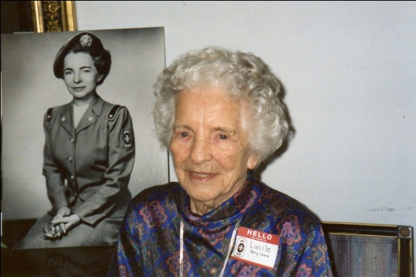
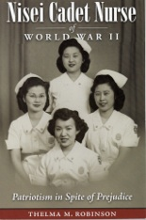
Learning and Working Commitments
Lucile Petry, R.N., Emeritus Director Division of Nurse Education, U.S. Public Health Service
Images courtesy of cadetnurse.com
Notes:
5 minutes
Thelma continues….
Twenty years ago, we celebrated 50 years at a commemorative conference in Bethesda. We heard Lucile Petry Leone, Emeritus Chief Nurse of the Cadet Nurse Corps reflect on “Continuing the Tradition.” At this gala celebration, my sister, Paulie Perry and I launched our Cadet Nurse Story Telling Project during a poster session.
Paulie and I dedicated our retirement years to researching, collecting stories and writing about the Cadet Nurse Corps. A big thrill for my sister and I was to come to know to Lucile Petry and hear first hand, her stories about the Corps. Each year we brought cadet nurses from the San Francisco area together to celebrate her birthday.
On her 95 birthday we read this letter from the nurses of the Public Health Service. “Your leadership of the Cadet Nurse Corps opened new horizons in nursing as a profession, in nursing education, and in service. Your insistence in equality and quality of schools of nursing pioneered integration. And your rise to Assistant Surgeon General created career paths in the uniformed services for women and nurses who followed. We salute you and thank you for your vision and excellence in nursing.”
In San Francisco, we got know Japanese American women who overcame prejudice and joined the Cadet Nurse Corps. The Japanese American women who shared their stories taught us an important lesson in life; that of forgiveness and getting on with our lives. They are ever grateful for the Cadet Nurse Corps in giving them their ticket to freedom and the opportunity to train as a nurse.
Thank you.

Slide 7
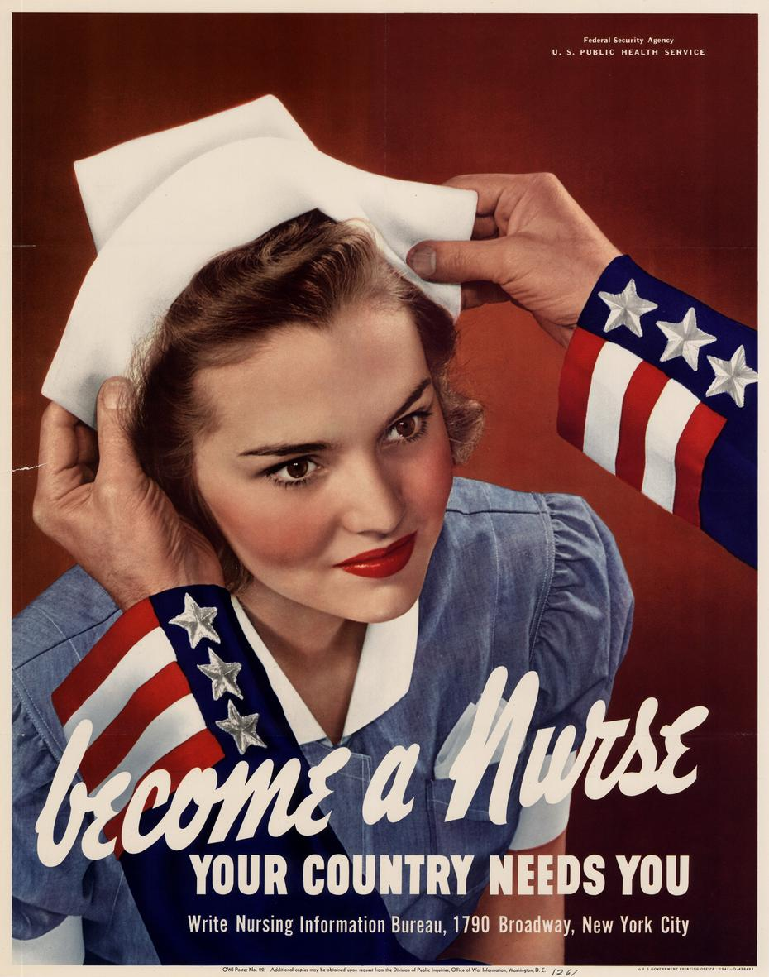
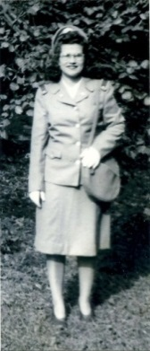
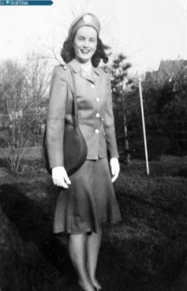
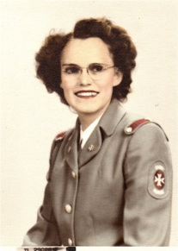
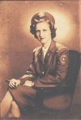
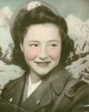
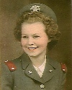
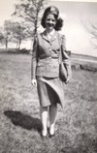
Career & Education Paths
Professor
Administrator
Staff Nurse
Supervising Nurse
Community Health
Public Health
Doctor’s Office Nurse
School Nurse Practitioner
ER
Military
VA
Indian Service
Notes:
2 minutes
I am also honored to introduce Elizabeth Yeznach.
Elizabeth’s remarks start.
Elizabeth’s talk will begin with a discussion of what it was like upon completion of nurse’s training, beginning at the point the student completed classroom and clinical training in the hospital school of nursing.

Slide 8
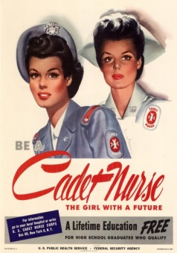
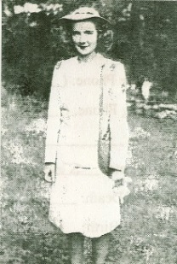
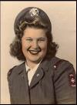
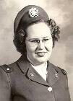
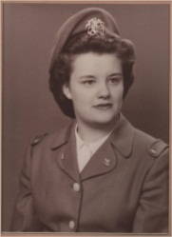
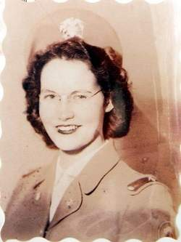
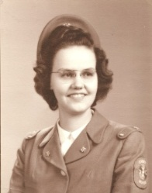
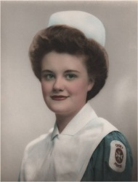
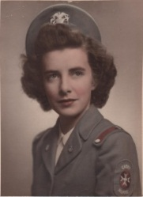
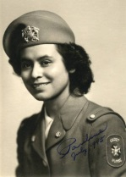
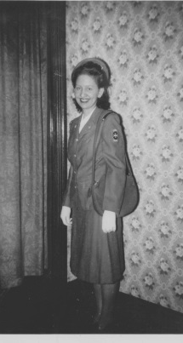
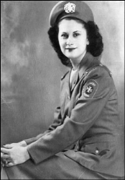
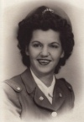
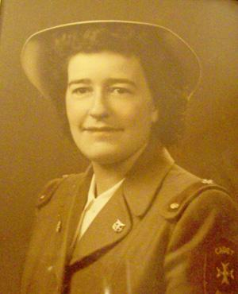
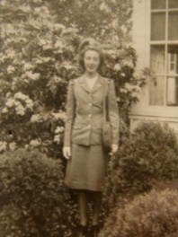
A Lifetime Education FREE
By Jon Whitcomb, 1944
Notes:
5 minutes
Elizabeth Yeznach’s talk will continue with a discussion on the contributions of USCNC nurses at the end of WWII and into the early 1950s baby boom.
If our time is up by the end of Elizabeth’s comments, this will be the end of the presentation. If time permits, the presentation will continue quickly through the next 4 slides and close on Slide 13.
The entire presentation will be available after the conference on the uscadetnurse.org website.

Slide 9
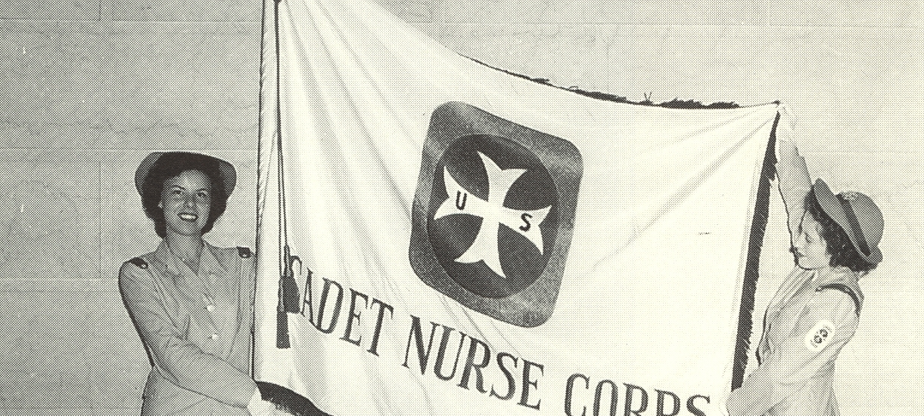
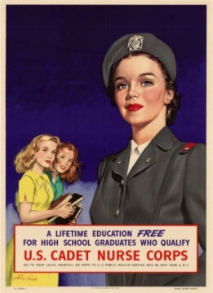
Resources
Official flag of the Cadet Nurse Corps features a Maltese Cross emblazoned on a field of white.
Online | Books| Recent Research
By Alexander Ross 1945
Notes:
In this third section, we highlight sources of additional information about the U.S. Cadet Nurse Corps.
On this slide we see the official flag of the Cadet Nurse Corps, which features a Maltese Cross emblazoned on a field of white. The Maltese cross was the earliest symbol of nursing. It dated back to the time of the First Crusade where it was used by the Knights Hospitalers of St. John. The cross symbolized caring for the sick.
The eight points also symbolize the eight obligations or aspirations of the knights:
to live in truth
to have faith
to repent one's sins
to give proof of humility
to love justice
to be merciful
to be sincere and wholehearted
to endure persecution
The eight points of the cross represent the eight Beatitudes.
Tactful (“that he may without thoughtless questions learn the symptoms and history of the case, and secure the confidence of the patients and bystanders”)
Resourceful (“That he may use to the best advantage whatever is at hand to prevent further damage, and to assist Nature’s efforts to repair the mischief already done”)
Dextrous (“that he may handle a patient without causing unnecessary pain, and use appliances efficiently and neatly”)
Explicit (“that he may give clear instructions to the patient or the bystanders how best to assist him”)
Discriminating (“that he may decide which of several injuries presses most for treatment by himself, what can best be left for the patient or bystanders to do, and what should be left for the medical men”)
Persevering (“that he may continue his efforts, though not at first successful.”)
Sympathetic (“that he may give real comfort and encouragement to the suffering”)
Slides 10-12 can be skipped or will be accelerated, if time does not permit.

Slide 10
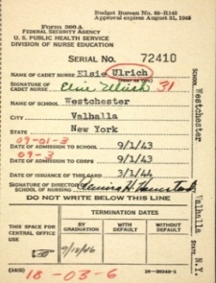
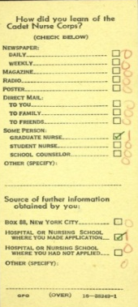
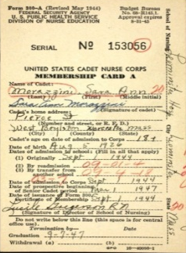
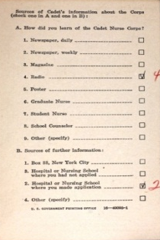
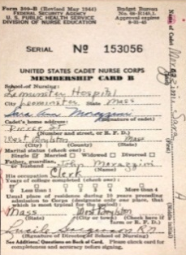
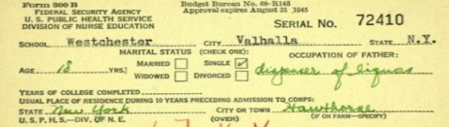
Online Resources
USCNC Membership Cards available from National Archives through ancestry.com
uscadetnurse.org
http://uscadetnurse.org
Cadet Nurse Project
http://cadetnurse.com
Reward Unlimited (USCNC Recruitment film)
http://uscadetnurse.org/links
Women in Military Service to America Memorial
http://www.womensmemorial.org/index.html
Notes:
There are also a number of online resources. If you are to remember only one of them, please remember uscadetnurse.org, as it links to the rest of the links on this slide.
Discussion of this slide can be abbreviated or referred to the afternoon meet-and-greet.

Slide 11
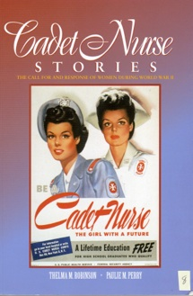
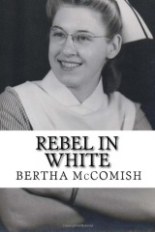
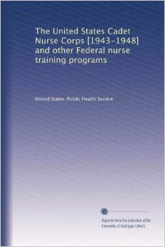
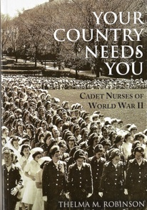
Books
Kalisch, B. & Kalisch, P. (1973). Cadet Nurse: The Girl with a Future. Nursing Outlook, 21(7), pp. 444-449.
Robinson, T. & Perry, P. (2001). Cadet Nurse Stories. Indianapolis, IN: Sigma Theta Tau International Honor Society of Nursing.
Robinson, T. (2005). Nisei Cadet Nurse of World War II: Patriotism in Spite of Prejudice. Boulder, CO: Black Swan Mill Press.
Robinson, T. (2009). Your Country Needs You: Cadet Nurses of World War II. Bloomington, IN: Xlibris.
U.S. Public Health Service (1950). The United States Cadet Nurse Corps, 1943-1948. PHS Publication No. 38. Washington, D.C. United States Government Printing Office.
Notes:
We also bring to your attention a number of books.
The 1950 U.S. Public Health Service Publication 38, The United States Cadet Nurse Corps, 1943-1948 is freely available electronically or for a price as a hardcopy reprint available from amazon.com. This publication is available for download from uscadetnurse.org.
Thelma Robinson’s three books are also recommended and are available through bookstores and amazon.com.
Kalisch and Kalisch’s 1973 article is available for download through uscadetnurse.org.
Let audience know of Thelma’s booth.
Discussion of this slide can be abbreviated or referred to the afternoon meet-and-greet.

Slide 12
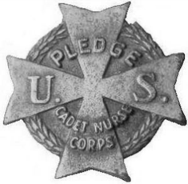
Research Activity
 | Topic | Field
Nancy Heard, Mississippi State University Thesis in progress | The U.S. Cadet Nurse Corps in the Deep South | History
Meghann Lanae Landry, Louisiana State University Thesis, 2012 | Fashioning the future: The U.S. Cadet Nurse Corps, 1943-1948 | History
April Matthias, Ph.D., R.N., C.N.E. University of North Carolina, Wilmington Research in progress | 1946 graduates of the Cadet Nurse Corps BSN program at the University of Cincinnati | Nursing
Joseph Provenzano, Ph.D., American University Dissertation, 2008 | Federal nurse training legislation: A study in legislative opportunity | Education
Elsie Szecsy, Ed.D., Arizona State University Research in progress | Crosscurrents in the desert: The U.S. Cadet Nurse Corps in Arizona, 1943-1948 | History
Notes:
Finally, in recent years there has been renewed interest in World War II history, and the Cadet Nurse Corps has been no exception. Two graduate students have studied or are studying an aspect of the U.S. Cadet Nurse Corps for their Master’s theses, and another studied the policy context for the USCNC for his dissertation. April Matthias, a nurse educator at the University of North Carolina – Wilmington, is studying 1946 graduates of a BSN program at the University of Cincinnati, and I am studying the U.S. Cadet Nurse Corps at the 5 participating schools of nursing in Arizona. One of the schools was the nation’s only accredited school of nursing for Native Americans, and another was in the first integrated hospital west of the Mississippi.
Discussion of this slide can be abbreviated or referred to the afternoon meet-and-greet.

Slide 13
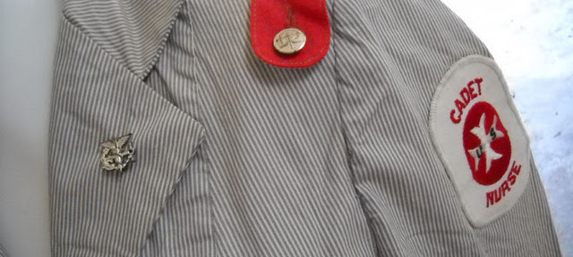
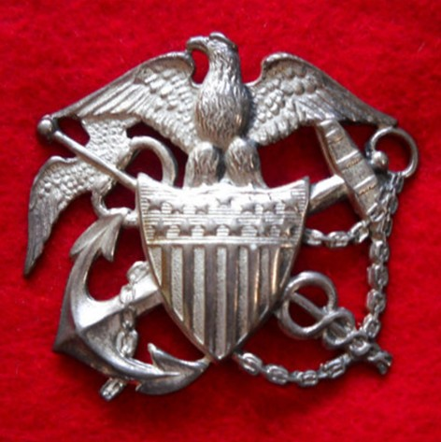
Thank you!
Notes:
The U.S. Cadet Nurse Corps played an important role at a critical point in history, and was a catalyst in advancing the nursing profession not only during World War II, but for many years afterward. One might say that the nursing profession is where it is now in large part because of the U.S. Cadet Nurse Corps.
Among educators, it is commonly known that when the educational opportunities for the mother are increased, the educational outcomes for their children are too. So, not only the nursing profession, but we children of Cadet Nurses are also where we are because of this program.
We thank you for this opportunity.
Thank you!

