Slide 1
Peace
Within you

Slide 2
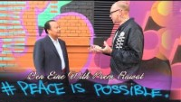
Peace
Possible / Impossible

Slide 3
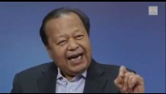

Slide 4
In conclusion, peace is our way out-
Peace is the way out of the world’s current state. All around the planet younger and older generations work together in closing the gaps. Organizations as well as individuals struggle every day to make Earth a more joust and peaceful place to live in.
If we help spread the message and join our efforts to create awareness on the importance of peace, chances are we can change the world soon. Peace is the way out of inequity and violence and a golden ticket to enter a new, brighter future for humankind.
Have a Good Time Ahead

