Slide 1
SMART INTERFACE FOR BONE MARROW DONATION
AED FINAL PROJECT

Slide 2
TEAM MEMBERS
Deepak Reddy - 002338763
1
Sai Teja Reddy - 002337043
2
Ram Srikar Putcha - 002304724
3

Slide 3
PROBLEM STATEMENT
For individuals with diseases like leukemia, aplastic anemia, and other blood-related ailments, bone marrow donation can save their lives. The effectiveness of the current system is hampered by a number of issues, despite its vital necessity. Finding appropriate donors and matching them with patients in need might be delayed due to a number of factors, including inadequate coordination and communication between hospitals, bone marrow banks, and anemia centers. Additionally, fragmented workflows caused by the lack of a single, integrated platform make it challenging for businesses to effectively collaborate and share data.

Slide 4
INTRODUCTION
Bone marrow donation is a life-saving process for patients battling conditions like aplastic anemia and leukemia, but the current system often struggles with inefficiencies and delays. Poor communication between hospitals, bone marrow banks, legal teams, and anemia centers can make it harder to find and match donors quickly, costing precious time.
Our project aims to change that. We're creating a centralized platform designed to bring all the key players together. By using AI to match donors and assess anemia cases, and by improving how information is shared, this platform will streamline the entire process. The goal is simple but powerful: to make bone marrow donation faster, easier, and more effective, so more lives can be saved and patients get the care they deserve.

Slide 5
PROJECT OVERVIEW
Centralized Platform: Develops a unified system to streamline bone marrow donation workflows, addressing communication gaps among stakeholders.
Role-Based Management: Defines clear roles and responsibilities to ensure accountability across all tasks, from donor recruitment to legal compliance.
Enhanced Collaboration: Improves data sharing and coordination between hospitals, bone marrow banks, legal teams, and anemia centers.
Life-Saving Impact: Expands the donor pool and ensures timely, ethical management to improve outcomes for patients with conditions like aplastic anemia and leukemia.

Slide 6
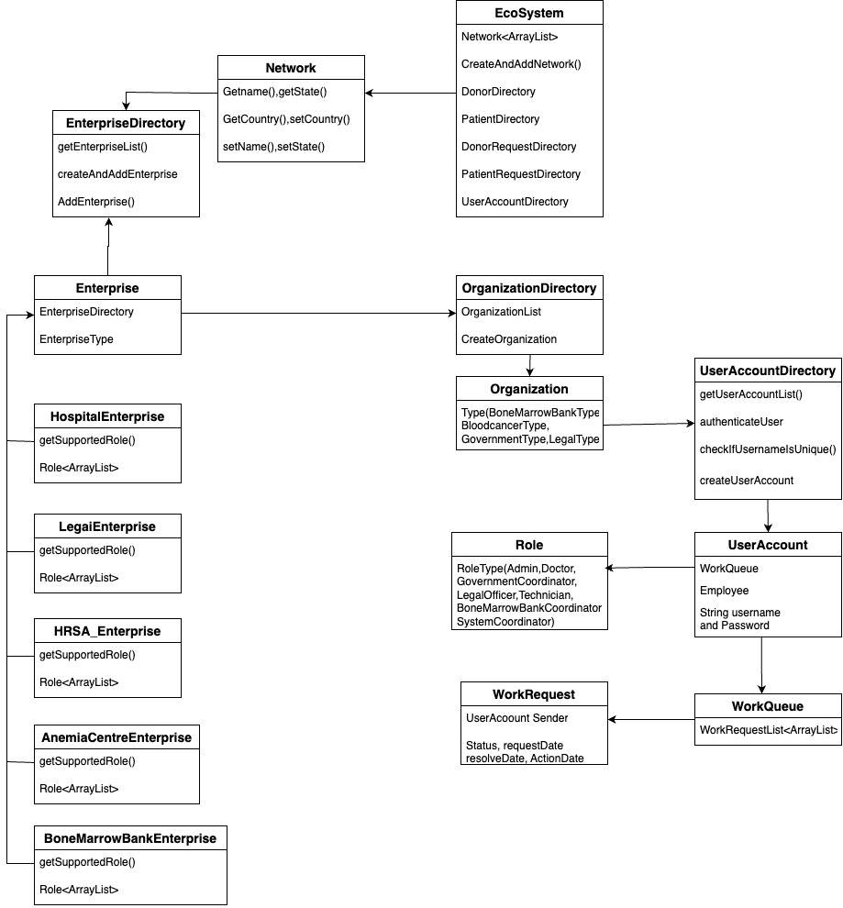
UML DIAGRAM

Slide 7
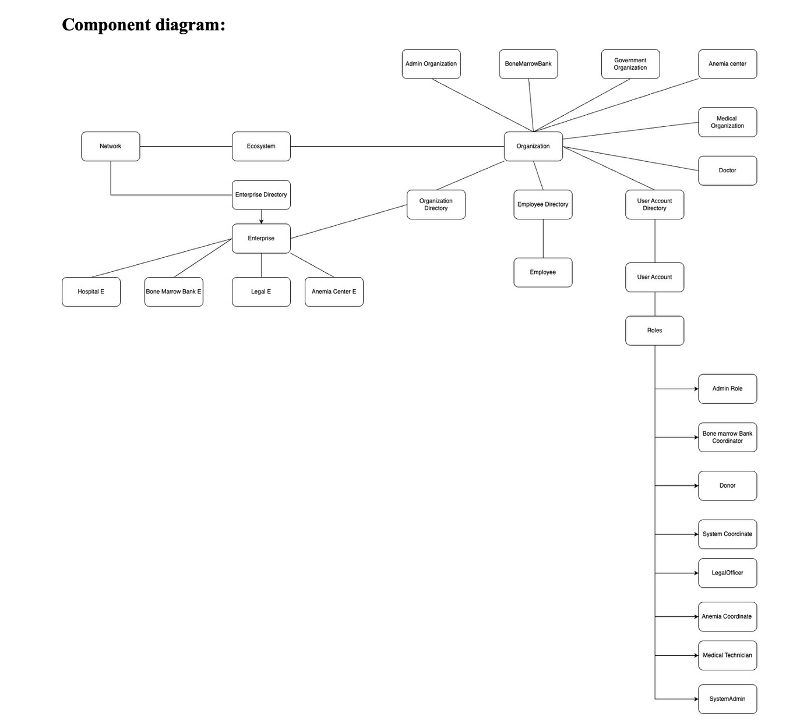
COMPONENT
DIAGRAM

Slide 8
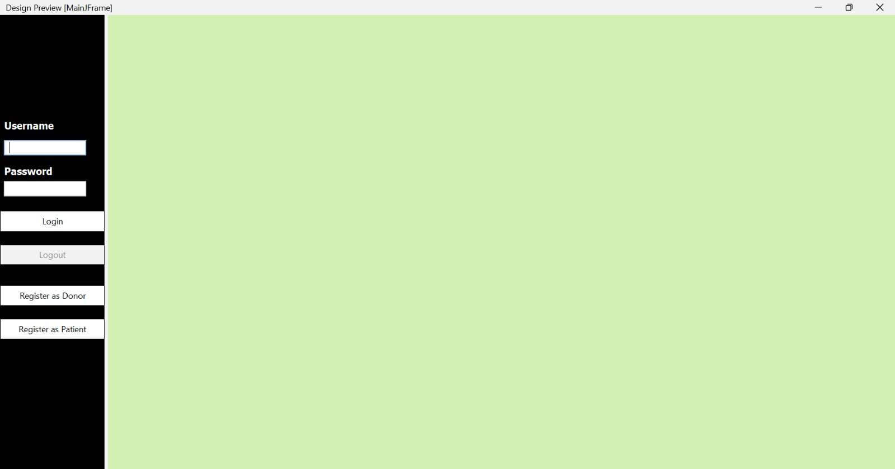
LOGIN PAGE

Slide 9
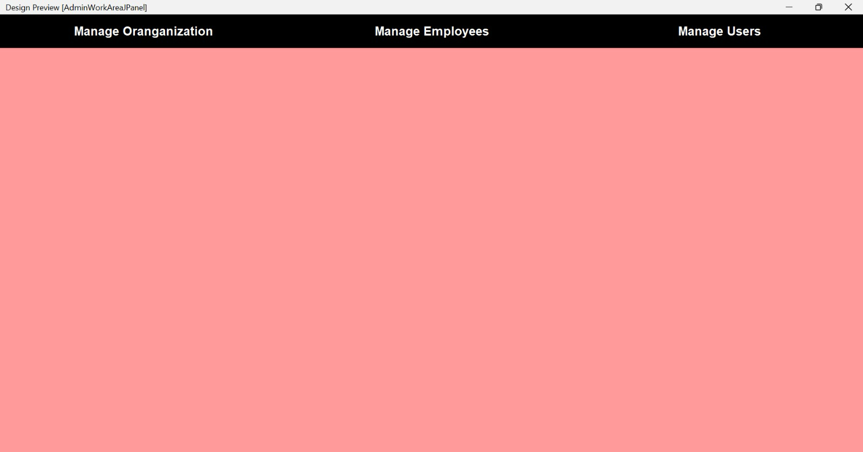
ADMINISTRATOR DASHBOARD

Slide 10
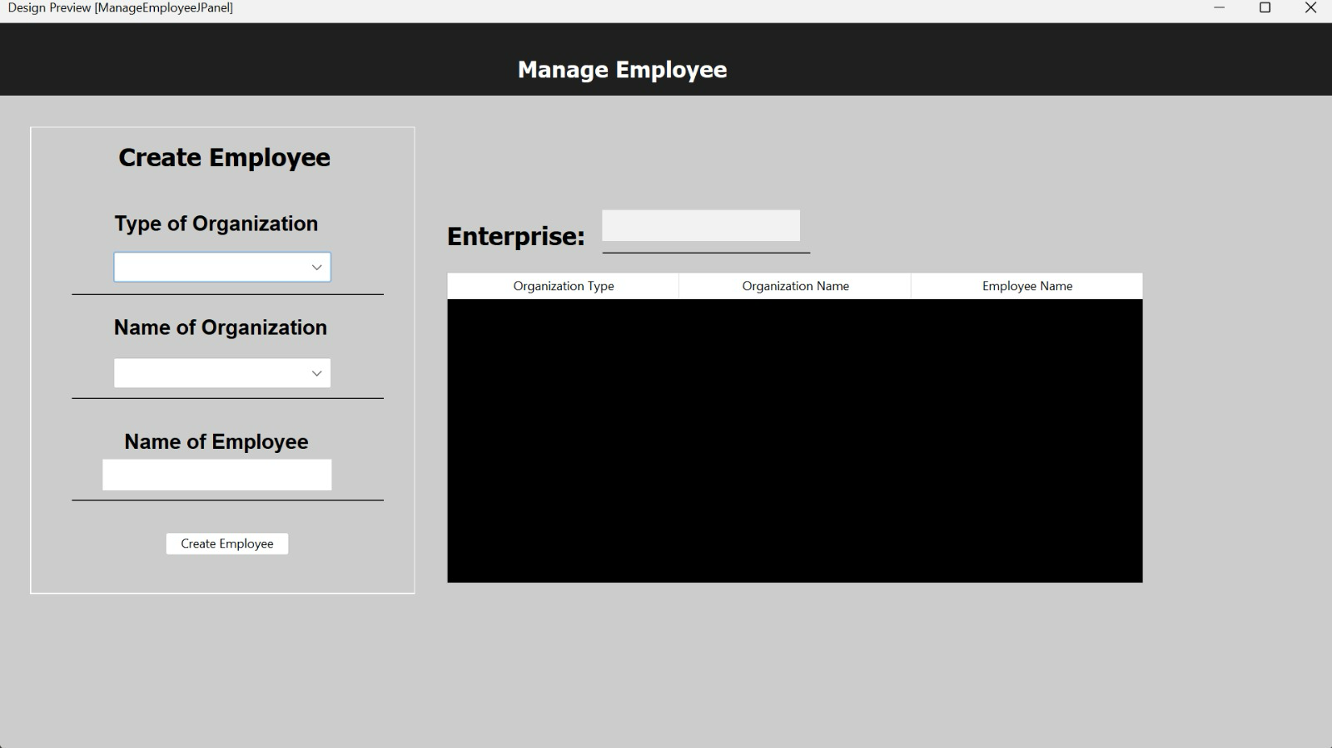
MANAGE EMPLOYEE

Slide 11
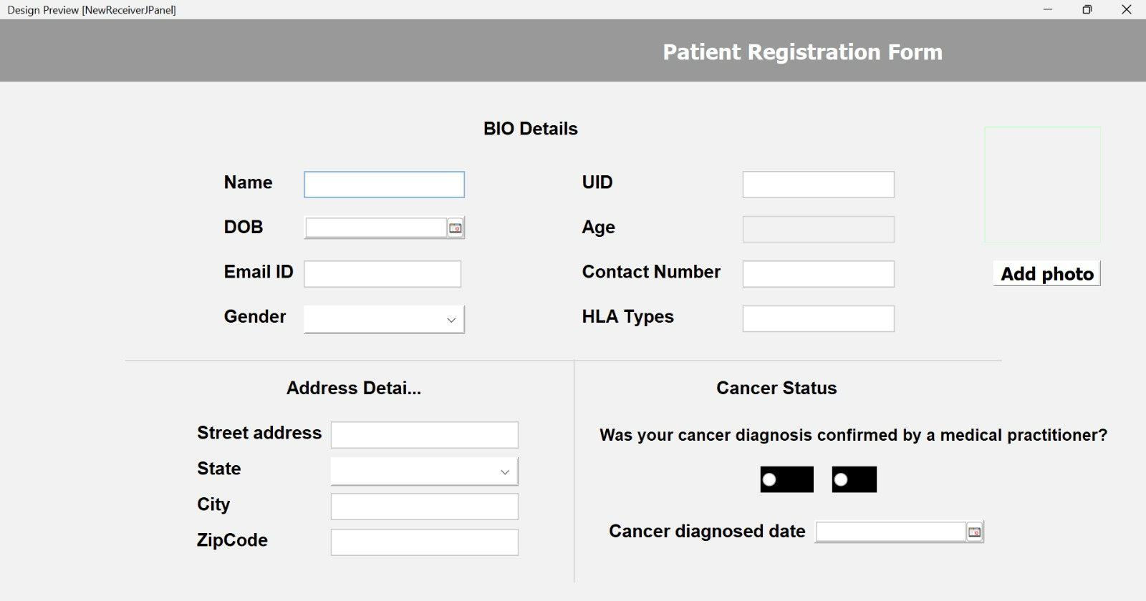
PATIENT REGISTRATION FORM

Slide 12
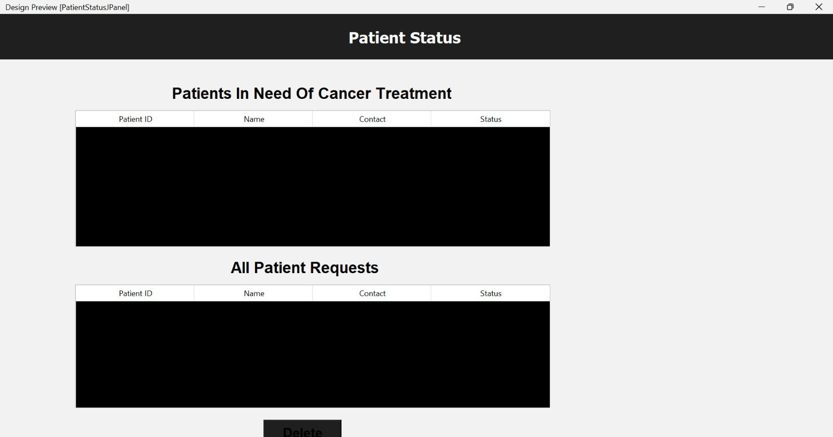
PATIENT STATUS

Slide 13
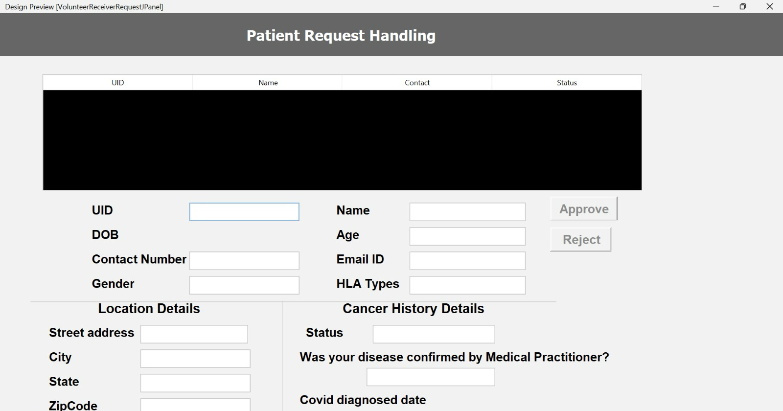
PATIENT REQUEST HANDLING

Slide 14
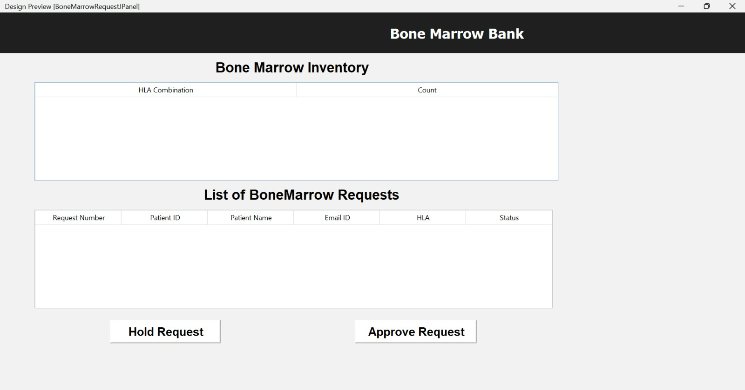
BONE MARROW BANK

Slide 15
SOLUTION
The role-based management approach of our project ensures responsibility at every level by clearly defining roles for administrators, coordinators, medical personnel, and legal officers. The technology eliminates delays and inefficiencies by streamlining complicated operations like donor recruitment, sample management, and patient matching when combined with seamless workflow integration. This feature guarantees that each participant is aware of their responsibilities, encouraging teamwork and raising the process's overall effectiveness for bone marrow donation.

Slide 16
CONCLUSION
The main goal of this project is to change the way bone marrow donations are handled. It seeks to streamline, expedite, and improve the process by establishing a single platform that unites all parties and makes roles clear. This approach will assist guarantee that no opportunities are lost, that donors and patients are matched promptly, and that treatments are completed on schedule. In the end, it is about saving lives and improving the prognosis for those suffering from diseases like leukemia and aplastic anemia.

Slide 17
THANK
YOU

