Slide 1
Final Project – Go to Europe!
Jitka, Ray, Teresa, Mauricio

Slide 2



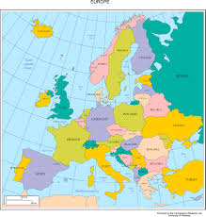

What tools did we use?

Slide 3
Our Original Purpose
Take you to Europe!
Have fun – create something that would allow us to predict a fun vacation for you
Use multiple features as input
Age
Sex
State
knowledge about Europe
Type of vacationer
Your answers to trivia questions
Use ML algorithm to predict your ideal destination!

Slide 4
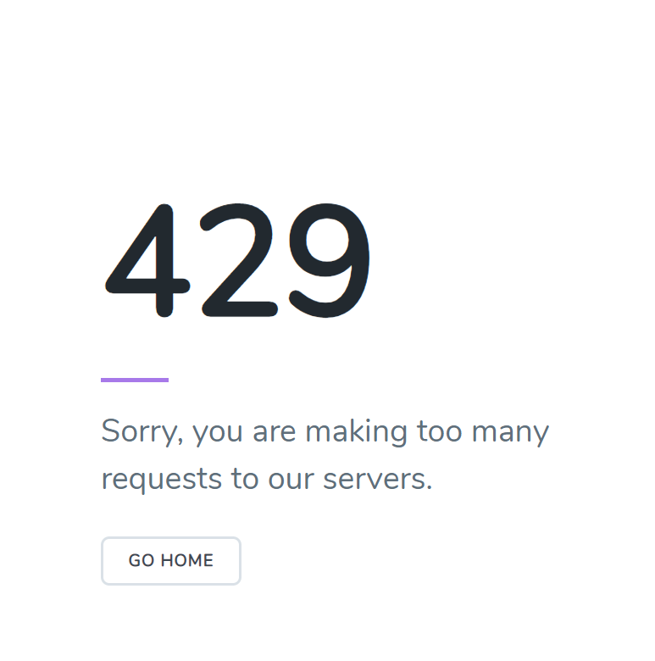
Our obstacles
Not a lot of datasets available that included all the features that we wanted
Some websites really don’t like you scraping their data
Using only Mock data is good for a Conceptual model, but we wanted to also make something practical

Slide 5
Our new Purpose
Take you to Europe!
Have fun – create something that would allow us to predict a fun vacation for you
Use multiple features as input
Age
Sex
State
Use ML algorithm to predict your ideal destination! – based on less features, but still predicting!

Slide 6
Our process
Decompose the ask
Identify Data sources
Define Strategy and Metrics
Build Data Retrieval Plan
Retrieve the Data
Assemble and Clean the data
Analyze for Trends
Acknowledge Limitations
Make the Call
Where would your ideal destination be? Predicting it with 3 Variables: Sex, State, Age
AirBnb
Yelp
Tripadvisor
Booking.com
MTP!
Divide and conquer
Get the Data
Train a ML model
Create Website/app
Save people’s input in SQL
Pull everything together
Scraoe data from MTP
Scrape data from other places
scrape the Data
Sometimes small data is big data
Most common countries to go to:
United Kingdom, Spain, France, Itlay.
Not Enough data.
No dataset big enough with our features.
429 server
You should go to…

Slide 7
Results – Data scraping
Sometimes Webpages don’t like you scraping their data
But you can get around it using time.sleep()!
Also, people don’t post as much as we would like to: 8140 users in the webpage only posted about ~1500 posts and of those only 40 went and posted about Europe!

Slide 8
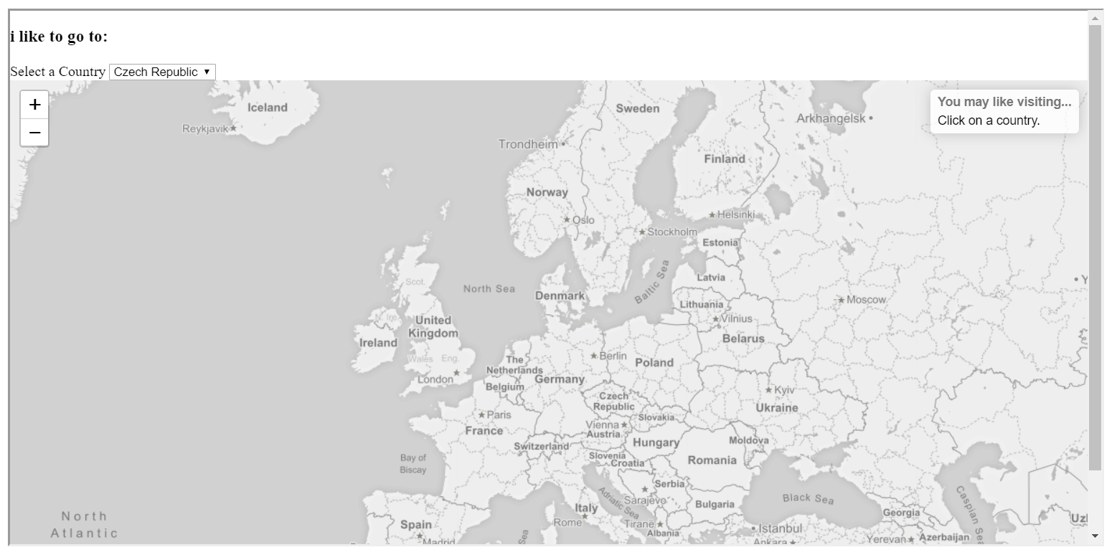
Results - Map
Our map will show you
Where you should go and
Also give you some fun trivia
From that place!

Slide 9
Results – ML Algorithm
We tried a couple of ML algorithms:
Decision tree classifier with mock data; Score: 0.16
Turns out only labeling will make your decision tree classifier very bad (you need one-hot encoding)
Random Forest (With real data ~n=40); Score: 0.95
Great score! But also, because it only had 40 data points, we had the ability to predict based upon only 19 states
Random Forest combining real data and mock data; Score: 0.68
Once we created a probability distribution function on where people would go and joined that with our real and mock data, our model could predict where anyone would go!

Slide 10
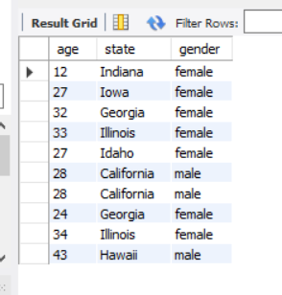
Result – SQL data base
Our SQL data base saved information about people and would allow us to retrain the model every time – WIP.

Slide 11
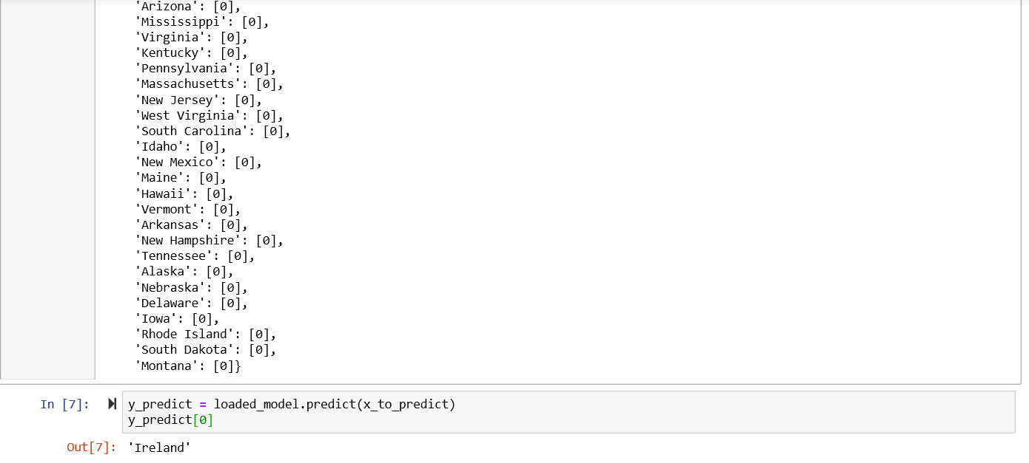
Results - APP
A 29 year old Male from the state of California should definitely consider going to Ireland!

Slide 12
Questions?

