Slide 1
Spring Flex – Integration
Notes:
© 2009 Capgemini - All rights reserved
© 2009 Capgemini - All rights reserved

Slide 2
Table Of Contents
Remote Objects Instantiation and Life Cycle
Old SpringFactory Approach
Spring BlazeDS Integration Overview
Spring BlazeDS Integration requirements
Configuring MessageBroker and Spring DispatcherServlet
Flex clients alongside Spring MVC
Integration with BlazeDS Remoting Destination
Integration with BlazeDS Message Destination
Sending AMF Messages with the MessageTemplate
MessageBroker Customization
Custom Exception Translators
Custom Message Interceptors
Advanced Topics
The information contained in this presentation is proprietary. Copyright ©2010 Capgemini. All rights reserved.

Slide 3
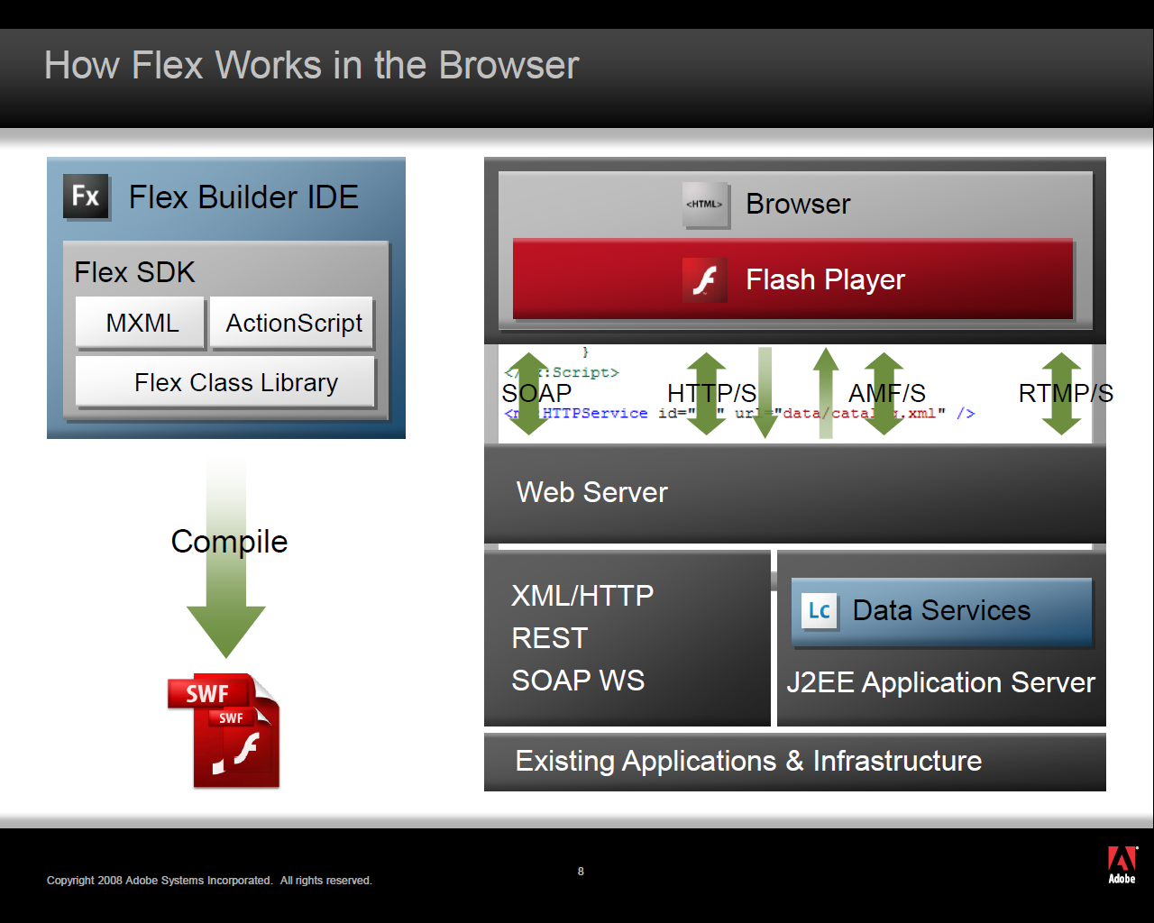
How Flex Works in the Browser
The information contained in this presentation is proprietary. Copyright ©2010 Capgemini. All rights reserved.

Slide 4
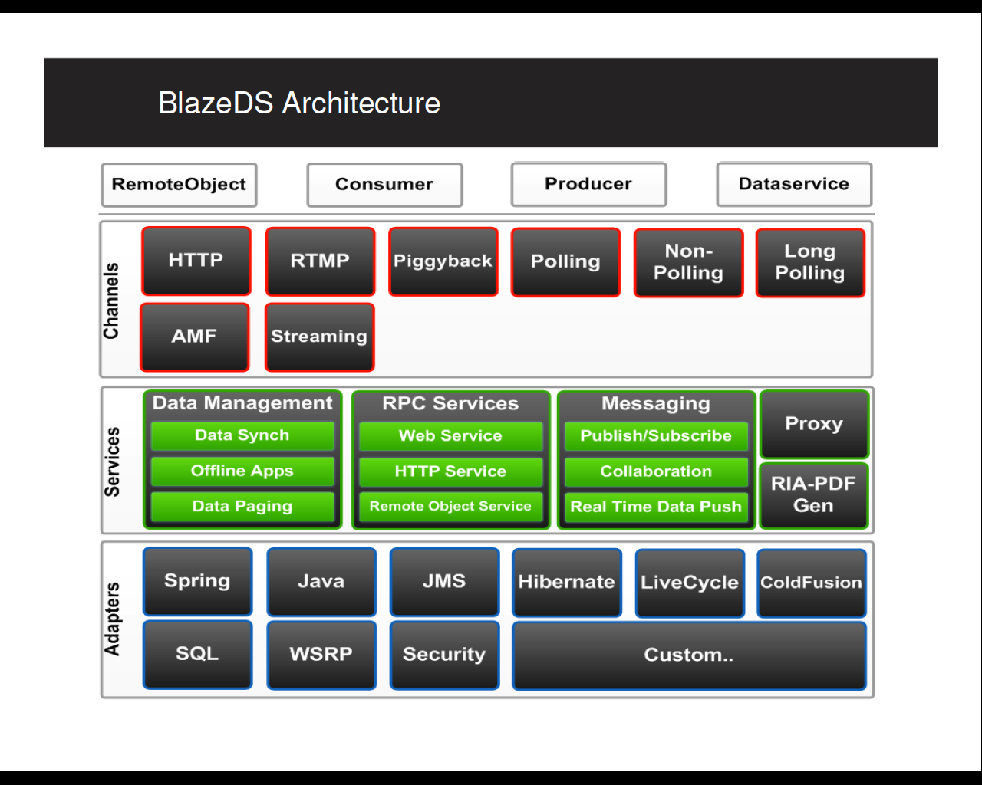
Open Source BlazeDS
The information contained in this presentation is proprietary. Copyright ©2010 Capgemini. All rights reserved.

Slide 5
Remoting
<mx:RemoteObject id="srv" destination="product"/>
<mx:Button label="Get Data" click="srv.getProducts()"/>
<mx:DataGrid dataProvider="{srv.getProducts.lastResult} "/>
remoting-config.xml
  <destination id="product">
  <properties>
  <source>flex.samples.ProductService</source>
  </properties>
</destination>
The information contained in this presentation is proprietary. Copyright ©2010 Capgemini. All rights reserved.

Slide 6
Remote Objects Instantiation and Life Cycle
By default, BlazeDS takes care of remote objects instantiation using no-arg constructor
Scope can be request(default), session, or application
<destination id="contacts">
<properties>
<source>flex.samples.ProductService</source>
<scope>application</scope>
</properties>
</destination>
Instantiation process can be delegated using factories
In the “old” Spring/BlazeDS integration approach, a SpringFactory was used to let Spring instantiate remote objects with appropriate dependency injection
The information contained in this presentation is proprietary. Copyright ©2010 Capgemini. All rights reserved.

Slide 7
Old SpringFactory Approach
services-config.xml
<factories>
<factory id="spring" class="flex.samples.factories.SpringFactory"/>
</factories>
remoting-config.xml
<destination id="productService">
<properties>
<factory>spring</factory>
<source>productBean</source>
</properties>
</destination>
The information contained in this presentation is proprietary. Copyright ©2010 Capgemini. All rights reserved.

Slide 8
Spring BlazeDS Integration Overview
The current path is overly complex
Using the “dependency lookup” approach of the SpringFactory feels antithetical to the “Spring Way”
The burden of configuration is multiplied
Potential for deep integration beyond just remoting is limited
Ultimately acts as a potential barrier to adoption of Flex by the Spring community
Ideally lower the barrier to adoption of Flex by the Spring communityConfiguration using the “Spring Way”
Deeper integration beyond remoting
Make Flex the obvious and easy choice for a Spring-powered RIA
SpringSource and Adobe have formed a joint partnership to turn this idea into reality
A new Spring subproject in the web portfolio: Spring BlazeDS Integration
The information contained in this presentation is proprietary. Copyright ©2010 Capgemini. All rights reserved.

Slide 9
Spring BlazeDS Integration Overview Cont.,
Spring has emerged as the de facto standard for the business tier of Java Enterprise applications.
BlazeDS is an open source project from Adobe that provides the remoting and messaging foundation for connecting a Flex-based front-end to Java back-end services.
Bootstrap the BlazeDS MessageBroker as a Spring-managed bean (no more web.xmlMessageBrokerServlet config needed)
Route http-based Flex messages to the MessageBroker through the Spring DispatcherServlet
The information contained in this presentation is proprietary. Copyright ©2010 Capgemini. All rights reserved.

Slide 10
Spring BlazeDS Integration requirements
Java 5 or higher
Spring 2.5.6 or higher *
Adobe BlazeDS 3.2 or higher **
* As of the 1.0.2.RELEASE version, Spring BlazeDS Integration is forward-compatible with Spring 3.0.x
** As of the 1.0.3.RELEASE version, Spring BlazeDS Integration is forward-compatible with BlazeDS 4.
The information contained in this presentation is proprietary. Copyright ©2010 Capgemini. All rights reserved.

Slide 11
Configuring MessageBroker and Spring DispatcherServlet
MessageBroker is the central component of Spring BlazeDS Integration.
<flex:message-broker/>
HTTP messages from the Flex client will be routed through the Spring DispatcherServlet to the Spring-managed MessageBroker.
There is no need to configure the BlazeDS MessageBrokerServlet when using the Spring-managed MessageBroker.
<servlet>
<servlet-name>Spring Flex Dispatcher Servlet</servlet-name>
<servlet-class>org.springframework.web.servlet.DispatcherServlet</servlet-class>
<init-param>
<param-name>contextConfigLocation</param-name>
<param-value>/WEB-INF/config/web-application-config.xml</param-value>
</init-param>
<load-on-startup>1</load-on-startup>
</servlet>
The information contained in this presentation is proprietary. Copyright ©2010 Capgemini. All rights reserved.

Slide 12
Configuring MessageBroker and Spring DispatcherServlet Cont.,
<servlet-mapping>
<servlet-name>Spring Flex Dispatcher Servlet</servlet-name>
  <url-pattern>/messagebroker/*</url-pattern>
  </servlet-mapping>
The information contained in this presentation is proprietary. Copyright ©2010 Capgemini. All rights reserved.

Slide 13
Flex clients alongside Spring MVC
<context-param>
<param-name>contextConfigLocation</param-name>
<param-value> /WEB-INF/spring/*-context.xml </param-value>
</context-param>
<listener>
<listener-class>org.springframework.web.context.ContextLoaderListener</listener-class>
</listener>
<servlet>
<servlet-name>flex</servlet-name>
<servlet-class>org.springframework.web.servlet.DispatcherServlet</servlet-class>
<load-on-startup>1</load-on-startup>
</servlet>
<servlet-mapping>
<servlet-name>flex</servlet-name>
<url-pattern>/messagebroker/*</url-pattern>
</servlet-mapping>
<servlet>
<servlet-name>spring-mvc</servlet-name>
<servlet-class>org.springframework.web.servlet.DispatcherServlet</servlet-class>
<load-on-startup>1</load-on-startup>
</servlet>
<servlet-mapping>
<servlet-name>spring-mvc</servlet-name>
<url-pattern>/spring/*</url-pattern>
</servlet-mapping>
The information contained in this presentation is proprietary. Copyright ©2010 Capgemini. All rights reserved.

Slide 14
Integration with BlazeDS Remoting Destination
Expose Spring beans for remoting using typical Spring remoting exporter configurationUsing XML namespace tags or Java annotations
No more remoting-config.xml
<flex:remoting-service default-adapter-id="my-default-remoting-adapter" default-channels="my-amf, my-secure-amf" />
<bean id="productService" class="flex.samples.product.ProductServiceImpl" />
<flex:remoting-destination ref="productService" />
<bean id="productService" class="flex.samples.product.ProductServiceImpl" > <flex:remoting-destination include-methods="read, update" exclude-methods="create, delete" channels="my-amf, my-secure-amf" />
</bean>
The information contained in this presentation is proprietary. Copyright ©2010 Capgemini. All rights reserved.

Slide 15
Integration with BlazeDS Message Destination
  Integration with the BlazeDS MessageService.
  No more need for messaging-config.xml
  <flex:message-service default-adapter-id="my-default-messaging-adapter" default-channels="my-polling-amf" />
Use Spring configuration to manage BlazeDS MessageDestinations
MessageTemplate provides simple server-push capabilities
  Adapters provided for Spring JMS and Spring Integration.
  Allows easy communication from Flex clients to Spring message-driven POJOs
<flex:message-destination id=“chat" />
The information contained in this presentation is proprietary. Copyright ©2010 Capgemini. All rights reserved.

Slide 16
Sending AMF Messages with the MessageTemplate
A convenient MessageTemplate helper class is provided that allows you to push messages to any BlazeDS MessageDestination from a simple POJO.
This provides a nice abstraction over push style messaging that hides away the details of the underlying messaging protocol.
Whether using a simple AMF based destination or full-blown JMS, etc., the use of the MessageTemplate stays the same.
The only thing the MessageTemplate requires is a reference to a Spring-managed MessageBroker.
<bean id="defaultMessageTemplate" class="org.springframework.flex.messaging.MessageTemplate" />
<flex:message-destination id=“simple-feed" />
The information contained in this presentation is proprietary. Copyright ©2010 Capgemini. All rights reserved.

Slide 17
MessageBroker Customization
A special MessageBrokerConfigProcessor callback interface is provided that allows custom processing to be done on the newly created MessageBroker after each phase, before it is made available for request processing.
Implementing MessageBrokerConfigProcessor
<flex:message-broker>
<flex:config-processor ref="myConfigProcessor" />
</flex:message-broker>
<bean id="myConfigProcessor" class="com.example.MyDestinationCountingConfigProcessor" />
RemotingDestinationExporter will log all destinations which are loaded and started by spring container.
The information contained in this presentation is proprietary. Copyright ©2010 Capgemini. All rights reserved.

Slide 18
Custom Exception Translators
Requirement is to throw business exceptions from the service implementations. This meant that the Flex client application would receive a fault event, which it had to strip to get to the actual exception.
public class InvalidCriteriaException extends Exception {
public string getCode(){
return ExceptionCode.INVALID_CRITERIA.toString();
}
}
public SearchById(SearchCriteriaDto criteria) throws InvalidCriteriaException {
try { // do some processing, use the DAO layer ... }
catch (SomeDaoException e) { // convert the DAO exception into a service exception and then throw the new exception ... }
catch (Throwable e) { // any unexpected exception is caught and a new service exception is created and thrown further ... } }
The information contained in this presentation is proprietary. Copyright ©2010 Capgemini. All rights reserved.
Notes:
© 2010 Capgemini - All rights reserved
© 2010 Capgemini - All rights reserved

Slide 19
Custom Exception Translators Cont.,
private function handleException(event:FaultEvent) : void {
var errorMessage:ErrorMessage = event.message as ErrorMessage; Alert.show(errorMessage.rootCause.code);
}
As you can see, the Java service code is cluttered within a try..catch block, which also contains the details on converting possible exceptions to service exceptions. On top of this, the client-side code is not very clean either, because it uses an untyped object ( rootCause ) on which we make assumptions and assumptions are generally a bad thing to do in your code. The right solution on the client-side would be to take advantage of the properties of the ErrorMessage object.
A better exception mechanism
In order to leverage the properties of the Flex class ErrorMessage, we decided to only throw instances of flex.messaging.ServiceException, which is shipped in LCDS (and BlazeDS). To do this in an easy way, we proceeded in making sure that each of our custom exception would inherit ServiceException :
The information contained in this presentation is proprietary. Copyright ©2010 Capgemini. All rights reserved.

Slide 20
Custom Exception Translators Cont.,
<bean id="myExpTranslator" class="com.foo.app.MyBusinessExceptionTranslator"/>
<flex:message-broker>
<flex:exception-translator ref="myExpTranslator"/>
</flex:message-broker>
public class InvalidCriteriaException extends ServiceException { …)
The service layer would now throw only ServiceException-derived exceptions, which get deserialized on the client-side as instances of ErrorMessage. The Java exception has a field called code, who is translated in the Flex class as the field faultCode. So the only thing left to do is make sure that the code field is set to a proper value on the server side.
The information contained in this presentation is proprietary. Copyright ©2010 Capgemini. All rights reserved.

Slide 21
Custom Message Interceptors
Custom message interceptors may be used to apply special processing logic to incoming and outgoing AMF messages in their de-serialized Java form. For example, an interceptor can be used to inspect the contents of the incoming message, or to add extra information to the outgoing message.
Custom message processing logic is provided through implementations of the org.springframework.flex.core.MessageInterceptor interface.
<bean id="myMessageInterceptor" class="com.foo.app.MyMessageInterceptor"/> <flex:message-broker>
<flex:message-interceptor ref="myMessageInterceptor"/>
</flex:message-broker>
The information contained in this presentation is proprietary. Copyright ©2010 Capgemini. All rights reserved.

Slide 22
Advanced Topics
Custom Service Adapters
    ManageableComponentFactoryBean for integrating 3rd-party adapters (i.e., dpHibernate, Gilead)
Securing BlazeDS Destinations with Spring Security
JMS Message Destinations
Spring Integration Message Destinations
The information contained in this presentation is proprietary. Copyright ©2010 Capgemini. All rights reserved.

Slide 23
Reference
http://static.springsource.org/spring-flex/docs/1.0.x/reference/htmlsingle/spring-flex-reference.html
http://www.margelatu.org/2009/06/15/meaningful-exceptions-in-lcdsblazeds-applications-using-spring-blazeds-integration/
The information contained in this presentation is proprietary. Copyright ©2010 Capgemini. All rights reserved.

