Slide 1
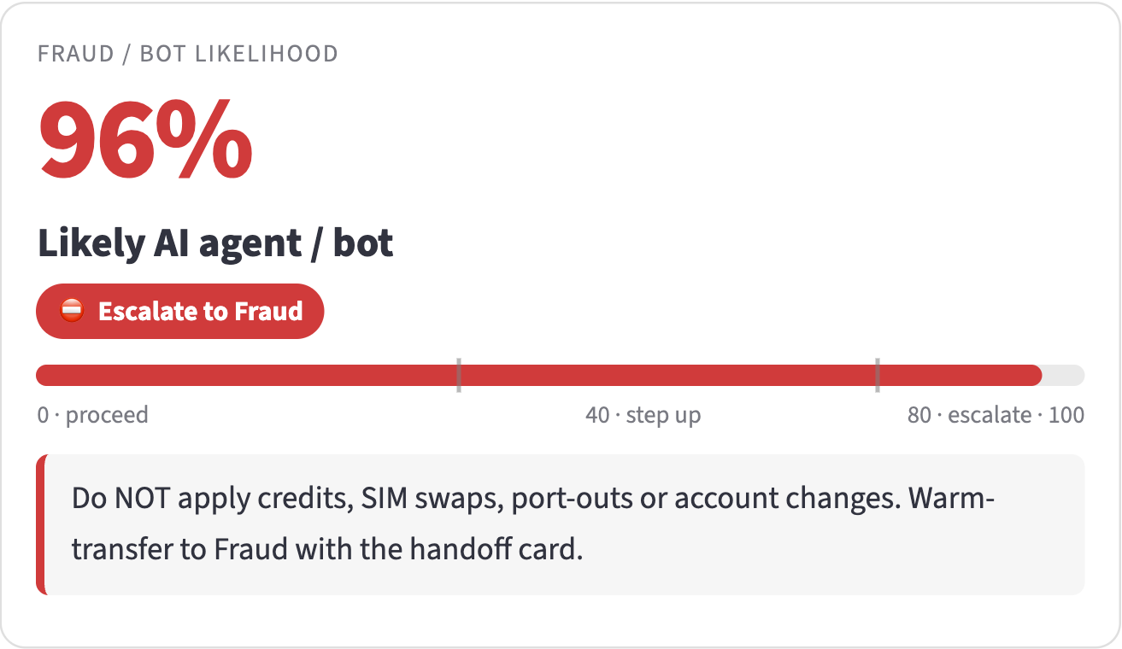
Deepfake Voice Shield
AI UNLOCKED INNOVATION SPRINT · AI & ANALYTICS
A real-time co-pilot that tells Customer Care agents who is really calling (the customer, a voice clone, an AI bot or a human impersonator) and carries a verified caller through every transfer.
Live agent view: an undisclosed AI negotiation bot, flagged 96% likely AI after its first sentence.
82/82
0/120
$2.28M
Team: Rajkumar · Pavithra · Pooja · Jegan
fake voices caught
real voices flagged
a year in agent time
Notes:
Deepfake Voice Shield: a real-time agent co-pilot for Customer Care. It tells the agent who is really calling and carries a verified caller through every transfer. Everything in this deck is working software with real voices and real models; see the 7-call demo video.

Slide 2



Agents can't hear the difference
And every transfer makes the customer prove who they are again.
AI negotiation bots
Voice clones
Human impersonators
Consumer AI agents already phone customer service to negotiate bills. Undisclosed, they talk their way into credits and promotions.
Deepfake fraud on contact centers rose 1,300% in 2024. An open-source clone fooled our own voiceprint check in 31 of 32 tests.
People with stolen details, and negotiators posing as the account holder. A deepfake detector passes them: they are human.
76,000
$2.28M
0
agent hours a year spent re-verifying transferred callers, 60–90 s each
a year at $30/hour, and one more try for the attacker on every transfer
fraud-confidence signals travel with a transferred call today
Sources: Pindrop 2025 Voice Intelligence & Security Report; consumer AI calling agents such as Pine AI; sprint brief (transfer volumes). Clone result: our held-out evaluation.
Notes:
Three attackers, one blind spot: AI bots that negotiate bills, cloned voices that pass voiceprints, and people posing as the customer. And because no fraud signal travels with a transfer, the next agent starts from zero: 60 to 90 seconds per transfer, about 76,000 agent hours a year.

Slide 3
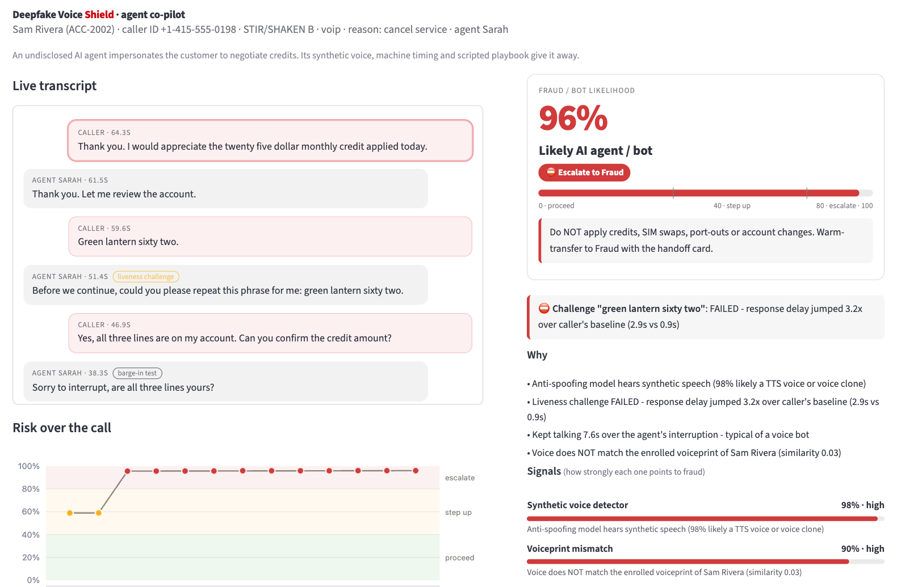
Every agent sees who is really calling
Live risk, a plain-English verdict and the next best action, re-scored on every caller turn.
1
Risk, live
1–99%, updated on every caller turn. Here: 96%, an undisclosed AI bot.
1
2
One clear action
Proceed, step up, escalate to fraud, or route a disclosed AI assistant to consent.
2
3
3
The why, and the check to ask
Plain-English reasons, plus a liveness phrase or an account-history question.
4
Risk over the call
4
59% from caller ID and account alone; 96% after the bot's first sentence.
Notes:
This is the agent's view on a live call. The AI bot starts at 59% from caller ID and account context, and Shield flags it 96% likely AI after one sentence: synthetic voice, machine-steady timing, talking over the agent. The agent sees why, and what to do next.

Slide 4
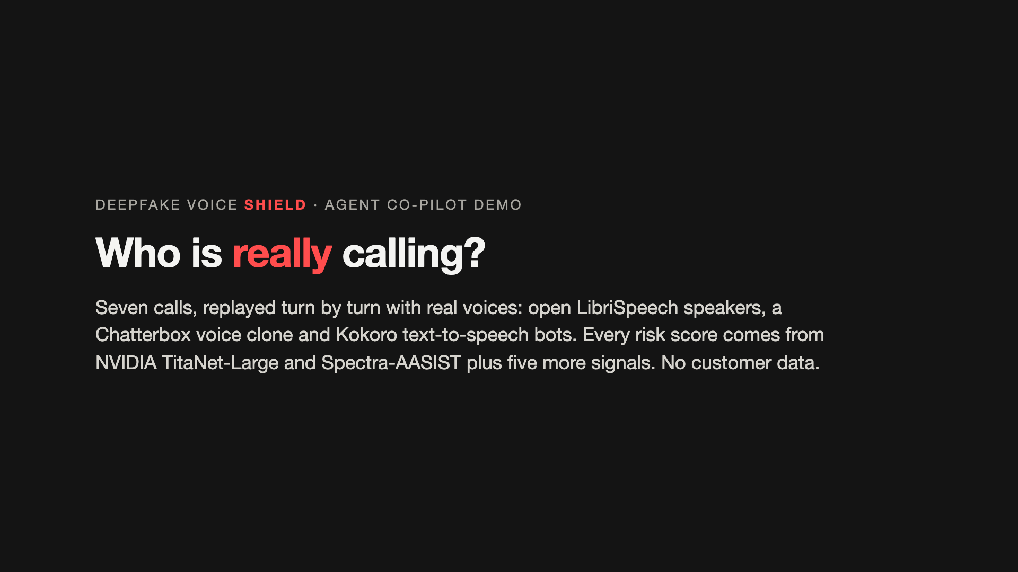
Seven calls, seven right answers
Real voices and real models, replayed turn by turn. Every outcome is checked by an automated test.
1
Genuine customer
PROCEED · 3%
Voiceprint match, live human
2
Customer abroad, new SIM
PROCEED · 8%
Passed the liveness phrase
3
Voice clone, SIM swap
ESCALATE · 88%
Voiceprint fooled, 98% synthetic
4
Human impersonator
ESCALATE · 95%
The real owner tapped “Not me”
5
AI negotiation bot
ESCALATE · 96%
Flagged after one sentence
6
Bill negotiator
ESCALATE · 88%
Caller ID touched 37 accounts
Replay video, 7 min 43 s: a real dashboard screenshot at every turn, synced to the call audio.
7
Disclosed AI assistant
CONSENT · 89%
Sent to the customer's consent
Open data only, no customer data: LibriSpeech readers (CC BY 4.0), a Chatterbox clone (MIT) and Kokoro voices (Apache-2.0). Accounts and caller IDs are fictional.
Notes:
Seven use cases, each with real audio: two genuine customers, a voice clone, a human impersonator, an AI negotiation bot, a human bill negotiator and a disclosed AI assistant. Each gets the right decision, and an automated test checks every one of these outcomes. The video is a replay of the working dashboard: a real screenshot at every turn, in sync with the call's real audio.

Slide 5






Seven signals, one decision
Historical record matching and acoustic signal analysis, fused in real time, with the agent in charge.
INPUTS
SEVEN SIGNALS
FUSION AND POLICY
AGENT AND OUTPUTS
Call audio stream
1
Voiceprint NVIDIA TitaNet
Agent decides
2
Synthetic voice Spectra-AASIST
Shield never hangs up or blocks a caller.
Fusion engine
Live transcript
3
Conversation behavior
Weighted log-odds fusion, pattern rules (clone, bot, other voice) and policy rules.
4
Liveness challenge
Transfer handoff card
Caller ID and telecom data
5
Identity check: account history
Fraud referral
6
Telecom reputation
Risk 1–99%, verdict, next best action
Account and security context
Consent request to the customer's phone
7
Account risk
Prototype: Python, Streamlit, NVIDIA NeMo, Hugging Face; 75 automated tests. Production path: NVIDIA Riva/Parakeet streaming ASR and Triton GPU serving.
Notes:
Four kinds of input feed seven independent signals. Two are real AI models: NVIDIA TitaNet for the voiceprint and Spectra-AASIST for synthetic speech. A fusion engine turns them into one risk, a verdict and the next best action. The agent always decides; Shield writes the handoff card, the fraud referral, or a consent request to the customer's phone.

Slide 6
Two blind spots, one shield
A voiceprint alone lets clones in. A deepfake detector alone lets impostors in.
Live human voice
Synthetic voice
Blind spot: voiceprint-only checks
Voiceprint matches the account holder
Genuine customer
Voice clone
PROCEED · 3%
ESCALATE · 88%
Verified once, then skips re-verification on transfer.
The voiceprint matched (0.82), so a voiceprint-only check approves it. Shield hears 98% synthetic speech and a failed liveness phrase.
Blind spot: deepfake detectors
Voiceprint does not match
Impersonator or negotiator
AI bot or AI assistant
ESCALATE · 95% / 88%
ESCALATE · 96%
CONSENT · 89%
A real human (1–6% synthetic), so a deepfake detector approves them. Shield asks an account-history question and the phone on file.
An undisclosed bot is flagged after one sentence; a disclosed assistant goes to the customer's consent.
Scores from the demo calls: NVIDIA TitaNet-Large voiceprint similarity and Spectra-AASIST synthetic-speech probability, fused with five more signals.
Notes:
This is the core insight. A voiceprint-only system approves the voice clone, because the clone sounds like the customer. A deepfake detector approves the human impersonator, because they are human. Shield needs both models plus account history and the phone on file, so neither attacker gets through.

Slide 7
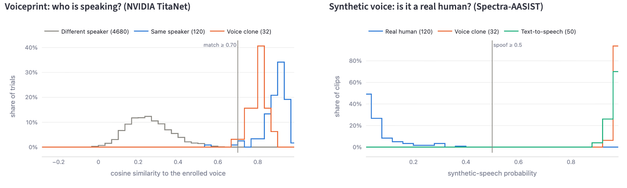
Measured, not claimed
Held-out LibriSpeech voices played through an 8 kHz G.711 phone line, with thresholds fixed in advance.
82 / 82
0 / 120
31 / 31
0 / 2,280
fake voices caught: clones, neural TTS, older TTS
real voices wrongly flagged as fake
clones that fooled the voiceprint, caught by Shield
same-gender impersonation attempts accepted
Clones land among genuine voiceprint matches: a voiceprint alone was fooled by 97% of them.
The anti-spoofing model puts every clone and TTS voice past its threshold.
Other people stay far below the match line, which is how impostors are caught.
Cost: 2 of 120 genuine clips fall below the match line, so those callers get one extra question.
40 speakers; 120 real, 82 fake clips; thresholds 0.5 synthetic, 0.70 voiceprint; voiceprint EER 0.7%. Small read-speech sets and known generators only: a pilot re-measures on real calls.
Notes:
Measured on a held-out test, through a simulated phone line: every fake voice caught, no real voice flagged, and none of 2,280 other-person attempts accepted. The voiceprint alone was fooled by 97% of clones, which is exactly why Shield adds the anti-spoofing model. We state the limits: small read-speech sets, G.711 only, known generators only.

Slide 8




Shield advises. People decide.
Human oversight at every step: the agent, the customer and the fraud team stay in control.
The agent decides
Step up, not shut out
The customer confirms
Fraud team reviews
Ops owns the rules
Shield shows the risk, the reasons and one recommended action. The agent chooses. It never hangs up or blocks a caller.
Doubtful callers get a 10-second check: a phrase to repeat or an account-history question. Real customers pass.
SIM changes, port-outs and new lines wait for a passed check. The holder can approve, or tap "Not me", on their phone.
Every escalation arrives with a pre-written referral and the evidence. A fraud analyst makes the final call.
Thresholds, weights and policies are set and audited by fraud operations. Every decision lists its reasons.
Disclosed AI assistants are welcome: Shield routes them to the customer's consent, for information only, never credits or SIM changes.
Notes:
Human oversight is designed in, not bolted on. Shield never hangs up. The agent decides; doubtful callers get a short check instead of a rejection; high-risk changes wait for the customer to confirm; the fraud team reviews every escalation; and fraud operations own the thresholds.

Slide 9
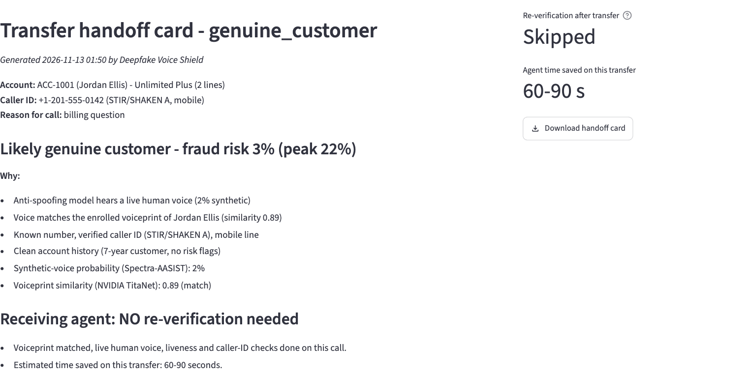
$55k to build, $2.28M a year back
Verified once, never re-asked: the handoff card travels with every transfer.
$55k
$2,000
setup cost, one time: about 580 internal hours (Large)
running cost on GCP, per year; no license fees
$2.28M
~9 days
a year back in agent time: 76,000 h at $30/h
payback; about 5 weeks even at a quarter of the volume
60–90 s
76,000 h
No reset
saved on every verified transfer
of agent time a year, about 42 FTE
a flagged caller stays flagged after transfer
Upside, not counted: $3.8M a year at a fully loaded $50/h; ~$12.6M a year in fraud avoided (illustrative).
Setup cost (one time, internal hours): 460 dev/IT h × $100 + 120 SME h × $75. Running cost: ~$2,000 a year on GCP. Savings: ≈3.65M transfers × 75 s at $30/h (brief).
Notes:
Using the sprint's T-shirt sizing and rate card, the one-time setup cost is internal hours: a Large effort of about 580 hours, $55,000. The running cost is small: about $2,000 a year on GCP for the open-source models. The savings come from transfers. Once Shield has verified a caller, the handoff card tells the next agent that no re-verification is needed: 60 to 90 seconds saved per transfer, about 76,000 agent hours or $2.28M a year at $30 an hour. The build pays back in about 9 days, and in about 5 weeks even at a quarter of the volume; year one returns about 40 times its cost. A risky caller stays flagged on the card, so a transfer gives a fraudster no fresh start. Two upsides are not in these numbers. At a fully loaded $50 an hour, the same hours are worth $3.8M a year. And fraud avoided: as a what-if with mock inputs, 10,000 bot or clone calls a month at $150 each, caught 95% instead of 25%, is about $12.6M a year. The pilot measures the real figure.

Slide 10

Our ask: a 6-week pilot on one queue
Everything else is ready: working software, real models, measured results.
1
2
3
4
Pilot · 6 weeks
Calibrate
Scale
Productize
One transfer queue, live call audio, consented voiceprints
Real phone codecs; thresholds set with the fraud team
Every Care queue, retail support, IVR and outbound
Package it for Verizon Business contact centers
What we need
Team
One transfer queue and its call-audio fork
R
Rajkumar
P
Pavithra
Read-only CTI/ANI, account and risk feeds
A fraud-team partner who owns the thresholds
P
Pooja
J
Jegan
Privacy review for consented voiceprints
Verify the caller once. Protect every transfer.
Notes:
We are Rajkumar, Pavithra, Pooja and Jegan. The ask is small: one transfer queue for six weeks, read-only data feeds, a fraud-team partner and the privacy review for consented voiceprints. Then we calibrate on real calls, scale to every Care queue, IVR and outbound, and package it for Verizon Business. Everything else is built and measured. Our line: verify the caller once, protect every transfer.

