Slide 1
Chapter 20: Data Analysis

Slide 2
Decision-Support Systems: Overview
Data analysis tasks are simplified by specialized tools and SQL extensions
  Example tasks
    For each product category and each region, what were the total sales in the last quarter and how do they compare with the same quarter last year
    As above, for each product category and each customer category
Statistical analysis packages (e.g., : S++) can be interfaced with databases
  Statistical analysis is a large field, but not covered here
Data mining seeks to discover knowledge automatically in the form of statistical rules and patterns from large databases.
A data warehouse archives information gathered from multiple sources, and stores it under a unified schema, at a single site.
  Important for large businesses that generate data from multiple divisions, possibly at multiple sites
  Data may also be purchased externally

Slide 3
Data Warehousing
Data sources often store only current data, not historical data
Corporate decision making requires a unified view of all organizational data, including historical data
A data warehouse is a repository (archive) of information gathered from multiple sources, stored under a unified schema, at a single site
  Greatly simplifies querying, permits study of historical trends
  Shifts decision support query load away from transaction processing systems

Slide 4
Data Warehouse vs. Operational DBMS
OLTP (on-line transaction processing)
  Major task of traditional relational DBMS
  Day-to-day operations: purchasing, inventory, banking, manufacturing, payroll, registration, accounting, etc.
OLAP (on-line analytical processing)
  Major task of data warehouse system
  Data analysis and decision making
Distinct features (OLTP vs. OLAP):
  Data contents: current, detailed vs. historical, consolidated
  Database design: ER, Normalized design + application vs. star + subject
  View: current, local vs. evolutionary, integrated
  Access patterns: update vs. read-only but complex queries
Data Mining: Concepts and Techniques

Slide 5

OLTP vs. OLAP
Data Mining: Concepts and Techniques

Slide 6
Why Separate Data Warehouse?
High performance for both systems
  DBMS— tuned for OLTP: access methods, indexing, concurrency control, recovery
  Warehouse—tuned for OLAP: complex OLAP queries, multidimensional view, consolidation
Different functions and different data:
  missing data: Decision support requires historical data which operational DBs do not typically maintain
  data consolidation: DS requires consolidation (aggregation, summarization) of data from heterogeneous sources
  data quality: different sources typically use inconsistent data representations, codes and formats which have to be reconciled
Note: There are more and more systems which perform OLAP analysis directly on relational databases
Data Mining: Concepts and Techniques

Slide 7
Data Warehouse: A Multi-Tiered Architecture
Monitor
&
Integrator
OLAP Server
Other
sources
Metadata
Analysis
Query
Reports
Data mining
Operational
DBs
Extract
Transform
Load
Refresh
Data
Warehouse
Serve
Data Marts
Data Sources
Data Storage
OLAP Engine
Front-End Tools
Data Mining: Concepts and Techniques

Slide 8
Conceptual Modeling of Data Warehouses
Modeling data warehouses: dimensions & measures
  Star schema: A fact table in the middle connected to a set of dimension tables
  Snowflake schema: A refinement of star schema where some dimensional hierarchy is normalized into a set of smaller dimension tables, forming a shape similar to snowflake
  Fact constellations: Multiple fact tables share dimension tables, viewed as a collection of stars, therefore called galaxy schema or fact constellation
Data Mining: Concepts and Techniques

Slide 9
Example of Star Schema
date
date_key
day
day_of_the_week
month
quarter
year
item
item_key
item_name
brand
type
supplier_type
Sales Fact Table
date_key
item_key
location_key
location
units_sold
location_key
street
city
state_or_province
country
dollars_sold
avg_sales
Measures
Data Mining: Concepts and Techniques

Slide 10
From Tables to Data Cubes
A data warehouse is based on a multidimensional data model which views data in the form of a data cube
A data cube, such as sales, allows data to be modeled and viewed in multiple dimensions
  Dimension tables, such as item (item_name, brand, type), or date(day, week, month, quarter, year) or location
  Fact table contains measures (such as dollars_sold) and keys to each of the related dimension tables
In data warehousing literature, an n-D base cube is called a base cuboid. The top most 0-D cuboid, which holds the highest-level of summarization, is called the apex cuboid. The lattice of cuboids forms a data cube.
Data Mining: Concepts and Techniques

Slide 11

A Sample Data Cube
Date
Total annual sales
of TV in U.S.A.
1Qtr
2Qtr
3Qtr
4Qtr
sum
Product
TV
PC
U.S.A
VCR
sum
Canada
Country
Mexico
sum
All, All, All
Data Mining: Concepts and Techniques

Slide 12
Multidimensional Data
Sales volume as a function of product, month, and region
Dimensions: Product, Location, Time
Hierarchical summarization paths
Region
Industry Region Year
Category Country Quarter
Product City Month Week
Office Day
Product
Month
Data Mining: Concepts and Techniques

Slide 13
A Concept Hierarchy: Dimension (location)
all
all
region
Europe
...
North_America
country
Germany
...
Spain
Canada
...
Mexico
city
Frankfurt
...
Vancouver
...
Toronto
office
L. Chan
...
M. Wind
Data Mining: Concepts and Techniques

Slide 14
Cube: A Lattice of Cuboids
all
0-D(apex) cuboid
time
item
location
supplier
1-D cuboids
time,location
item,location
location,supplier
time,item
2-D cuboids
time,supplier
item,supplier
time,location,supplier
3-D cuboids
time,item,location
time,item,supplier
item,location,supplier
4-D(base) cuboid
time, item, location, supplier
Data Mining: Concepts and Techniques

Slide 15
Typical OLAP Operations
Roll up (drill-up): summarize data
  by climbing up hierarchy or by dimension reduction
Drill down (roll down): reverse of roll-up
  from higher level summary to lower level summary or detailed data, or introducing new dimensions
Slice and dice: project and select
Pivot (rotate):
  reorient the cube, visualization, 3D to series of 2D planes
Other operations
  drill across: involving (across) more than one fact table
  drill through: through the bottom level of the cube to its back-end relational tables (using SQL)
Data Mining: Concepts and Techniques

Slide 16

Data Mining: Concepts and Techniques

Slide 17
Important Instructions
Read these slides and also the paper on Association Rule Mining

Slide 18
End of Chapter

Slide 19
Example of Snowflake Schema
time
item
time_key
day
day_of_the_week
month
quarter
year
item_key
item_name
brand
type
supplier_key
supplier
Sales Fact Table
supplier_key
supplier_type
time_key
item_key
branch_key
branch
location
location_key
location_key
street
city_key
branch_key
branch_name
branch_type
units_sold
dollars_sold
city
city_key
city
state_or_province
country
avg_sales
Measures
Data Mining: Concepts and Techniques

Slide 20
Example of Fact Constellation
time
time_key
day
day_of_the_week
month
quarter
year
item
Shipping Fact Table
item_key
item_name
brand
type
supplier_type
Sales Fact Table
time_key
time_key
item_key
shipper_key
item_key
branch_key
from_location
branch
location_key
location
to_location
branch_key
branch_name
branch_type
units_sold
location_key
street
city
province_or_state
country
dollars_cost
dollars_sold
units_shipped
avg_sales
shipper
Measures
shipper_key
shipper_name
location_key
shipper_type
Data Mining: Concepts and Techniques

Slide 21
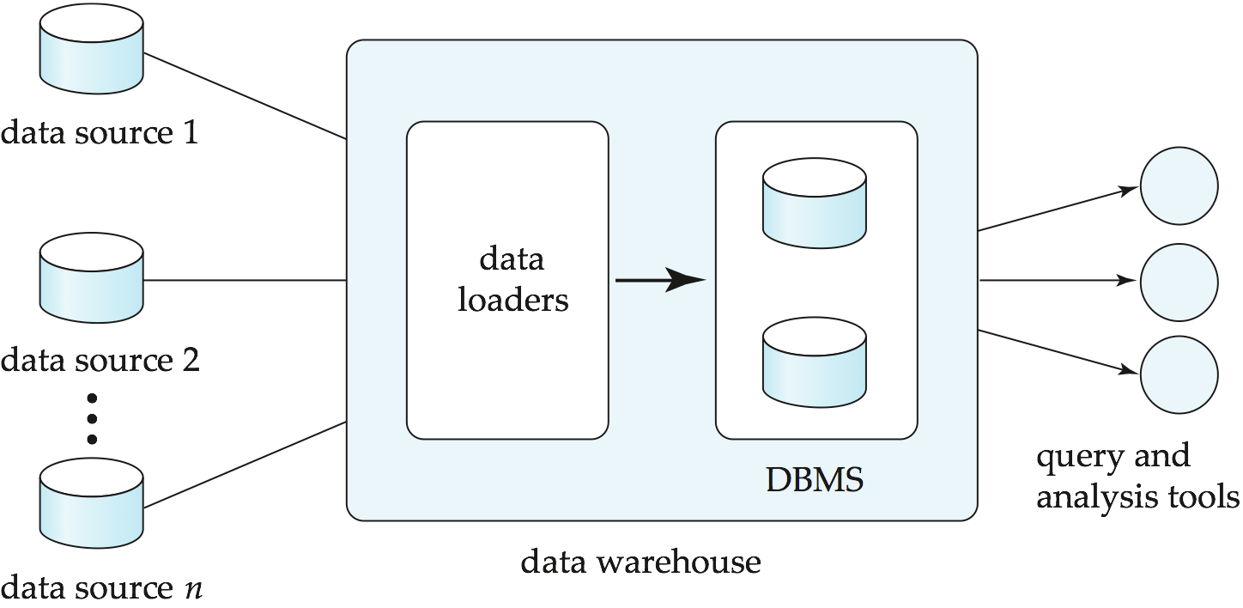
Data Warehousing

