Slide 1
Deep Learning CS60010
Abir Das, Sudeshna Sarkar
Computer Science and Engineering Department
Indian Institute of Technology Kharagpur
http://cse.iitkgp.ac.in/~adas/
http://www.facweb.iitkgp.ac.in/~sudeshna/

Slide 2
Agenda
To brush up basics of Linear Algebra.
04 Jan, 2020
Notes:
<number>

Slide 3
Resources
”Deep Learning”, I. Goodfellow, Y. Bengio, A. Courville. (Chapter 2)
04 Jan, 2020
Notes:
<number>

Slide 4
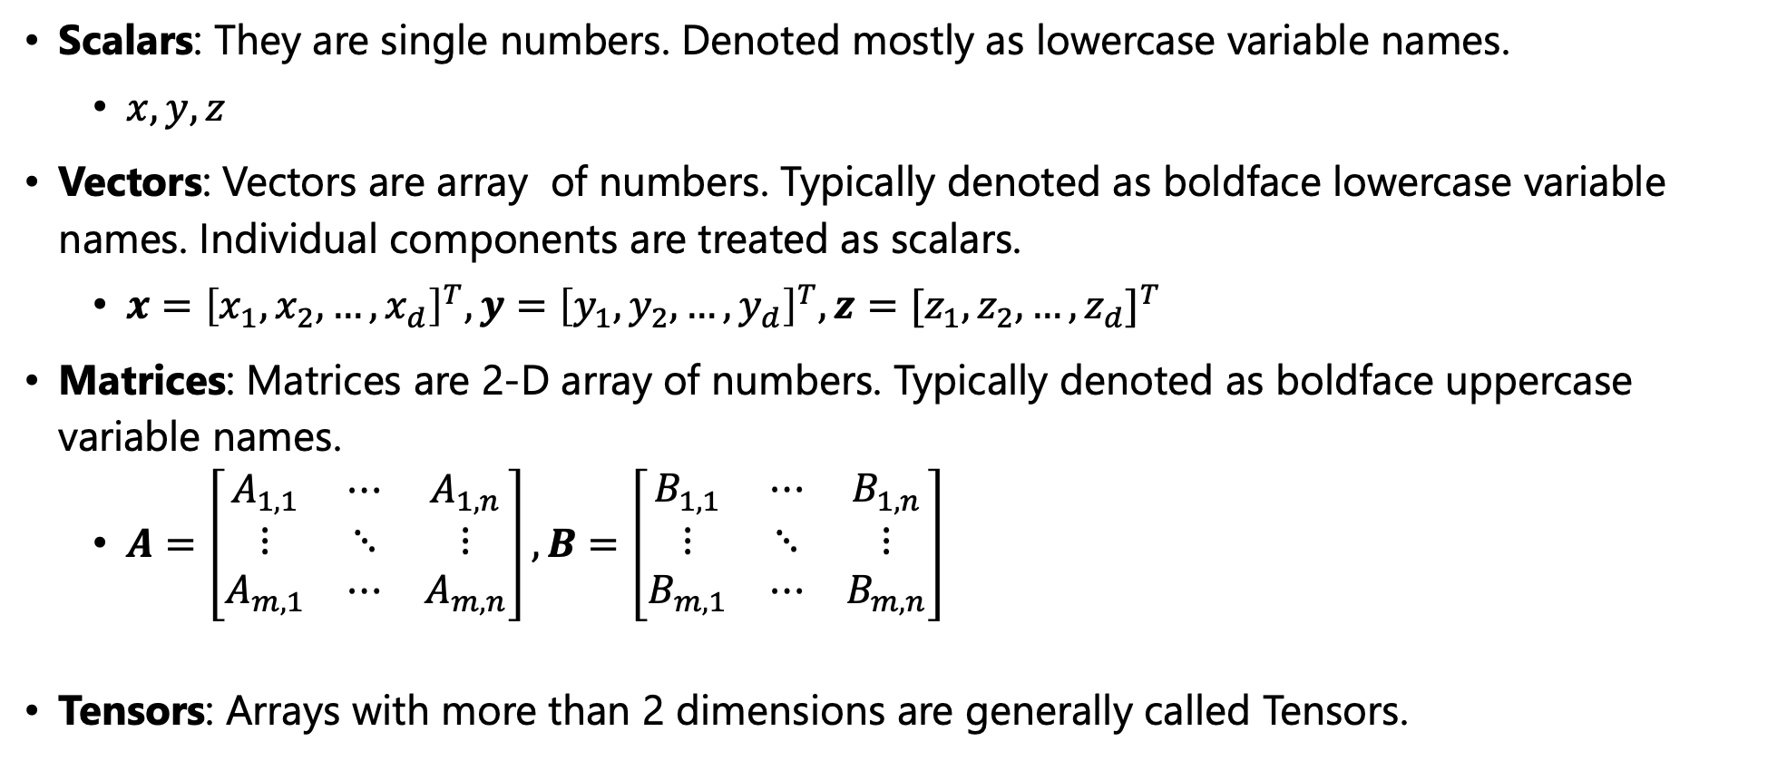
Scalars, Vectors, Matrices and Tensors
04 Jan, 2020
Notes:
<number>

Slide 5
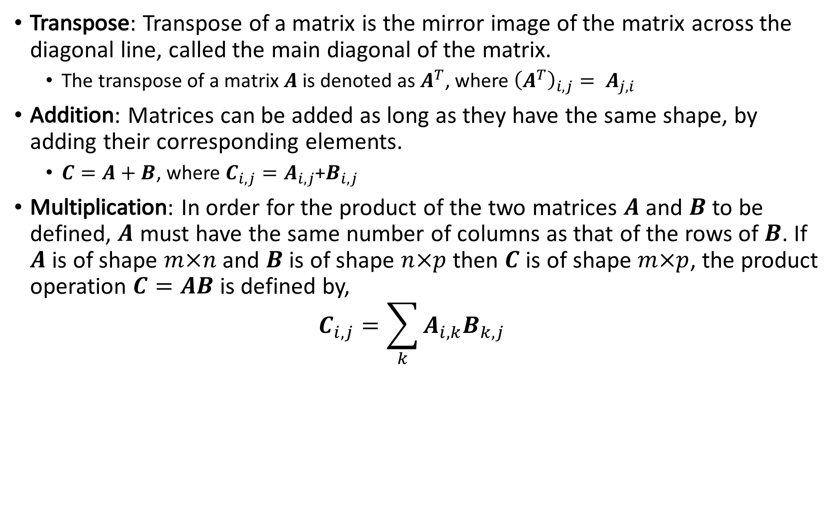
Matrix Operations
04 Jan, 2020
Notes:
<number>

Slide 6
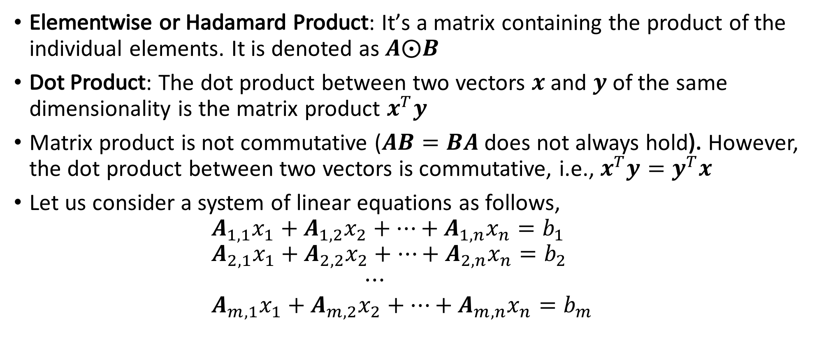
Matrix Operations
04 Jan, 2020
Notes:
<number>

Slide 7
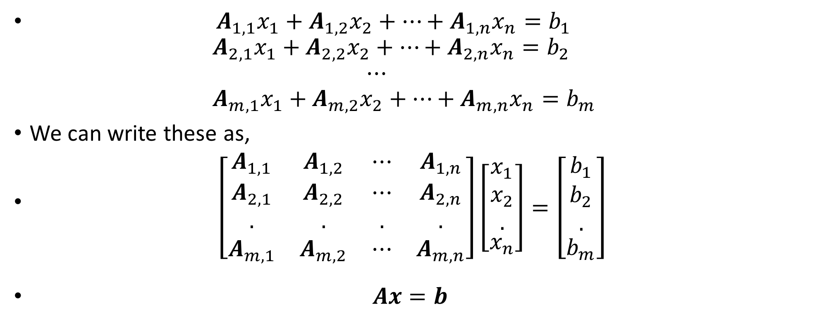
System of Linear Equations
04 Jan, 2020
Notes:
<number>

Slide 8
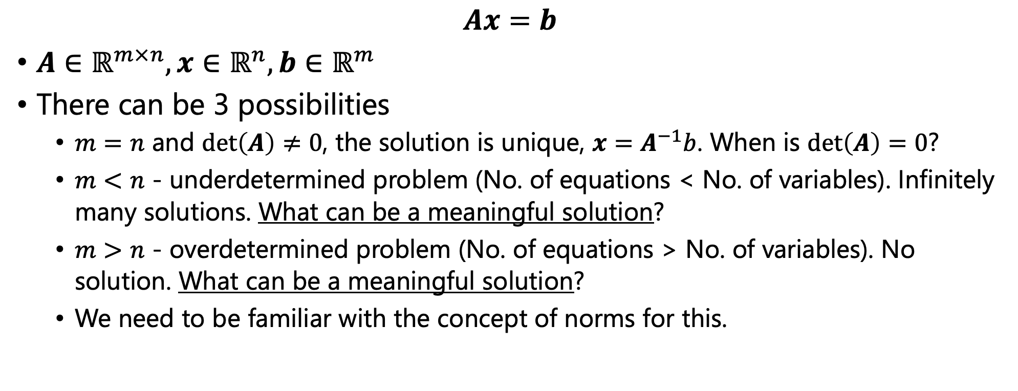
System of Linear Equations
04 Jan, 2020
Notes:
<number>

Slide 9
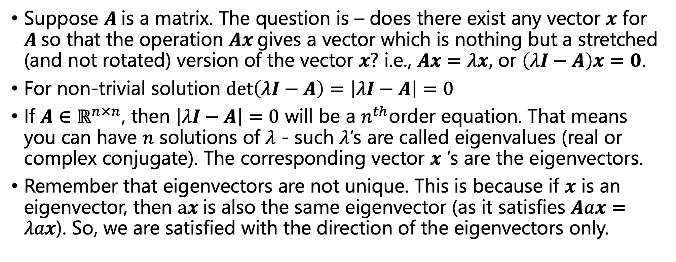
Eigenvalues and Eigenvectors
04 Jan, 2020
Notes:
<number>

Slide 10
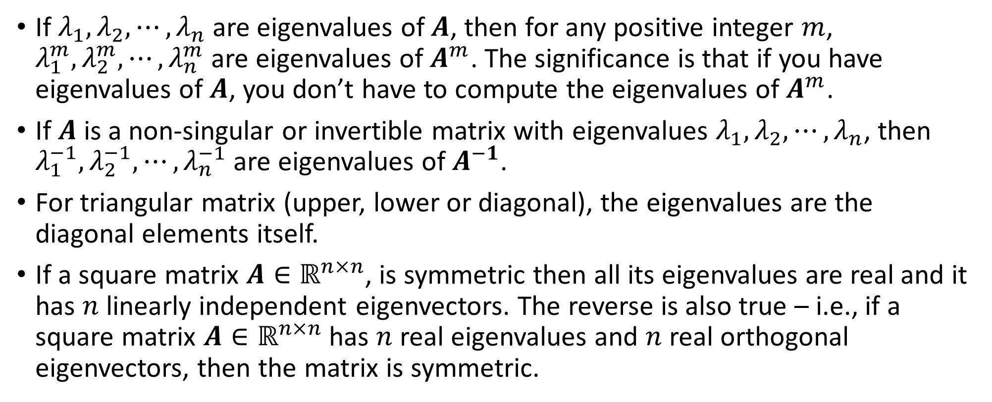
Standard Results on Eigenvalues and Eigenvectors
04 Jan, 2020
Notes:
<number>

Slide 11
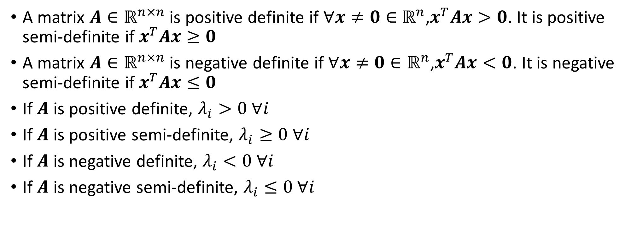
Standard Results on Eigenvalues and Eigenvectors
04 Jan, 2020
Notes:
<number>

Slide 12
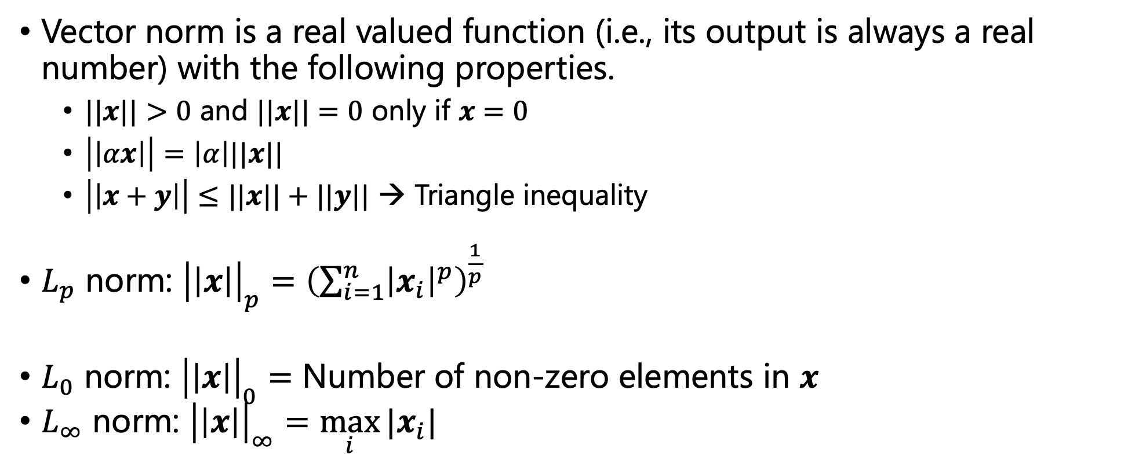
Vector Norms
04 Jan, 2020
Notes:
<number>

Slide 13
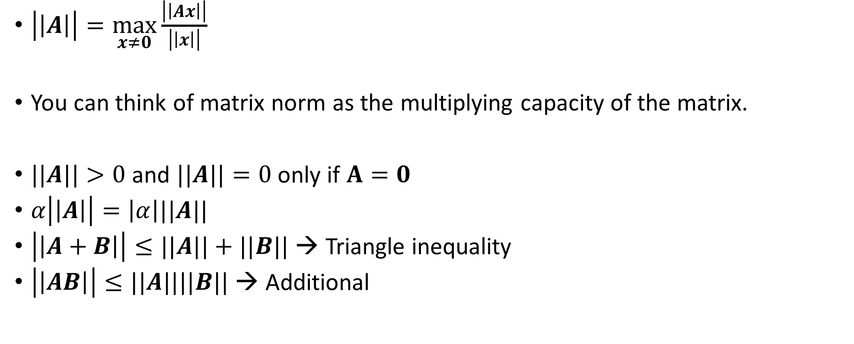
Matrix/Induced Norms
04 Jan, 2020
Notes:
<number>

Slide 14
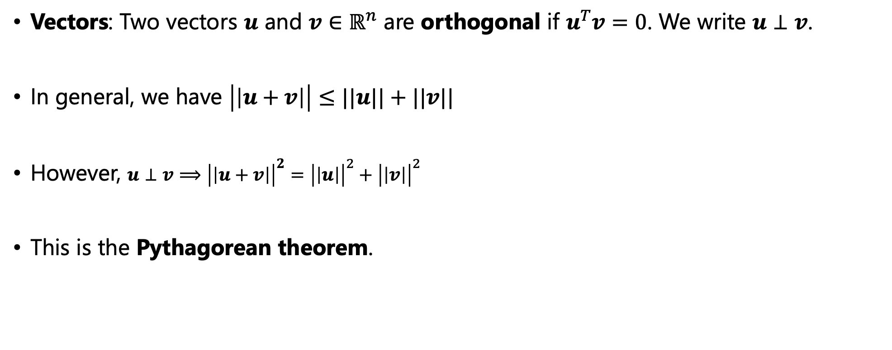
Orthogonality
04 Jan, 2020
Notes:
<number>

Slide 15
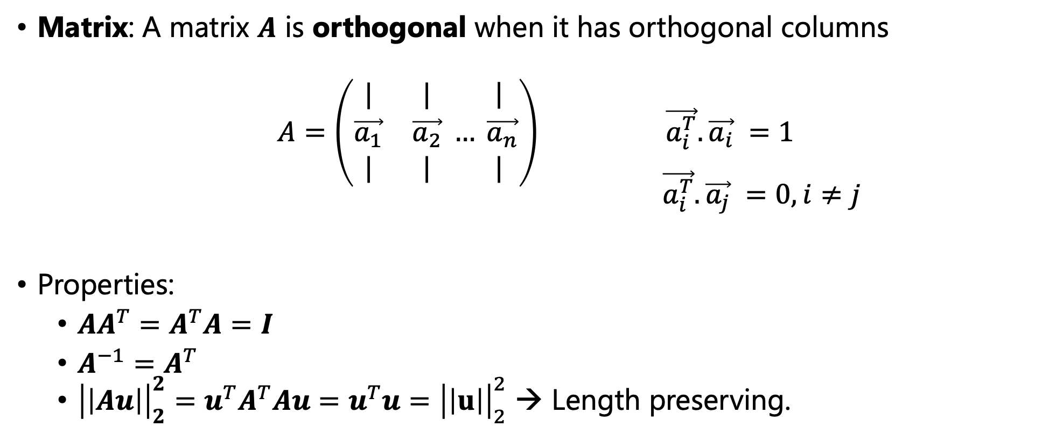
Orthogonality
04 Jan, 2020
Notes:
<number>

Slide 16
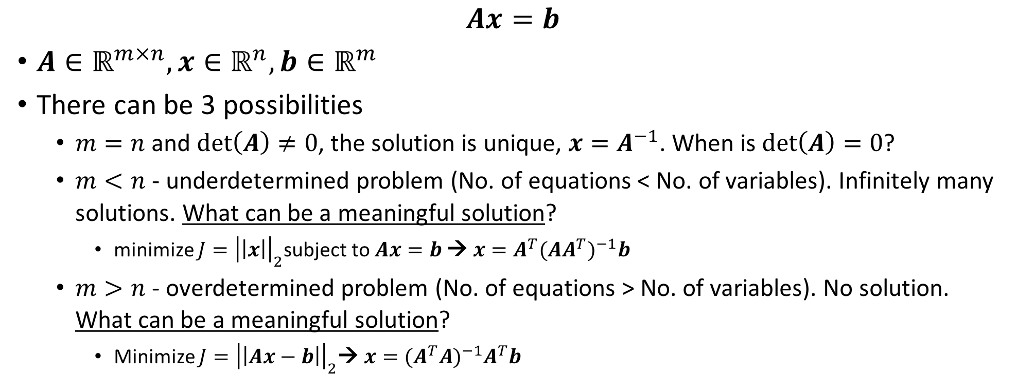
System of Linear Equations
04 Jan, 2020
Notes:
<number>

Slide 17
Thank You!!

