Slide 1
Deep Learning
CS60010
Abir Das, Sudeshna Sarkar
Computer Science and Engineering Department
Indian Institute of Technology Kharagpur
http://cse.iitkgp.ac.in/~adas/
http://www.facweb.iitkgp.ac.in/~sudeshna/

Slide 2
Agenda
Understand basics of Matrix/Vector Calculus and Optimization concepts to be used in the course.
Understand different types or errors in learning

Slide 3
Resources
”Deep Learning”, I. Goodfellow, Y. Bengio, A. Courville. (Chapter 8)

Slide 4
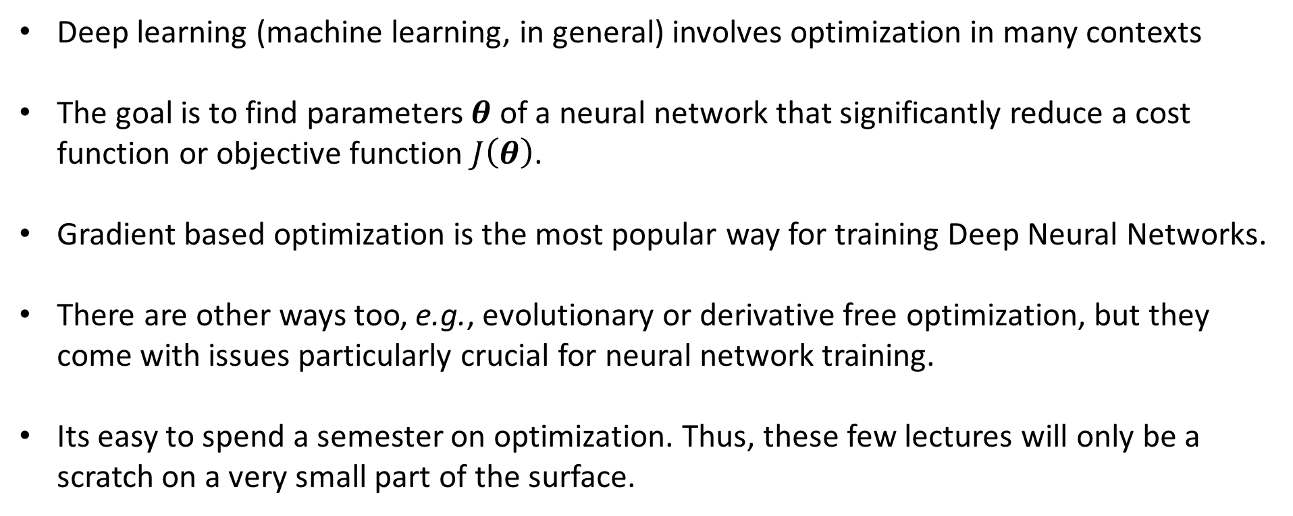
Optimization and Deep Learning- Connections

Slide 5
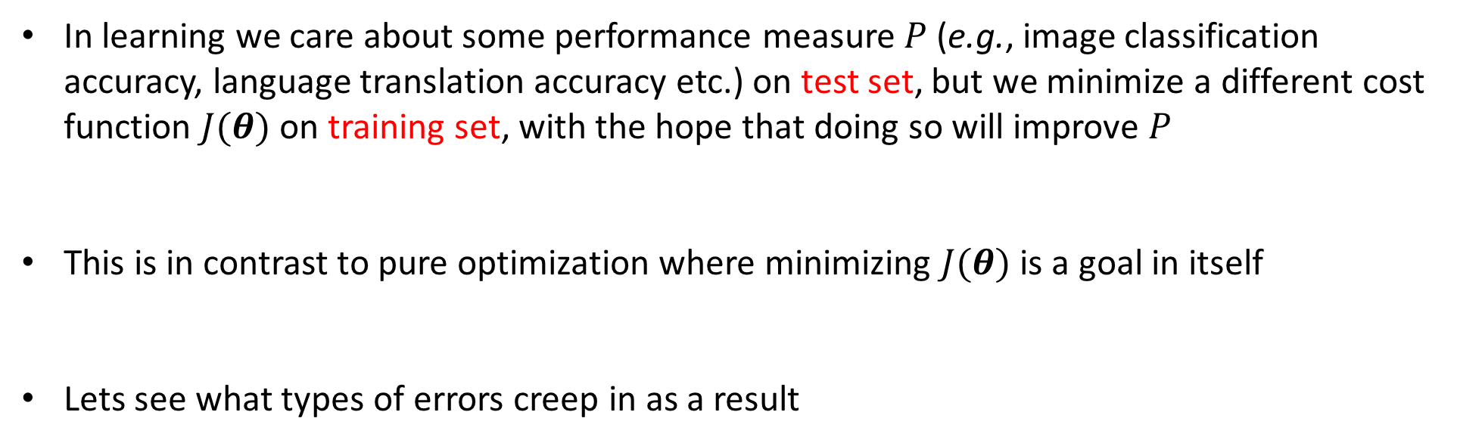
Optimization and Deep Learning- Differences

Slide 6
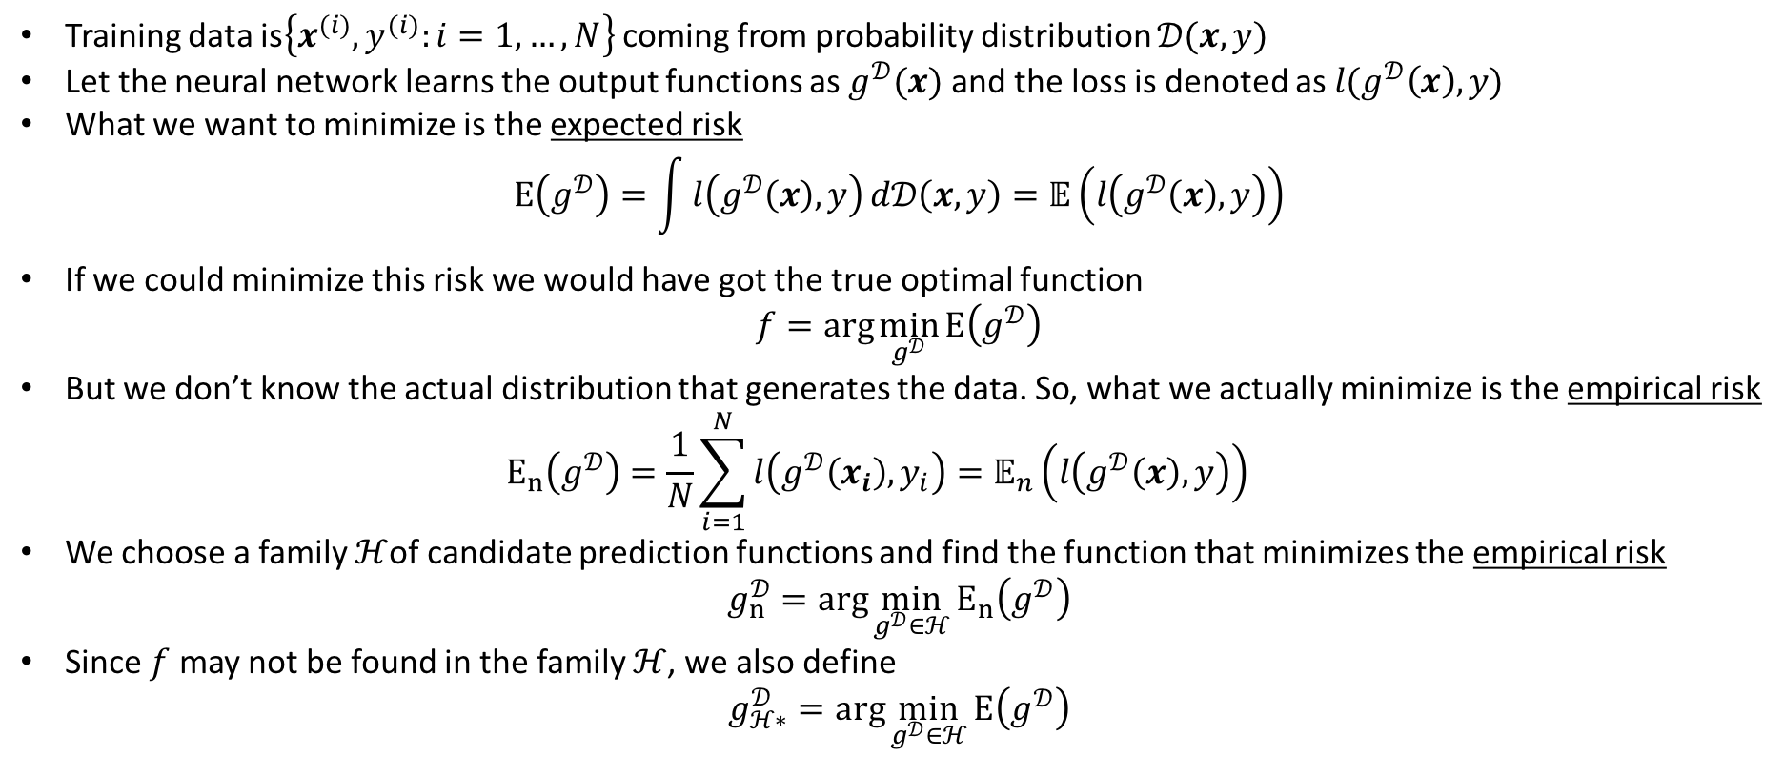
Expected and Empirical Risk

Slide 7
Sources of Error
 | Minimizes | Staying within
 | expected risk | No constraints on function family | True data distribution known Family of functions exhaustive
 | expected risk | family of functions | True data distribution known Family of functions not exhaustive
 | empirical risk | family of functions | True data distribution not known Family of functions not exhaustive
 | Minimizes | Staying within
 | expected risk | No constraints on function family | True data distribution known Family of functions exhaustive
 | expected risk |  | True data distribution known Family of functions not exhaustive
 | empirical risk |  | True data distribution not known Family of functions not exhaustive
True data generation procedure not known
Family of functions [or hypothesis] to try is not exhaustive
(And not to forget) we rely on a surrogate loss in place of the true classification error rate

Slide 8
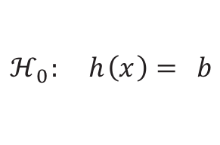
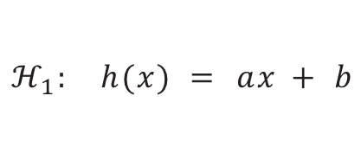
A Simple Learning Problem
2 Data Points. 2 hypothesis sets:
y
y
x
x
Slide courtesy: Malik Magdon-Ismail

Slide 9
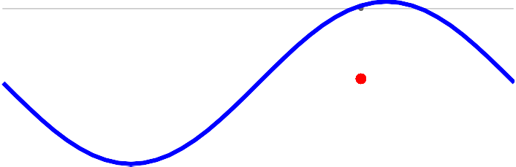
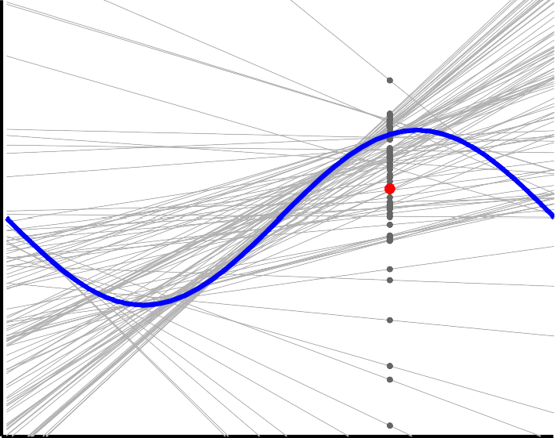
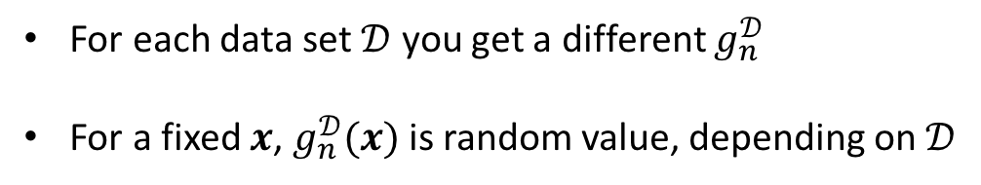
Let’s Repeat the Experiment Many Times
Slide courtesy: Malik Magdon-Ismail

Slide 10


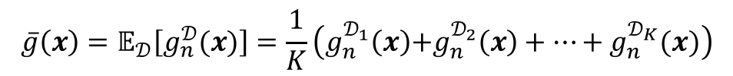

What’s Happening on Average
y
g¯(x)
g¯(x)
y
sin(x)
sin(x)
We can define
x
x
Random value, depending on
Your average prediction on
How variable is your prediction
Slide courtesy: Malik Magdon-Ismail
Notes:
Any intuition why variance is less in the middle of the right figure

Slide 11






on Test Point for Data
f (x)
f (x)
E_{o}^{D}_{ut}(x)
E_{o}^{D}_{ut}(x)
x
x
Squared error, a random value depending on
Expected value of the above random value
Slide motivation: Malik Magdon-Ismail

Slide 12






The Bias-Variance Decomposition
Bias
Variance
Bias
Variance
Slide motivation: Malik Magdon-Ismail
Notes:
Approximation: how far your prediction is on average from the actual value.

Slide 13

Bias-Variance to Overfitting-Underfitting

Slide 14
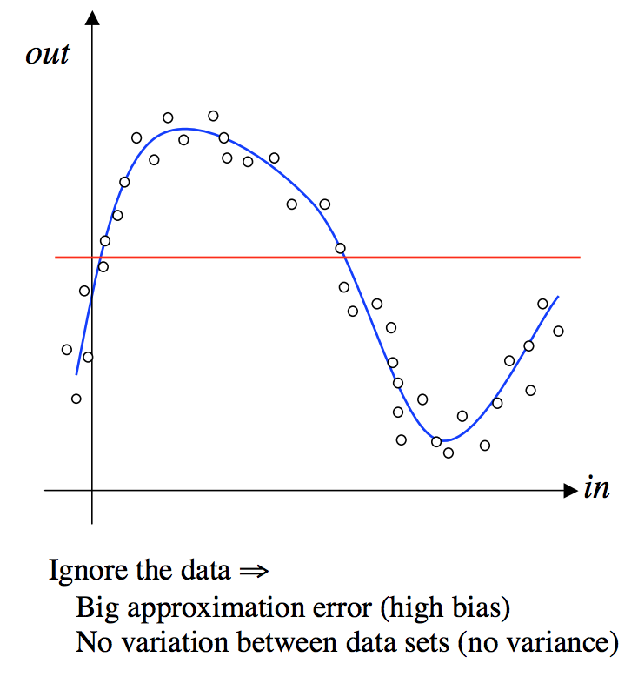
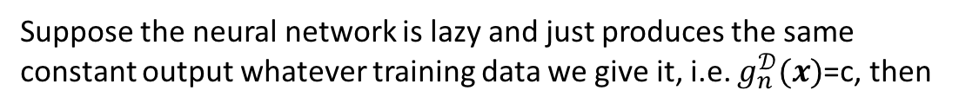




The Extreme Cases of Bias and Variance - Under-fitting
A good way to understand the concepts of bias and variance is by considering the two extreme cases of what a neural network might learn.
In this case the variance term will be zero, but the bias will be large, because the network has made no attempt to fit the data. We say we have extreme under-fitting
Slide motivation: John A. Bullinaria

Slide 15
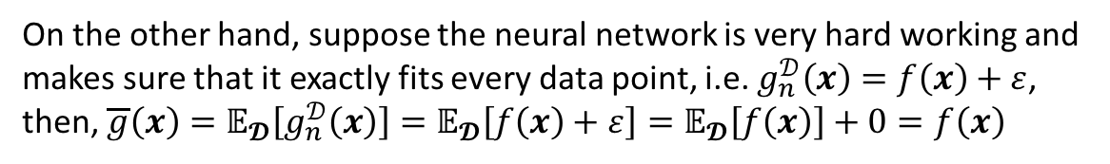
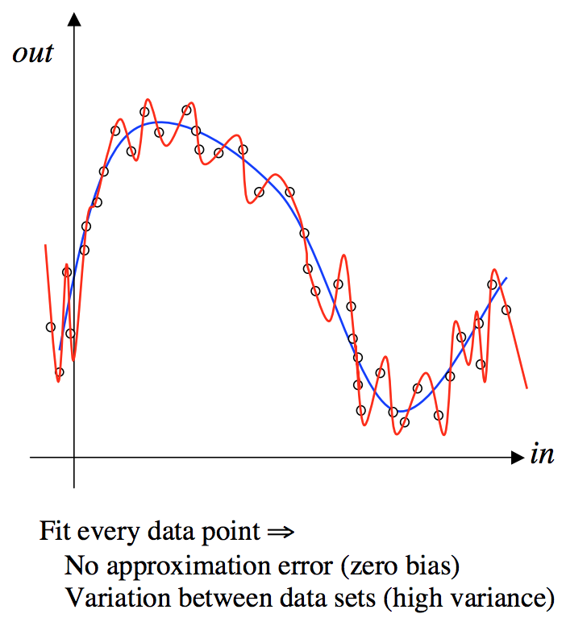





The Extreme Cases of Bias and Variance - Over-fitting
In this case the bias term will be zero, but the variance is the square of the noise on the data, which could be substantial. In this case we say we have extreme over-fitting.
Slide motivation: John A. Bullinaria

Slide 16
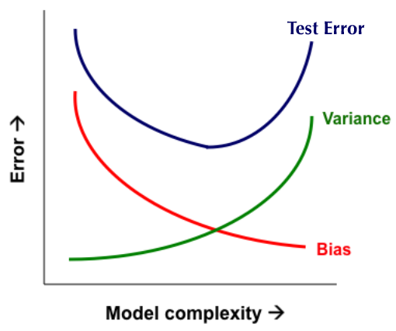
Bias-Variance Trade-off
Overfitting
Underfitting
Error
Test Error
Training Error
Number of Data Points, N

Slide 17
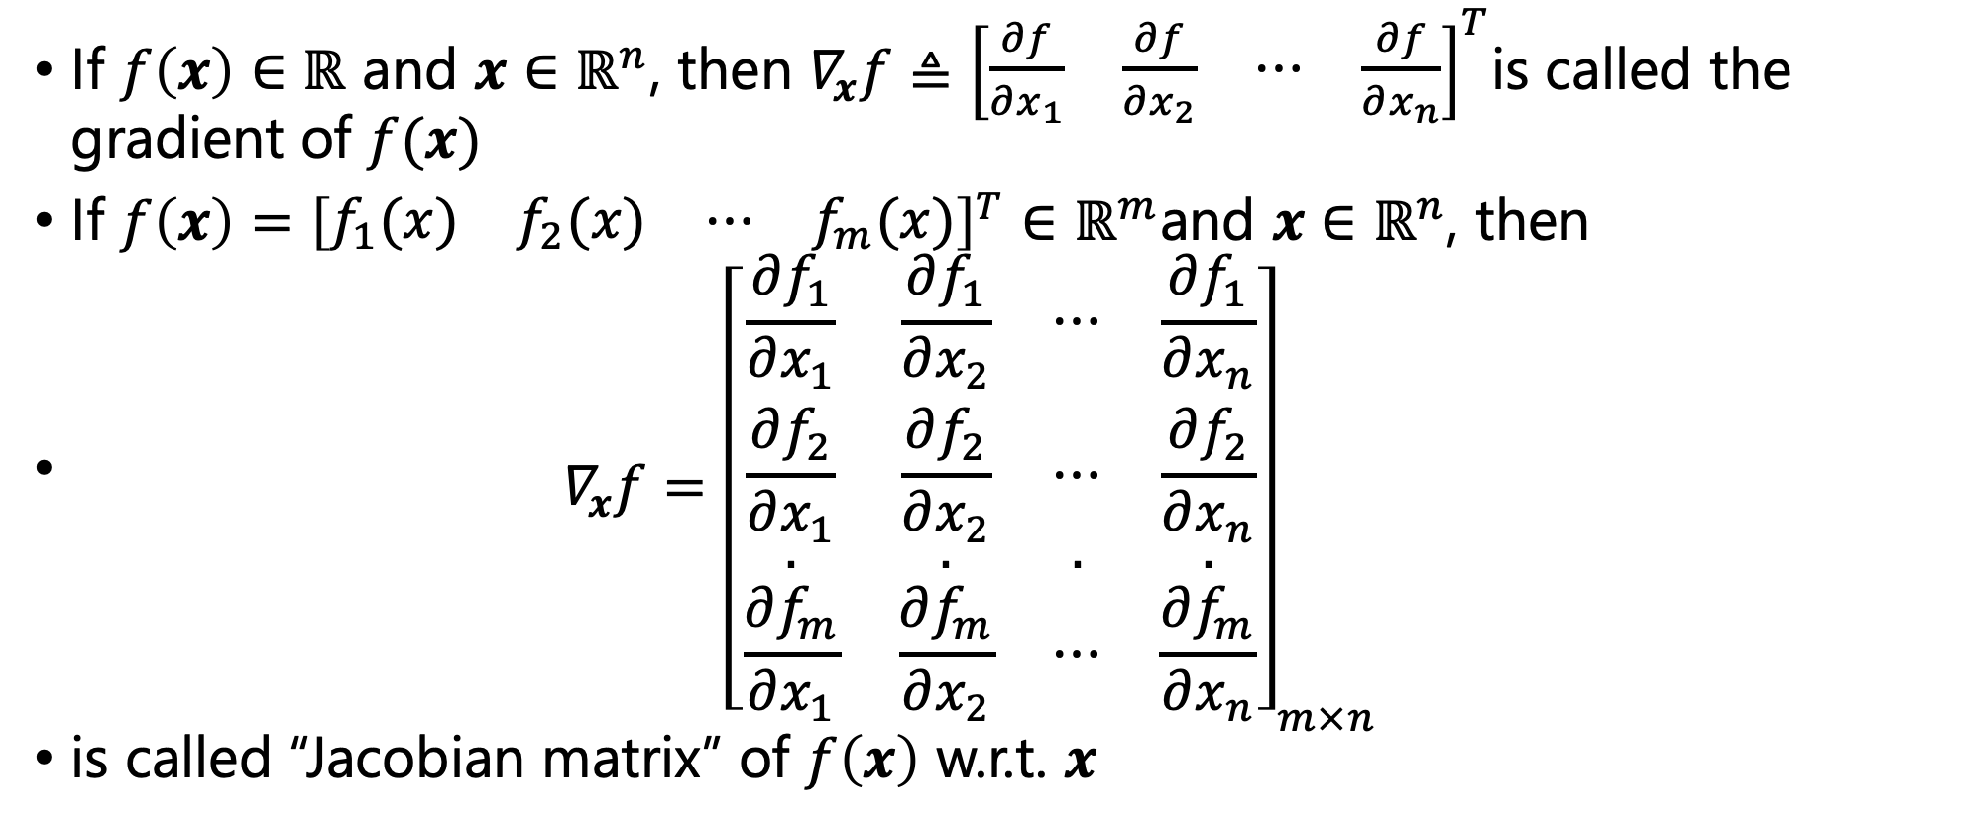
Vector/Matrix Calculus

Slide 18
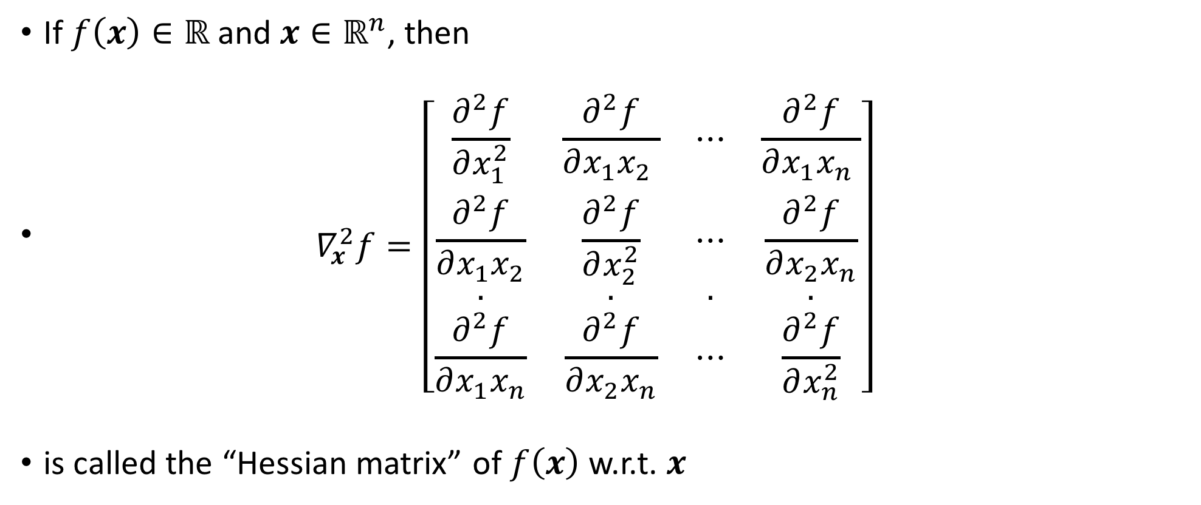
Vector/Matrix Calculus
is called the “Hessian matrix” of w.r.t.

Slide 19
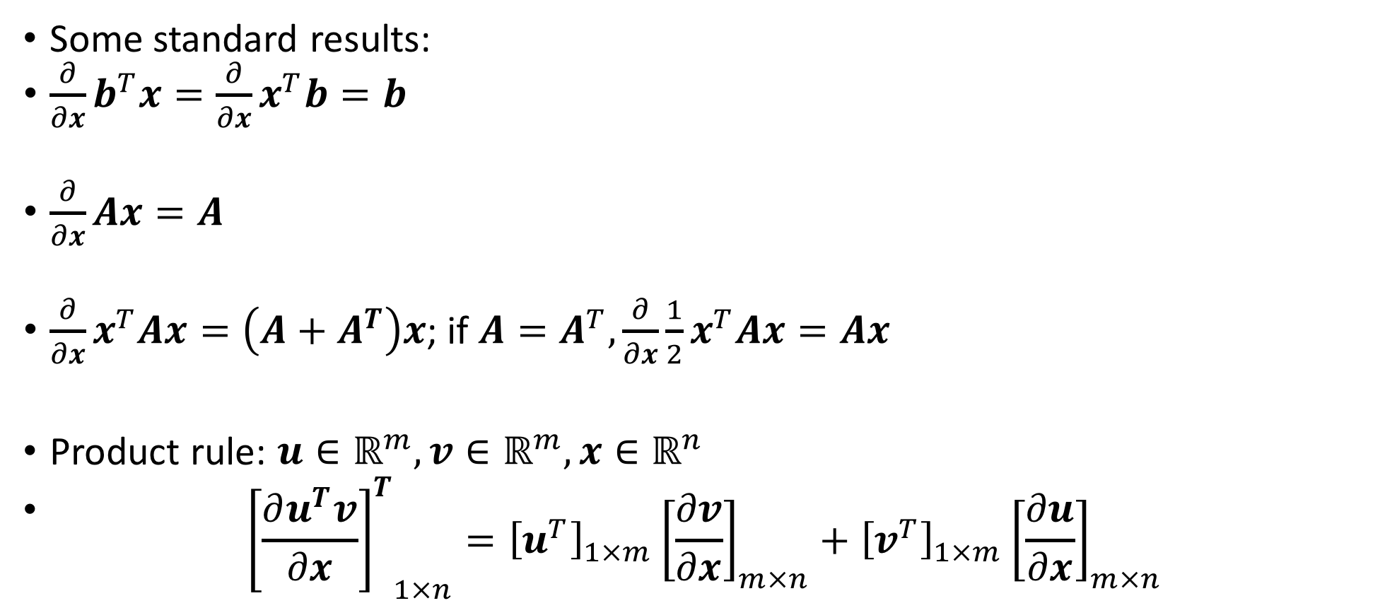
Vector/Matrix Calculus

Slide 20
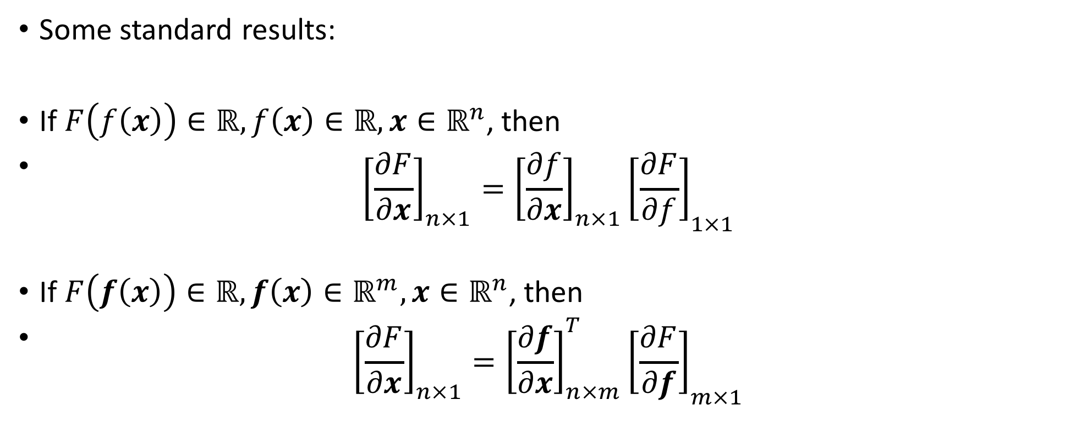
Vector/Matrix Calculus

Slide 21
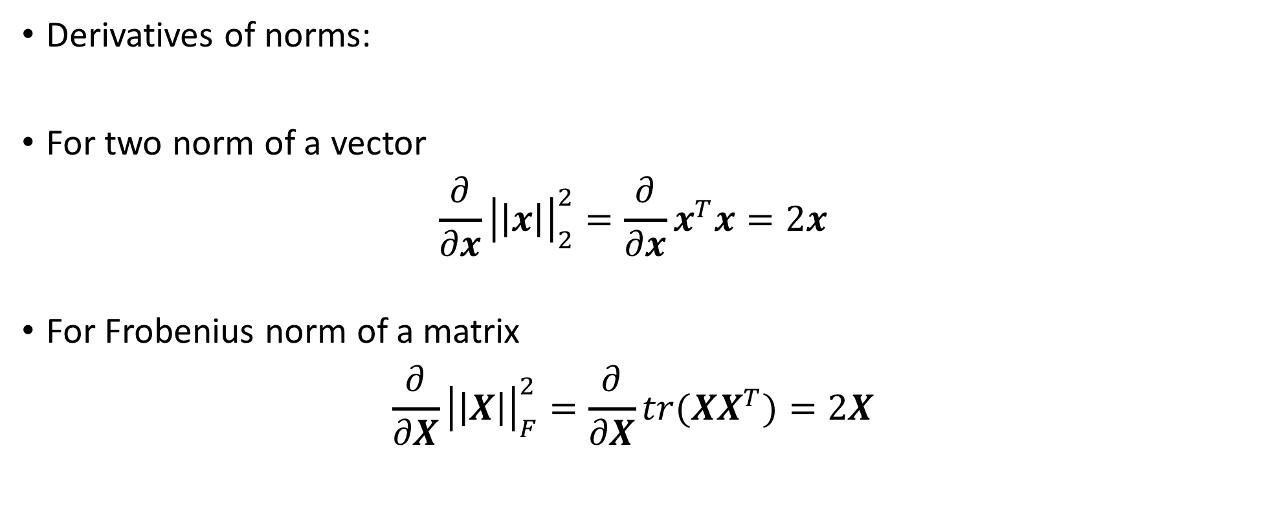
Vector/Matrix Calculus
Derivatives of norms:
For two norm of a vector
For Frobenius norm of a matrix

Slide 22
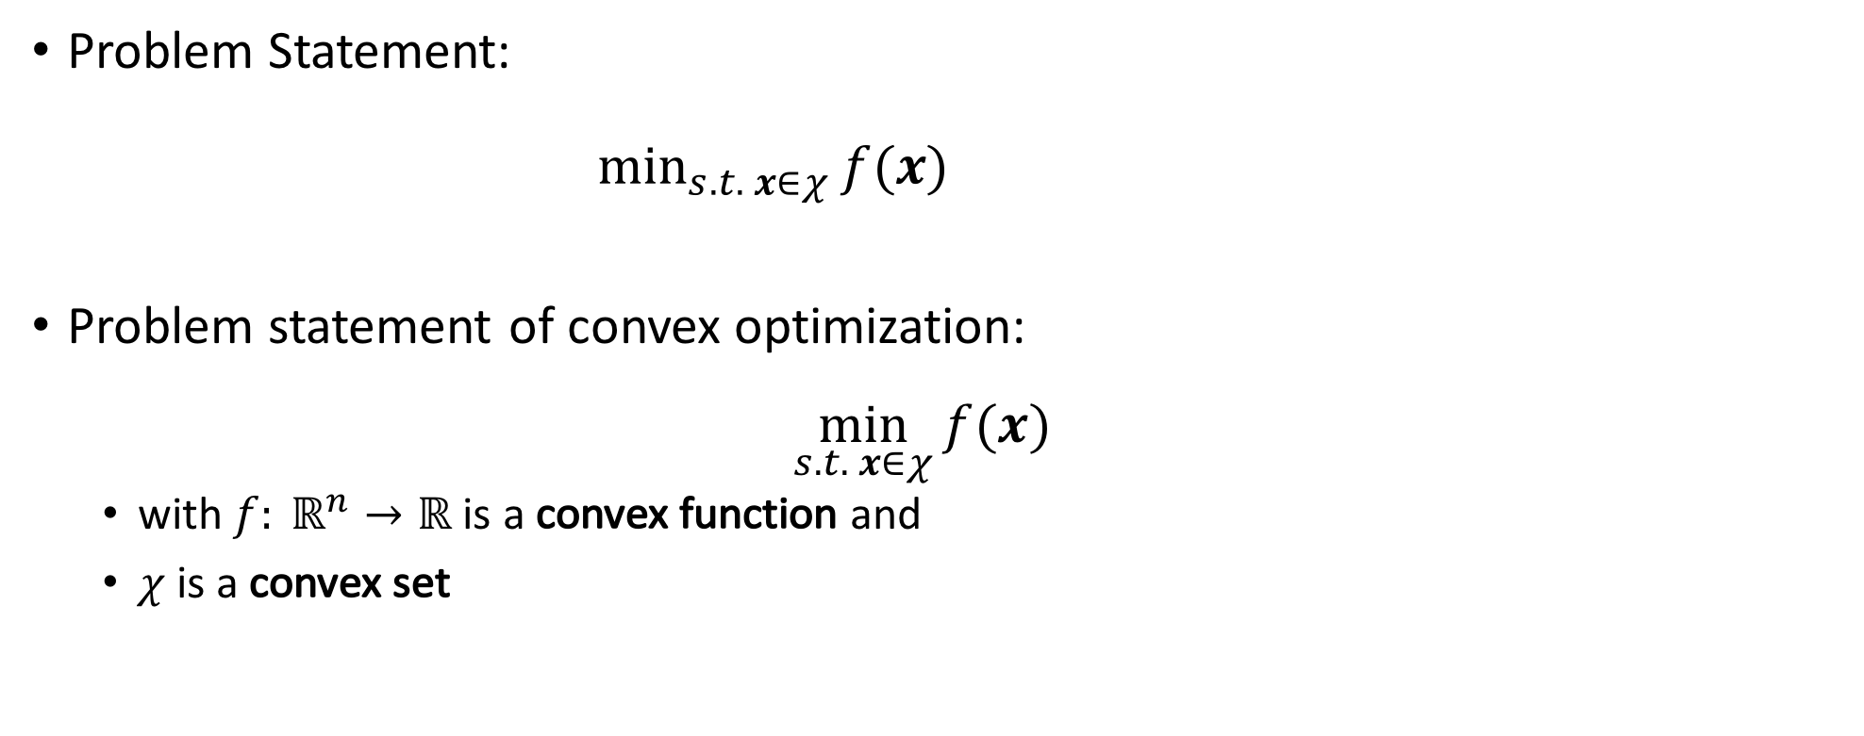
Optimization Problem
Problem Statement:
Problem statement of convex optimization:
  with is a convex function and
  is a convex set

Slide 23
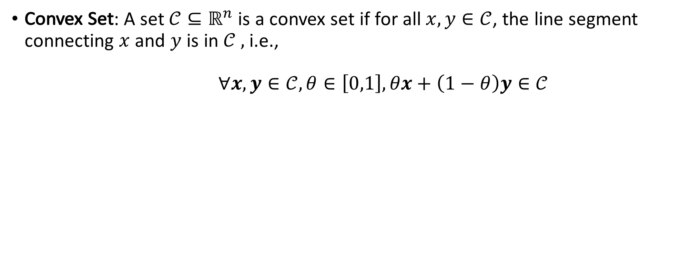




Convex Sets and Functions

Slide 24
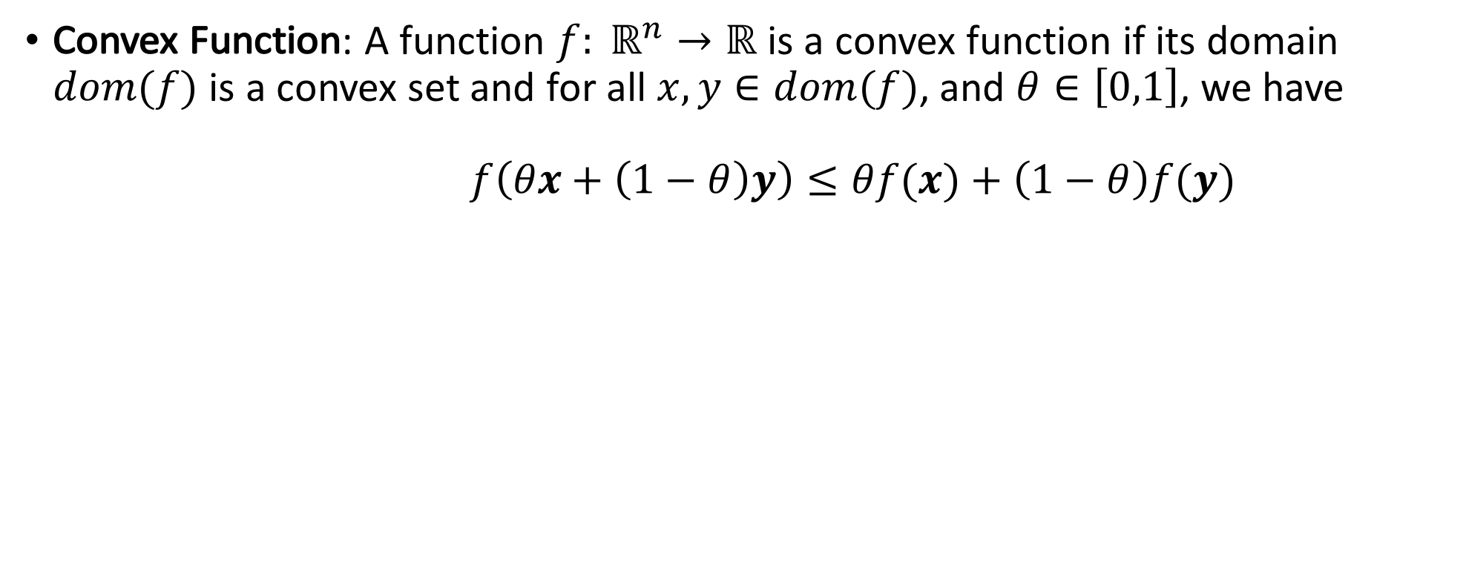

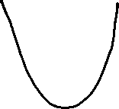









Convex Sets and Functions
All norms are convex functions

Slide 25
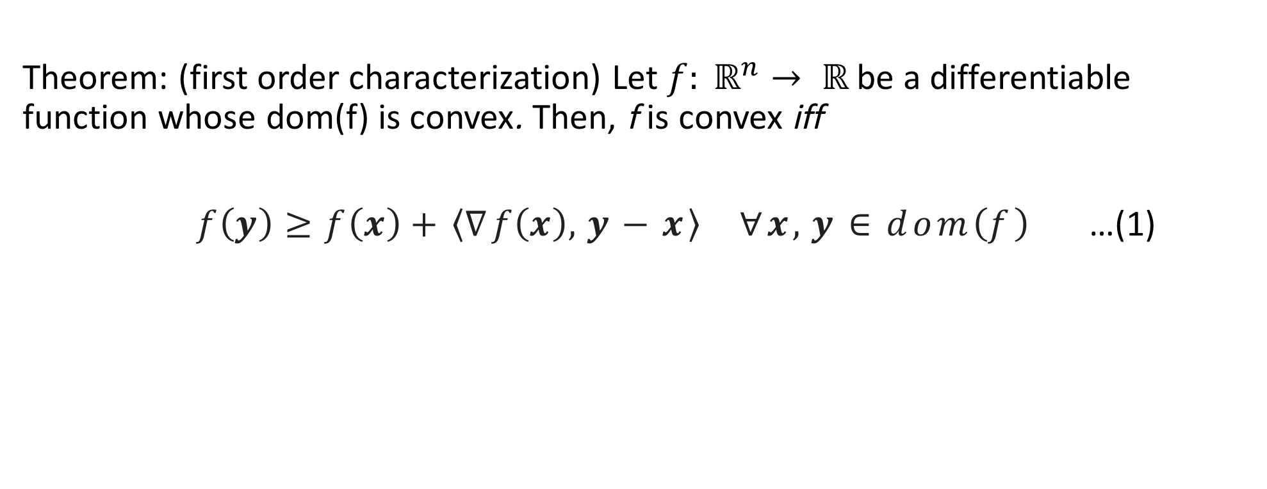
Alternative Definition of Convexity for differentiable functions

Slide 26
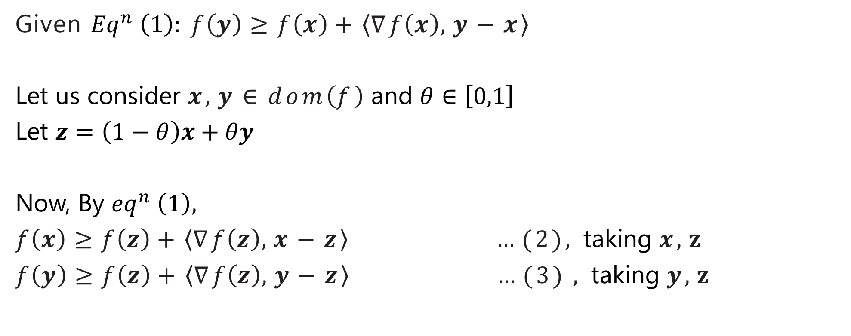
Proof (part 1):

Slide 27
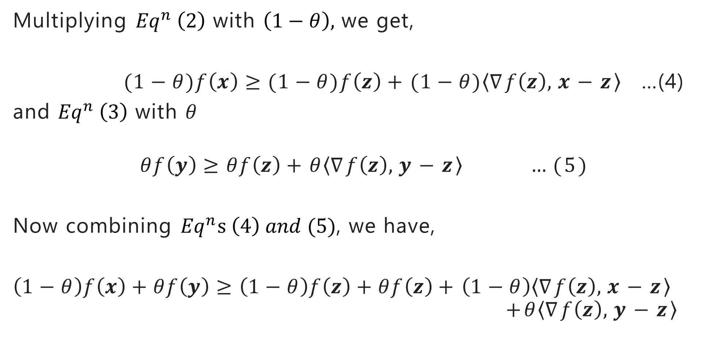
Multiplying with we get,
…(4)
and with
Now combining , we have,

Slide 28
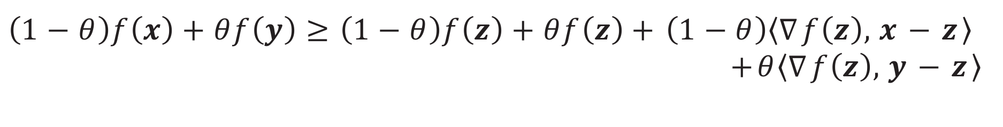
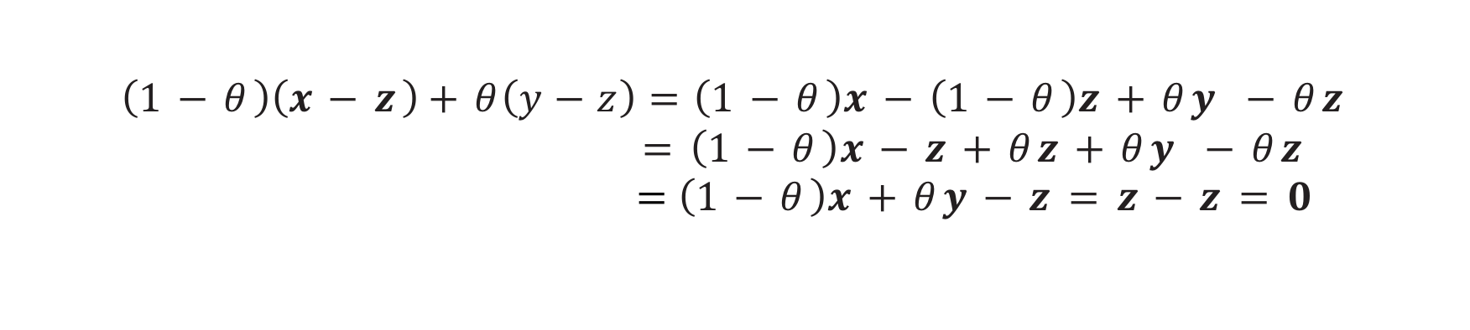

=0 (Why ?)

Slide 29

Proof (part 2):
Equivalently,

Slide 30

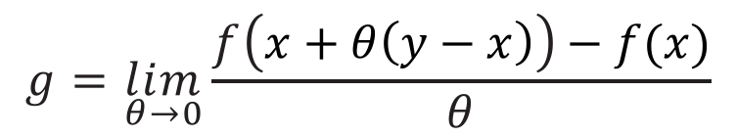

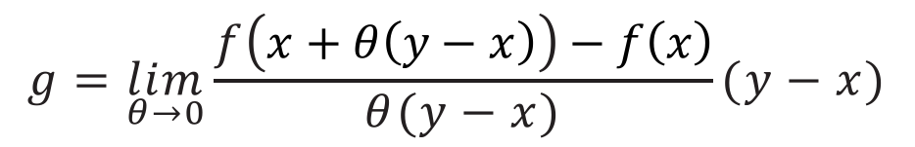
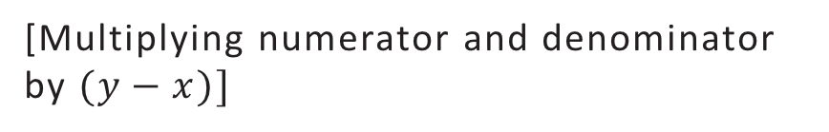
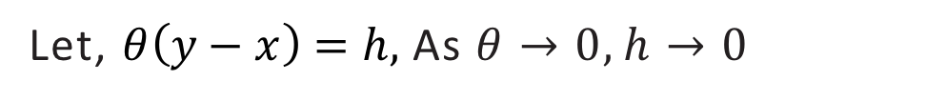
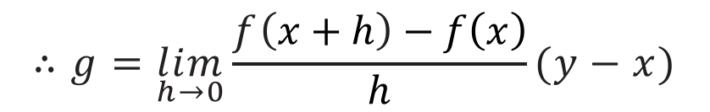

(How?)
By taking the limit as on both sides and using the definition of derivative, we obtain,
[Let us see in case of 1-D .]
[Multiplying numerator and denominator by
Let, As

Slide 31



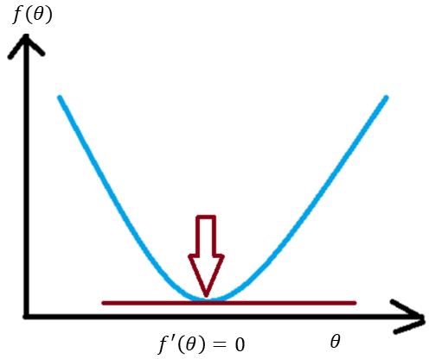

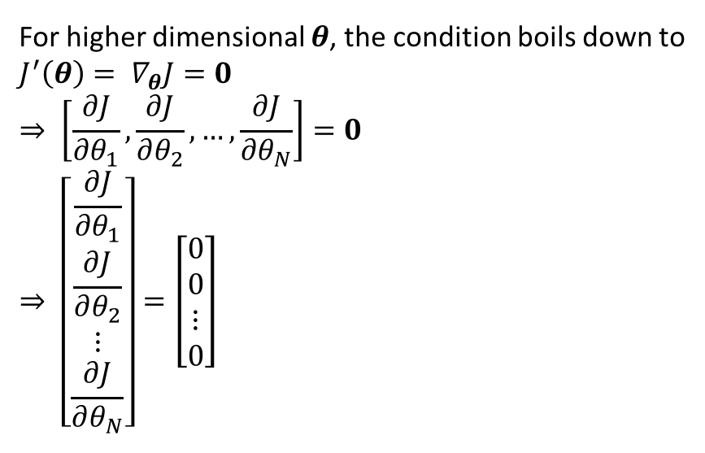


Gradient Descent
More formally,
For scalar , the condition is
For higher dimensional , the condition boils down to
Notes:
We are after those w and b which gives the minimum loss.

Slide 32
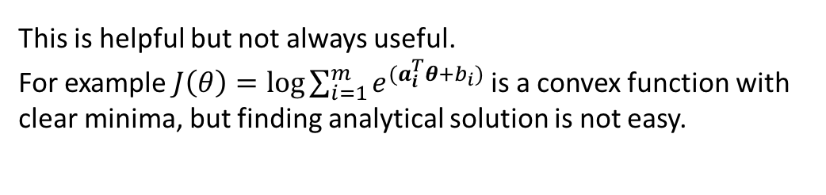
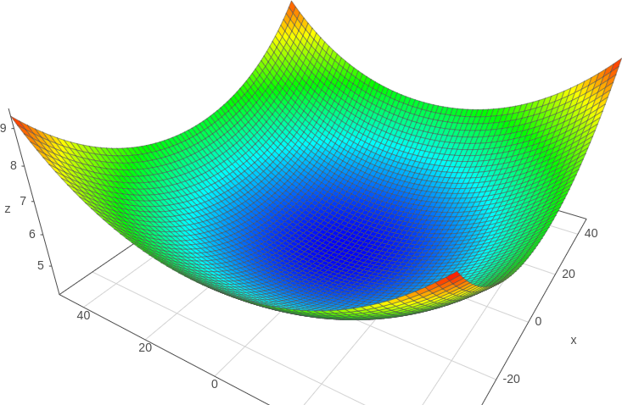
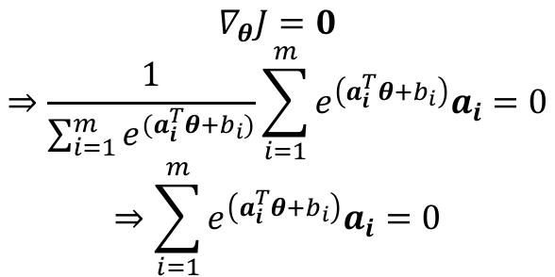
One Way to Find Minima – Gradient Descent
So, a numerical iterative solution is sought for.

Slide 33

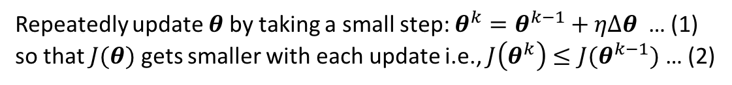
One Way to Find Minima – Gradient Descent
So, for to minimize to satisfy (2) we have to choose some that is negative when a dot product of it is done with the gradient .
Then why not choose, !!
Then, surely is a negative quantity and satisfies the condition.

Slide 34
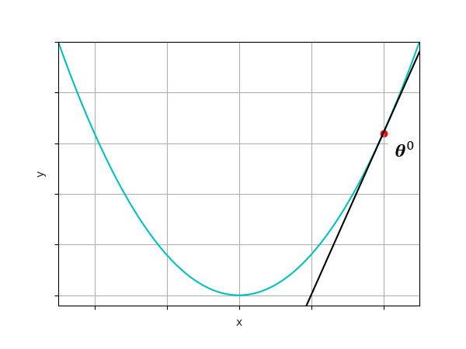
Gradient Descent
Start with an initial guess
Repeatedly update by taking a small step: until convergence ( is very small)

Slide 35
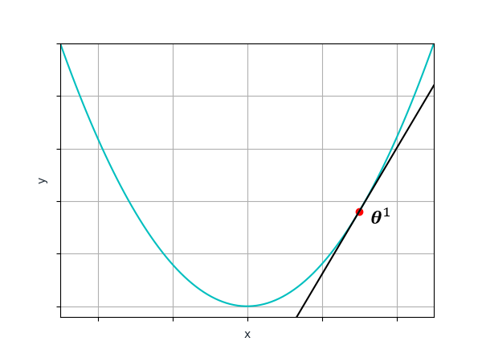
Gradient Descent
Start with an initial guess
Repeatedly update by taking a small step: until convergence ( is very small)

Slide 36
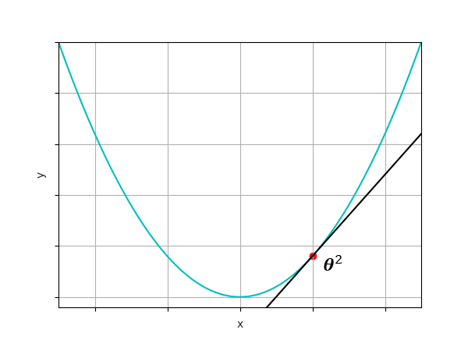
Gradient Descent
Start with an initial guess
Repeatedly update by taking a small step: until convergence ( is very small)

Slide 37
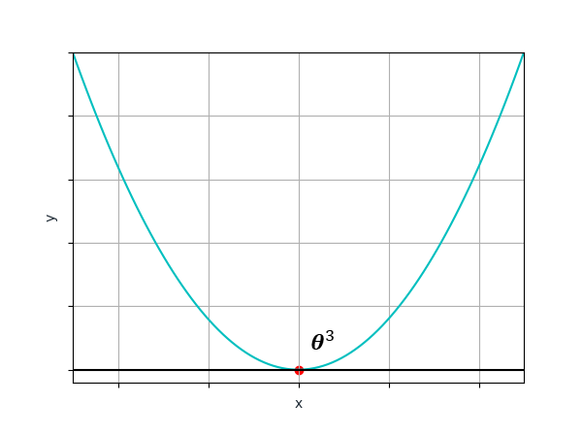
Gradient Descent
Start with an initial guess
Repeatedly update by taking a small step: until convergence ( is very small)
Remember, in Neural Networks, the loss is computed by averaging the losses for all examples

Slide 38
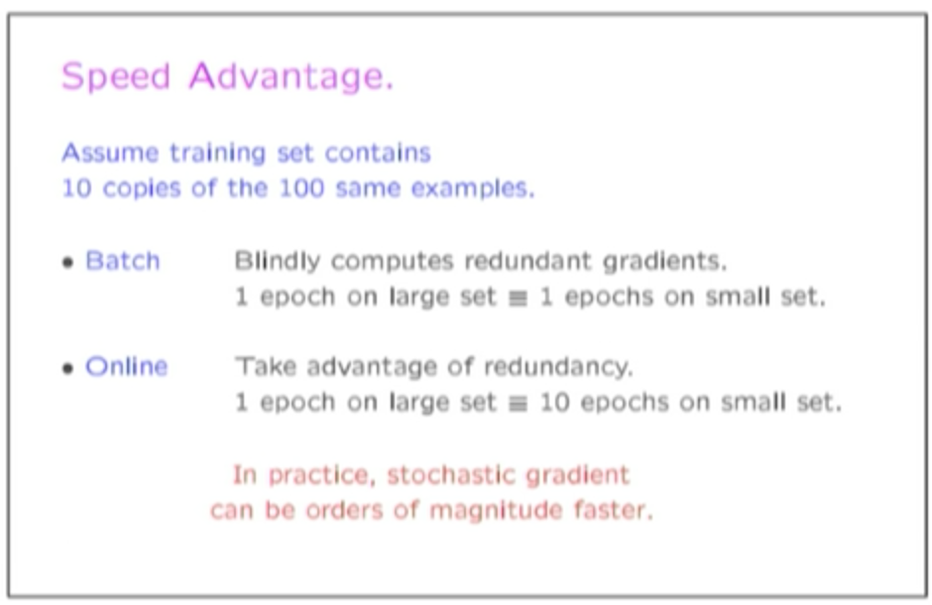
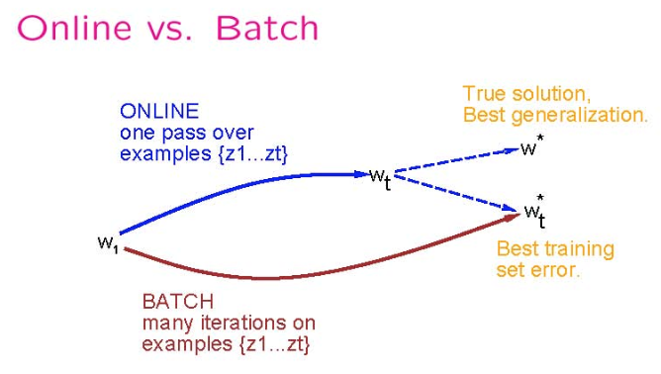
But Imagine This
Adapted from Olivier Bousquet’s invited talk at NeurIPS 2018 after winning Test of Time Award for NIPS 2007 paper: “The Trade-Offs of Large Scale Learning” by Leon Bottou and Olivier Bousquet. Link of the talk.

Slide 39
Batch, Stochastic and Minibatch
Optimization algorithms that use the entire training set to compute the gradient are called batch or deterministic gradient methods. Ones that use a single training example for that task are called stochastic or online gradient methods
Most of the algorithms we use for deep learning fall somewhere in between!
These are called minibatch or minibatch stochastic methods

Slide 40
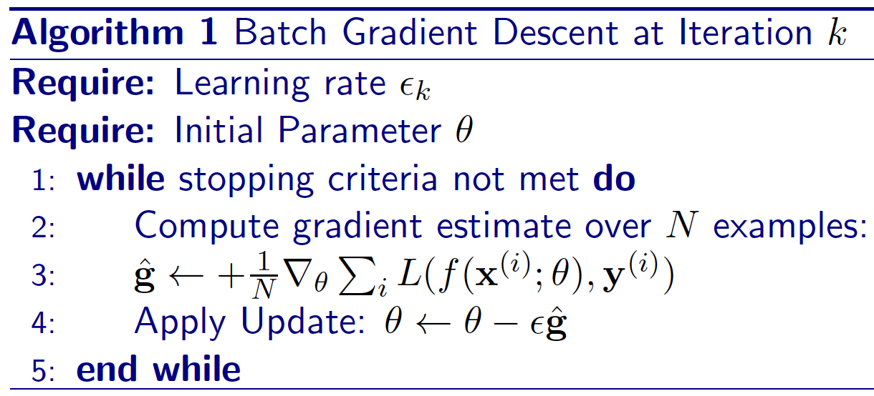
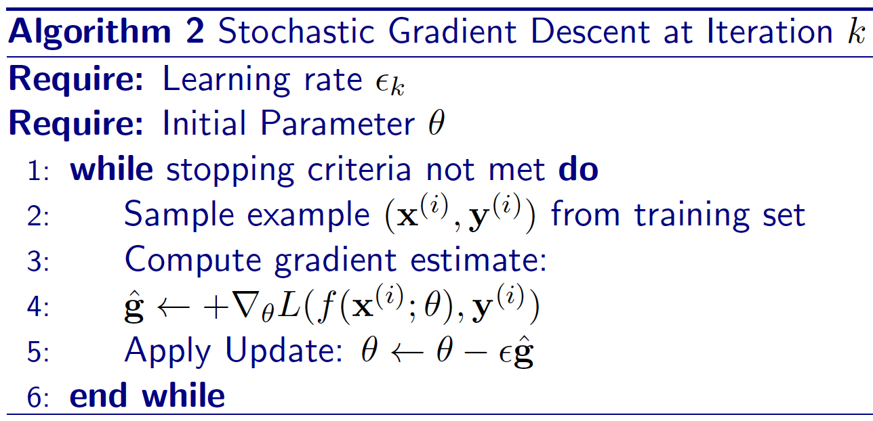
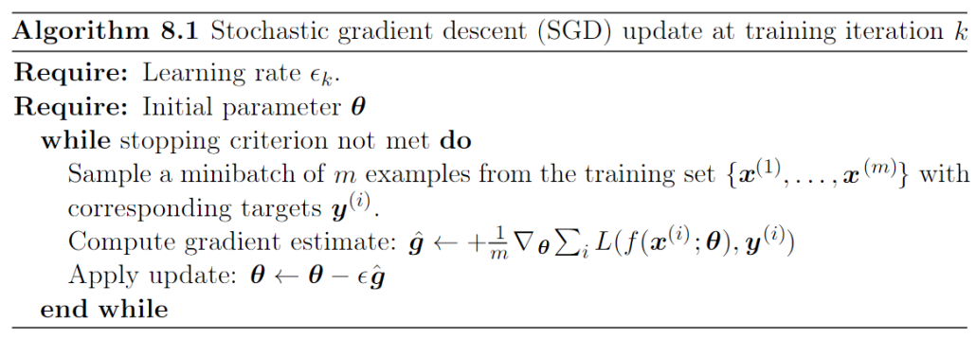
Batch, Stochastic and Mini-batch Stochastic Gradient Descent
Mini-batch
Images courtesy: Shubhendu Trivedi et. Al, Goodfellow et. al..

Slide 41
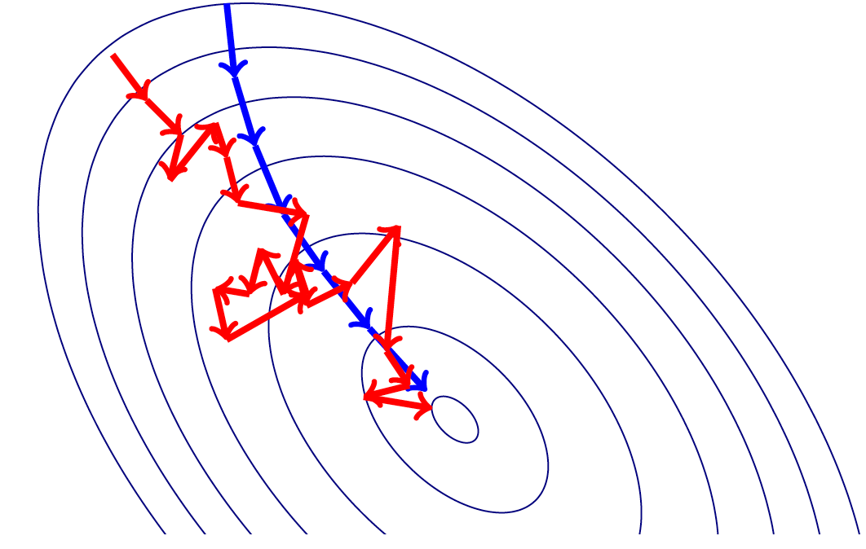
Batch and Stochastic Gradient Descent
Images courtesy: Shubhendu Trivedi et. al.

Slide 42
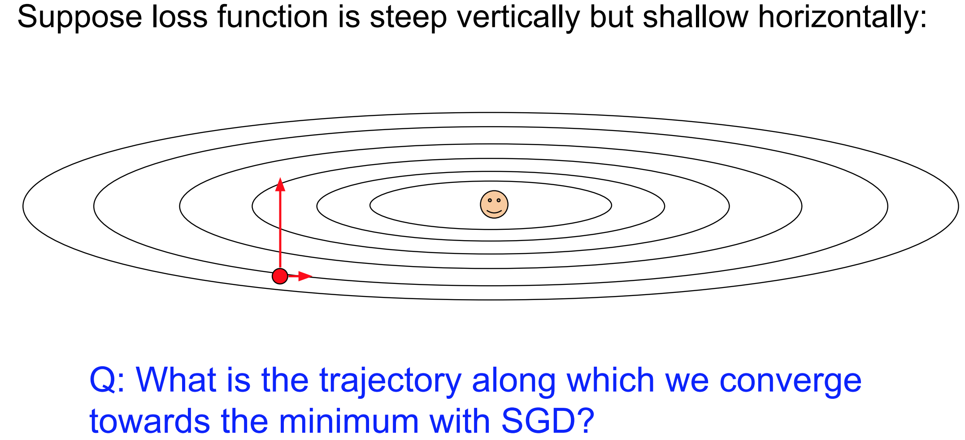
Images courtesy: Karpathy et. al.

Slide 43

Images courtesy: Karpathy et. al.

Slide 44


Slide 45
Gradient Descent: only one force acting at any point.

Slide 46

i)
Momentum at the point
Actual step
ii)
Negative of gradient at the point. (Would have reached here w/o momentum)
Momentum: Two forces acting at any point.
i) Momentum built up due to gradients pushing the particle at that point
ii) Gradient computed at that point

Slide 47



Stochastic Gradient Descent with Momentum
Momentum at the point
Actual step
Negative of gradient at the point. (Would have reached here w/o momentum)
Images courtesy: Goodfellow et. al.

Slide 48

Nesterov Momentum
The difference between Nesterov momentum and standard momentum is where the gradient is evaluated.
With Nesterov momentum the gradient is evaluated after the current velocity is applied.
In practice, Nesterov momentum speeds up the convergence only for well behaved loss functions (convex with consistent curvature)
Images courtesy: Goodfellow et. al.

Slide 49

Distill Pub Article on Why Momentum Really Works

Slide 50
Adaptive Learning Rate Methods
Till now we assign the same learning rate in all directions.
Would it not be a good idea if we can move slowly in a steeper direction whereas move fast in a shallower direction?
Images courtesy: Karpathy et. al.

Slide 51

AdaGrad
Downscale learning rate by square-root of sum of squares of all the historical gradient values
Parameters that have large partial derivative of the loss – learning rates for them are rapidly declined
Images courtesy: Shubhendu Trivedi et. al.

Slide 52

AdaGrad
, , …,
, , ….,

Slide 53

RMSProp
One problem of AdaGrad is that the ‘r’ vector continues to build up and grow its value.
This shrinks the learning rate too aggressively.
RMSProp strikes a balance by exponentially decaying contributions from past gradients.
Images courtesy: Shubhendu Trivedi et. al.

Slide 54

RMSProp
, , …,
RMSProp uses an exponentially decaying average to discard history from the extreme past so that the accumulation of gradients do not stall the learning.
AdaDelta is another variant where instead of exponentially decaying average, a moving window average of the past gradients is taken
Nesterov acceleration can also be applied to both these variants by computing the gradients at a ‘look ahead’ position (i.e., at a place where the momentum would have taken the parameters).

Slide 55
ADAM (Adaptive Moments)
Variant of the combination of RMSProp and Momentum.
Incorporates first order moment of the gradient which can be thought of as equivalent to taking advantage of the momentum strategy. Here momentum is also added with exponential averaging.
It also incorporates the second order term which can be thought of as the RMSProp like exponential averaging of the past gradients.
Both first and second moments are corrected for bias to account for their initialization to zero.

Slide 56

ADAM (Adaptive Moments)
Biased first order moment
Biased second order moment
Bias corrected first order moment
Bias corrected second order moment
Weight update (operations applied elementwise)

Slide 57

ADAM (Adaptive Moments)
Images courtesy: Shubhendu Trivedi et. al.

Slide 58

Visualization
Find more animations at
https://tinyurl.com/y6tkf4f8
animation courtesy: Alec Radford

Slide 59
Thank You!!

