Slide 1
Exception Handling
Prof. P. P. Das and Prof. I. Sengupta
October 29, 2020

Slide 2
What is an Exception?
It is an event, which occurs during the execution of a program, that disrupts the normal flow of the program’s instructions.
When an exception occurs, a block of code called “exception handler” is executed.
Exception is considered to be a type of “interrupt”.
Every processor has some mechanism for handling interrupts.
Interrupts can be of different types, depending on the cause of occurrence.

Slide 3
Types of Interrupts
Interrupts
From outside – I/O devices, timer
Internally generated
Hardware Interrupt
Software Interrupt
Maskable Interrupt
Non-Maskable Interrupt
System Calls
Exception

Slide 4
Central
Processing
Unit
Main
Memory
Timer
System Bus
I/O
device
I/O
device
I/O
device
I/O
device

Slide 5
What happens when an interrupt occurs?
The program (normally) finishes execution of the current instruction, following which the interrupt is acknowledged.
For some types of interrupt (e.g. page fault), the instruction needs to be re-executed or restarted.
The processor / software identifies the source of the interrupt, and branches to an “Interrupt Handler” or “Interrupt Service Subroutine (ISS)”.
The ISS saves the processor status, handles the interrupt, and returns control back to the interrupted program.
Complications: multiple interrupts, interrupt priority, etc.

Slide 6
CPU’s “fetch-execute” Cycle
User
Program
Fetch instruction at IP
ld
add
st
mul
ld
sub
bne
add
jmp
…
IP
Decode the fetched instruction
Save context
Get INTR ID
Execute the decoded instruction
Lookup ISS
Advance IP to next instruction
Execute ISS
Interrupt?
IRET
yes
no

Slide 7
#include <iostream>
using namespace std;
double division (int a, int b) {
if( b == 0 ) {
throw "Division by zero condition!";
}
return (a/b);
}
int main () {
int x = 50; int y = 0; double z = 0;
try {
z = division(x, y);
cout << z << endl;
} catch (const char* msg) {
cerr << msg << endl;
}
return 0;
}
Exception Handling in C++
Compiler generates code such that the exceptions can be detected during execution.
A set of standard exception types is defined in C++.

Slide 8
#include<stdio.h>
#include<signal.h>
// Handler for SIGINT, caused by
// Ctrl-C at keyboard
void handle_sigint(int sig)
{
printf ("Caught signal %d\n", sig);
}
int main()
{
signal(SIGINT, handle_sigint);
while (1) ;
return 0;
}
Signal Handling in C using Unix System Calls
UNIX defines a set of signal types, some of which are user-defined.
The user can override the signal handler if required.

Slide 9
Exception Handling in x86 Processors
Exception and Interrupt Vectors:
Each exception and interrupt condition is assigned a unique identification number, called a vector number.
The processor uses the vector number as an index into the Interrupt Descriptor Table (IDT), which contains the entry points of the interrupt handlers.
Vector numbers can range from 0 to 255.
0-31 are reserved by IA-32 and x86-64 architectures.
32-255 are designated as user-defined interrupts, and are generally assigned to external I/O devices.

Slide 10
Some Vector Numbers
Vector No. | Description
0 | Divide by zero
2 | Non-maskable interrupt
3 | Breakpoint
4 | Overflow
6 | Invalid opcode
7 | Device not available (math co-processor)
11 | Segment not present
12 | Stack segment fault
14 | Page fault
19 | SIMD floating-point exception

Slide 11
External Interrupt
External interrupts are received through pins on the processor or through a local Advanced Programmable Interrupt Controller (APIC).
The local APIC is connected to the primary interrupt pins LINT[1:0].
When the local APIC is disabled, the LINT[1:0} pins are configured as Interrupt Request (INTR) and Non-Maskable Interrupt (NMI).
In response to a signal on INTR, the processor reads from the system bus the interrupt vector number provided by an external interrupt controller.
The NMI interrupt always corresponds to vector number 2.

Slide 12
Maskable Hardware Interrupts:
Any external interrupt that is delivered to the processor through INTR or the local APIC is maskable.
The IF flag in the EFLAGS register permits all maskable hardware interrupts to be masked as a group.
Trap Flag (TF): When set, causes an interrupt after execution of each instruction.
Interrupt enable Flag (IF): When set, the processor will recognize interrupts.
I/O Privilege Flag (IOPL): When set, causes the processor to generate an exception on all accesses to I/O devices during protected-mode operation.

Slide 13
Software-Generated Interrupts:
The “INT n” instruction permits interrupts to be generated from within the program by supplying an interrupt vector number as operand.
“INT 3” invokes the ISS corresponding to breakpoint.
Any of the interrupt vector numbers (0-255) can be used as a parameter in this instruction.
Such software-generated interrupts cannot be masked by the IF flag in the EFLAGS register.

Slide 14
Sources of Exceptions
Program-Error Exceptions:
Generated when program errors are detected during execution.
Software-Generated Exceptions:
The “INT n” instruction permits exceptions to be generated in software.
Machine-Check Exceptions:
The x86 family of processors provide both internal and external machine-check mechanisms for checking the operation of the internal chip hardware and bus transactions.
When an error is detected, the processor signals a machine-check exception (vector 18) and returns an error code.

Slide 15
Interrupt Descriptor Table (IDT)
IDT associates each exception or interrupt vector with a Gate Descriptor for the respective ISS.
IDT is an array of 8-byte descriptors (similar to Local/Global Descriptor Tables --- LDT and GDT).
The base addresses of the IDT are aligned on an 8-byte boundary; the limit value is expressed in bytes and is added to the base address to get the address of the last valid byte.
The IDT may reside anywhere in the linear address space.
Processor locates the IDT using the IDTR register.
The “LIDT” instruction is used to initialize the IDTR register.

Slide 16
Accessing IDT Entry

Slide 18
Exception Fundamentals

Slide 19
What are Exceptions?
Conditions that arise
Infrequently and unexpectedly
Require a considered programmatic response
Runtime anomalies
Yes, but not necessarily

Slide 20
My program was correct, well tested, but for …
Unexpected System State
Exhaustion of resources
Low free memory space
Low disk space
Pushing to a full stack
External Events
^C
Socket event

Slide 21
I managed to crash the system …
Logical Errors
Pop from an empty stack
Invalid memory read/write
Runtime Errors
Arithmetic overflow
Out of range
Undefined Operation
Division by zero

Slide 22
Do we need Exception Handling?
Exception Handling:
It is a mechanism that separates the detection and handling of circumstantial Exception Flow from Normal Flow.
Current state saved in a pre-defined location
Execution switched to a pre-defined handler

Slide 23
Types of Exceptions
Asynchronous
Exceptions that come unexpectedly (e.g. interrupt in a program).
Takes control away from the executing thread context to a context that is different from that which caused the exception.
Synchronous
Planned exceptions.
Handled in an organized manner.
The most common type implemented as a “throw”.

Slide 24
Stages of Exception Handling
Error Incidence
Synchronous (software) logical error.
Asynchronous (hardware) interrupt.
Create Object & Raise Exception
An exception object can be any Complete Type.
An “int” to a full-blown C++ class object.
Detect Exception
Polling (using software tests)
Notification :: control (stack) adjustments

Slide 25
Stages of Exception Handling (contd.)
Handle Exception
Ignore :: hope someone else catches it.
Act :: but allow others to handle it later (i.e. Catch, Handle and Re-Throw).
Own :: take complete ownership, i.e. Catch and Handle.
Recover from Exception
Continue Execution :: if handled inside the program.
Resuming execution from where it was generated.
Terminate exception from where the exception was handled.
Abort Execution :: if handled outside the program.

Slide 26
int f() {
int error;
/* ... */
if (error) /* Stage 1: error occurred */
return -1; /* Stage 2: generate exception object */
/* ... */
}
int main(void) {
if (f() != 0) /* Stage 3: detect exception */
{
/* Stage 4: handle exception */
}
/* Stage 5: recover from exception */
}

Slide 27
Exceptions in C

Slide 28
Support for Exceptions in C
Language Feature:
Return Value & Parameters
Local goto
Standard Library Support:
Global variables
Abnormal termination
Conditional termination
Non-local goto
Signals

Slide 29
(a) Return Value & Parameters
Function return value mechanism
Created by Callee as temporary objects.
Passed onto the Caller.
Caller checks for error conditions.
Return values can be ignored and lost.
Return values are temporary.
Function (output) parameter mechanism
Outbound parameters, bound to arguments, offer multiple logical return values.

Slide 30
int Push(int i) {
if (top_ == size-1) // Incidence
return 0; // Raise
else
stack_[++top_] = i;
return 1;
}
int main() {
int x;
// ...
if (!Push(x)) // Detect
{
// Handling
}
// Recovery
}

Slide 31
(b) Local goto
Local goto mechanism:
[At Source] Escapes: gets control out of a deep nested loop.
[At Destination] Refactors: actions from multiple points of error inceptions.
A group of C features:
goto Label;
break; & continue;
default switch case

Slide 32
_PHNDLR __cdecl signal(int signum, _PHNDLR sigact)
{ // Lifted from VC98\CRT\SRC\WINSIG.C
... /* Check for sigact support */
if ( (sigact == ...) ) goto sigreterror;
/* Not exceptions in the host OS. */
if ( (signum == ... ) { ... goto sigreterror; }
else { ... goto sigretok; }
/* Exceptions in the host OS. */
if ( (signum ...) ) goto sigreterror;
...
sigretok:
return(oldsigact);
sigreterror:
errno = EINVAL;
return(SIG_ERR);
}

Slide 33
(c) Global Variables
GV mechanism:
Use a designated global error variable.
Set it on error.
Poll / check it for detection.
Standard library GV mechanism:
<errno.h>
Windows GV mechanism:
<winbase.h> / <windows.h>

Slide 34
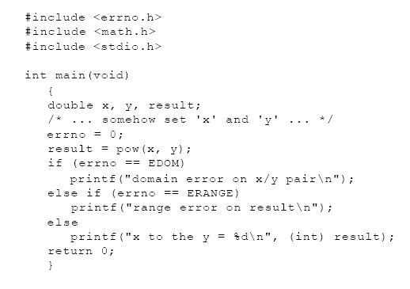

Slide 35
(d) Abnormal Termination
Abnormal termination mechanism:
Program halting functions provided by <stdlib.h>
abort()
exit()
atexit()

Slide 36
(e) Conditional Termination
Conditional termination mechanism:
Diagnostic ASSERT macro defined in <assert.h> .
Assertions valid when NDEBUG macro is not defined.
Assert calls internal function, reports the source file details and then terminates.

Slide 37
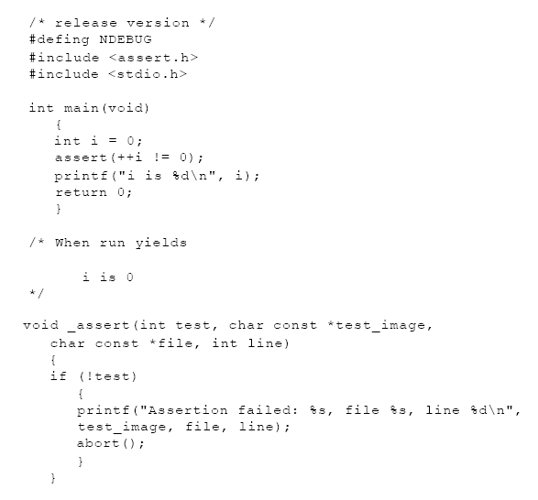

Slide 38
(f) Non-local goto
Non-local goto mechanism:
setjmp() and longjmp() functions provided in <setjmp.h> header along with collateral type jmp_buf .
setjmp(jmp_buf)
Sets the jump point filling up the jmp_buf object with the current program context.
longjmp(jmp_buf,int)
Effects a jump to the context of the jmp_buf object.
Control returns to setjmp call last called on jmp_buf .

Slide 39
void f() {
A a;
if (setjmp(jbuf) == 0)
{
B b;
g();
h();
}
else {
cout <<
ex.what();
}
return;
}
jmp_buf jbuf;
void g()
{
A a;
UsrExcp ex(“From g()”);
longjmp(jbuf, 1);
return;
}

Slide 40
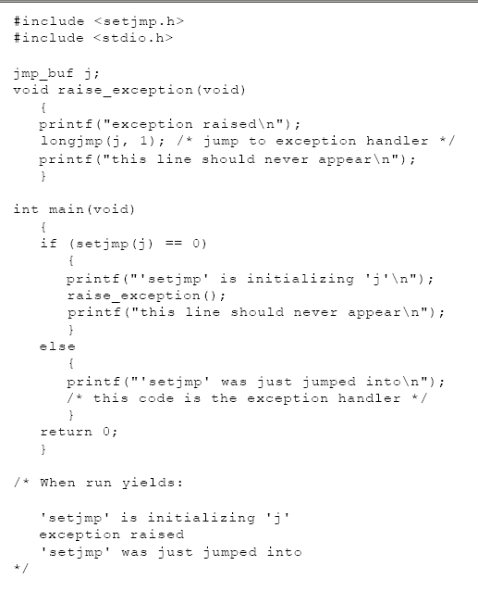

Slide 41
(g) Signals
Signal mechanism:
Include header <signal.h>
raise()
Sends a signal to the executing program.
signal()
Registers interrupt signal handler.
It returns the previous handler associated with the given signal.

Slide 42
// Use signal to attach a signal
// handler to the abort routine
#include <stdio.h>
#include <stdlib.h>
#include <signal.h>
#include <tchar.h>
void SignalHandler(int signal) {
printf("Application aborting...\n");
}
int main() {
typedef void (*SignalHandlerPointer)(int);
SignalHandlerPointer previousHandler;
previousHandler = signal(SIGABRT, SignalHandler);
abort();
}

Slide 43
Exceptions in C++

Slide 44
try – catch – throw
void f() {
A a;
try {
B b;
g();
h();
}
catch (UsrExcp& ex) {
cout <<
ex.what();
}
return;
}
class UsrExcp:
public exceptions {}
void g()
{
A a;
UsrExcp ex(“From g()”);
throw ex;
return;
}

Slide 45
try Block: Exception Scope
try block
Consolidate areas that might throw exceptions.
Function try block
Area for detection is the entire function body.
Nested try block
Semantically equivalent to nested function calls.
void f()
try {
throw E();
} catch (E& e) {
}
try {
try { throw E(); }
catch (E& e) { }
} catch (E& e1) {
}

Slide 46
catch Block: Exception Arguments
catch block
Name for the exception handler.
Catching an exception is like invoking a function.
Immediately follows the try block.
Unique formal parameter for each handler.
Can be simply a type name to distinguish its handler from others.

Slide 47
try-catch : Exception Matching
Exact Match:
The catch argument type matches the type of the thrown object.
No implicit conversion is allowed.
Generalization / Specialization:
The catch argument is a public base class of the thrown class object.
Pointer:
Pointer types – convertible by standard conversion.

Slide 48
try-catch : Order of Match
In the order of appearance with matching.
If Base Class catch block precedes Derived Class catch block:
Compiler issues a warning and continues.
Unreachable code (derived class handler) ignored.
catch(...) block must be the last catch block because it catches all exceptions.
If no matching handler is found in the current scope, the search continues to find a matching handler in a dynamically surrounding try block.
If eventually no handler is found, terminate() is called.

Slide 49
throw Expression: Semantics
Expression is treated the same way as:
A function argument in a call or the operand of a return statement.
Exception Context
class Exception {};
The Expression
Generate an Exception object to throw
throw Exception();
Or, Copies an existing Exception object to throw
Exception ex;
…
throw ex; // Exception(ex);
Exception object is created on the Free Store.

Slide 50
throw Expression: Restrictions
For a UDT Expression:
Copy Constructor and Destructor should be supported.
The type of Expression cannot be
An incomplete type (like void, array of unknown size or of elements of incomplete type, Declared but not Defined Structure/Union/Enumerations/Classes Objects or Pointers to such Objects).
OR
A pointer to an Incomplete type, except void*, const void*, volatile void*, const volatile void*

Slide 51
(re) throw: Throwing Again?
Re-throw:
catch may pass on the exception after handling.
Re-throw is not same as throwing again!
// Throws again
try { ... }
catch (Exception& ex) {
// Handle and
...
// Raise again
throw ex;
// ex copied
// ex destructed
}
// Re-throw
try { ... }
catch (Exception& ex) {
// Handle and
...
// Pass-on
throw;
// No copy
// No Destruction
}

Slide 52
Exceptions in C++: Advantages
Destructor-savvy:
Stack unwinds; Orderly destruction of Local-objects.
Unobtrusive:
Exception Handling is implicit and automatic.
No clutter of error checks.
Precise:
Exception Object Type designed using semantics.
Native and Standard:
EH is part of the C++ language.
EH is available in all standard C++ compilers.

Slide 53
Scalable:
Each function can have multiple try blocks.
Each try block can have a single handler or a group of handlers.
Each Handler can catch a single type, a group of types, or all types.
Fault –tolerant:
Functions can specify the exception types to throw; Handlers can specify the exception types to catch.
Violation behavior of these specifications is predictable and user-configurable.

Slide 54
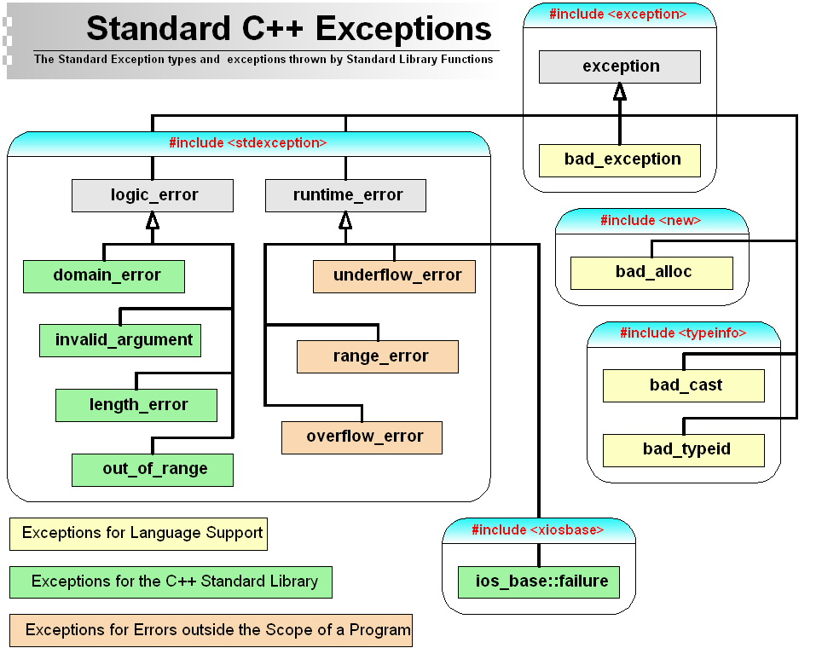

Slide 55
(a) Exceptions for Language Support
Operators & Mechanisms
operator new
bad_alloc: on allocation failure
operator dynamic_cast
bad_cast: on failure to resolve a reference
operator typeid
bad_typeid: on NULL pointer
unexpected() functions
bad_exception: on mismatched specification

Slide 56
(b) Exceptions for Standard Library
logic_errors
Internal program bugs
Theoretically preventable
Exceptions are:
invalid_argument
length_error
out_of_range
domain_error

Slide 57
(c) Exceptions for Errors outside the Program Scope
runtime_errors
External to program’s control
Difficult to predict
Exceptions are:
range_error
overflow_error
underflow_error

Slide 58
Thank you

