Slide 1
INVENTORY
ANALYTICS

Slide 2

Project Name : Manufacturing Analytics Mentor : SURAJ KUMAR
Group No- 2 Project Members :
Mr. Ratnakar Mr. Harish Pottabhathini
Ms. Keerthi Lavidya
Mr. Abhishek Gowda R
Ms. Priya

Slide 3






AGENDA
z
Introduction & Problem
Statement
Business Objective
KPIS
DASHBOARD
Conclusion

Slide 4
INTRODUCTION:
Inventory analytics involves the collection and analysis of inventory-related data, including product data, performance metrics, stocks data, product sales, state wise sales and other relevant data points. By using advanced analytical tools and techniques, analytics provides valuable insights into inventory processes and trends, enabling organizations to make more informed decisions about their products and improve overall performance.
Problem Statement:
Total Sales(MTD,QTD,YTD)
Product Wise Sales
Sales Growth
Monthly Sales Trend
State Wise Sales
Top 5 Store Wise Sales
Region Wise Sales
Total Inventory
Inventory Value
Over stock, Out Stock , Under stock

Slide 5
Business Objective:
:
An inventory analytics project typically aims to improve the management and optimization of a company's inventory by leveraging data analysis and insights. The specific objectives of such a project may vary based on the organization's needs and industry, but here are some common objectives for an inventory analytics project:
Optimize Stock Levels
Cost Reduction
Inventory Turnover Improvement
Data Visibility and Integration
Risk Management
Performance Metrics

Slide 6
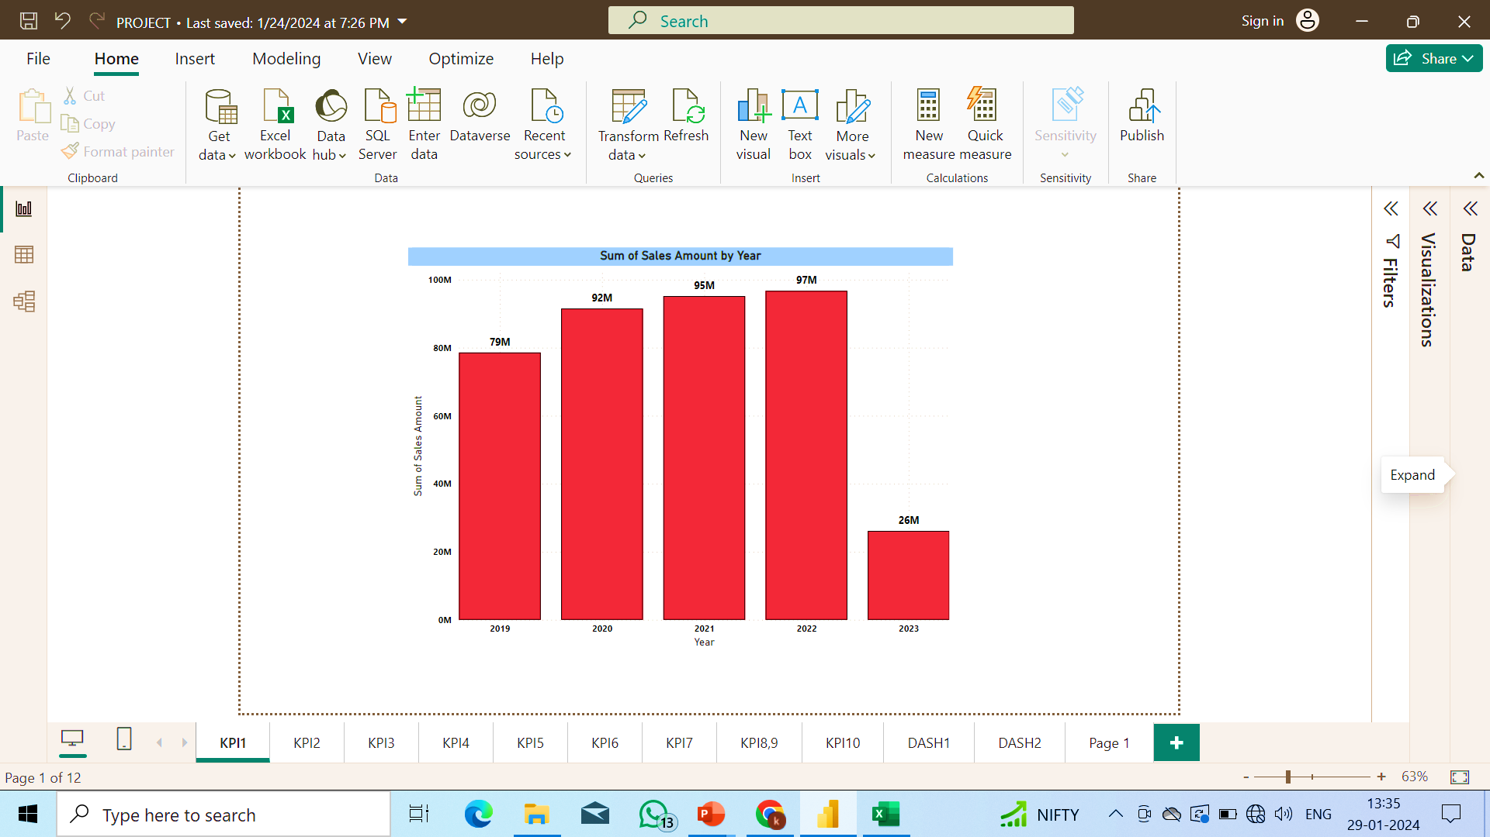
Insights of KPI 1:
From this analysis we can see that the Sales Amount by year.
Total Sales Amount: The cumulative Sales Amount over the analyzed period is substantial, amounting to $338.13 million. This aggregate figure gives an overall understanding of the revenue generated during the specified timeframe.
Yearly Breakdown: The analysis presents a breakdown of Sales Amount by year, allowing for a detailed examination of performance over individual years. Each year contributes to the overall sales figure, and understanding the year-wise distribution helps in identifying trends, patterns, and potential areas for improvement or expansion.
Peak Performance in 2022: The data highlights a notable peak in sales in the year 2022, with a record-high Sales Amount of $97 million. This specific insight is crucial for understanding the factors contributing to the exceptional performance in that particular year. Identifying the drivers behind this peak can offer valuable insights for strategic planning and decision-making.
In summary, the analysis not only provides an overview of the total sales but also delves into the performance on a yearly basis, emphasizing the exceptional sales achievement in 2022. This information is instrumental for stakeholders and decision-makers in evaluating the overall business performance, identifying successful strategies, and making informed decisions for future planning and growth

Slide 7
Insights of KPI2:
From this analysis we can see that the Product wise Sales.
Arts & Entertainment - Highest Product Sale (90.76M):
This category stands out as the top performer in terms of product sales, generating a substantial revenue of $90.76 million. Understanding the factors contributing to the success of Arts & Entertainment products can be crucial for replicating strategies or leveraging the popularity of this category for future growth.
Mobiles - Lowest Product Sale (54.06M):
Mobiles emerge as the category with the lowest product sales, amounting to $54.06 million. This insight indicates potential challenges or areas where improvements may be needed. It could prompt a closer examination of market trends, consumer preferences, or competitive factors affecting the performance of mobile products.

Slide 8
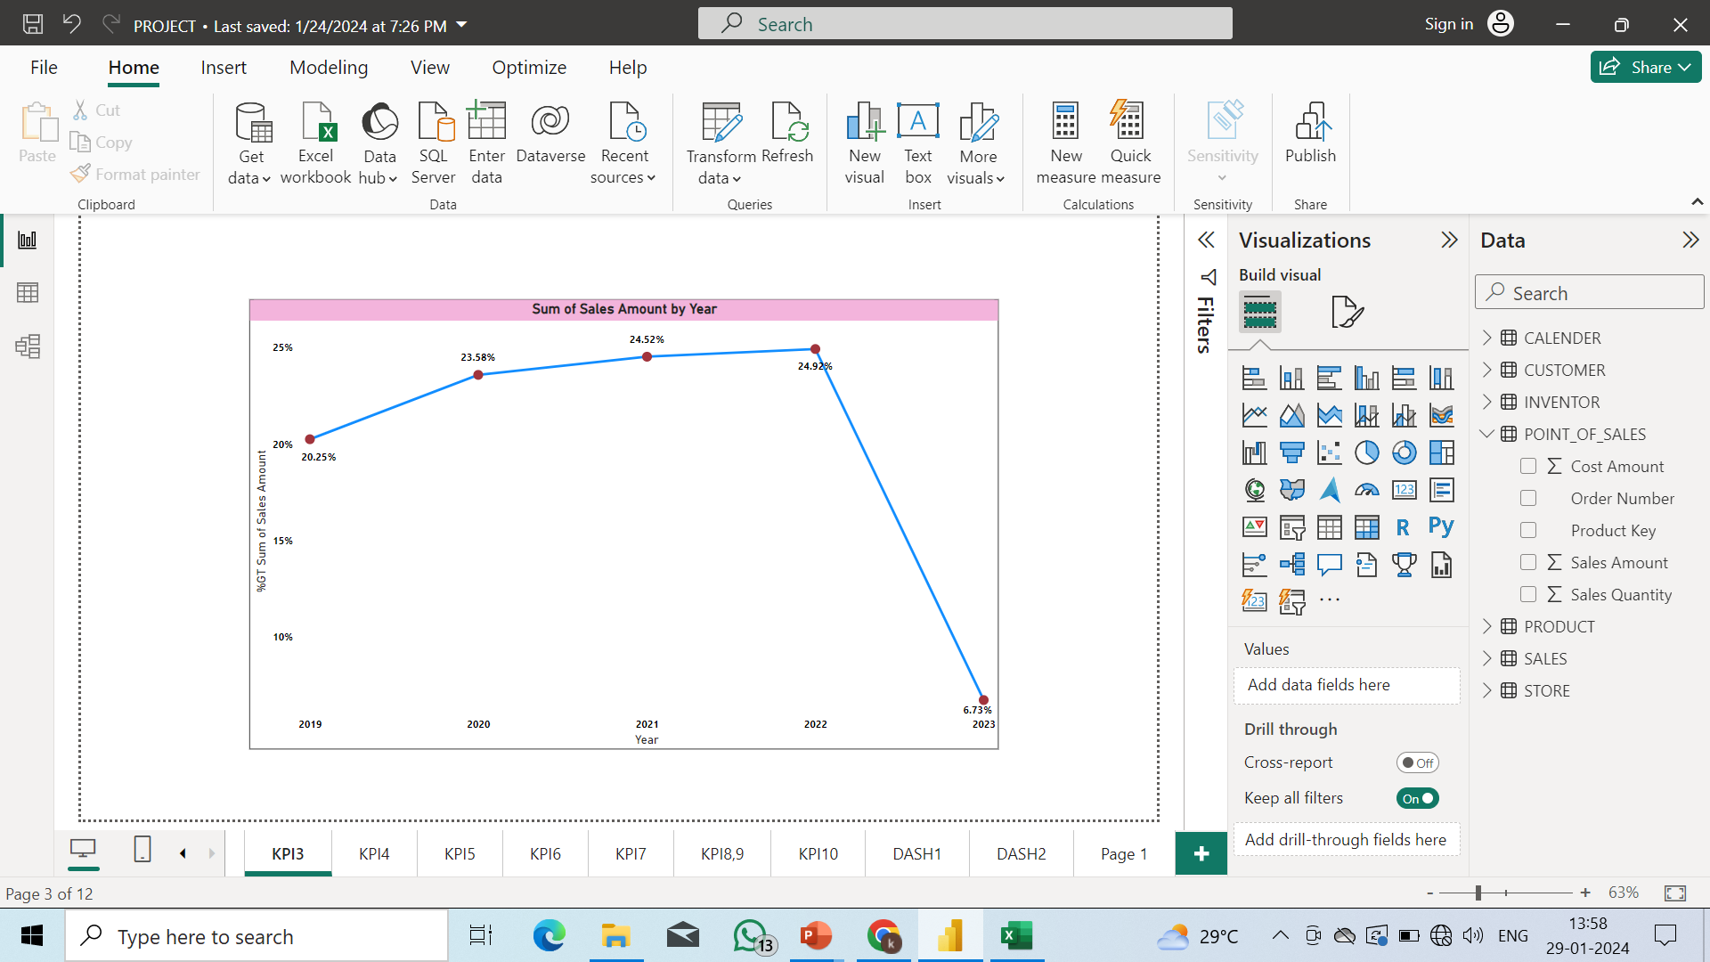
Insights of KPI3:
From this analysis we can see that the Sales Growth by year
In the year of 2022 the sales growth is high with 24.92%.
In the year of 2023 the sales growth is low with 6.73%.
The sales growth is gradually increasing from 2019-2022 but it dropped in 2023.
In summary, the sales growth analysis provides a nuanced view of the business performance over the specified years. While 2022 reflects a peak in growth, 2023 presents a challenge with lower growth. The overall trend of gradual growth from 2019 to 2022 suggests positive business momentum, but the drop in 2023 requires careful consideration and analysis to make informed decisions for future strategies and business planning.

Slide 9
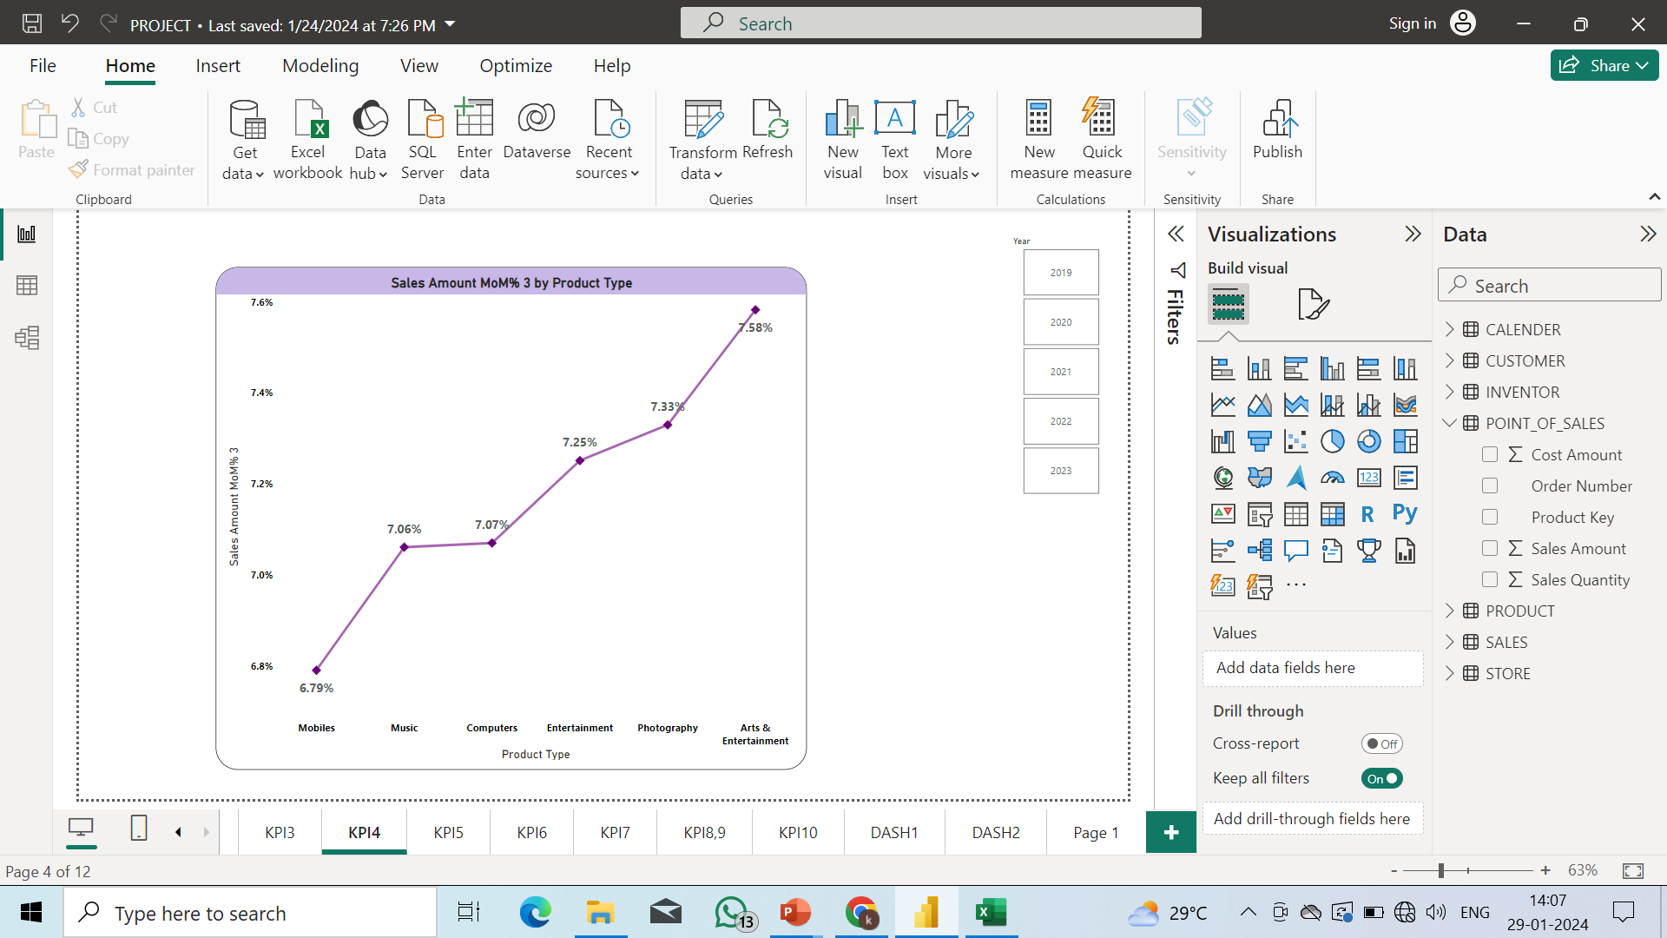
Insights of KPI4:
From this analysis we can see that the Monthly sales Trends.
High Sales in Arts & Entertainment (7.58%):
Arts & Entertainment emerges as the category with the highest monthly sales percentage, accounting for 7.58% of total sales. This indicates a strong performance for this category during the analyzed period. Exploring the factors contributing to the popularity of Arts & Entertainment products in a specific month can inform strategic decisions and marketing efforts.
Lower Sales in Mobiles (6.79%):
Mobiles exhibit comparatively lower monthly sales, representing 6.79% of the total. Understanding the reasons behind the lower sales in this category can be essential for addressing potential challenges or optimizing marketing strategies to boost mobile product sales.
In summary, the monthly sales trends analysis provides valuable insights into the performance of different product categories during a specific period. The variation in sales percentages across categories indicates diverse consumer preferences and product popularity. This information can guide marketing strategies, inventory management, and overall business planning, allowing for a targeted approach to maximize sales and capitalize on the strengths of each product category.

Slide 10
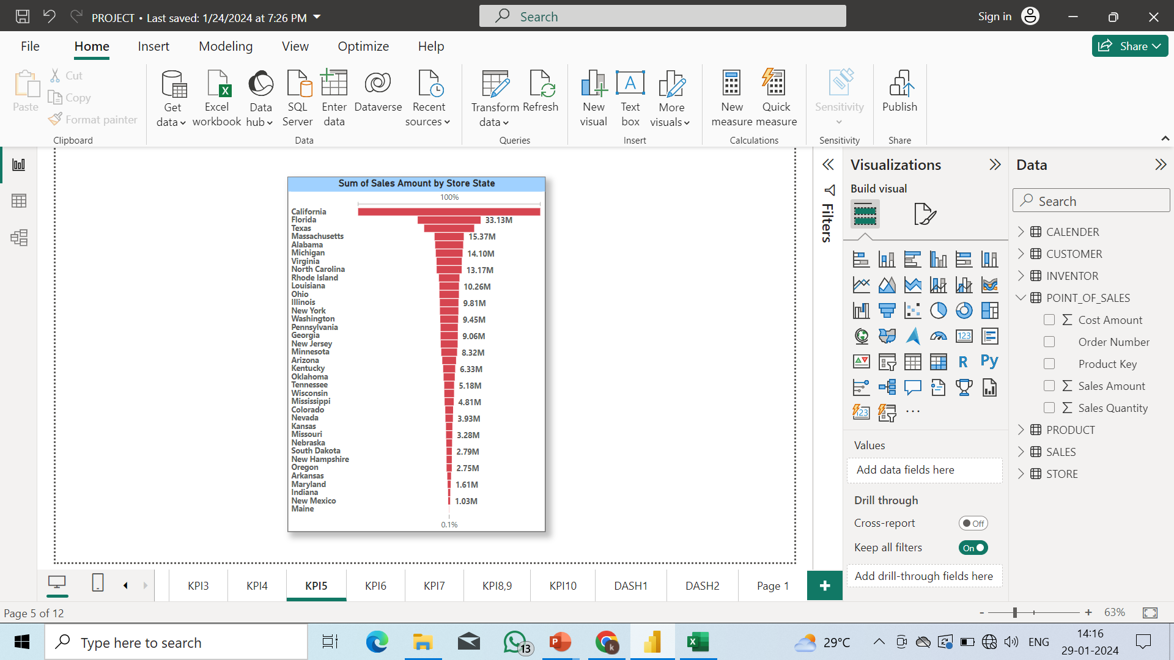
Insights of KPI5:
From this analysis we can see the State Wise Sales.
Highest Sales in California State (95.82M):
California emerges as the leading state in terms of sales, generating a substantial revenue of $95.82 million. This could be indicative of a large customer base, a robust market presence, or successful marketing strategies in the California region. Understanding the factors contributing to the high sales in California can be crucial for sustaining and replicating this success in other markets.
Lowest Sales in Maine State (0.08M):
Maine State registers the lowest sales, amounting to $0.08 million. This suggests a relatively smaller market presence or potential challenges in that particular region. Exploring the reasons behind the low sales in Maine, such as demographic factors, market saturation, or specific product preferences, can inform decisions on whether to invest further in that market or adjust strategies accordingly.
In summary, the state-wise sales analysis highlights the varying levels of market performance across different geographical regions. Understanding the dynamics of high-performing states can guide efforts to replicate success, while insights from states with lower sales can inform targeted strategies for improvement. This information is valuable for businesses aiming to optimize their market presence, allocate resources effectively, and tailor their approach to different regional markets.

Slide 11
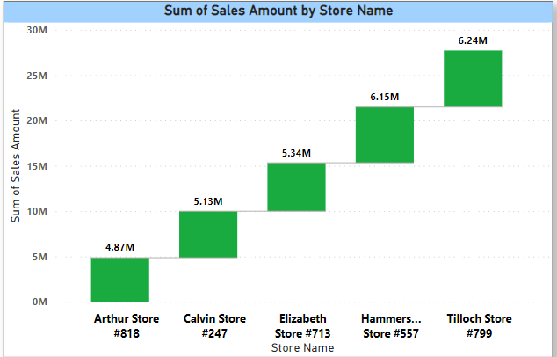
Insights of KPI6:
From this analysis we can see Top 5 Stores with the Sales Amount.
The Top store is Tilloch Store with 6.24M.
The Lowest Store is Arthur Store with 4.87M.
The other stores like Calin Store has 5.13M, Elizabeth Store has 5.34M and Hammersmith store has 6.15M.
In summary, Tilloch Store stands out as the top-performing store, while the other stores, including Hammersmith, Elizabeth, Calin, and Arthur, each have their distinct sales amounts, contributing to the overall sales landscape. This analysis provides a snapshot of the sales performance of these stores, offering valuable insights into their respective contributions to the total sales figure

Slide 12
Insights of KPI7:
From this analysis we can see the Sales by Region.
The West region has 29% sales with the highest amount of 111.94M.
The Southwest region has 12% sales with the lowest amount of 44.61M. In summary, the analysis provides a glimpse into the distribution of sales across different regions. The West region stands out as the top-performing region, contributing the highest sales percentage and amount, while the Southwest region, with a lower sales percentage, still plays a significant role in the overall sales landscape. This information allows for a better understanding of how sales are distributed geographically, enabling businesses to make informed decisions based on regional performance.

Slide 13
Insights of KPI8:
From this analysis we can see the Total Inventory Value.
Total Inventory Value:
The analysis provides insight into the overall value of the entire inventory.
While the specific monetary value is not mentioned, the mention of the "Total Inventory Value" suggests that it represents the combined worth of all items or products within the inventory.
Count of Inventory Value:
The count of inventory value is specified as 1906.
This indicates that there are 1906 individual items, products, or units in the inventory that collectively contribute to the total inventory value.
In summary, the analysis informs us about the size and scale of the inventory by providing the count of items, which is 1906. The total inventory value is a comprehensive metric that reflects the combined worth of all the items in the inventory, and the count serves as a quantitative measure of the inventory's scope. This information is valuable for businesses and organizations to assess the scale of their inventory and make informed decisions regarding stock management and resource allocation.
TOTAL INVENTORY
1906

Slide 14
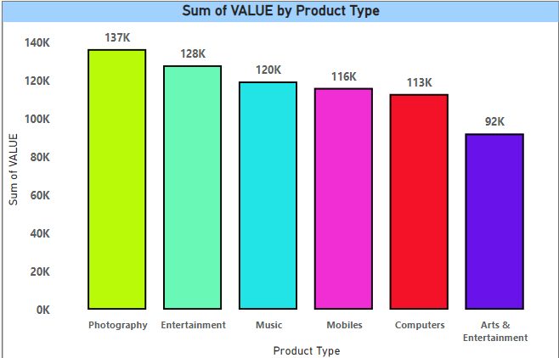
Insights of KPI 9 :
From this analysis we can see Inventory Value by Product Type.
The Total inventory value has 706.21K.
The highest value is 137K in Photography.
The lowest value is 92K in Arts and Entertainment.
In summary, the analysis provides a breakdown of the inventory value based on different product types. Photography stands out with the highest inventory value, while Arts and Entertainment have the lowest. This information is crucial for businesses to understand the composition of their inventory, identify top-performing product categories, and make strategic decisions regarding inventory management and product offerings.

Slide 15
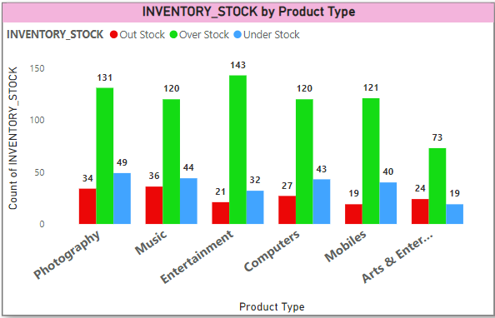
Insights of KPI 10:
From this analysis we can see Stocks that has Out stock, Over stock and Under stock.
Through this analysis we can see that the stock is well maintained.
Over stock is high in every product type.
The conclusion drawn from the analysis is that the overall stock appears to be well maintained. However, a notable observation is that the presence of overstock is high across all product types. While this might suggest a proactive approach to preventing stockouts, it also warrants careful attention to prevent potential issues associated with excess inventory.
Addressing overstock situations may involve implementing strategies such as demand forecasting, adjusting order quantities, or exploring promotions to stimulate sales. By fine-tuning the inventory management process, the company can achieve a better balance between supply and demand, leading to improved overall performance and customer satisfaction.

Slide 16
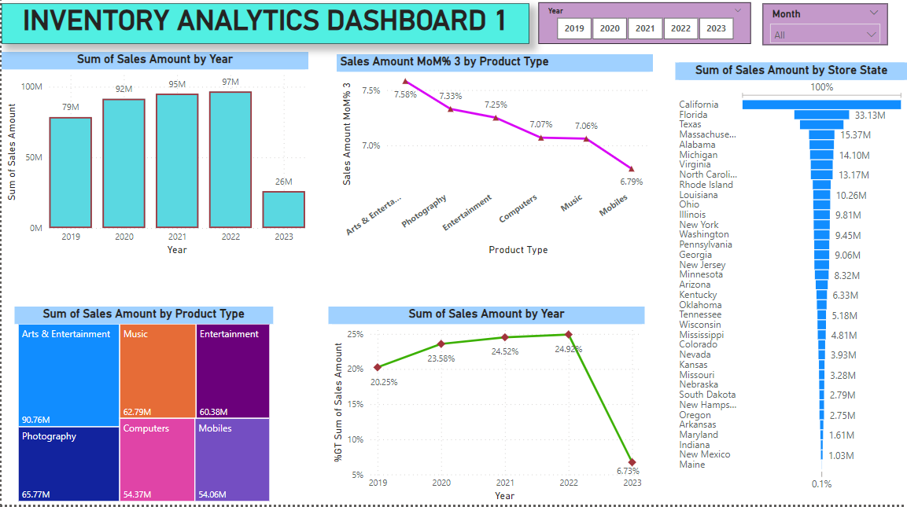

Slide 17
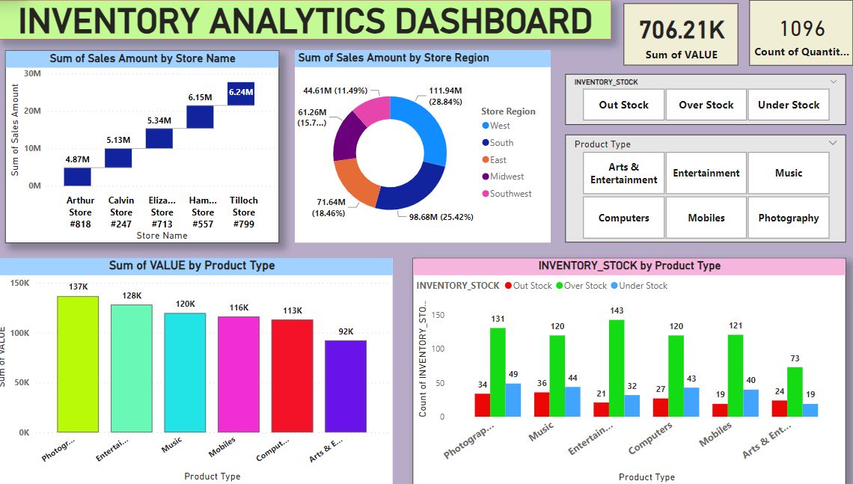

Slide 18

THANK YOU

