Slide 1
Finger print lock system
COMPONENTS:
Arduino Uno
Finger Print Scanner (FPM10A DY50)
5V relay
Solenoid 12V lock
12 V battery/ 12 V AC Dc
Jumper wires
Laptop

Slide 2
USES/FEATURES:
Safe and secure
Home and office purposes
Adafruit fingerprint sensor is used
Can store up to 50 fingerprints
More efficient
Unlocks if fingerprint matches
Each fingerprint has an unique id
Operates on rechargeable battery

Slide 3
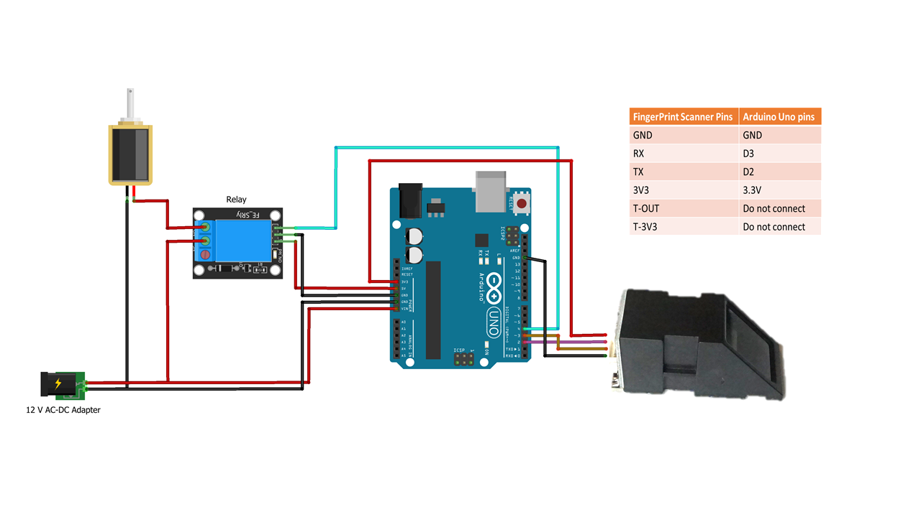
CIRCUIT DIAGRAM

Slide 4
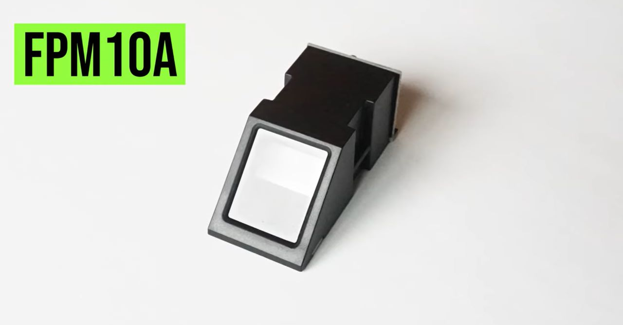

Slide 5
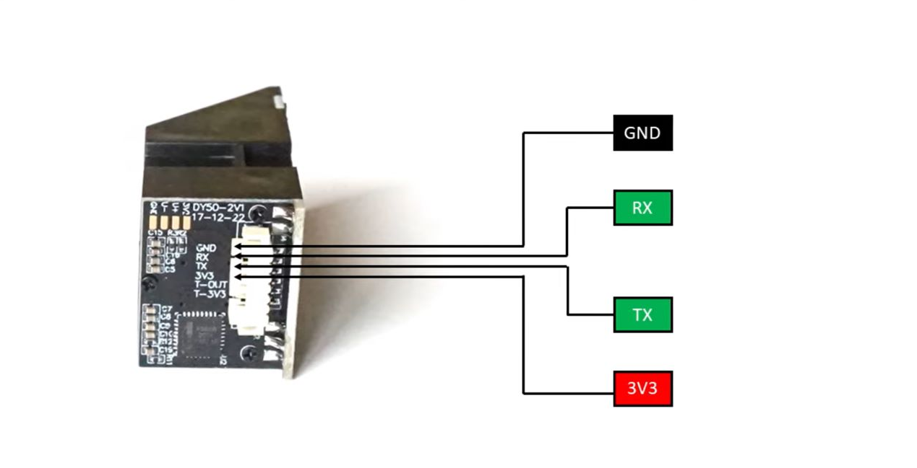

Slide 6
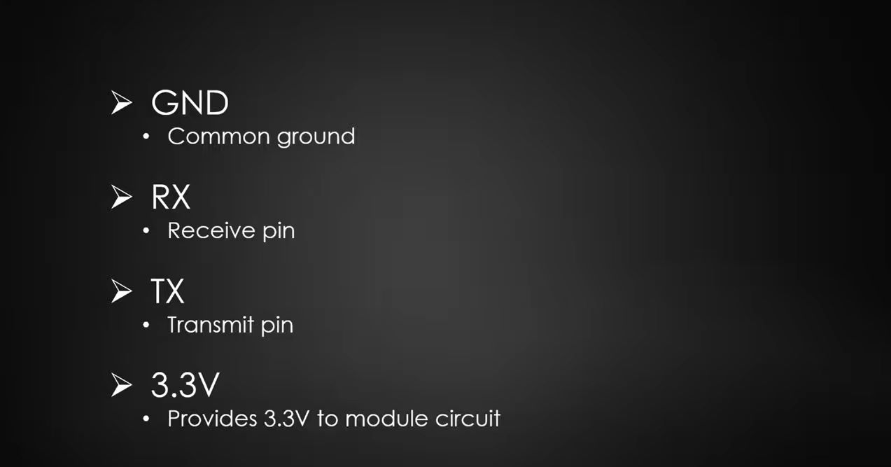

Slide 7
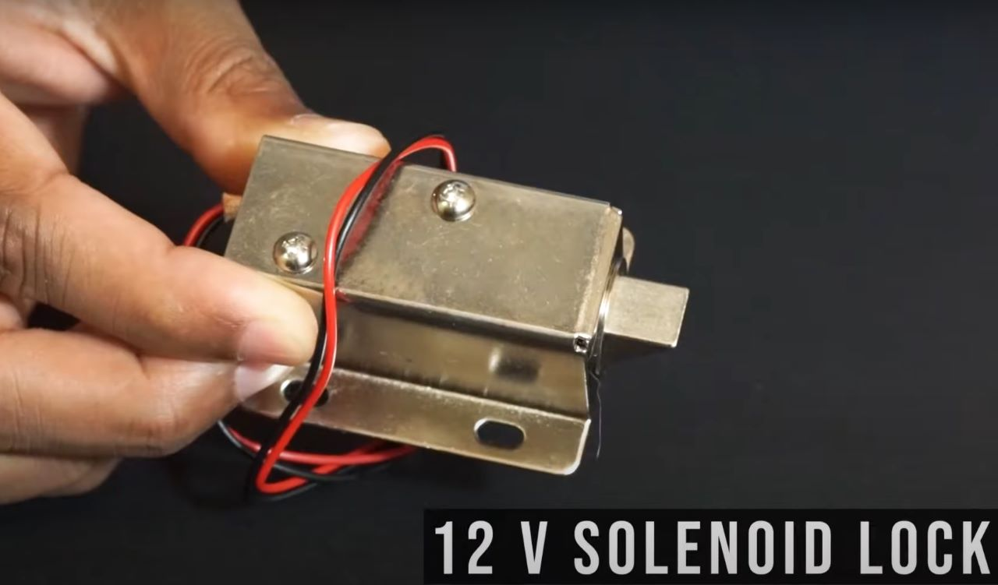

Slide 8
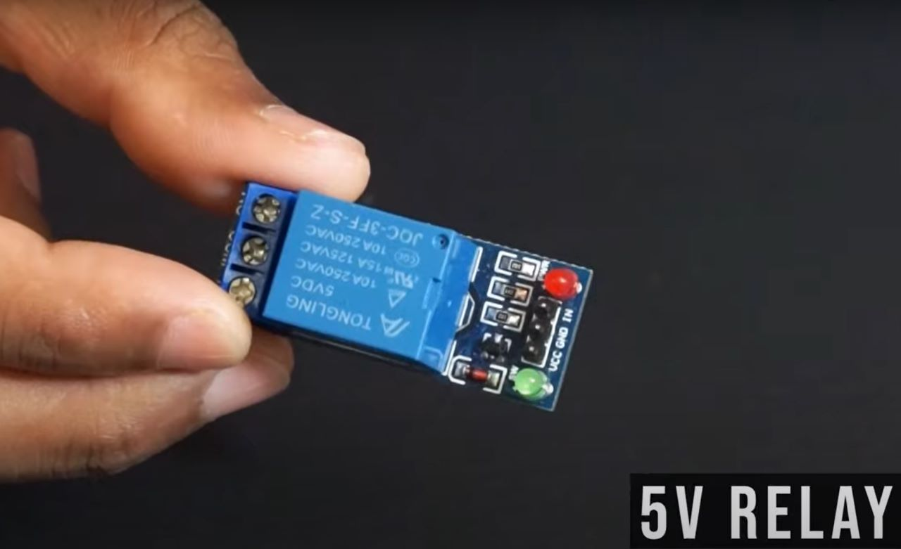

Slide 9
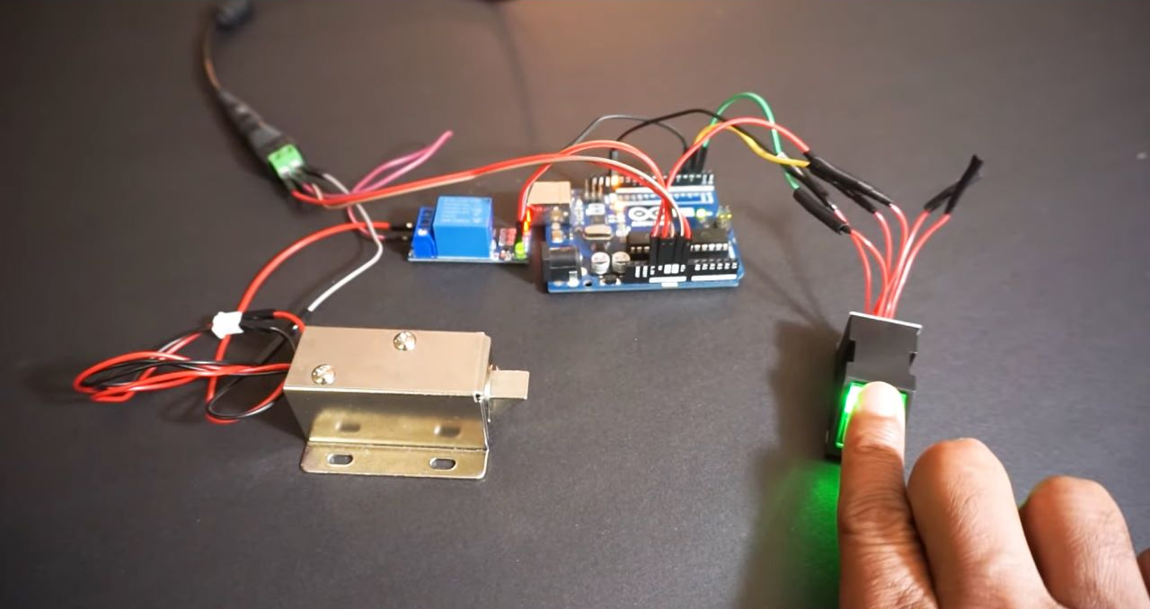

Slide 10
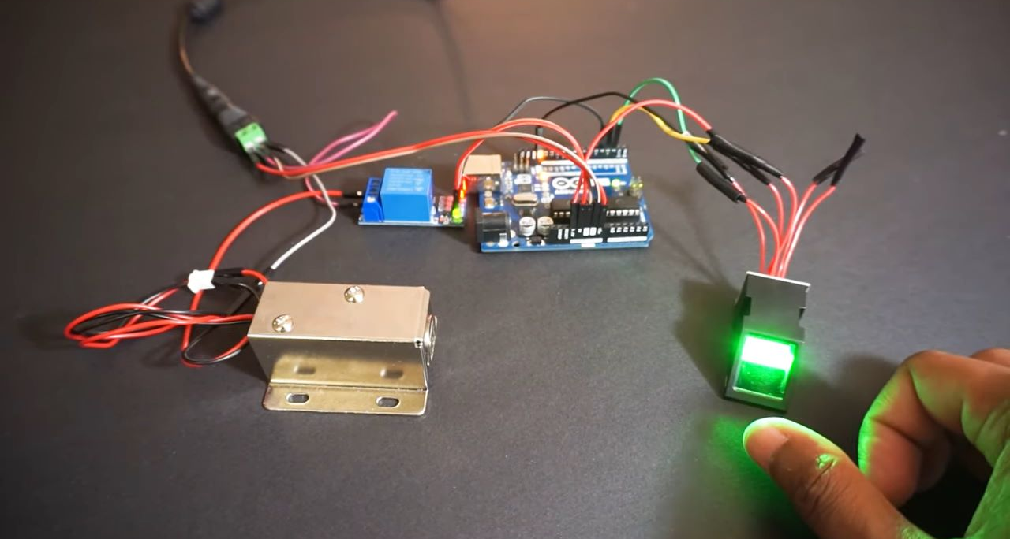

Slide 11
THANK YOU
~Saji Krishna R S

