Slide 1
AUTOMATION AND CONTROL LABORATORY
Automation and Control Engineering 2015/2016
Control of linear vibrations
Alberto Ficicchia, Alessio Russo, Gianluca Savaia
School of Industrial and Information Engineering
Politecnico di Milano
https://github.com/rssalessio/linearVibrationsControl

Slide 2

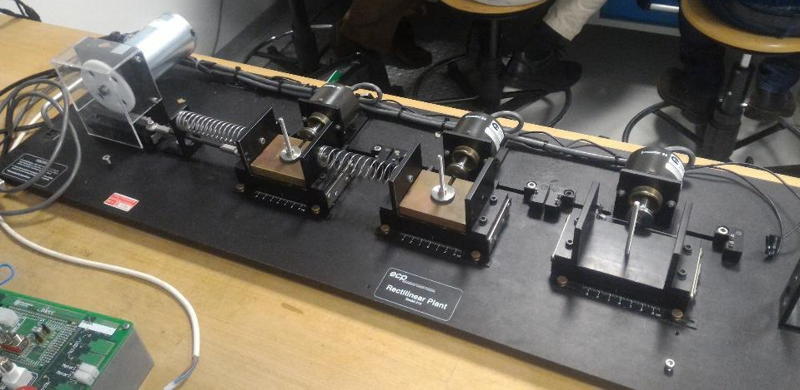
System description
Control of linear vibrations
Brushed motor
Incremental encoder
Cart
Weight
Spring
Arduino board
POLITECNICO DI MILANO
Automation and Control Laboratory – Ficicchia Russo Savaia
Notes:
Fare due slide e più figure e meno testo

Slide 3
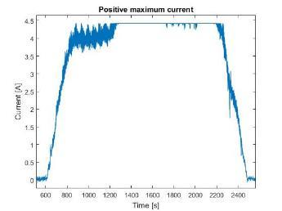
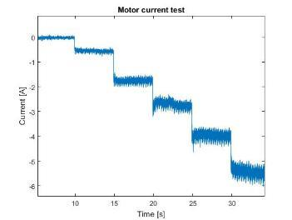
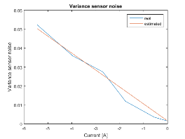
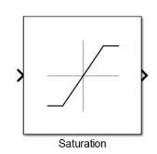
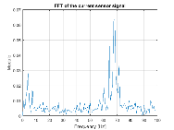
Preliminary issues
Control of linear vibrations
Measurement saturation
Measurement noise
Variable variance
Solved
Solved
White noise
+ det. comp.
Solved
Fourier analysis
LS estimation
POLITECNICO DI MILANO
Automation and Control Laboratory – Ficicchia Russo Savaia
Notes:
Fare due slide e più figure e meno testo

Slide 4
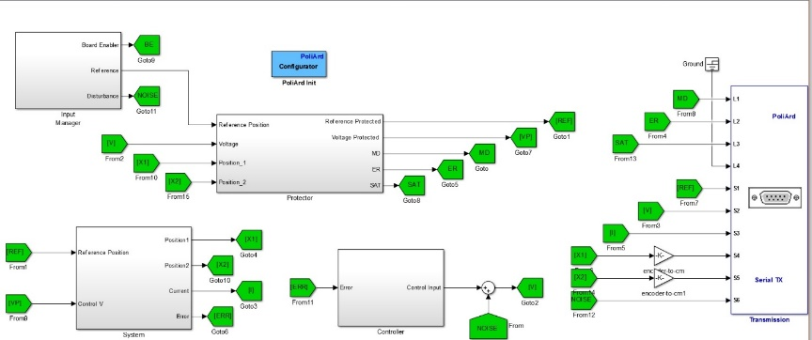
Protection system: four macroblocks
Control of linear vibrations
Input manager:
Selects input, applies noise
Protector (state machines):
Saturates voltage, displacement and reference
Synchronizes Arduino and signal starting time
Triggers alert
System:
Motor and encoder feedback
Controller:
Contains control action
POLITECNICO DI MILANO
Automation and Control Laboratory – Ficicchia Russo Savaia
Notes:
Fare due slide e più figure e meno testo

Slide 5
Modelling
Control of linear vibrations
Modelling
POLITECNICO DI MILANO
Automation and Control Laboratory – Ficicchia Russo Savaia
Notes:
Fare due slide e più figure e meno testo

Slide 6
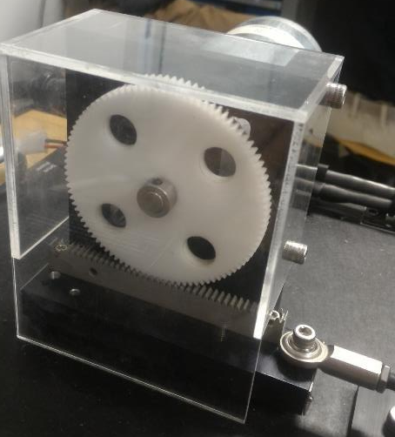
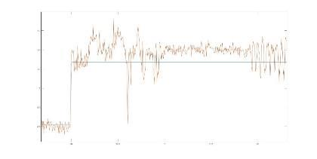
Modelling: motor
Control of linear vibrations
Linear first order system:
where
: back-emf effect
: motor torque
: torque constant
POLITECNICO DI MILANO
Automation and Control Laboratory – Ficicchia Russo Savaia
Notes:
Mettere foto carrellino
Fare sezioni a scomparsa con immagini riferite al pezzo del modello

Slide 7
Modelling: pinion/rack
Control of linear vibrations
Pinion/rack:
where:
: inertia of motor, pinion and rack
: load torque transmitted to the carts
: non linear motor friction
POLITECNICO DI MILANO
Automation and Control Laboratory – Ficicchia Russo Savaia
Notes:
Mettere foto carrellino
Fare sezioni a scomparsa con immagini riferite al pezzo del modello

Slide 8
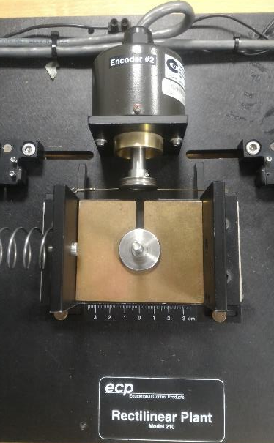
Modelling: carts
Control of linear vibrations
Each cart: where
: total damping (viscous + spring) of the i-th cart
Setting and neglecting nonlinear friction
where
POLITECNICO DI MILANO
Automation and Control Laboratory – Ficicchia Russo Savaia
Notes:
Mettere foto carrellino
Fare sezioni a scomparsa con immagini riferite al pezzo del modello

Slide 9
Equations: 1-2-3 DOF
Control of linear vibrations
1 DOF
2-3 DOF: Lagrangian approach: where
2 DOF
3 DOF
POLITECNICO DI MILANO
Automation and Control Laboratory – Ficicchia Russo Savaia

Slide 10
Identification
Control of linear vibrations
Identification
POLITECNICO DI MILANO
Automation and Control Laboratory – Ficicchia Russo Savaia
Notes:
Fare due slide e più figure e meno testo

Slide 11

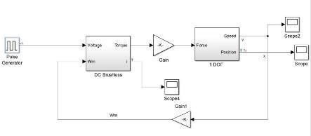
White box identification: steps
Control of linear vibrations
1. Define a model for the system
2. Perform a set of tests on the real system
and collect the relevant data
3. Use model to get the wanted parameters from measured data
4. Perform a simulation of the system with the identified parameters
5. Validate the results comparing the simulation output with the real one
How to compare?
Which metric?
POLITECNICO DI MILANO
Automation and Control Laboratory – Ficicchia Russo Savaia
Notes:
Voltaggio a onda quadra con corrente che lo segue e fare vedere che la disatnza a steady state è R. L’abbiamo idnetificata cosi.
Per la fuznione di straferimento mettere il blocchetto di simulink nei modelli

Slide 12
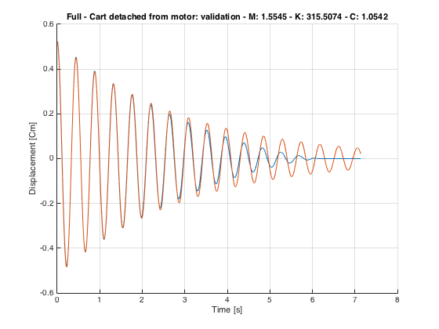
Validation cost function
Control of linear vibrations
Distance expressed by L₂ norm
Simulated output
represents the energy of the difference signal
A more practical index is:
Real output
In this way d=1 represents a perfect fit
POLITECNICO DI MILANO
Automation and Control Laboratory – Ficicchia Russo Savaia
Notes:
Voltaggio a onda quadra con corrente che lo segue e fare vedere che la disatnza a steady state è R. L’abbiamo idnetificata cosi.
Per la fuznione di straferimento mettere il blocchetto di simulink nei modelli

Slide 13
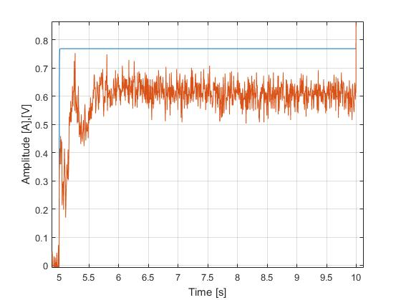
Motor identification: resistance
Control of linear vibrations
Steady state: identify
Voltage
Current
Transient
Steady state
POLITECNICO DI MILANO
Automation and Control Laboratory – Ficicchia Russo Savaia
Notes:
Voltaggio a onda quadra con corrente che lo segue e fare vedere che la disatnza a steady state è R. L’abbiamo idnetificata cosi.
Per la fuznione di straferimento mettere il blocchetto di simulink nei modelli

Slide 14
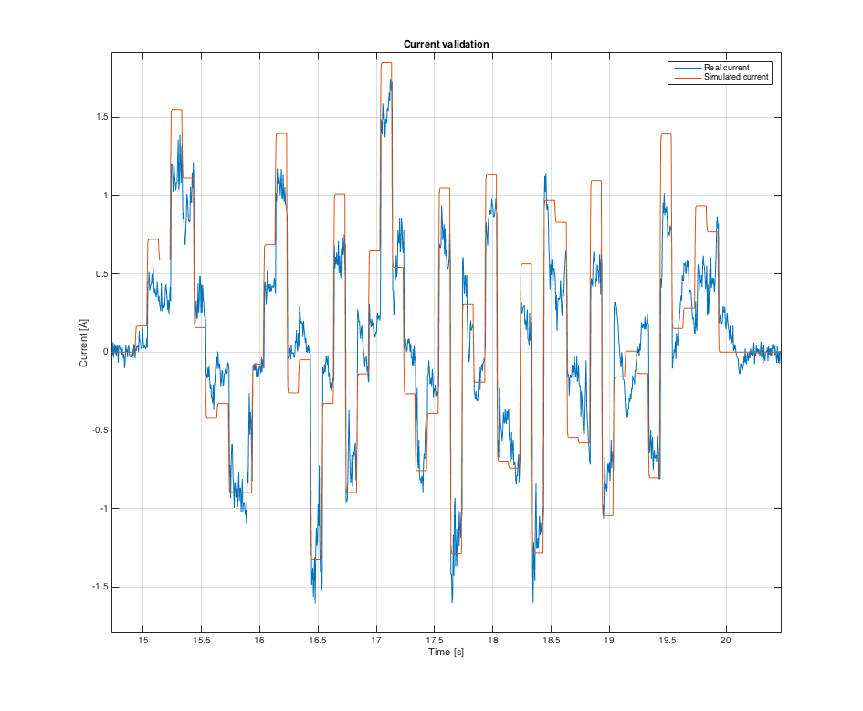
Motor identification: inductance
Control of linear vibrations
Matlab tfest (first order)
From data
Nominal values from datasheet
Validation with input
Fit = (81.42±3,64) %
POLITECNICO DI MILANO
Automation and Control Laboratory – Ficicchia Russo Savaia
Notes:
Voltaggio a onda quadra con corrente che lo segue e fare vedere che la disatnza a steady state è R. L’abbiamo idnetificata cosi.
Per la fuznione di straferimento mettere il blocchetto di simulink nei modelli

Slide 15
Identification
Cart identification

Slide 16
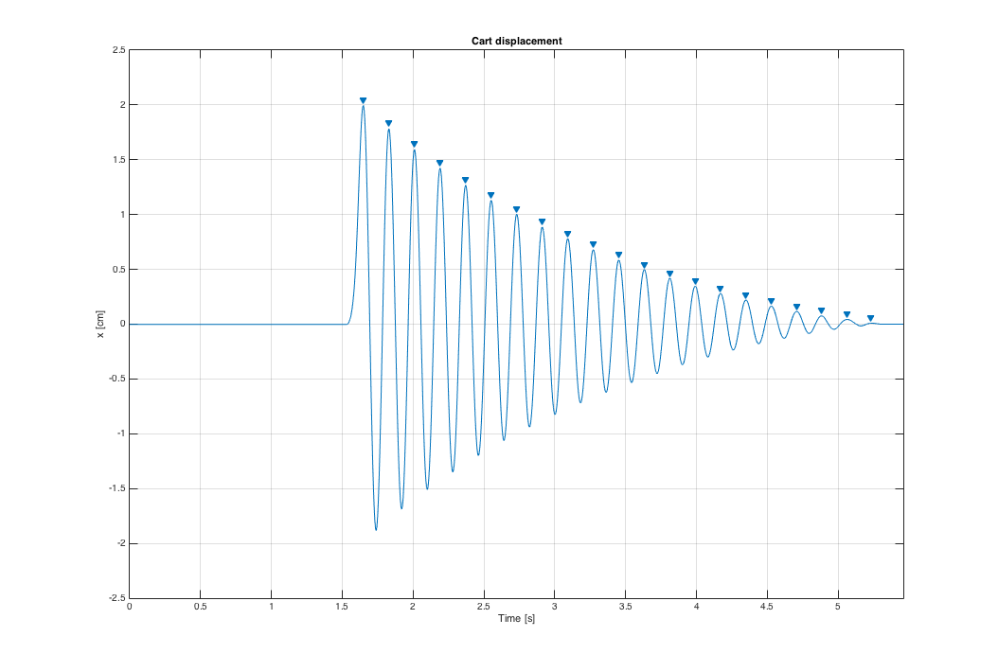
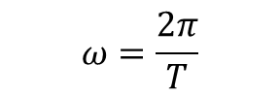
Identification
Mass of the cart?
Damping and stiffness of the springs?
$$ω=\frac{2π}{T}$$

Slide 17
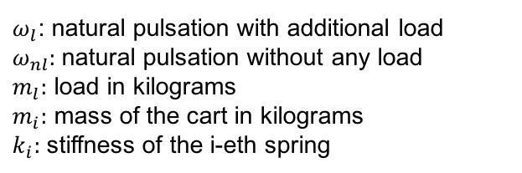

Identification
To find the stiffness of the spring and the mass of the cart we need two equations..
Since we have 2 unknown variables! But what coefficient do we change? The mass!
We know the load!
Remember, $ω_{}^{2}=\frac{K}{M}$
$ω_{l}$: natural pulsation with additional load
$ω_{nl}:$natural pulsation without any load
$m_{l}:$ load in kilograms
$m_{i}:$ mass of the cart in kilograms
$k_{i}:$ stiffness of the i-eth spring

Slide 18
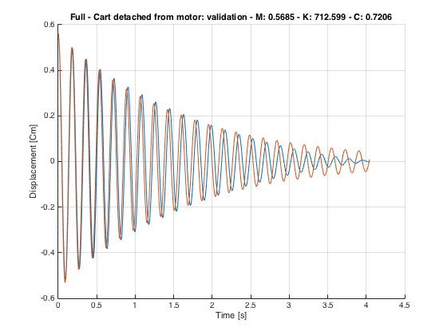
Identification
Validation
Identification: use same x(0)
Validation: random x(0)
Orange: simulated signal
Blue: real signal
Friction effect!

Slide 19
Identification
Overall system
Identification

Slide 20
Identification
So far we estimated the main parameters of the motor, and of the cart.
We still miss:
Electrical torque constant
Inertia of the motor/pinion/rack
Induced stiffness and damping of the motor

Slide 21

Identification
What about electrical torque constant?
Remember, $x\left(s\right)=G_{2}\left(s\right)G_{1}\left(s\right)v\left(s\right)$
,
Electrical torque
constant
Force transmitted from the motor:
Diameter of the pinion
To identify gamma use:
Where infinity stands for steady state

Slide 22
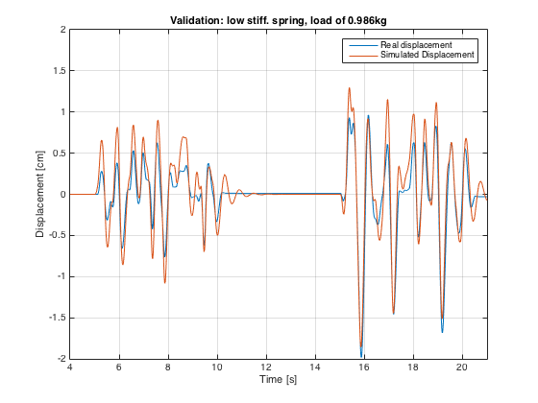
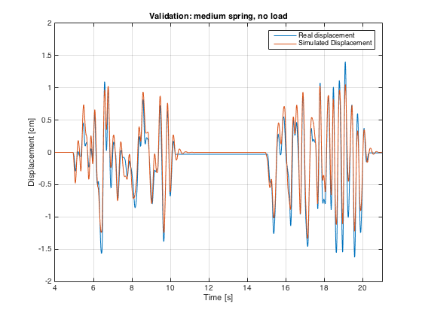
Identification
Validation – 1 DOF
Used white noise for validation! Friction effects are still visible
85.42% of fit

Slide 23
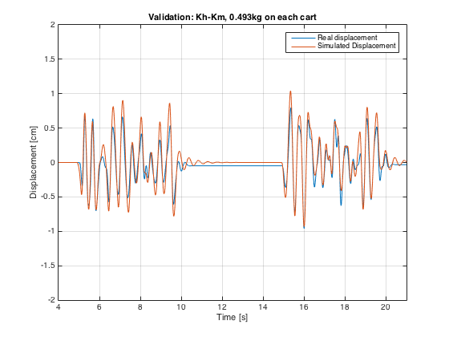
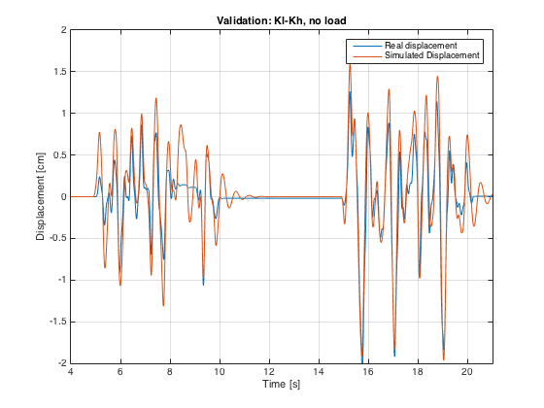
Identification
Validation – 2 DOF
87.29% of fit for the first cart, 85.79% for the second one. Plots shown only for
the second cart

Slide 24
Identification
Gray Box Identification

Slide 25
Identification
Since the identification process was long, we first used a rapid approach to estimate
All the variables in play.
Feed a train of pulses into the system and measure both the current and
displacement of the cart
Measured
Simulated

Slide 26
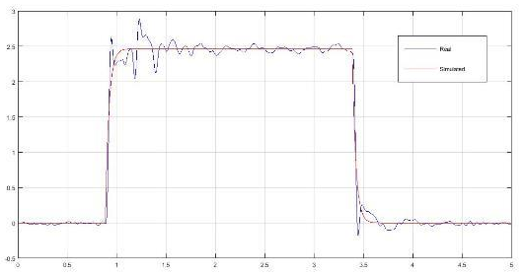
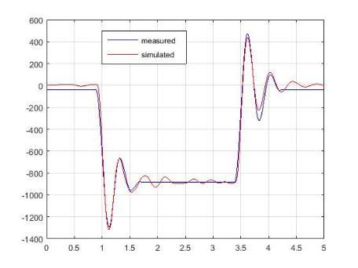
Identification
Identification results
Cart
Motor

Slide 27
Identification
Non Linearities Identification

Slide 28
Identification
Non Linear Gain
During the course of the project we found many non-linearities, especially in the
Motor, responsible of poor performances in some cases.
One of the most important was that the gain was input-dependant.
We performed multiple experiments, using a step signal, at different voltages.
Ideal current, simulated
Real current, measured
Least squares
Approximation of f(v)

Slide 29
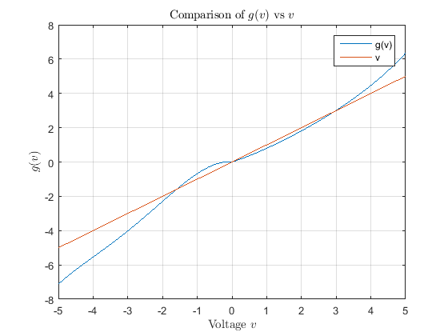
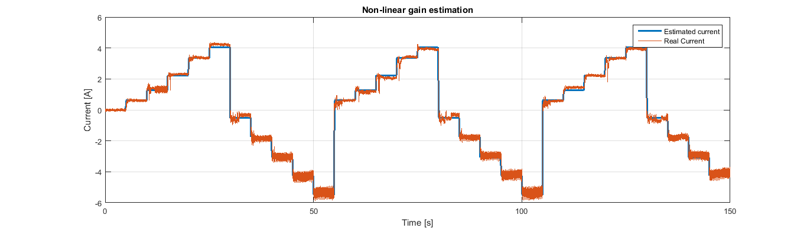
Identification
As seen from the figure,
f(v)=g(v)/v is a nonlinearity with
sector [a,b], a >0, b < infinity.
Results:

Slide 30
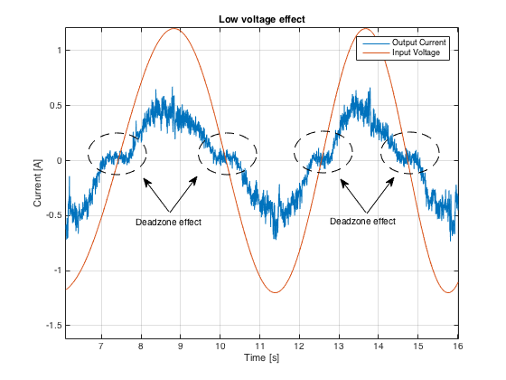
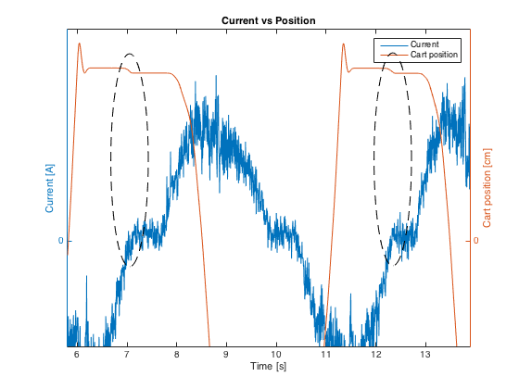
Identification
Motor Electrical Friction
Find c?
Minimize a cost function
Or use the fact that the current is WN

Slide 31
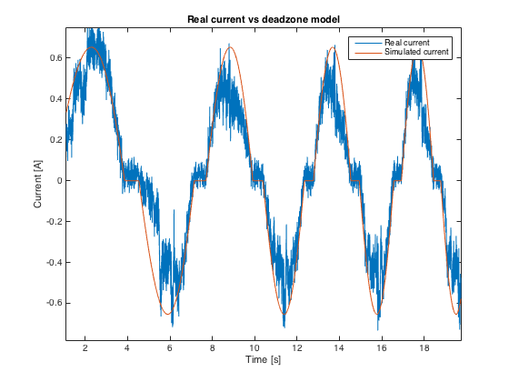
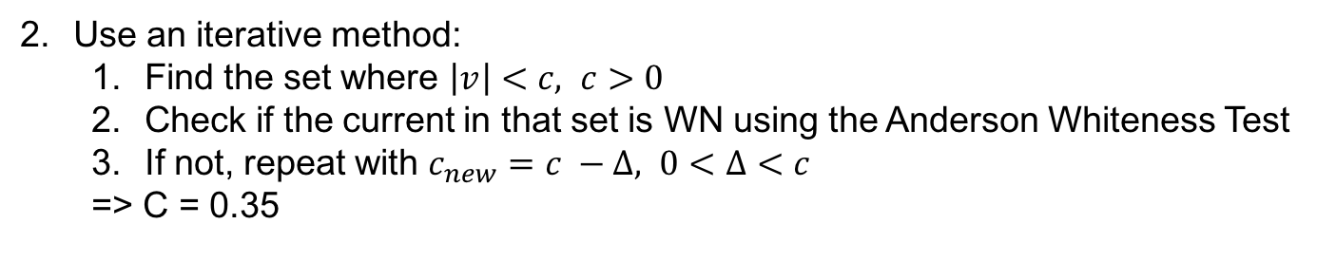
Identification
1. Minimize:
=> c= 0.4621, using genetic algorithm
Use an iterative method:
Find the set where $\left|v\right|<c, c>0$
Check if the current in that set is WN using the Anderson Whiteness Test
If not, repeat with $c_{new}=c −Δ, 0<Δ<c$
=> C = 0.35

Slide 32
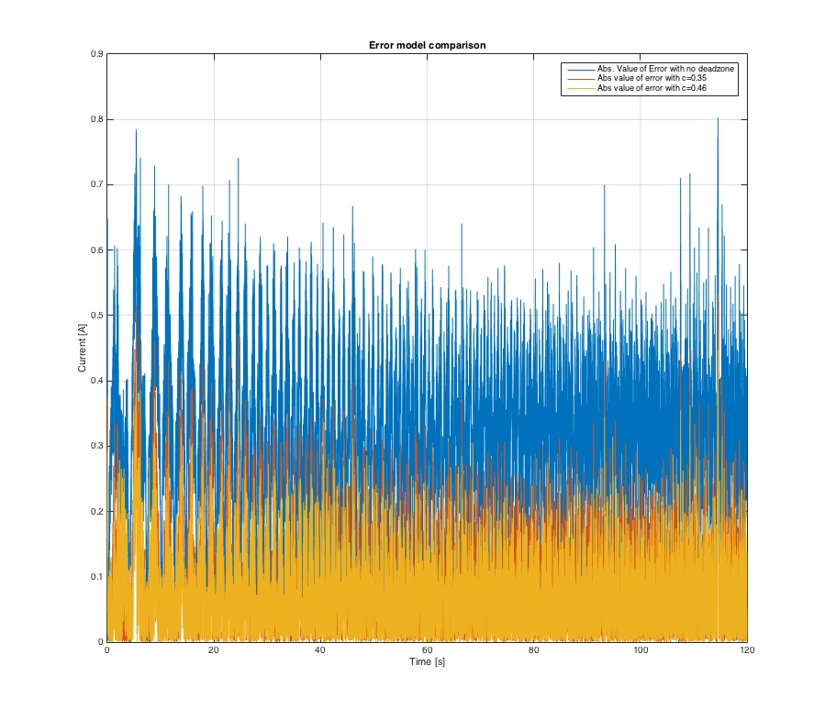

Identification
Plot of $e\left(t\right)=i_{real}−i_{sim}$
C=0.46 slightly outperforms C=0.35

Slide 33
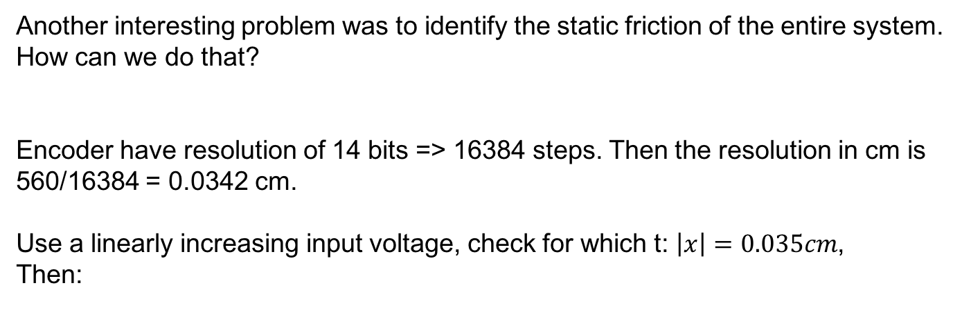
Identification
Static Friction
Another interesting problem was to identify the static friction of the entire system.
How can we do that?
Encoder have resolution of 14 bits => 16384 steps. Then the resolution in cm is
560/16384 = 0.0342 cm.
Use a linearly increasing input voltage, check for which t: $\left|x\right|=0.035cm$,
Then:
Force transmitted
Knowledge of the other
Nonlinearities was needed
In order to estimate the friction
Correctly!
Where N is the load,
i the current at time t.

Slide 34
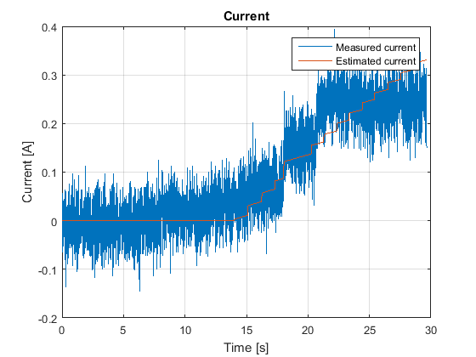
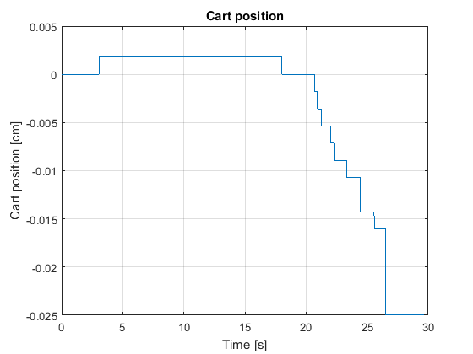
Identification
Static Friction

Slide 35
Identification
Filtering

Slide 36
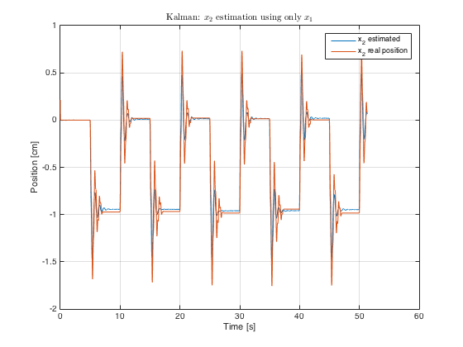
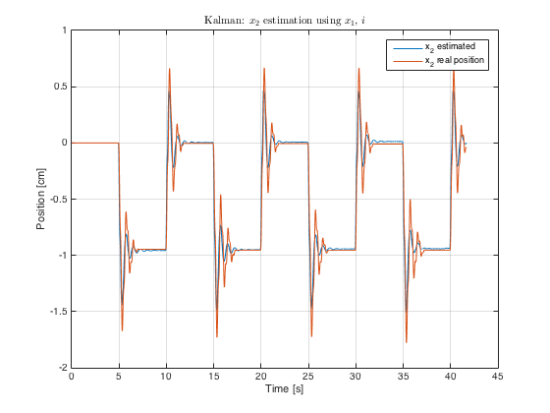
Identification
Noisy current sensor, third encoder not available. How to do state feedback,
Pole placement, etc…?
Use of Luenberger/Kalman observer. Tests done:
Estimate of the carts position (all 3 degree of freedom) using only the current.
Estimate of the carts position (second and third cart) using the current and the data from the first encoder.
Estimate of the carts position (second and third cart) using only the data from the first encoder.
90% fit

Slide 37
Control
Control

Slide 38
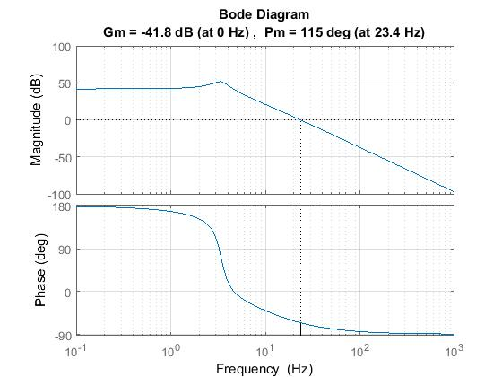
Loopshaping
3Hz
Poles coming from the cart dynamics.
We would like to cancel this behavior.

Slide 39
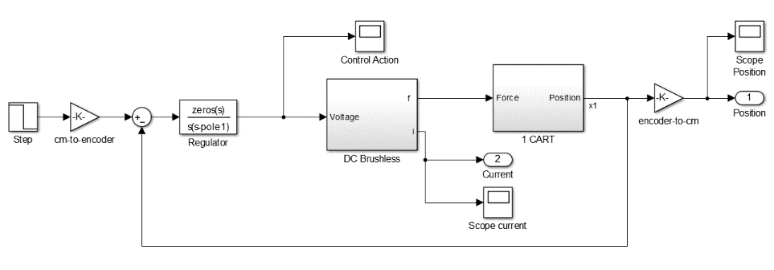
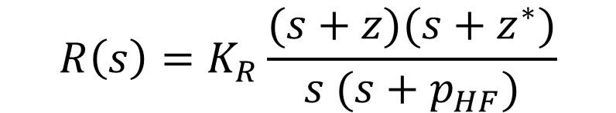
Loopshaping
cancel out cart dynamic
$$R\left(s\right)=K_{R}\frac{(s+z)(s+z^{∗})}{s (s+p_{HF})}$$
Integral action
causal block

Slide 40
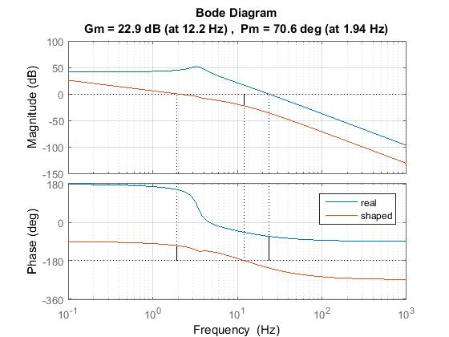
Loopshaping

Slide 41
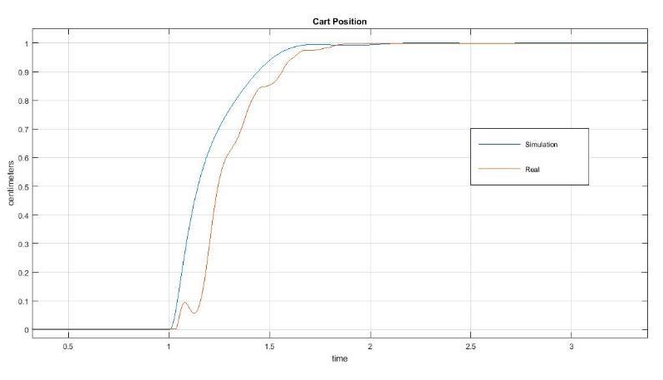
Loopshaping
Transient does not take into account non-linearities,
but rising time and steady-state value match what we expected.

Slide 42
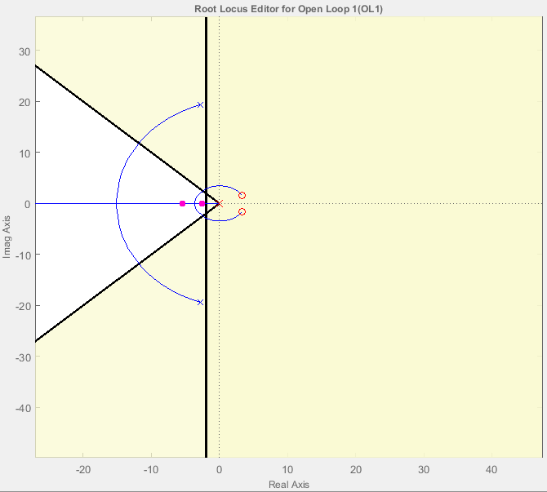
Positive zeros
What if there is another helpful position for the zeros of the regulator?
Admissible Area wrt Performance
Cart Poles

Slide 43
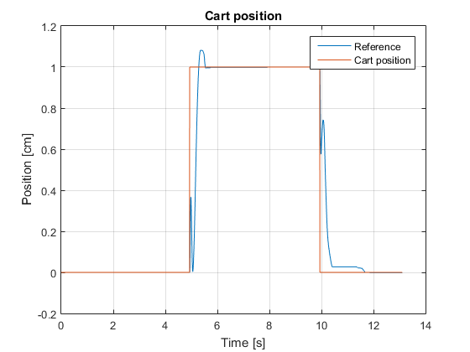
Positive zeros

Slide 44
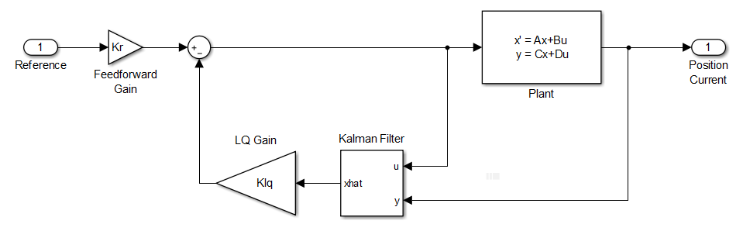
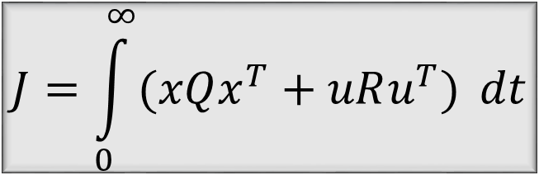
LQG
$$J=\int_{0}^{∞}{(xQx^{T}+uRu^{T})} dt$$
computed in order to guarantee zero tracking error at steady-state.
Notes:
LQG is a state-feedback controller => Kalman.
How do we weight Q and R?
Why didnt we include an integral action.

Slide 45
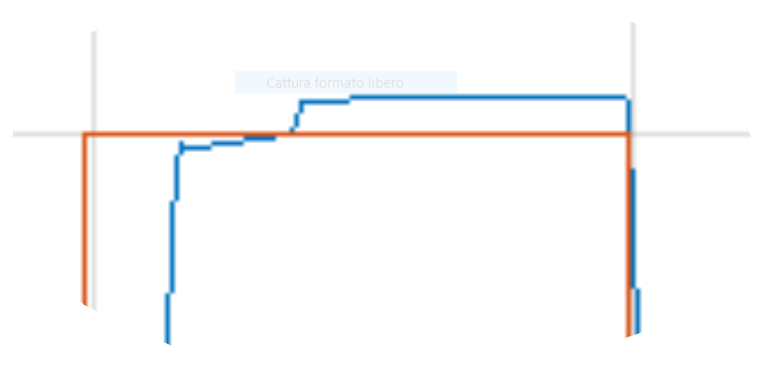
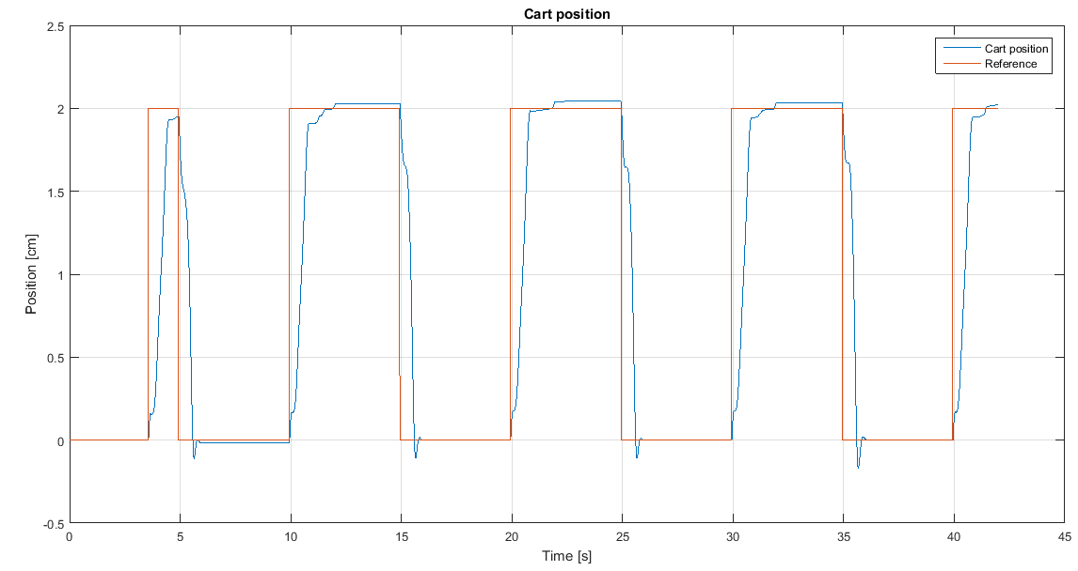
LQG
The compensator is not perfect even though error is below 1/100.

Slide 46
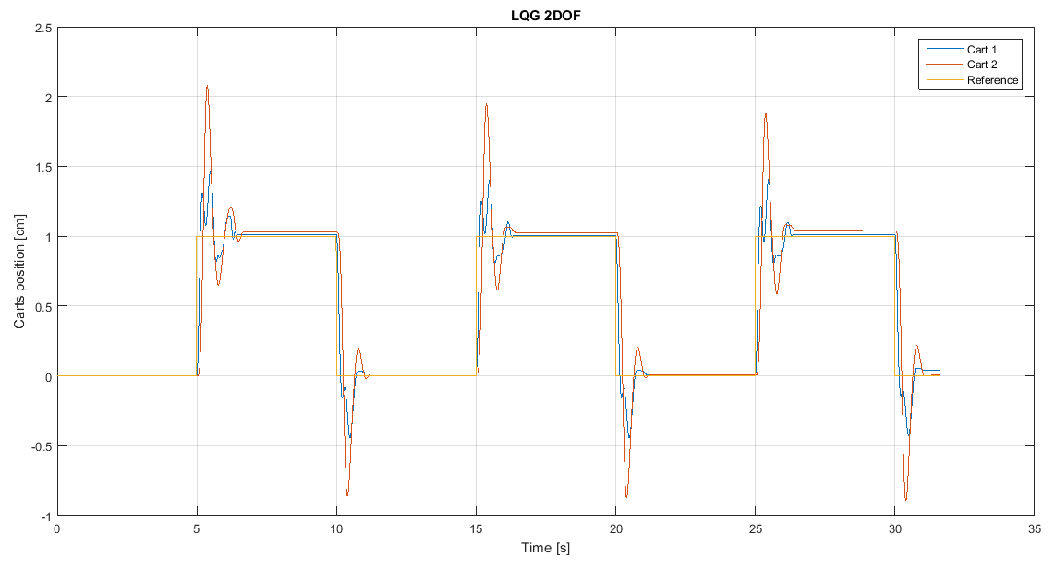
LQG 2dof

Slide 47
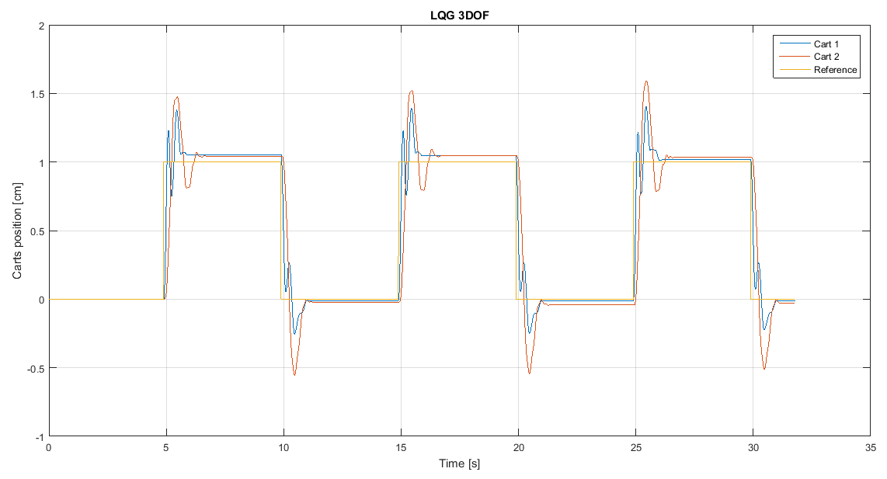
LQG 3dof

Slide 48
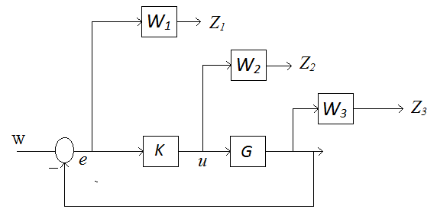


$$H_{∞}$$
$$γ=\min_{W_{1},W_{2}W_{3}}{{\left\|\begin{aligned}S\left(s\right)W_{1}(s) \\ K\left(s\right)W_{2}(s) \\ T\left(s\right)W_{3}(s)\end{aligned}\right\|}_{∞}}$$

Slide 49

$$H_{∞}$$
1Hz
The weights should have the inverse shape of the desired sensitivity.
The higher the weight the weaker the control action:
It is important since the motor saturates at ±5V.

Slide 50

$$H_{∞}$$

Slide 51

$$H_{∞}$$
Reducing the order of complexity of the regulator does not alter perfomance.

Slide 52

$$H_{∞}$$
Zero tracking error
Rising time less than 1 sec
Noise cancellation

Slide 53


$H_{∞}$ 2dof
Notes:
We feedback from the second output

Slide 54

$H_{∞}$ 2dof

Slide 55


$H_{∞}$ 2dof
The current is not directly measured, but estimated through a Kalman filter.
The current regulator allows to stabilize the motor effort.

Slide 56

$H_{∞}$ 2dof

Slide 57


$H_{∞}$ 3dof

Slide 58

$H_{∞}$ 3dof
The response (although not perfect) is way more stable with the inner current loop.

Slide 59
EKF
Extended Kalman Filter

Slide 60



EKF
Linear Model
Nonlinear Model

Slide 61

EKF
Steps:
Update state estimate $x_{k+1}=f\left(x\right)+Bu_{k}$
Linearize system around $\hat{x}$ $A= \frac{∂f}{∂x}(\hat{x})$
Update Kalman gain
Update prediction $x_{k+1|k+1}=x_{k+1}+K(y_{meas}−y_{k+1})$
Notes:
Discrete time because it works better.
There is no implementation of EKF on matlab.

Slide 62

EKF
Simulink simulation
Porting onto Arduino
Validation of results
Notes:
Correctness of implementation
Noisy data, Online
Comparing Arduino vs Simulink = Online vs Offline

Slide 63

EKF

Slide 64
THANK YOU!
QUESTIONS?

