Slide 1

Detecting Anomalies with Python and Influx DB using Machine Learning Algorithms
Submitted to:
Prof. Dr. Martin Zaefferer
January 2020
Mohammed Talat Abdelmaqsoud (11136985 )
Reeshika Sundaram (11134553)
Elaheh Najafiani (11136287)
Sunitha Radhakrishnan (11135196)

Slide 2
Overview
Introduction
Data Visualization
Data Analysis
Data Pre-processing
Anomaly Detection
Modelling and Implementation using ADTK – Algorithms in Python
Kapacitor and Influx DB – Detecting Anomalies in Online mode
Results
Conclusion
References
Mohammed, Reeshika, Elaheh, Sunitha
27.01.2020

Slide 3
Introduction
Mohammed, Reeshika, Elaheh, Sunitha
27.01.2020

Slide 4
Goal of this case study: Develop a change detection system to detect any kind of anomaly in time series data of drinking water quality(Thuriengen Fernwasservorgung).
Anomaly detection: A technique of identifying the observation of rare items that deviates from the actual behavior of majority of the data set.
Use of anomaly detection:
Fraud detection
Error signal detection of the instruments used in Industries
Categories for anomalies:
Point anomalies: Single instance of data is anomalous
Contextual anomalies: A data set is anomalous
Collective anomalies: A collection of related data instances is anomalous
Mohammed, Reeshika, Elaheh, Sunitha
27.01.2020

Slide 5
Data Analysis, Visualization and Data Preprocessing
Mohammed, Reeshika, Elaheh, Sunitha
27.01.2020

Slide 6
Data Analysis
Water quality indicators:
The amount of Chlorine Dioxide in the water
Water‘s pH value
The Redox potential
Water‘s electric conductivity
The Turbidity of the water
Any changes in quality indicators are considered as Events
Operational data:
Flow rate
The temperature of the water
Changes in operational data may led to changes in the quality values but are not considered as events themselves.
Mohammed, Reeshika, Elaheh, Sunitha
27.01.2020

Slide 7
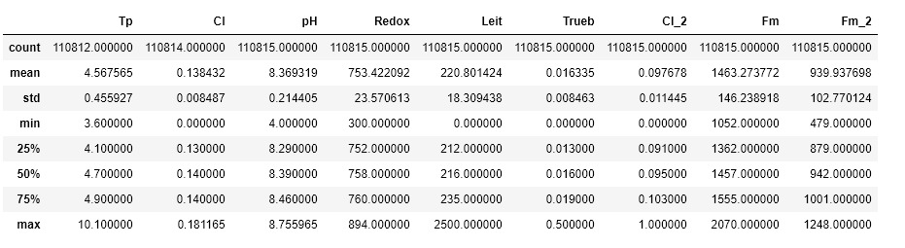
Using ´ Describe () ´ function, the summary of the data set with all statistics for each variable have been gotten.
Mohammed, Reeshika, Elaheh, Sunitha
27.01.2020

Slide 8
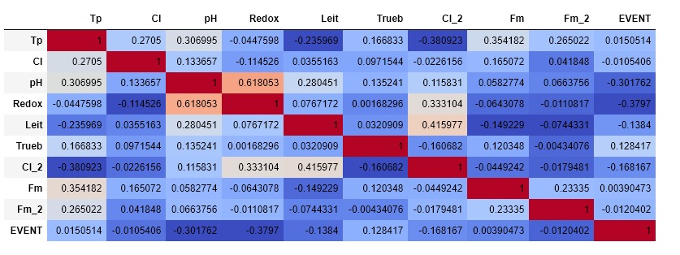
Correlation matrix
´corr () ´ function used to get correlation matrix.
Mohammed, Reeshika, Elaheh, Sunitha
27.01.2020

Slide 9
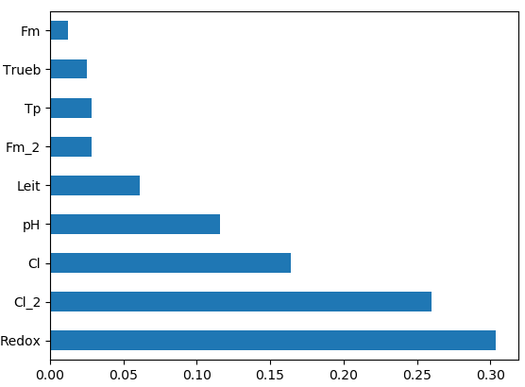
Variable importance
´RandomForestClassifier()´ used to get variable importance.
Mohammed, Reeshika, Elaheh, Sunitha
27.01.2020

Slide 10
Data Visualization
To understand the type and characteristics of the data, the data behavior have been investigated by Python.
Grafana is used for real time data visualization.
Grafana allows you to query, visualize, alert on and understand your metrics no matter where they are stored.
This tool has been linked with KAPACITOR-INFLUX DB interface for our time series data visualization
Mohammed, Reeshika, Elaheh, Sunitha
27.01.2020

Slide 11
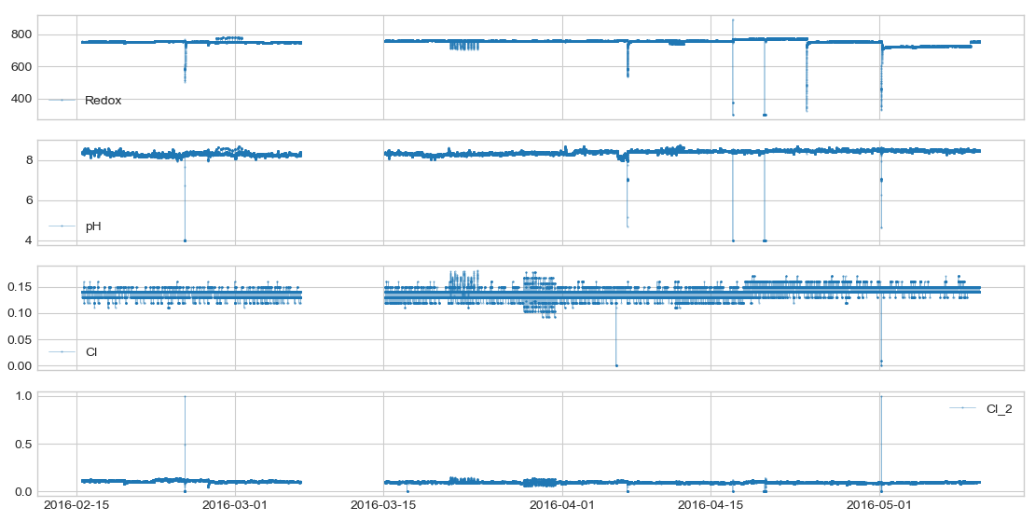
Raw data plot of Redox, pH, Cl and Cl_2
Mohammed, Reeshika, Elaheh, Sunitha
27.01.2020

Slide 12
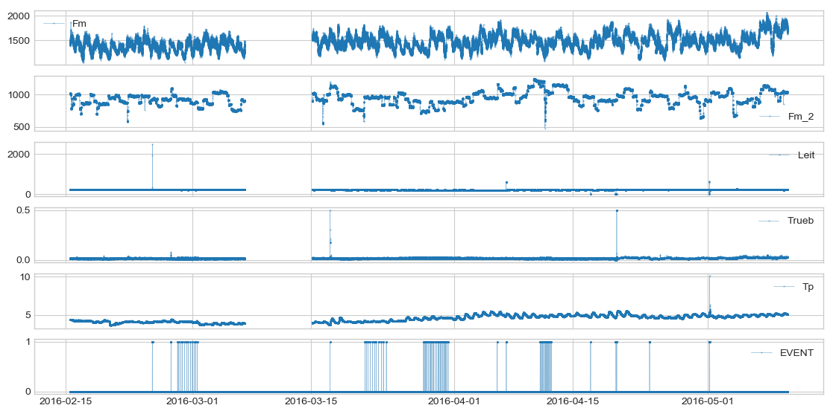
Fm, Fm_2,Leit,Turbidity,Temperature,Event – Raw data Visualization
Mohammed, Reeshika, Elaheh, Sunitha
27.01.2020

Slide 13
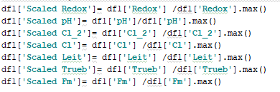
Data Preprocessing
Includes data cleaning, normalization, feature selection
In data preprocessing, the missing values in raw data was filled with mean values with respective time frame
Data Normalization, was done by scaling each variable in the range of 0 to 1.
Mohammed, Reeshika, Elaheh, Sunitha
27.01.2020

Slide 14
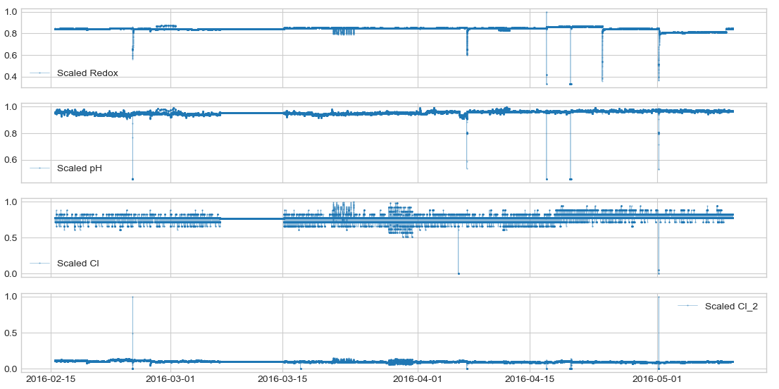

Slide 15
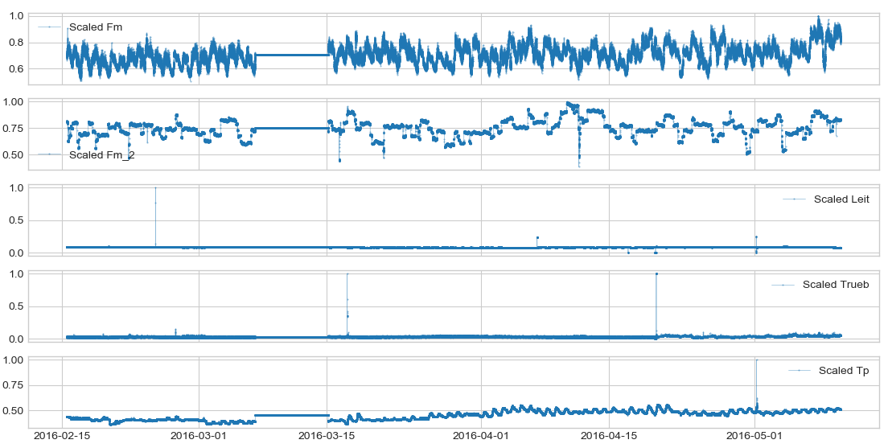
Mohammed, Reeshika, Elaheh, Sunitha
27.01.2020

Slide 16
Anomaly Detection Modelling and Implementation
Mohammed, Reeshika, Elaheh, Sunitha
27.01.2020

Slide 17
Anomaly Detection Algorithms:
Algorithms used for detecting Anomalies
Anomaly detector toolkit (ADTK Library) in python
ADTK components: Detector, Transformer and Aggregator
Our model include:
Detector (‘adtk.detector’): Scans time-series and returns anomalous time points
Aggregator (‘adtk.aggregator’): Combines different detections results.
Multivariate Timeseries
Mohammed, Reeshika, Elaheh, Sunitha
27.01.2020

Slide 18


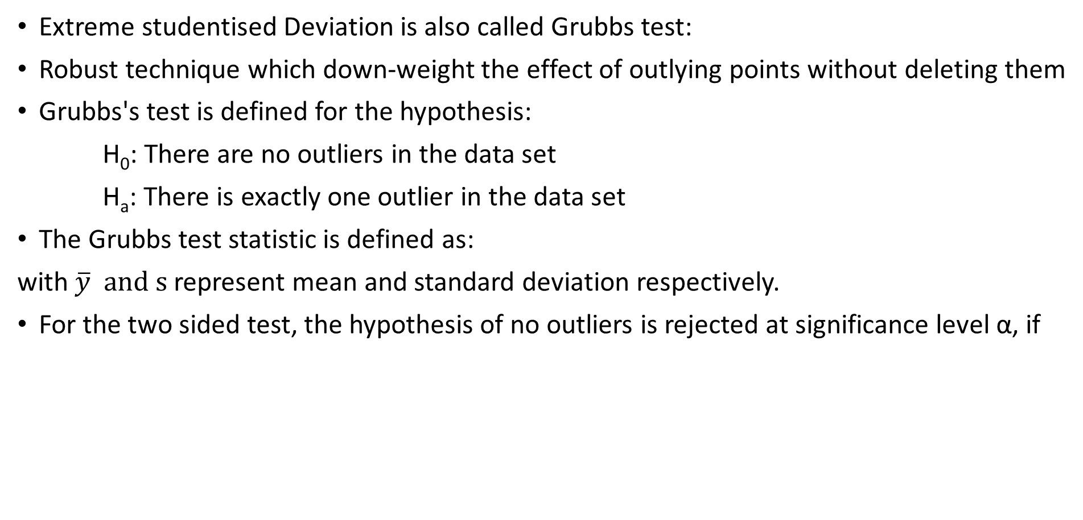
Generalized ESD Algorithm Overview
Extreme studentised Deviation is also called Grubbs test:
Robust technique which down-weight the effect of outlying points without deleting them
Grubbs's test is defined for the hypothesis:
H₀: There are no outliers in the data set
H_{a}: There is exactly one outlier in the data set
The Grubbs test statistic is defined as:
with $\overline{y} and s$represent mean and standard deviation respectively.
For the two sided test, the hypothesis of no outliers is rejected at significance level α, if
Mohammed, Reeshika, Elaheh, Sunitha
27.01.2020

Slide 19
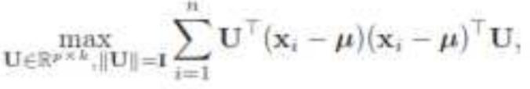
PcaAD Algorithm Overview
PCA can be used as an unsupervised learning problem. It is a technique for dimensionality reduction. The whole process of obtaining principle components from a raw dataset can be simplified in six parts :
Take the whole dataset consisting of d+1 dimensions and ignore the labels such that our new dataset becomes d dimensional.
Compute the mean for every dimension of the whole dataset.
Compute the covariance matrix of the whole dataset.
Compute eigenvectors and the corresponding eigenvalues.
Sort the eigenvectors by decreasing eigenvalues and choose k eigenvectors with the largest eigenvalues to form a d × k dimensional matrix U.
Use this d × k eigenvector matrix to transform the samples onto the new subspace
Mohammed, Reeshika, Elaheh, Sunitha
27.01.2020

Slide 20
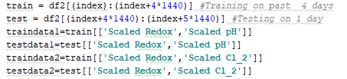
Implementation 1 - Anomaly Detection in Python
Initially, Standard Deviation, Isolation Forest algorithm was used and then moved to ADTK for better results.
Train test split
Use of rolling window inside for loop
Consideration of whole data set
Train on the first 4 days
Test on the 5th day
Mohammed, Reeshika, Elaheh, Sunitha
27.01.2020

Slide 21
Using Algorithm1 - Anomaly Detector
Generalized ESD (Extreme Studentized Deviate) Test AD
Is a statistical test for outliers and use on univariate data, in our case it is used in separate variables and then aggregated
As Redox and Cl_2 follow the normal distribution pattern partially in our data set, this algorithm was used on these 2 variables
Mohammed, Reeshika, Elaheh, Sunitha
27.01.2020

Slide 22
Using Algorithm2 – Anomaly Detector
Principal Component Analysis Anomaly Detector (PcaAD)
Use for multivariate time series
With reducing the dimensionality of the feature vectors led to better visualization and analysis of the data
As in choosen data set, Redox is the most important variable and the relation between Redox-pH is 0.6, Redox-pH was selected for PCA anomaly detection.
Mohammed, Reeshika, Elaheh, Sunitha
27.01.2020

Slide 23
OR Aggregator
The results of ESD Analysis on Redox and Chlorine and PCA Analysis on Redox-pH is merged together in a single data frame.
OR aggregator is applied
The result is compared with the ‘Event’
All results are concatenated together due to rolling window.
Mohammed, Reeshika, Elaheh, Sunitha
27.01.2020

Slide 24
Results of Implementation
Mohammed, Reeshika, Elaheh, Sunitha
27.01.2020

Slide 25
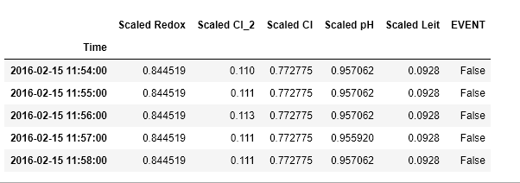
The ‘head’ of the dataframe is displayed below
Mohammed, Reeshika, Elaheh, Sunitha
27.01.2020

Slide 26
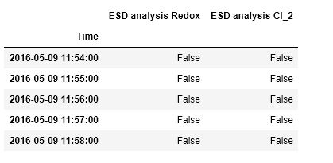
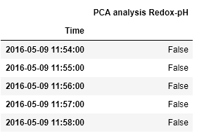
Mohammed, Reeshika, Elaheh, Sunitha
27.01.2020

Slide 27
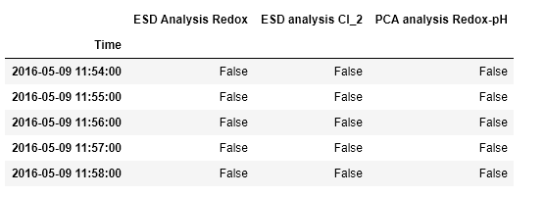
Mohammed, Reeshika, Elaheh, Sunitha
27.01.2020

Slide 28
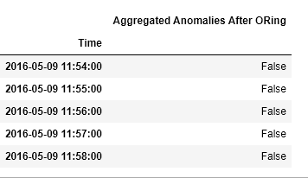
Mohammed, Reeshika, Elaheh, Sunitha
27.01.2020

Slide 29
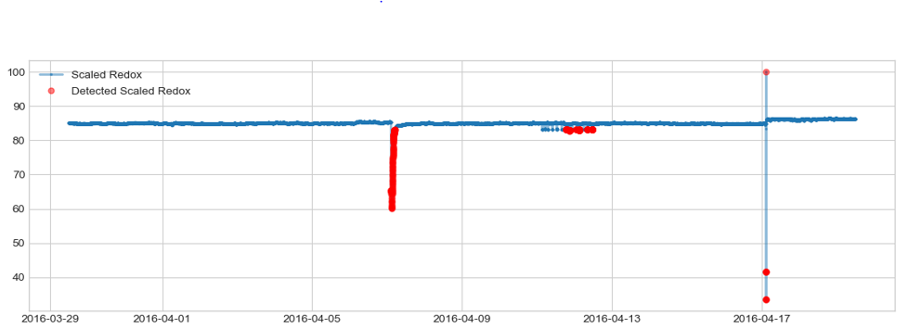
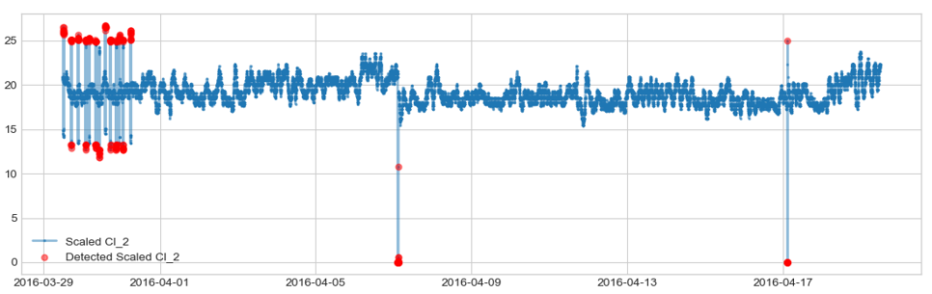
Generalized ESD Algorithm on REDOX and CL_2

Slide 30
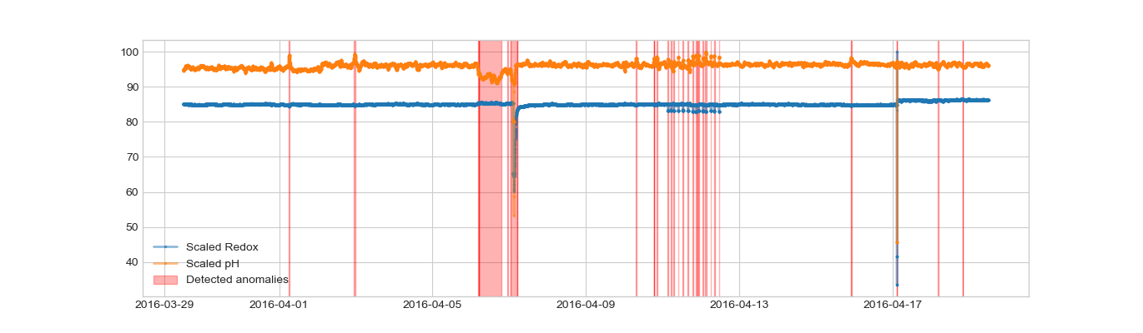
PCA Analysis on REDOX-pH
Mohammed, Reeshika, Elaheh, Sunitha
27.01.2020

Slide 31
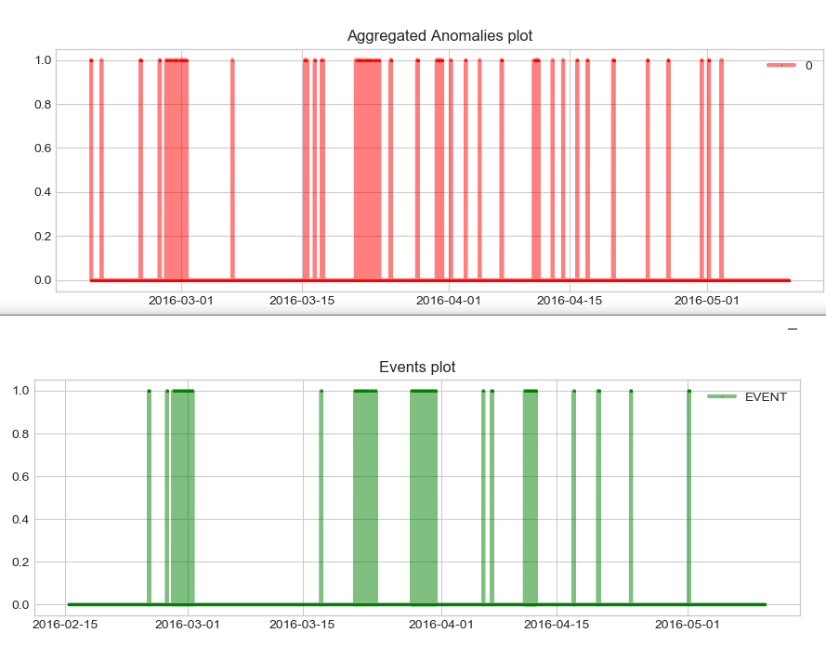
Mohammed, Reeshika, Elaheh, Sunitha
27.01.2020

Slide 32
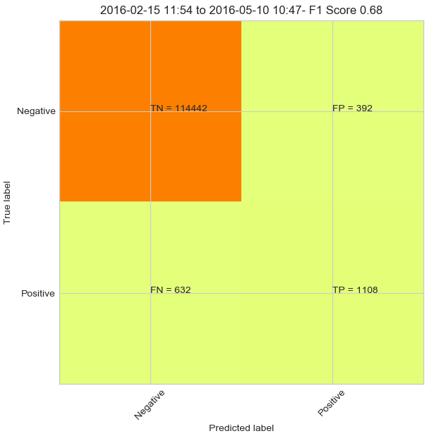
Confusion Matrix of PCA-ESD algorithm
Mohammed, Reeshika, Elaheh, Sunitha
27.01.2020

Slide 33
Comparison of 2 Algorithms - METRICS
ALGORITHM | True Positive | True Negative | False Positive | False Negative | Precision True Events | Recall True Events | Accuracy | F1_score of True Events
PCA-ESD | 1108 | 114442 | 392 | 632 | 0.74 | 0.64 | 0.99 | 0.68
ESD | 949 | 114442 | 392 | 791 | 0.71 | 0.55 | 0.99 | 0.62
PCA | 265 | 114834 | 0 | 1475 | 0.1 | 0.15 | 0.99 | 0.26
Mohammed, Reeshika, Elaheh, Sunitha
27.01.2020

Slide 34
Implementation by
Detecting Anomalies in Online fashion
Using Kapacitor and Influx DB
Mohammed, Reeshika, Elaheh, Sunitha
27.01.2020

Slide 35
Fetching Real Time Data using Kapacitor and InfluxDB:
Using Python the design have been implemented to fetch the history and the current values
The outliers have been detected
Outliers have been sent back to influxDB.
InfluxDB, stores the timestamp along with the anomaly detected points. Then they are visualized in Grafana.
Kapacitor: Process streaming data in real-time
Mohammed, Reeshika, Elaheh, Sunitha
27.01.2020

Slide 36
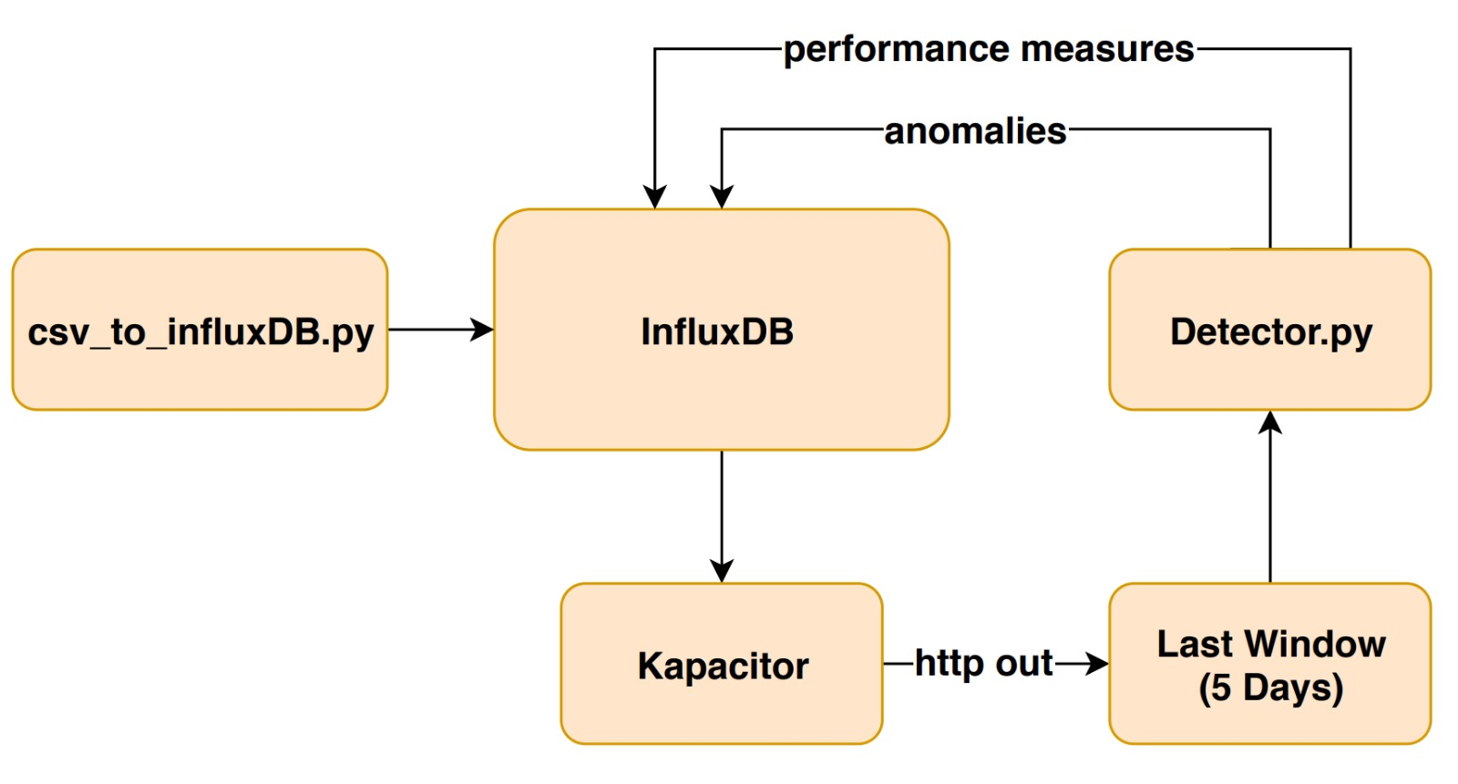
How Kapacitor works ?
Mohammed, Reeshika, Elaheh, Sunitha
27.01.2020

Slide 37
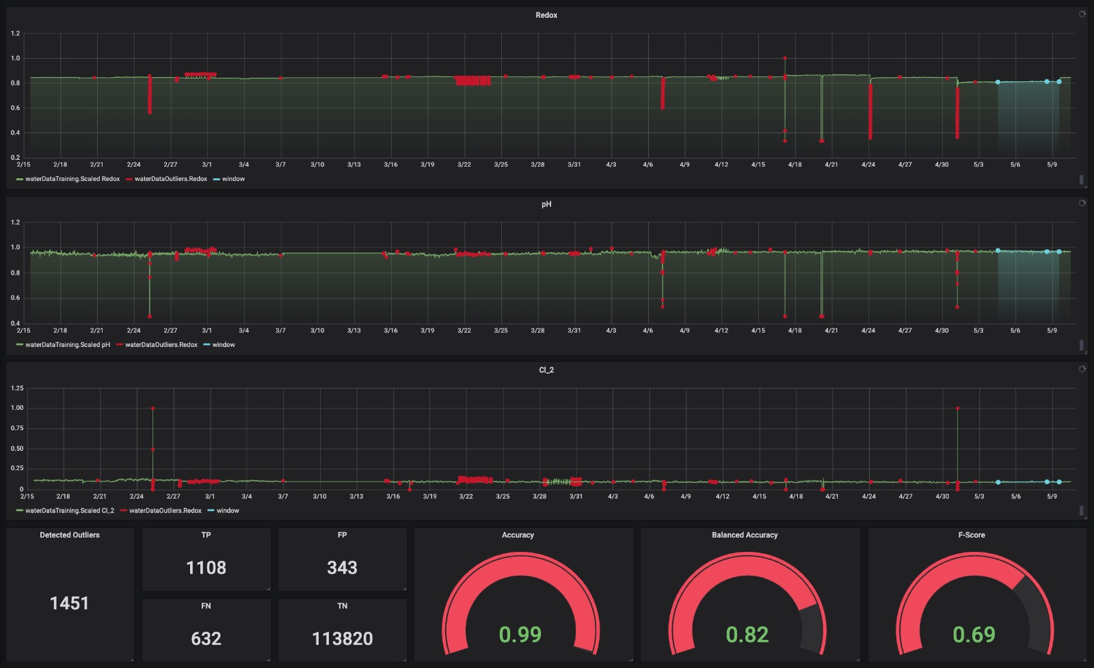
RESULTS
Mohammed, Reeshika, Elaheh, Sunitha
27.01.2020

Slide 38
Short Demo on Anomaly Detection using Kapacitor
Mohammed, Reeshika, Elaheh, Sunitha
27.01.2020

Slide 39
Conclusion
Hence, in this case study anomaly detection using multivariate time series dataset has been studied. With help of different machine learning algorithms like PCA and Generalized ESD, anomalies have been detected and implemented in Python. These algorithms were verified in Influx DB – Kapacitor - Grafana interface in a real time scenario. Metrics like confusion matrix, F1 Score, Accuracy, etc. were calculated. Out of 1760 True events, 1108 anomalies were detected and F1 Score of 69% has been achieved.
Mohammed, Reeshika, Elaheh, Sunitha
27.01.2020

Slide 40
References
Rameswara Anand.P, Tulasi Krishna Kumar.K : PCA Based Anomaly Detection. International Journal of Research in Advent Technology, Vol.2, No.2, February 2014 E-ISSN: 2321-9637
https://arundo-adtk.readthedocs-hosted.com/en/stable/notebooks/demo.html - Anomaly Detector Toolkit library in Python
https://www.itl.nist.gov/div898/software/dataplot/refman1/auxillar/esd.htm – Generalized ESD Test
https://www.influxdata.com/time-series-platform/kapacitor/ - Kapacitor and Influx DB Interface
https://grafana.com/grafana/ - Data Visualization
Mohammed, Reeshika, Elaheh, Sunitha
27.01.2020

Slide 41
Thank you
Mohammed, Reeshika, Elaheh, Sunitha
27.01.2020

