Slide 1

Clustering
Machine Learning Algorithm using Python
Dr. Mahesh Ramalingam
Associate Professor & Area Chairperson
Analytics & IT, IMT Hyderabad

Slide 2
Introduction to clustering
Clustering is usually one of the first tasks performed in most analytics projects. It helps data scientists to analyze individual clusters further.

Slide 3
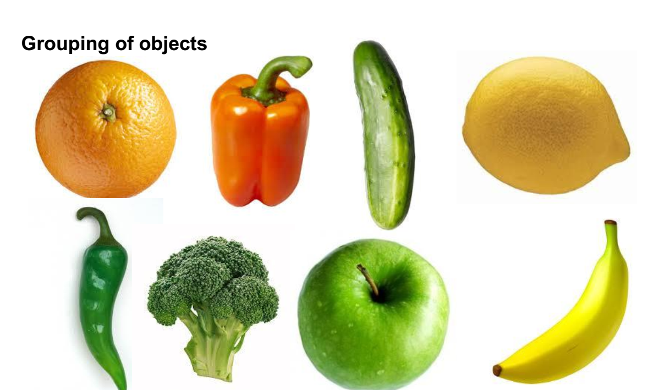
What is clustering?

Slide 4
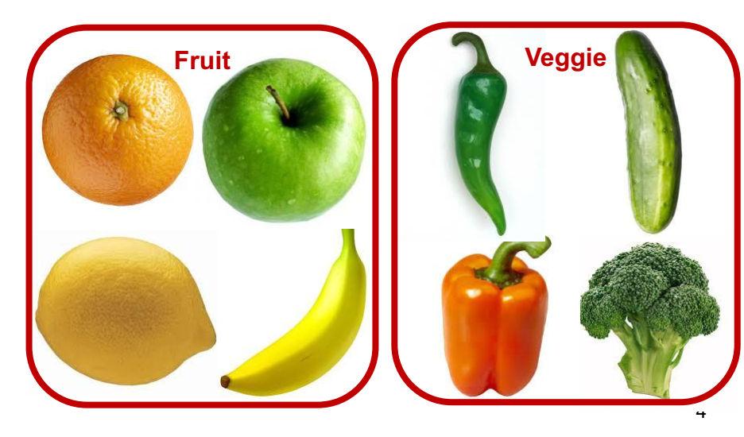
Clustering (By Type)

Slide 5
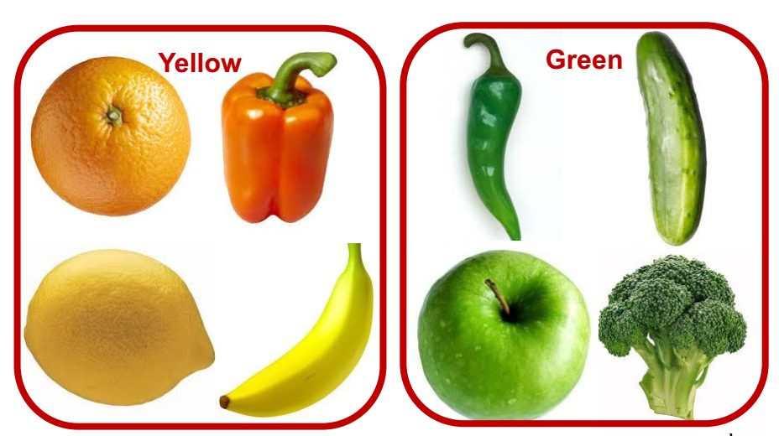
Clustering (By Color)

Slide 6
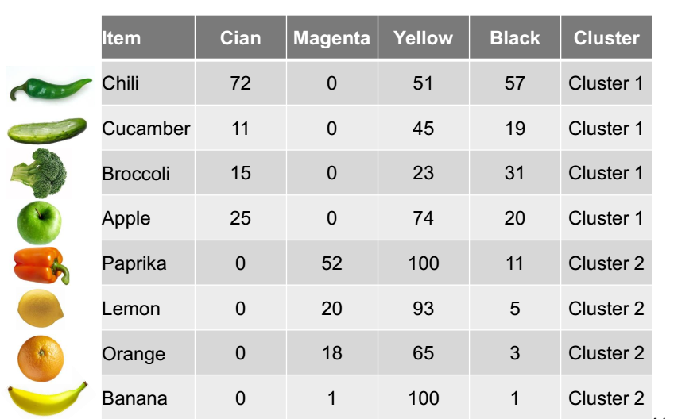
Clustering by color example

Slide 7
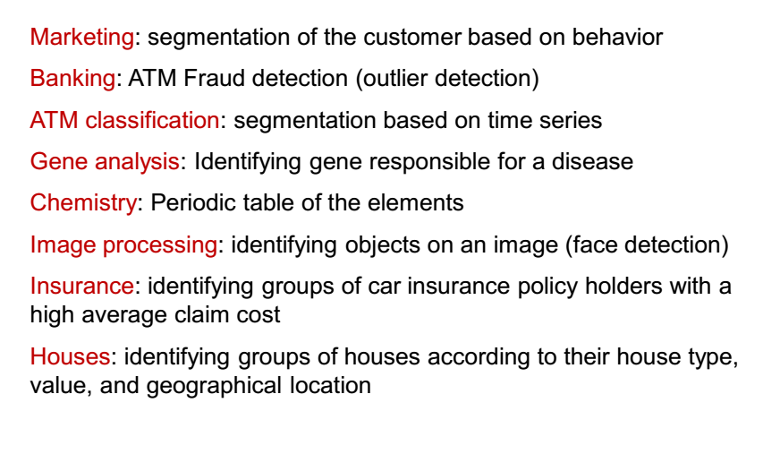
Applications of Clustering

Slide 8
What is Cluster analysis?
Cluster analysis is a techniques for grouping objects, cases, entities on the basis of multiple variables.
The advantage of the technique is that it is applicable to both metric and non-metric data.
The grouping can be done post hoc , i.e. after the primary data survey is over.
The technique has wide applications in all branches of management . However, it is most often used for market segmentation analysis.

Slide 9
Cluster analysis- basic tenets
Can be used to cluster objects, individuals and entities
Similarity is based on multiple variables
Measures proximity between study variables
Groups that are grouped in one cluster are homogenous as compared to others
Can be conducted on metric, non-metric as well as mixed data

Slide 10
Usage of cluster analysis
Market segmentation – customers/potential customers can be split into smaller more homogenous groups by using the method.
Segmenting industries – the same grouping principle can be applied for industrial consumers.
Segmenting markets – cities or regions with similar or common traits can be grouped on the basis of climatic or socio-economic conditions.

Slide 11
Usage of cluster analysis
Career planning and training analysis – for human resource planning people can be grouped into clusters on the basis of their educational/experience or aptitude and aspirations.
Segmenting financial sector/instruments – different factors like raw material cost, financial allocations, seasonality and other factors are being used to group sectors together to understand the growth and performance of a group of industries.

Slide 12
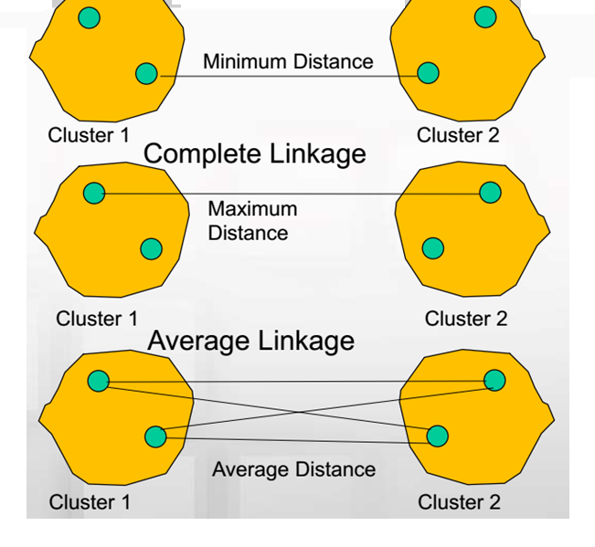
Linkage Method

Slide 13
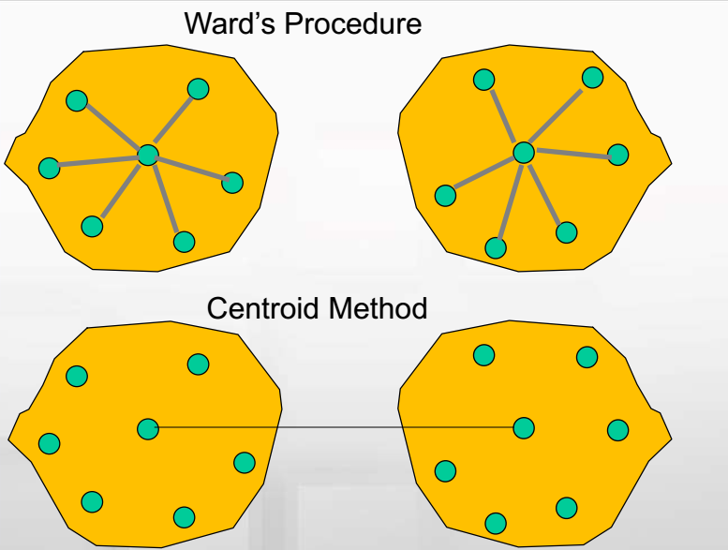

Slide 14
OVERVIEW
Clustering is frequently used in analytics applications. It helps create a homogeneous group of customers/entities for better management of customers/entities.
In many analytics projects, clustering is carried out before applying other analytical models once data preparation is completed.
It divides the dataset into homogenous groups which can be further used to prescribe the right strategy for different groups.
The aims to ensure that the variation within a cluster is minimized while the variation between clusters is maximized.
Clustering algorithms are unsupervised learning algorithms (classes are not known a priori).
The main objective of clustering is to create heterogeneous subsets (clusters) from the original dataset such that records within a cluster are homogeneous. It also aims to identify the characteristics that differentiate the subsets.

Slide 15
HOW DOES CLUSTERING WORK?
Clustering algorithms use different distance or similarity or dissimilarity measures to derive different clusters.
The type of distance/similarity measure used plays a crucial role in the final cluster formation.
Larger distance would imply that observations are far away from one another, whereas higher similarity would indicate that the observations are similar.

Slide 16
HOW DOES CLUSTERING WORK? (contd…)
Finding Similarities Using Distances
Clustering techniques assume that there are subsets in the data that are similar or homogeneous. One approach for measuring similarity is through distances measured using different metrics. Few distance measures used in clustering are:
Euclidean Distance: It is the radial distance between two observations or records.
Minkowski Distance: It is the generalized distance measure between two observations.
Jaccard Similarity Coefficient: It is a measure used when the data is qualitative, especially when attributes can be represented in binary form.
Cosine Similarity: In this, X₁ and X₂ are two n-dimensional vectors. It measures the angle between two vectors.
Gower’s Similarity Coefficient: This can be used when both quantitative and qualitative features are present.

Slide 17
K-MEANS Clustering
It is a non-hierarchical clustering method in which the number of clusters (K) is decided a priori.
The observations in the sample are assigned to one of the clusters (say C₁, C₂, …, C_{k}) based on the distance between the observation and centroid of the clusters.
The following steps are used in K-means clustering algorithm:
Decide the value of K (which can be fine-tuned later).
Choose K observations from the data that are likely to be in different clusters. There are many ways of choosing these initial K values; the easiest approach is to choose observations that are farthest (in one of the parameters of the data).
The K observations selected in step 2 are the centroids of those clusters.
For remaining observations, find the cluster closest to the centroid. Add the new observation (say observation j) to the cluster with the closest centroid. Adjust the centroid after adding a new observation to the cluster. The closest centroid is chosen based upon an appropriate distance measure.
Repeat step 4 until all observations are assigned to a cluster.

Slide 18
CREATING PRODUCT SEGMENTS USING CLUSTERING
Product segmentation is another example of clustering.
Let us take the example of a company that would like to enter the market with a new beer brand. Before it decides the kind of beer it will launch, it must understand what kinds of products already exist in the market and what kinds of segments the products address. To understand the segments, the company collects specification of few samples of beer brands.
Dataset: The dataset used is dataset beer.csv
Number of Clusters: For such high-dimensional data, the following techniques can be used for discovering the possible number of clusters:
Dendrogram
Elbow method
Creating Clusters: It is found that there are 3 clusters.
Interpreting the Clusters: The 3 clusters are created and numbered as cluster 0, 1, and 2. Print each cluster independently and interpret the characteristic of each cluster. We can print each cluster group by filtering the records.

Slide 19
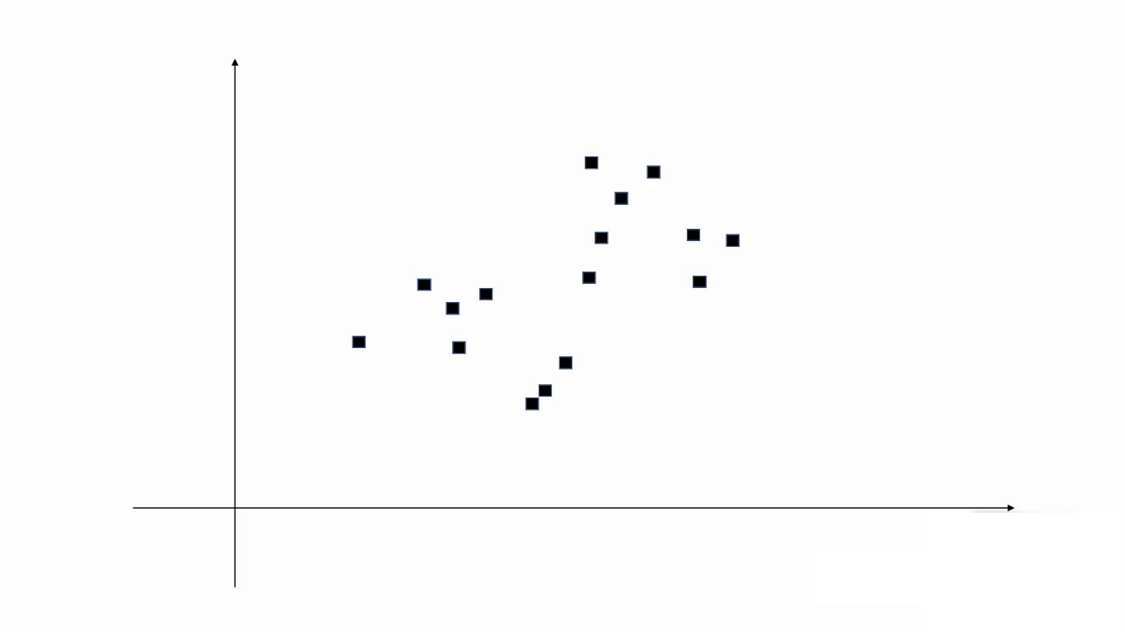


Slide 20
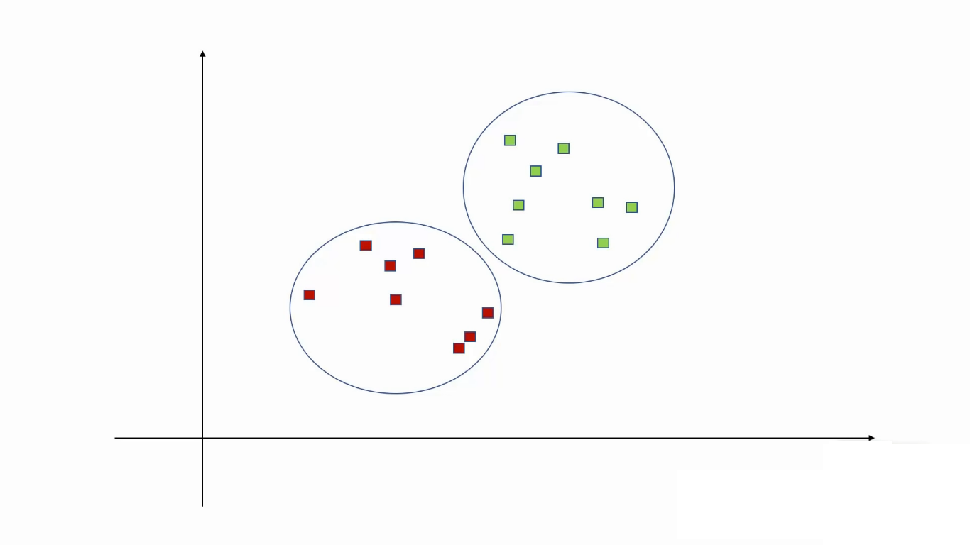

Slide 21
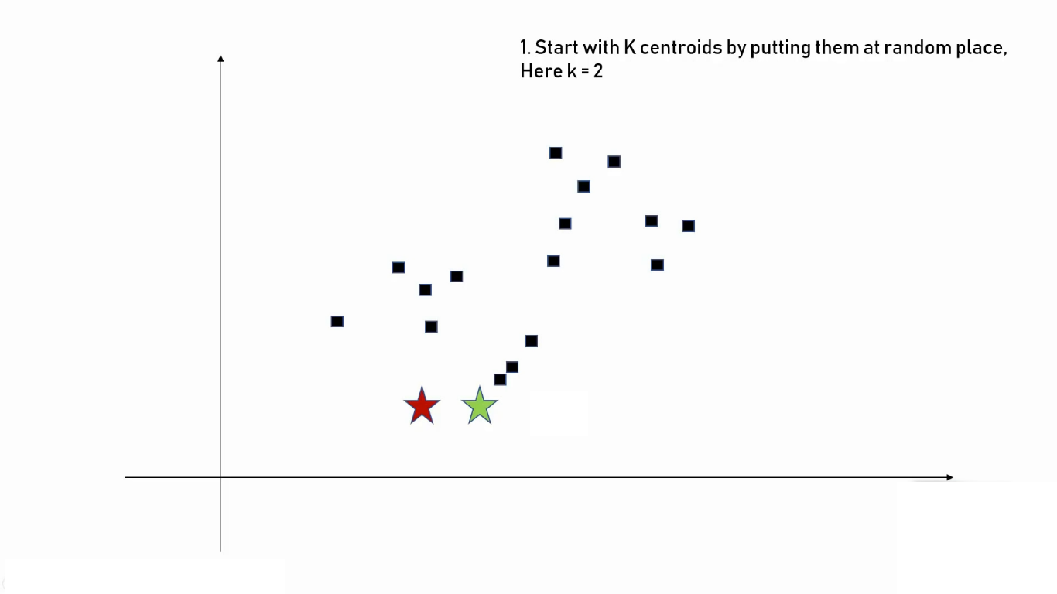

Slide 22
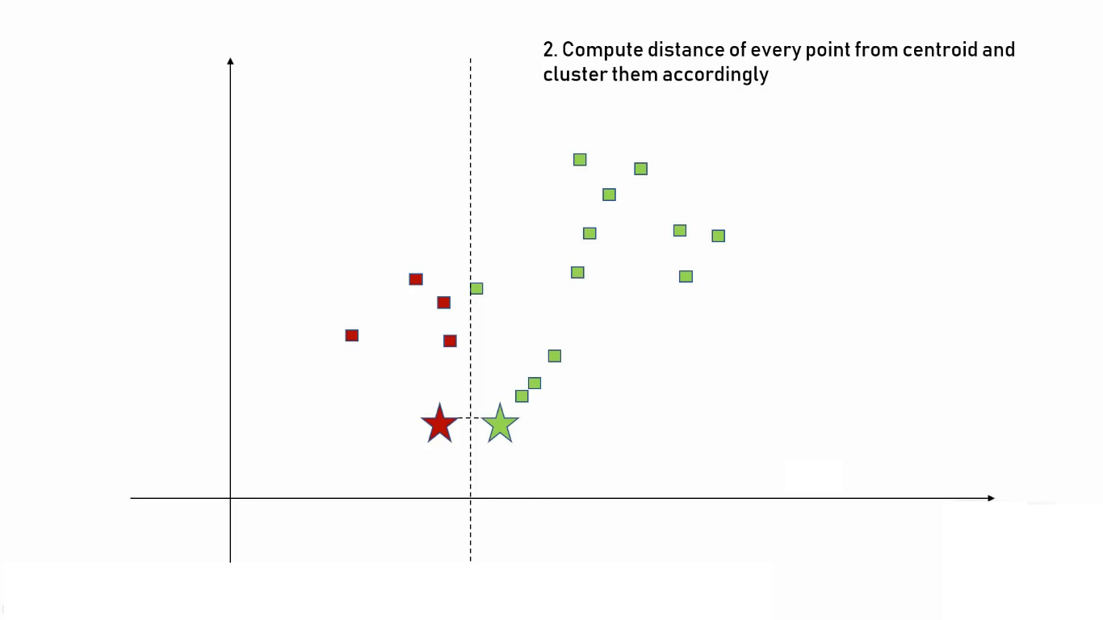

Slide 23


Slide 24
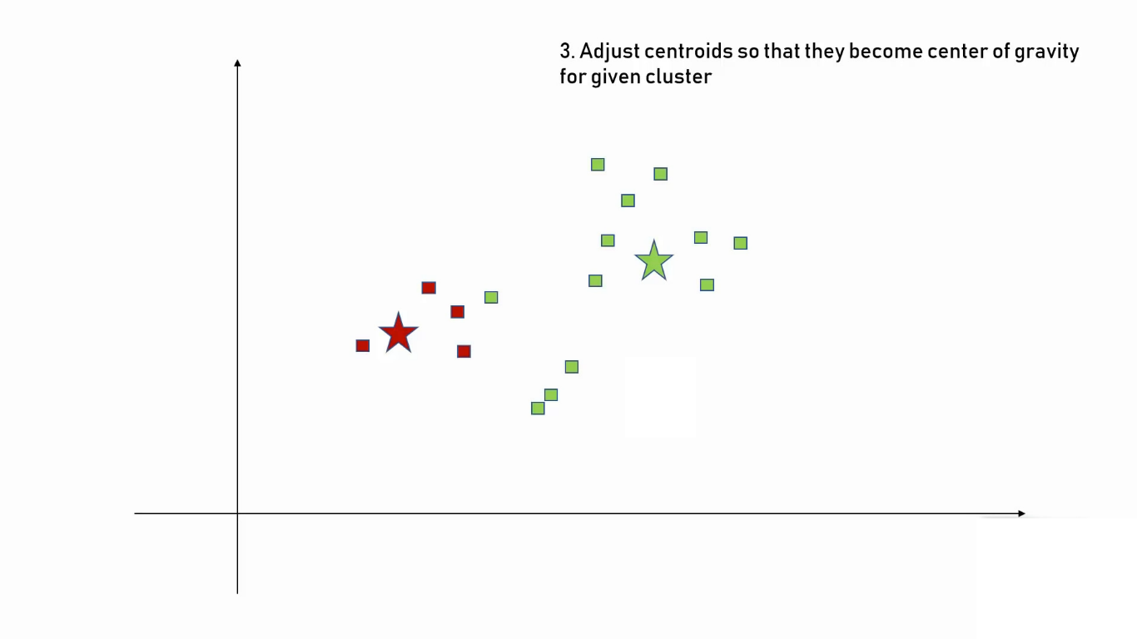

Slide 25
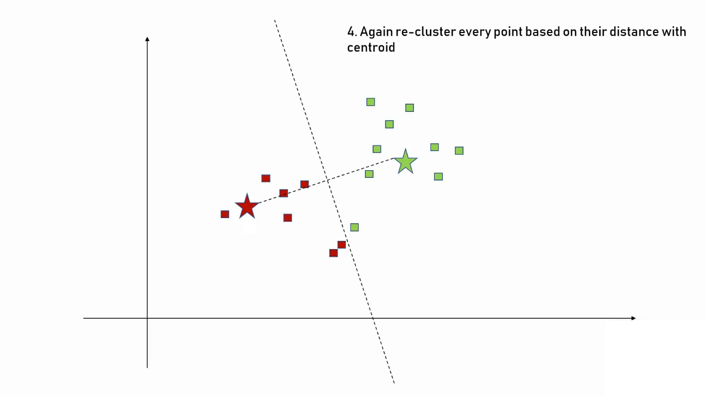

Slide 26
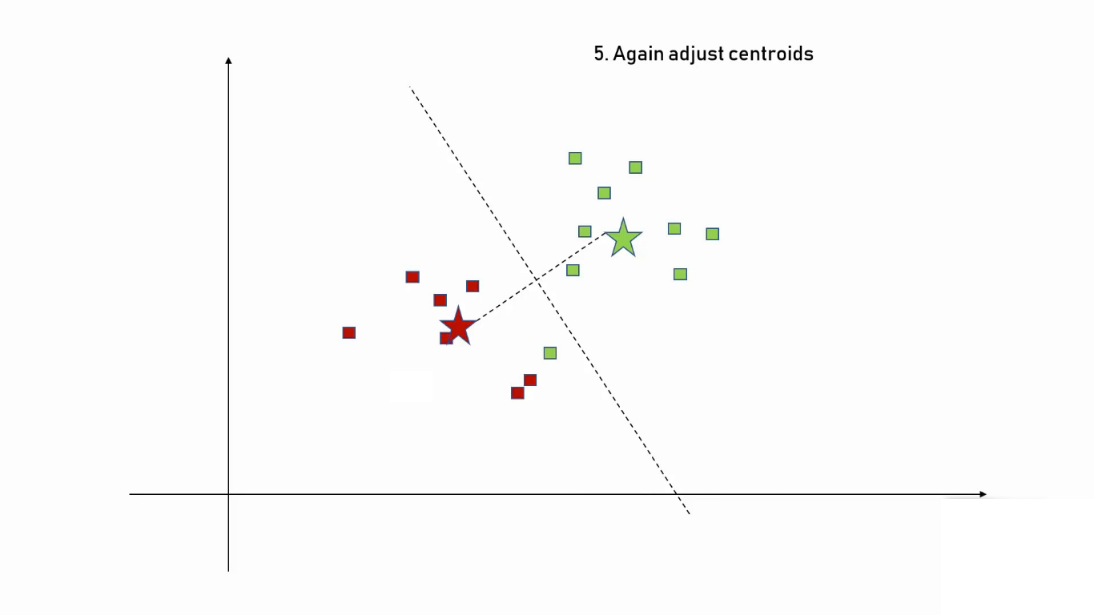

Slide 27
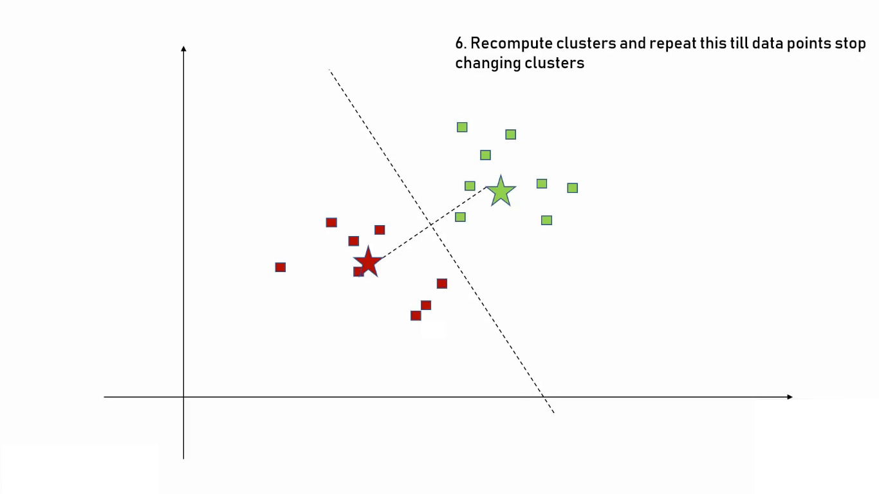

Slide 28
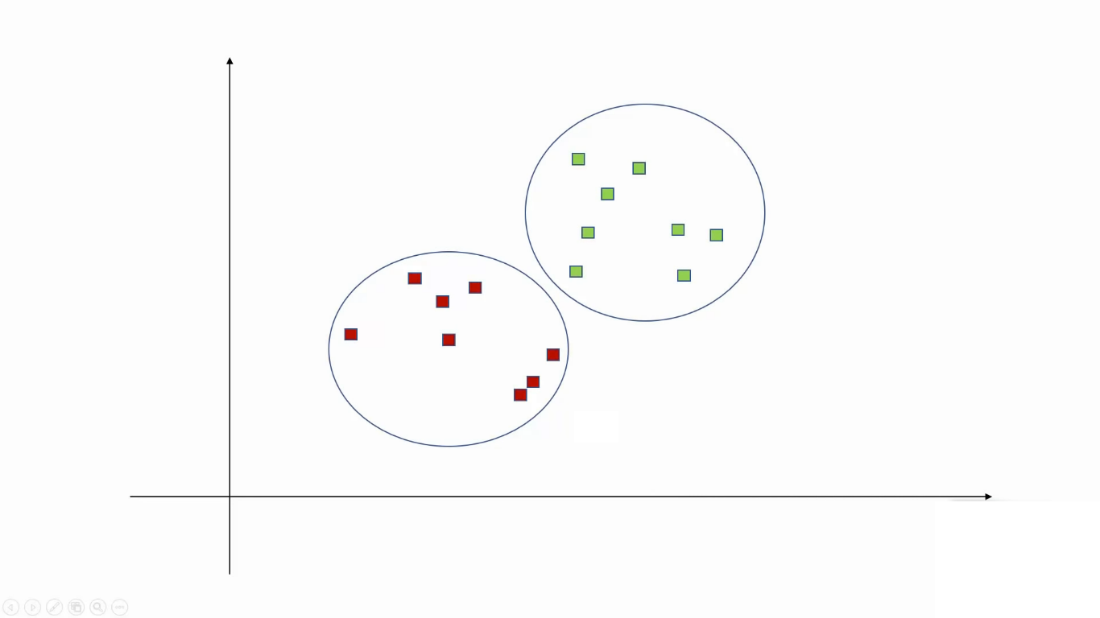

Slide 29
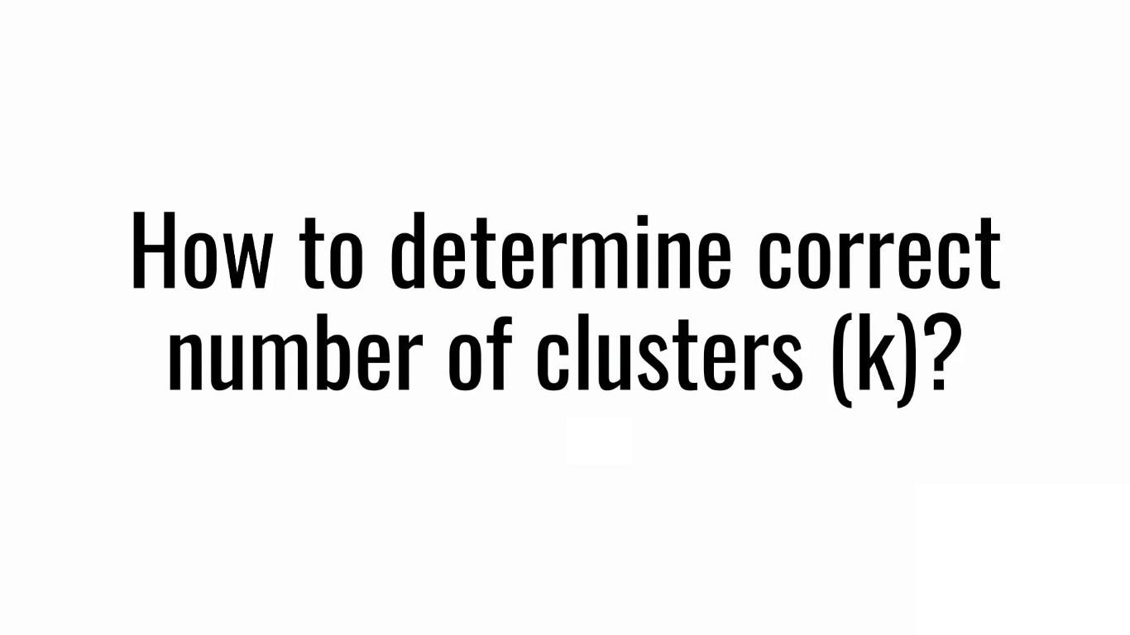

Slide 31
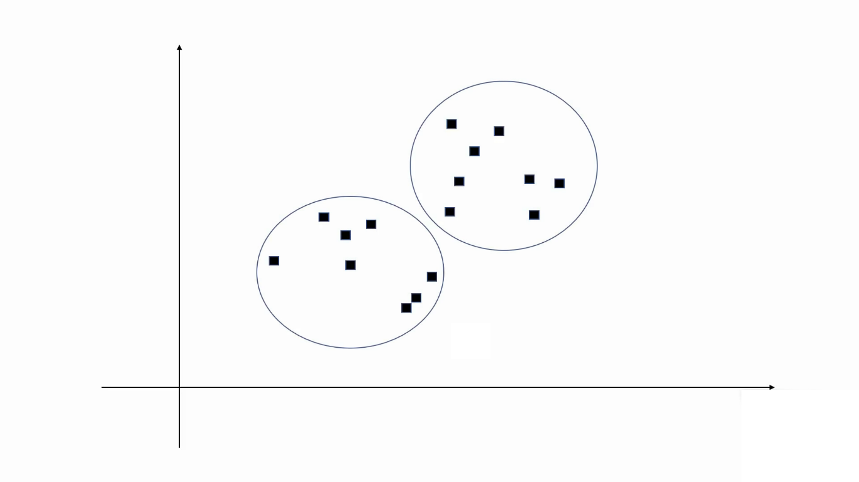

Slide 32
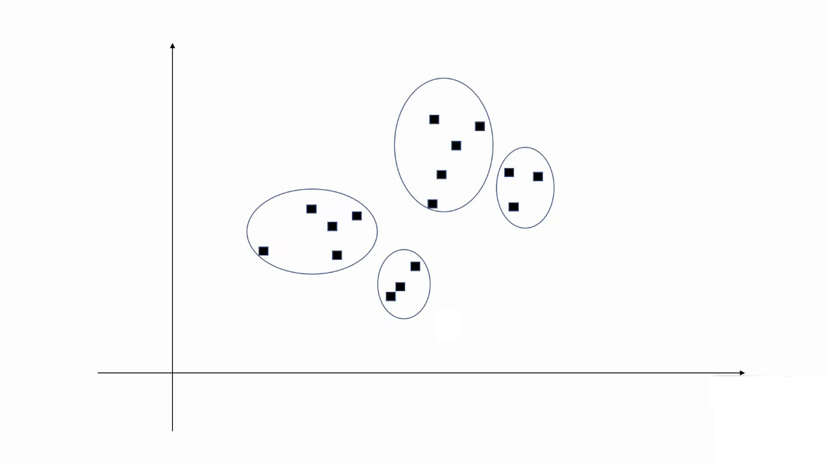

Slide 33
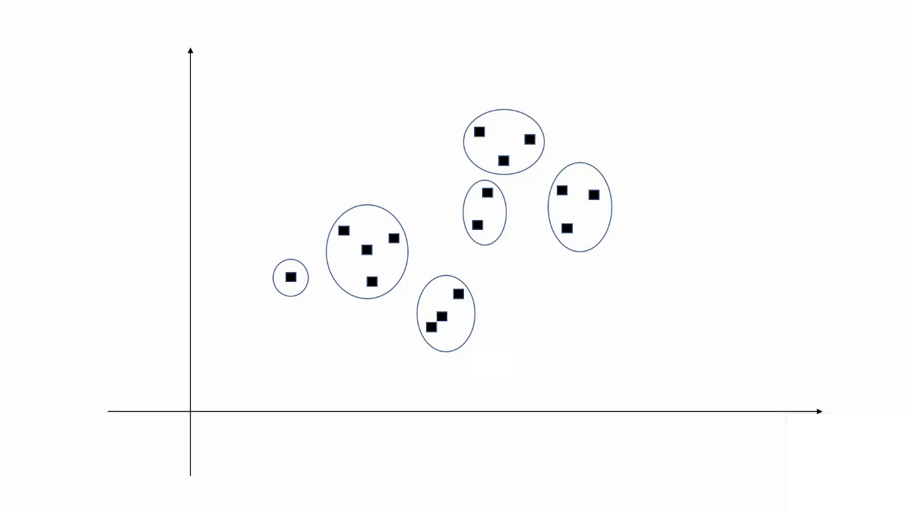

Slide 34
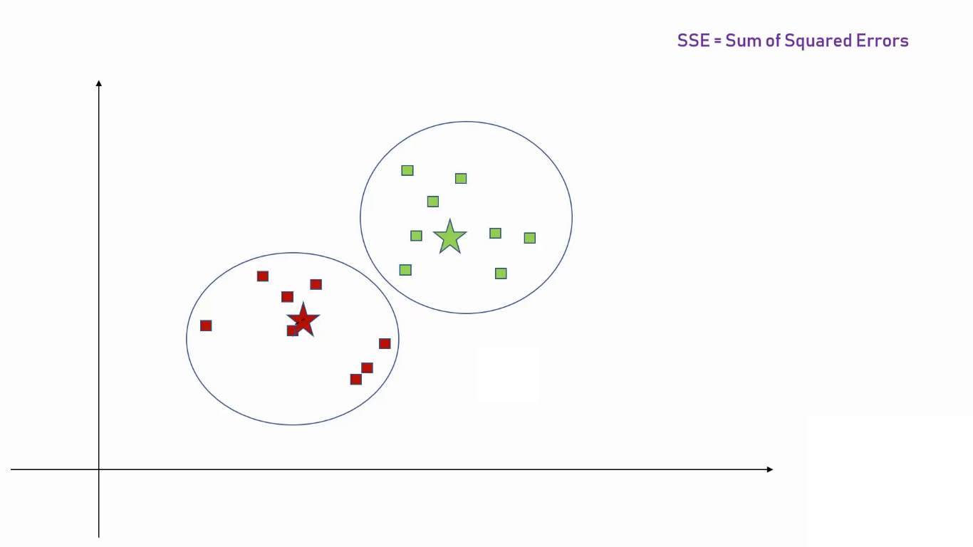

Slide 35
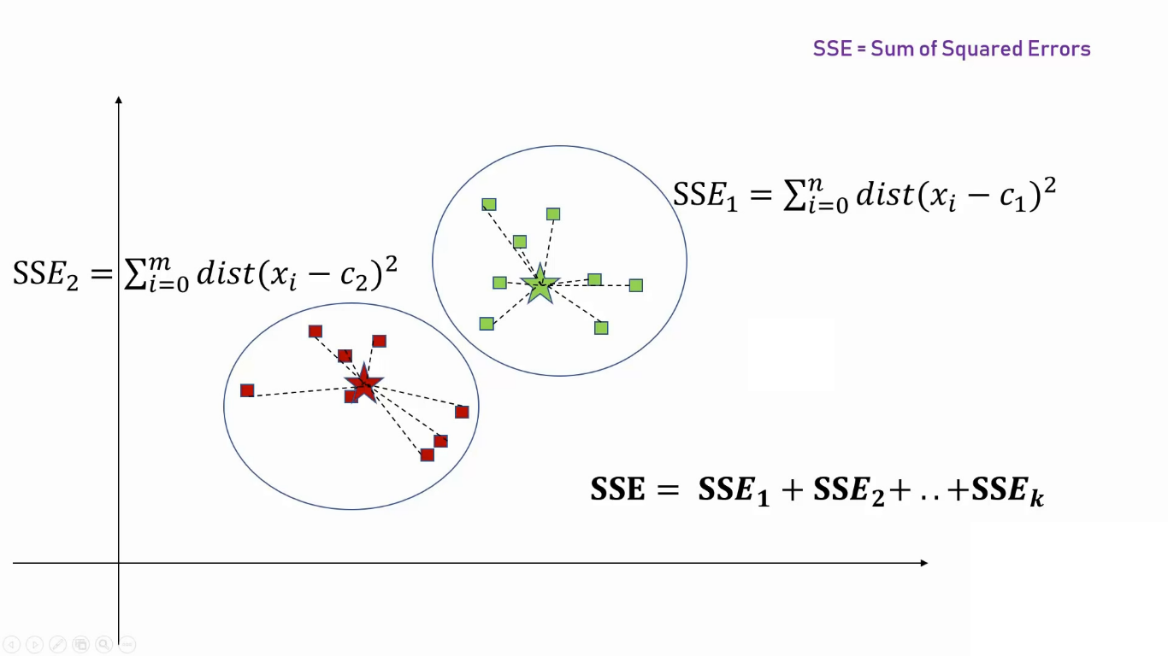

Slide 36
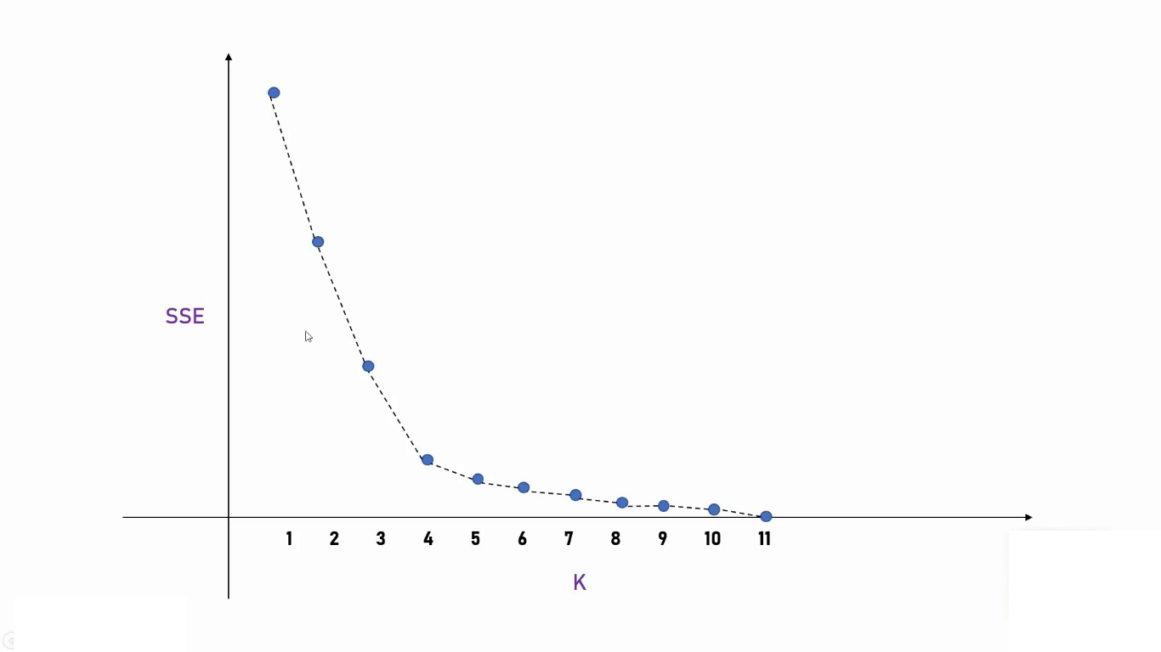

Slide 37
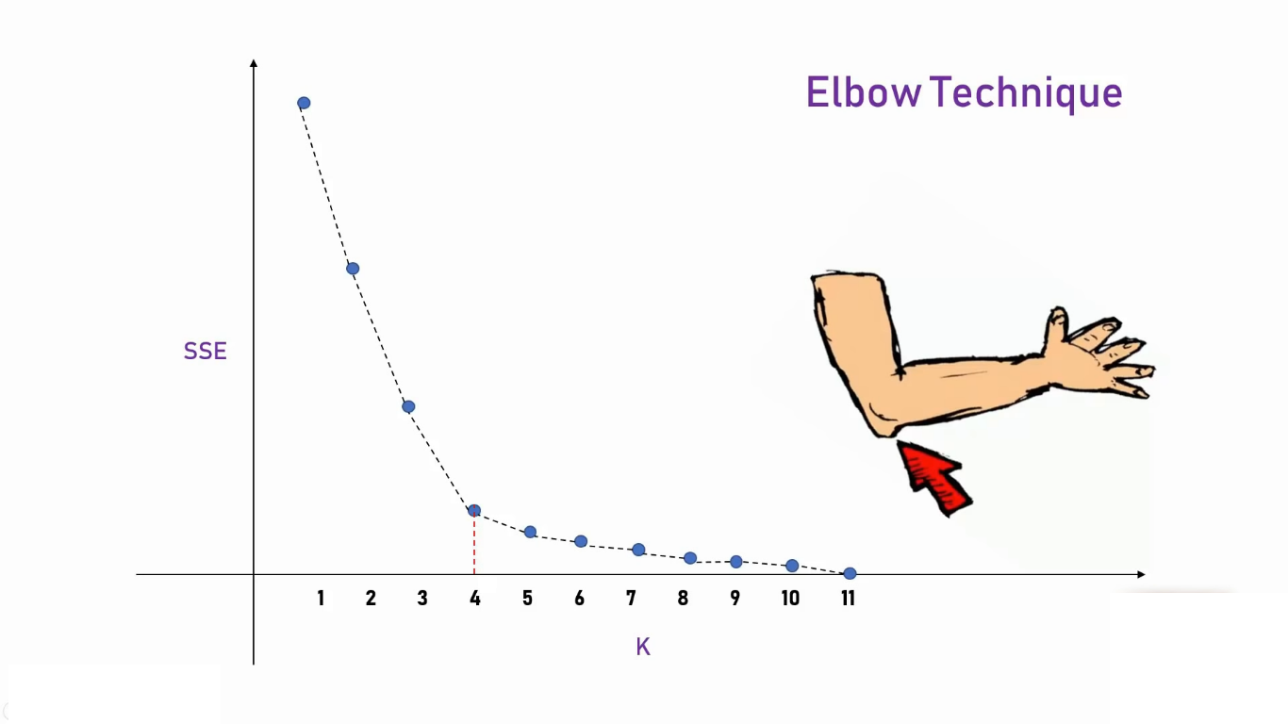

Slide 38
HIERARCHICAL CLUSTERING
This is a clustering algorithm which uses the following steps to develop clusters:
Start with each data point in a single cluster.
Find the data points with the shortest distance (using an appropriate distance measure) and merge them to form a cluster.
Repeat step 2 until all data points are merged together to form a single cluster.
The above procedure is called agglomerative hierarchical cluster.
AgglomerativeClustering in sklearn.cluster provides an algorithm for hierarchical clustering and also takes the number of clusters to be created as an argument.
The clustering can be represented and understood by using a dendrogram.

Slide 39
Hands-on

