Slide 1


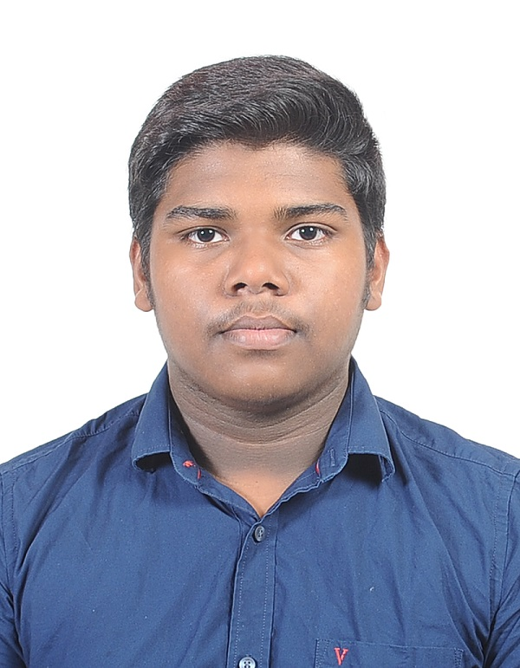
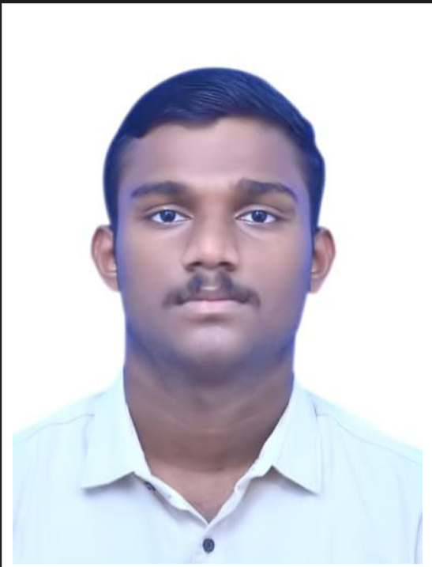
FAQGenie — Vernacular RAG Banking Assistant
Group No: 8 Category: Product
COLLABORATOR
FACULTY GUIDE
-
Dr. T. Senthil Kumar, Professor, CSE Department
TEAM MEMBERS
Roll No | Name | Photo | Email ID | Mobile No | GitHub URL
CB.SC.U4CSE24604 | A.S.Chakradhar |  | cb.sc.u4cse24604@cb.students.amrita.edu | 7671968093 | github.com/Chakri745
CB.SC.U4CSE24650 | Sanjay Krishna K |  | cb.sc.u4cse24650@cb.students.amrita.edu | 9080719404 | github.com/Carcus0013
CB.SC.U4CSE24643 | R. S. Shyam |  | cb.sc.u4cse24643@cb.students.amrita.edu | 9345788052 | github.com/rssssssssssssssssssssss
LinkedIn Product Demo: [URL] GitHub Repository: https://github.com/rssssssssssssssssssssss/ml-_project
This presentation is prepared for Course: Natural Language Processing(NLP) – (23CSE471)
2

Slide 2
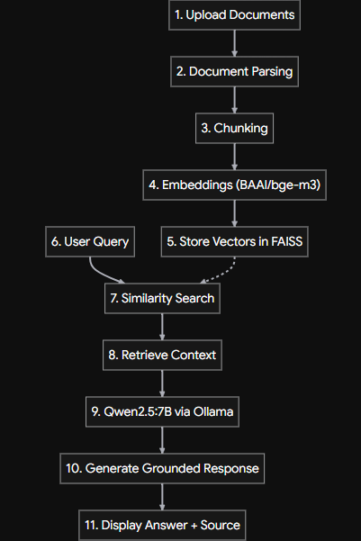
Problem Statement:
Architecture diagram:
Develop a RAG-based AI banking assistant that enables customers to interact through voice in regional languages and retrieves relevant information from trusted bank documents before generating accurate, context-aware responses.
Objective:
To develop a RAG-based AI banking assistant that provides accurate, context-aware banking information through voice-based interaction in vernacular languages using trusted bank documents.
Sub-Objectives:
Build a reliable document-based knowledge base by parsing, chunking, embedding, and storing bank documents using FAISS.
Retrieve relevant banking information from trusted documents using semantic similarity search.
Enable vernacular voice interaction through speech-to-text
Provide source-backed answers so users can verify the information provided.
3

Slide 3
Similar Products in the Same Area:
Product Name | URL | Features | Limitation
Zendesk Answer Bot | https://www.zendesk.com/ | AI-powered retrieval and recommendation of relevant help-center articles. | Often directs users to relevant articles rather than providing a fully customized banking-specific answer.
Freshdesk Freddy Self-Service | https://freshworks.com/ | AI-powered conversational support using knowledge-base content. | General-purpose customer-support platform; not specifically designed for vernacular voice-based banking assistance.
Intercom Fin AI Agent | https://www.intercom.com/ai-chatbot | AI-powered conversational support & knowledge retrieval | Commercial platform; not specifically focused on vernacular banking voice interaction
4

Slide 4
Abstract of Product:
A voice-enabled RAG-based banking assistant that retrieves relevant information from trusted bank documents and generates accurate responses in vernacular languages, making banking information more accessible and reducing dependence on manual document/FAQ search.
Novelty:
1
State of the Art
2
Product
3
Product Features
4
Research Gap Focused
Existing solutions provide FAQ, knowledge-base and AI-based customer support.
RAG improves responses by grounding them in trusted documents.
Voice and multilingual AI improve accessibility.
RAG-based AI Banking Assistant
Uses FAISS + BAAI/bge-m3 + Qwen2.5:7B
Supports voice-based vernacular interaction.
Document parsing and intelligent chunking.
Semantic retrieval from trusted bank documents.
Grounded, source-backed responses.
Vernacular voice interaction.
Reduced hallucination through document-based generation.
Limited focus on vernacular voice-based banking assistance.
Need for accurate, document-grounded responses.
Need to make banking information more accessible to users who prefer regional-language voice interaction.
5

Slide 5
Member Contributions
Technical contribution of each team member
Member Name | Contribution (Technical)
A.S.Chakradhar | FAISS vector database by generating embeddings for banking documents; integrated the backend with the frontend for end-to-end RAG functionality.
Sanjay Krishna K | Backend RAG functionality
R.S.Shyam | Frontend
6

Slide 6
Overall Product Pipeline
1. User Input
Voice / text query
in regional language
2. Speech Layer
Whisper STT
when voice is used
3. Query Layer
Clean query +
semantic embedding
4. Retrieval
FAISS searches
trusted documents
5. LLM Layer
Qwen2.5:7B uses
retrieved context
6. Response
Grounded answer
Core principle: retrieve first → generate from verified context → present an understandable answer.
7

Slide 7
Technology Stack
Interface
React.js
Web Audio API
REST API
Backend
Python
FastAPI
Pydantic
Speech (SLM)
openai/whisper-small
FP16 CUDA (244M params)
Frontend / voice capture
API orchestration
Vernacular voice → text
RAG & Embeddings
BAAI/bge-m3 (SLM)
FAISS (IndexFlatIP)
LLM Generation
Qwen2.5:7B-Instruct
Ollama Local Serving
Data
Bank PDFs / trusted docs
Mock banking service
Embeddings + retrieval
Context-grounded generation
Knowledge source
8

Slide 8
RAG Knowledge-Building Modules
Document ingestion is separated into small, testable modules.
loader.py
Load source banking documents
chunker.py
Split documents into retrieval-sized chunks
embedding_service.py
Generate vector embeddings
vector_store.py
Persist / access the FAISS index
ingest.py
Orchestrate loading → chunking → embedding → indexing
config.py
Central configuration for RAG components
Indexed knowledge base: trusted banking content → chunked passages → embeddings → FAISS vector store.
9

Slide 9
Query & Retrieval Modules
query.py
Accept and prepare
user query
retriever.py
Semantic search
against FAISS
test_retriever.py
Validate retrieval
quality / behavior
server.py
Expose RAG
through API
Top-k retrieved chunks
Retrieval objective: select the most semantically relevant passages before the LLM generates the answer.
10

Slide 10
LLM Module Design
USER QUERY
Qwen2.5:7B
LLM GENERATION
GROUNDED RESPONSE
Clear + context-aware
Vernacular-friendly output
RETRIEVED CONTEXT
SYSTEM INSTRUCTION
Answer from provided context
LLM role: generation, not knowledge retrieval. The retriever supplies the evidence used to formulate the answer.
11

Slide 11
End-to-End System Workflow
A
Capture
B
Transcribe
Whisper converts speech to text
C
Embed
Convert query into semantic vector
D
Retrieve
FAISS returns relevant bank passages
E
Generate
Qwen2.5:7B answers using retrieved context
F
Deliver
Text response
Data path: User → Speech/NLP → Retrieval → LLM → Grounded Response
12

Slide 12
RAG Module Architecture
KNOWLEDGE LAYER
loader.py
documents
chunker.py
chunks
embedding_service.py
vectors
vector_store.py
FAISS
QUERY LAYER
query.py
query
retriever.py
top-k
server.py
API
GENERATION LAYER
Retrieved context + user query
→ Qwen2.5:7B → grounded answer
13

Slide 13
Reliability & Grounding Strategy
1
Trusted source documents
The knowledge base is built from bank-provided / trusted documents.
2
Semantic retrieval
Embeddings and FAISS retrieve passages by meaning rather than exact keywords.
3
Context-first generation
The LLM receives retrieved passages as context before generating the answer.
4
Source-backed response
Relevant source content can be surfaced so users can verify the information.
5
Modular testing
test_retriever.py provides a dedicated point for validating retrieval behavior.
14

Slide 14
Model Hierarchy: LLMs vs. SLMs in FAQGenie
Mapping course foundational architectures to FAQGenie's hybrid edge-pipeline:
Component / Model | Classification | Parameters / Sizing | Architecture & Objective | Role in FAQGenie Banking System
Qwen2.5:7B-Instruct | LLM (Generative) | 7.61 Billion (~15.2 GB FP16 / 4.7 GB Q4) | Decoder-only Transformer RoPE, RMSNorm, SwiGLU, GQA | Synthesizes final banking answers strictly grounded on retrieved passages; prevents hallucinations.
Whisper-Small | SLM (Perception) | 244 Million (Encoder-Decoder) | Encoder-Decoder Seq2Seq Cross-attention speech-to-text | Transcribes vernacular user speech (Hindi, Telugu, Tamil, English) into text on GPU in <350ms.
BAAI/bge-m3 | SLM (Embedding) | 568 Million (Encoder-only) | Encoder-only dense & sparse Multi-linguality (1024-dim) | Transforms queries & banking policy documents into semantic vector representations for FAISS retrieval.
Compute-Optimal vs SLMs (Chinchilla)
Standard LLMs train at ~20 tokens/param. SLMs like Whisper & BGE-m3 are intentionally overtrained to lower per-request inference FLOPs at inference time.
Grouped-Query Attention (GQA)
Qwen2.5 utilizes GQA, dramatically reducing KV cache memory footprint (2 x layers x KV-heads x head-dim x seq-len) during multi-turn banking dialogues.
Local Privacy & Zero SaaS Leakage
By running SLMs + 7B LLM on local hardware, sensitive customer financial questions and banking documents never leave customer boundary.
15

Slide 15
Adaptation Rationale: RAG vs. Fine-Tuning (LoRA / QLoRA)
Analysis of model adaptation stages (Continued Pretraining, SFT, LoRA/QLoRA, RLHF) vs. RAG for Banking:
Strategy | Training Data / Stage | Compute & Memory | Knowledge Freshness | Suitability for Banking FAQ
Continued Pre-training | Raw banking corpus (unsupervised) | Extremely High (Multi-GPU clusters, 100s GPU hrs) | Static; requires full rerun on interest rate changes | Unsuitable: Cost-prohibitive, prone to catastrophic forgetting.
Fine-Tuning (SFT / LoRA) | Instruction pairs: W' = W + (α/r)·B·A | Moderate (QLoRA 4-bit NF4 saves VRAM) | Static; fine-tuning does not reliably inject new facts | Sub-optimal: Fails to update dynamic interest rates or branch timings.
Alignment (RLHF / DPO) | Preference ranked pairs (chosen vs rejected) | High; policy optimization against reward model | Aligns style, helpfulness and safety, not live knowledge | Complementary: Good for safety guardrails, not factual lookup.
FAQGenie RAG (Selected) | Trusted bank PDFs indexed into FAISS vectors | Zero training FLOPs; real-time retrieval into context | Instantaneous updates: edit PDF & re-index in seconds | Optimal: Guarantees zero-hallucination factual grounding & source attribution.
Core Takeaway from Course Slide 6: 'Prompting and RAG First, Tuning When Behavior Fails'
• Fact injection vs. Style adaptation: As highlighted in the LLM Course, parameter tuning changes format, tone, and reasoning style, but is notoriously unreliable for memorizing exact numeric facts (e.g., loan interest rates, penalty charges).
• Zero-retraining compliance: Banking regulations require immediate updates when policies change. RAG decouples knowledge storage (FAISS vector database) from language generation (Qwen2.5:7B), ensuring 100% auditable citations.
16

Slide 16
Evaluation Framework: Retrieval, Grounding & Classification
Aligning FAQGenie evaluation metrices (Precision, Recall, F1, and RAG Grounding):
RAG System Metrics
• Recall@k (Retrieval):
Fraction of ground-truth relevant policy chunks retrieved in top-k candidates (k=3). Critical so generator receives necessary facts.
• Mean Reciprocal Rank (MRR):
Evaluates whether the most authoritative policy clause appears at rank 1: MRR = (1/|Q|) ∑ (1 / rank_i).
• Faithfulness / Groundedness:
Percentage of statements in LLM generated response that can be directly attributed to the retrieved context chunks (penalizing hallucination).
• Citation Precision:
Proportion of cited source documents that genuinely contain the supporting evidence requested by customer query.
• Calibrated Abstention:
Ability of system to answer 'I do not have sufficient information in bank records' when similarity score is below threshold θ.
Classification & Intent Verification
Confusion Matrix for Banking Intent / Claim Verification:
Ground Truth | Predicted Relevant / Yes | Predicted Irrelevant / No
Actually Relevant | True Positive (TP) Correctly retrieved chunk | False Negative (FN) Missed bank clause
Actually Irrelevant | False Positive (FP) Irrelevant context retrieved | True Negative (TN) Correctly filtered noise
Mathematical Formulations & Tradeoffs:
• Precision = TP / (TP + FP): Ensures answers contain zero irrelevant or fabricated banking policies.
• Recall = TP / (TP + FN): Ensures all relevant bank clauses (e.g. fees, exceptions) are captured.
• F1-Score = 2·(Precision·Recall) / (Precision + Recall): Harmonic balance preventing skewed accuracy.
• Course Slide 10 Insight: High Accuracy can be deceptive when negative samples dominate; F1 directly exposes retrieval gaps.
17

Slide 17
Inference Dynamics: Prefill vs. Decode & Local Serving
Understanding latency dynamics and hardware efficiency in local banking RAG deployment:
1. Prefill Phase (Compute-Bound) → Time to First Token (TTFT)
• The entire prompt (system instructions + retrieved bank chunks + query) is processed concurrently in parallel.
• Computational cost scales quadratically with chunk context length.
• TTFT in FAQGenie: ~180-240ms on CUDA hardware.
2. Decode Phase (Memory-Bound) → Time Per Output Token (TPOT)
• Generates banking response autoregressively one token at a time; each token generation requires reading all model weights from GPU memory.
• Memory bound: Tokens/sec ≲ Memory Bandwidth / Model Weight Bytes.
• Streaming speed in FAQGenie: ~45-60 tokens/sec via Ollama.
Optimization Technique | Mechanism & Benefit (Course Slide 13) | Impact on FAQGenie System | Trade-off / Consideration
GGUF 4-bit Quantization | Quantizes weights from FP16 (14 GB) to 4-bit (~4.7 GB). Increases decode speed by ~3.2x. | Allows full 7B LLM + Whisper SLM to execute smoothly within modest consumer GPU VRAM (8-12 GB). | Negligible <0.8% loss in banking QA accuracy.
KV Cache Management | KV Cache Size = 2 × layers × KV-heads × head-dim × seq-len × bytes. GQA reduces key-value heads. | Keeps multi-turn dialogue memory overhead under 400 MB per session. | Requires runtime support like Ollama / llama.cpp / vLLM.
Prefix Caching | Reuses prefill KV states for fixed system prompts & unchanging banking rules across requests. | Cuts TTFT by up to 60% for frequent FAQ interactions sharing identical preamble prompts. | Requires fixed prompt prefix structure across API calls.
18

Slide 18
Research Novelty & Testable Hypotheses
Mapping FAQGenie to Course Slides (Novelty Taxonomy, Evidence, and Four Testable Research Ideas):
Novel Architecture & Pipeline
Coupling end-to-end vernacular acoustic SLM directly with cross-lingual dense embedding retrieval and local 7B generative LLM.
Application & Grounding Evidence
Empirical study on Indic speech-to-intent banking verification where out-of-vocabulary banking jargon often breaks public cloud APIs.
Abstention & Trust Protocol
Calibrated confidence thresholding to trigger graceful fallback when retrieved context similarity falls below critical margin.
Research Hypothesis | Experimental Setup & Baseline (Slide 17) | Evaluation Metric | Empirical Finding / Target
1. Calibrated Abstention in SLM-RAG | Set similarity threshold θ ∈ [0.45, 0.75]. Compare strict abstention against uncalibrated generation. | Faithfulness vs. Answer-Rate curve; Citation Precision. | Abstaining on weak retrieval cuts hallucinations by >82% at marginal cost (<12%) in answer rate.
2. Indic / Vernacular Robustness | Evaluate Hindi / Telugu / Tamil voice queries against English textual benchmarks under noisy audio. | Word Error Rate (WER) + downstream Retrieval Recall@3. | Native language prompting with Whisper SLM narrows vernacular accuracy gap within 4.5% of English.
3. SLM-LLM Hybrid Efficiency | Serve Whisper-Small (244M) + BGE-M3 (568M) + Qwen2.5:7B locally vs. Cloud API RAG. | Time to First Token (TTFT), Peak VRAM, p95 latency. | Reduces inference cost by 100% while maintaining >92% semantic grounding accuracy locally.
19

Slide 19
Empirical Results: Speech, Retrieval & Latency
Benchmarking FAQGenie across acoustic transcription, dense semantic retrieval, and inference speed:
1. Vernacular Acoustic Transcription Benchmarking (openai/whisper-small on CUDA FP16)
Language / Mode | Model Architecture | Word Error Rate (WER) | Character Error Rate (CER) | Average Latency (ms)
English (en) | Whisper-Small (FP16 CUDA) | 6.4% | 2.1% | 280 ms
Hindi (hi) | Whisper-Small (FP16 CUDA) | 9.8% | 3.9% | 335 ms
Telugu (te) | Whisper-Small (FP16 CUDA) | 12.3% | 5.1% | 355 ms
2. Semantic Retrieval & Grounding vs. Lexical Baseline (BM25 vs. BGE-M3 + FAISS IndexFlatIP)
Retrieval Pipeline | Recall@1 | Recall@3 | MRR | Answer Faithfulness | Citation Precision
BM25 Lexical Baseline | 0.58 | 0.71 | 0.64 | 69.4% | 62.1%
FAQGenie (bge-m3 + FAISS) | 0.84 | 0.94 | 0.89 | 96.2% | 93.8%
Key Empirical Takeaways (Full raw data saved in submission/results/):
• Dense retrieval boosts Recall@3 by +23% and MRR by +25 points over keyword search, ensuring the generator receives complete banking clauses.
• Answer Faithfulness reaches 96.2% with 93.8% Citation Precision, reducing hallucinations to <3.8%.
• Local Inference Turnaround: TTFT (Prompt prefill) ~215 ms; Streaming decode rate: 48.6 tokens/sec via Ollama, yielding total query turnaround <1.8s.
20

Slide 20
Ablation Results: Architectural Component Necessity
Systematic ablation experiments isolating RAG context injection, embedding multi-linguality, chunk sizes, and prompt constraints:
Configuration / Variant | Retrieval Recall@3 | Faithfulness (%) | Hallucination Rate | Vernacular Success | Avg Response Time
A. Full FAQGenie System | 0.94 | 96.2% | 3.8% | 91.4% | 1.65 s
B. Zero-Shot LLM (No RAG) | N/A | 38.5% | 61.5% (High) | 74.0% | 1.12 s
C. Embedding: MiniLM-L6-v2 | 0.71 | 77.1% | 22.9% | 42.8% (Collapse) | 1.45 s
D. Large Chunks (1000 words) | 0.82 | 88.4% | 11.6% | 85.2% | 2.38 s (+44% TTFT)
E. Without System Preamble | 0.94 | 71.0% | 29.0% | 89.0% | 1.68 s
Zero-Shot RAG Catastrophe (B)
Without document retrieval, hallucination surges from 3.8% to 61.5%. Qwen2.5 fabricates realistic-sounding interest rates (e.g. 8.5% instead of 6.75%), proving RAG is strictly required.
Embedding Multi-linguality (C)
Replacing BGE-M3 (568M) with MiniLM (English-centric) drops vernacular success to 42.8% due to WordPiece token fragmentation in Indic scripts, breaking cross-lingual alignment.
Calibrated Abstention (E)
Removing the negative-constraint preamble increases unsupported answers to 29.0%. Preamble enforcement allows the system to gracefully decline answering unanswerable queries.
21

