Slide 1
pDiTS #210318 pDiTS #210323
NiMeOS #210324
150K
Anisotropic backbone signal in oxidized pDiTS
--- This Week ---

Slide 2
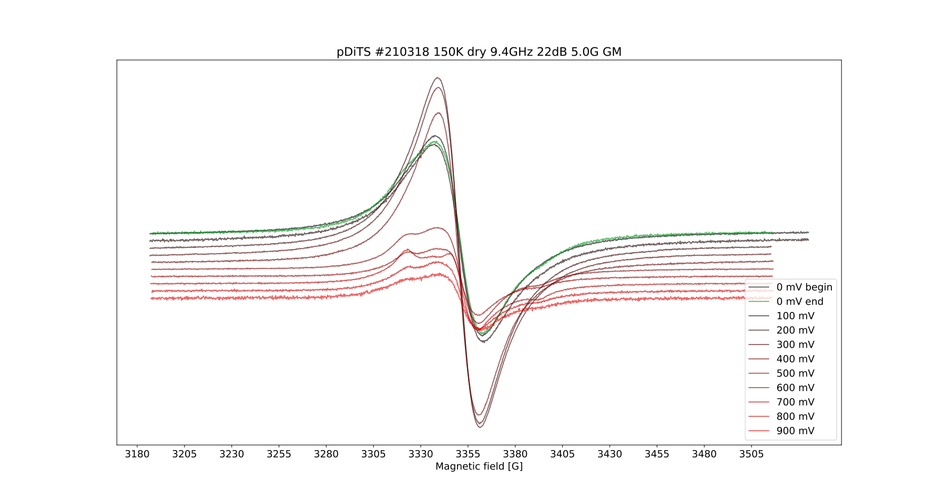
[95 cls]
[0 mV, e on TEMPO]
[500 mV, empty TEMPO?]
[500 mV, h on bb?]
Dry pDiTS film
shows anisotropic Signal 1
of NiMeOSalen after 500 mV
[>500 mV, singlet
bipolarons on bb]
gy
gx
gz
We are injecting
positive charge, but the
signal decreases with
oxidation. Formation of
(bi-polaron)diamagnetic
states on the backbone?
Timonov for NiMeOSalen:
gx = 2.0240
gy = 2.0094
gz = 1.9994

Slide 3
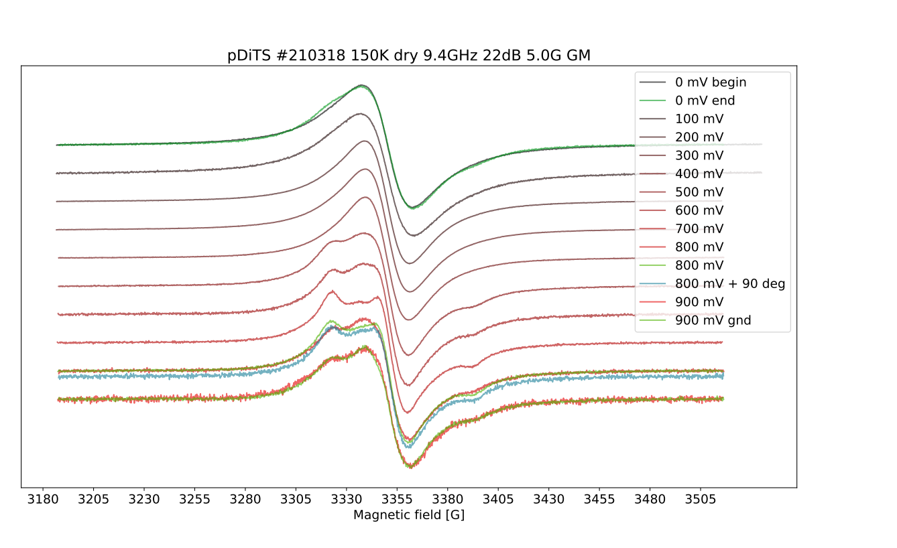
Same again. Normalized signals in the dry 95-cycle pDiTS film.

Slide 4
The Story of Failing
I failed to make a pDiTS cell for an automated high-res 240K red-ox,
because of being greedy (200cv overnight film peeled off)
and impatient (having troubles with AgCl RE in the narrow EPR tube).
My plan was to see the transition from the broad TEMPO line
to the anisotropic backbone signal in pDiTS under oxidation at 240K,
in higher resolution, using EMRE. Problem is, the cell is still liquid
at 240K and I have to use the narrow tube. In that tube the gentle AgCl RE broke.
I failed to get a decent cv in that tube and didn’t invest more t in that.
#ik: Make a [fat] cell in a normal tube, do echem in the tube at RT and freeze
it every time to 150K for taking cwEPR. Stick it to XQ. Forget about EMRE.
On the plot below you can see the cvs for the 70-cycle cell
recorded with different Reference Electrodes:
Ag/AgNO3 (our standard electrode, a silver wire in a membrane-tube with AgNO3)
Ag/AgCl (a silver wire electrochemically coated with AgCl, used in our cell)
Ag (just a ‘naked’ silver wire, that we used before. Turns out to ‘float’)
Ag/AgCl turned out to be very fragile, but yields a stable cv in tube.
This is the only RE that gave a decent cv in an EPR tube (standard 5mm)
And this is the best CV in a tube we have ever had.
Please see the red curve on the plot pDiTS 210323 on the next page.

Slide 5
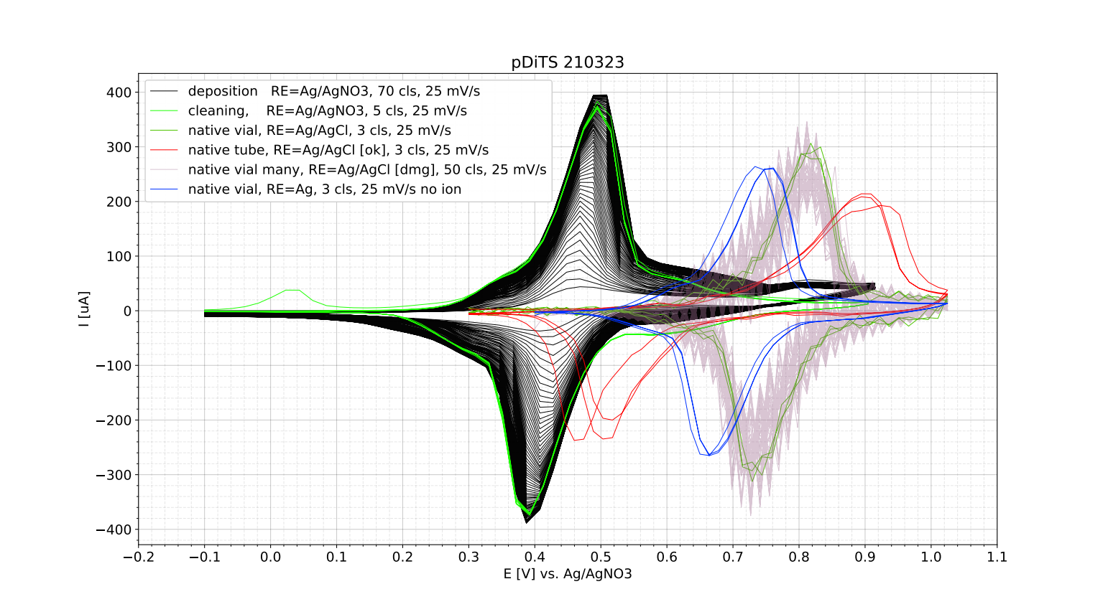
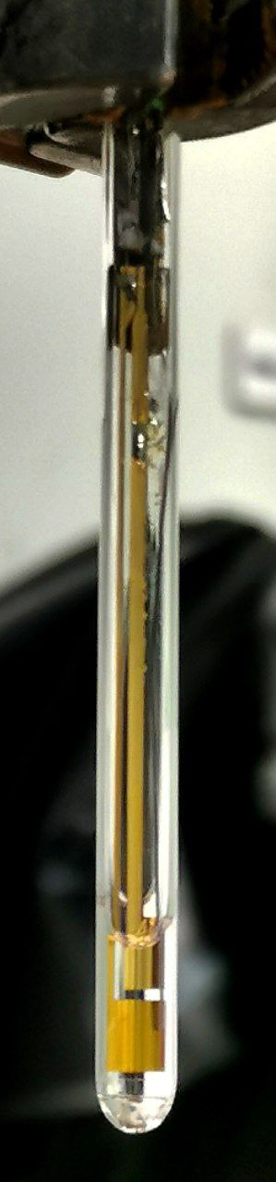
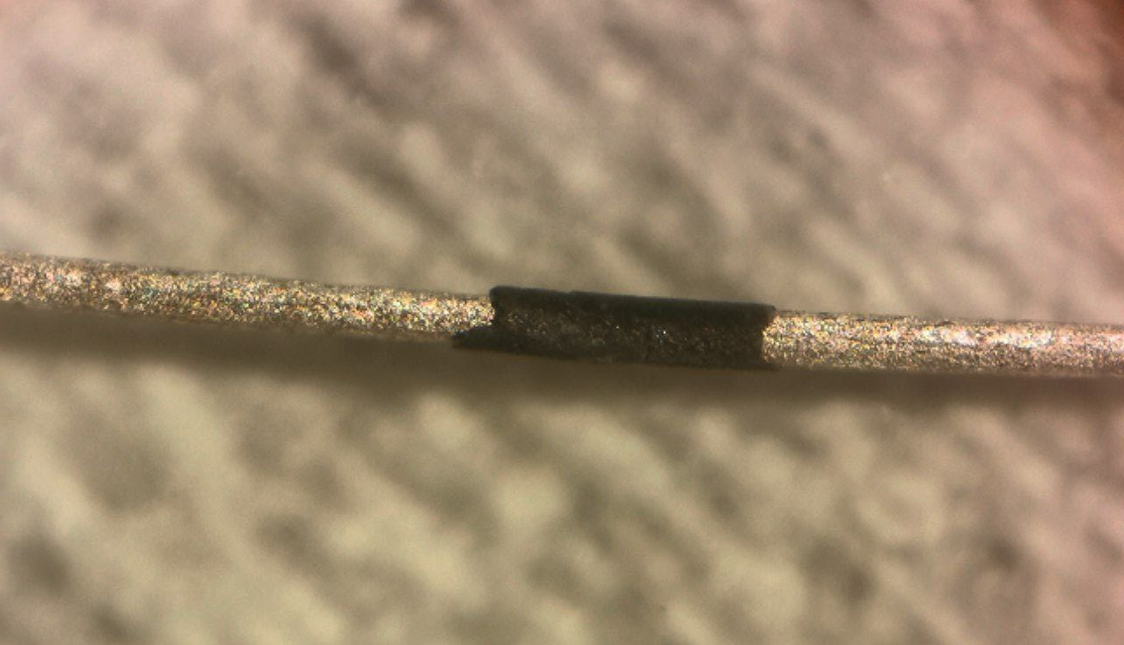
Reference Electrode for a pDiTS Cell
250 um
Ag
AgCl

Slide 6
Cell Design
AgCl coated RE shifts cv to ca. +100 mV,
CV in tube is ok
AgCl layer is fragile
No effect of deionizer found
because AgCl layer was destroyed. Try again.
pDiTS cell failed to show decent CV at RT.
For the next pDiTS red-ox I will use
the normal EPR tube
with ca. 200 uL of electrolyte
And AgCl RE
Doing electrochemistry in the tube
might let us to charge the cell to higher potentials.
Because
“the electrolyte may stabilize the charges in the film”, - NP
From here on the NiMeOS backbone sample is considered.
The aim is to see Signal 1 turining to Signal 2 and a decrease Signal 2.

Slide 7
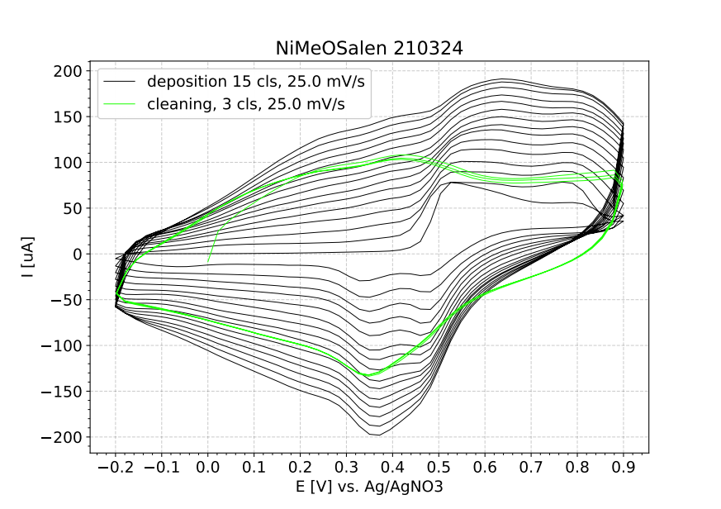
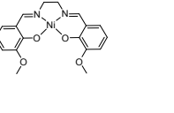
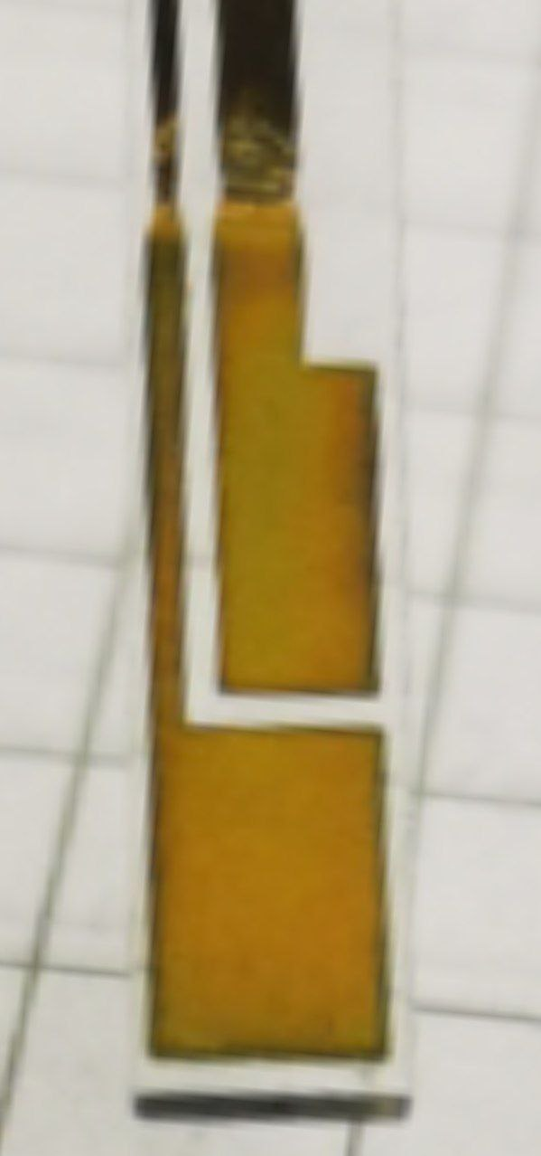
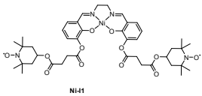
Backbone Deposition (NiMeOS)
NiMeOS
DiTS

Slide 8
Backbone, 150K. Will the signal decrease?
A cell with the NiMeOS molecule was prepared.
This one is similar to DiTS but lacking the TEMPOs and most of the carbon-oxygen linker. The backbone.
Both electrodes were covered with NiMeOS to get more signal. The
oxidation state of the film was being changed by applying a certain voltage to WE with respect to the standard Ag/AgNO3 RE.
In a 5 ml beaker. Outside of the resonator. For 20 to 120 s.
After that, the charged cell was taken out of the beaker, flushed in AN and dried on air (AN dries quickly).
Then inserted to the 5 mm tube. The tube was filled with N2 and sealed with parafilm. Then inserted into the SHQ @150K and 5 or more cw scans were taken at each potential.
Please see the plots on the next slides.

Slide 9
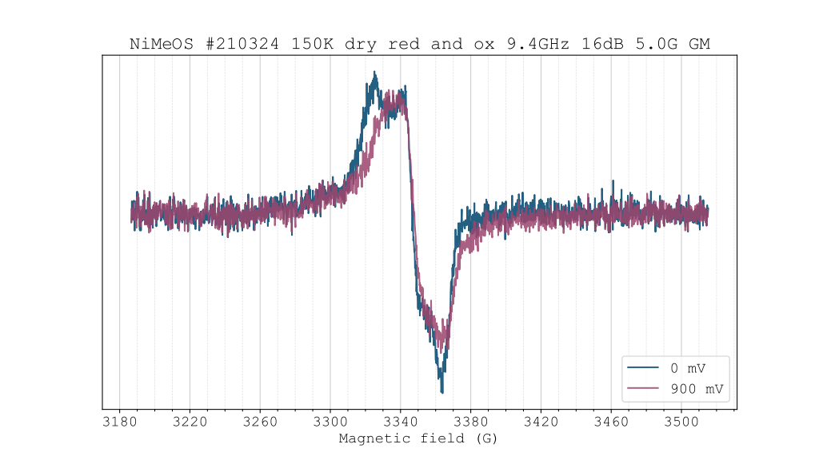
Reduced vs. Oxidized NiMeOS

Slide 10
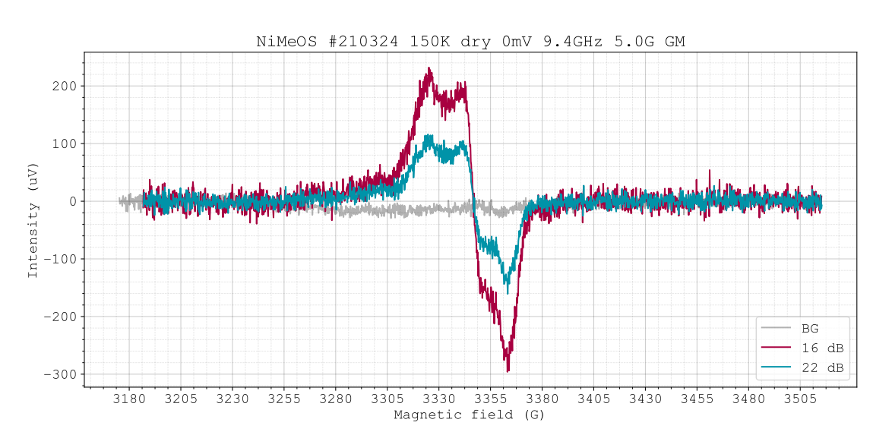
Quick Saturation Check for the Reduced Film
We will measure at 22 dB.

Slide 11
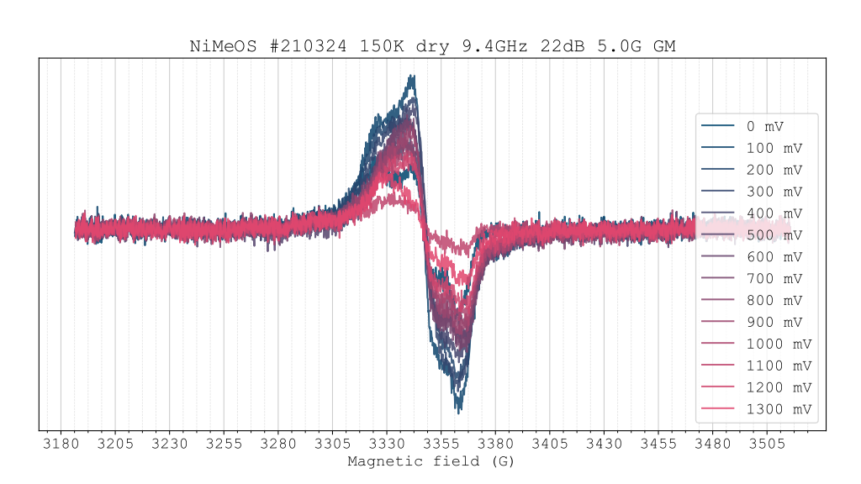
Oxidation Series

Slide 12
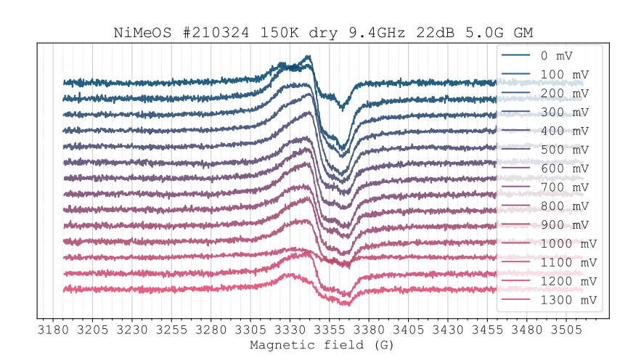
Oxidation Series
Intensities are not normalized. At 1100 mV the signal is minimal.
I forgot to take the Q factor. Naitik, please don’t punch me.

Slide 13
--- Next Week ---
Determine g tensor for NiMeOS with easyspin
Discuss further steps.

