Slide 1
Visual Words
Salient Points in Image
Descriptor of Local Appearance
Quantize to fixed-size dictionary of visual words

Slide 2
Inducing a Graph
K-nearest neighbors
Fixed-radius neighbors
Delaunay Triangulation

Slide 3
K-Nearest Neighbors

Slide 4
Fixed-Radius Neighbors

Slide 5
Delaunay Triangulation

Slide 6
Data
LabelMe
  Web application where users annotate images
  162,988 Images (43,175 annotated)
LabelMe Benchmark Data
  2920 Train/1033 Test Images

Slide 7
Topic Models
Latent Dirichlet Allocation
Author-Topic Model

Slide 8
Experimental Setup
10000 visual codewords
100 visual codewords
5000 relational codewords
  all pairs of 100x100

Slide 9
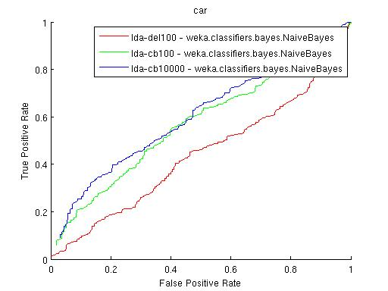
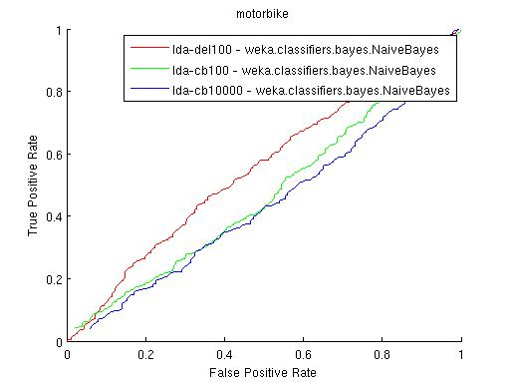
Initial Results
ROC Curves for two object categories
Delaunay feature does poorly
Some improvement, but still
barely better than random

Slide 10
Future Work
Integrate spatial relationships into generative model

