Slide 1
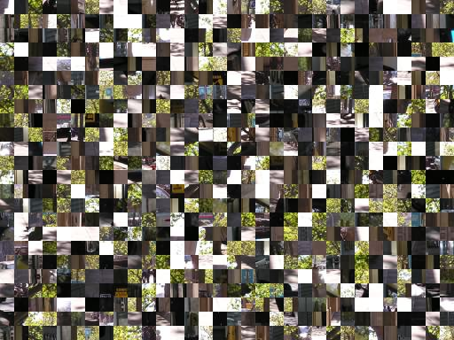
Spatial Relationships in
Image Understanding
Roman Stanchak
CMSC828G Link Mining Poster Session 05/13/2008

Slide 2
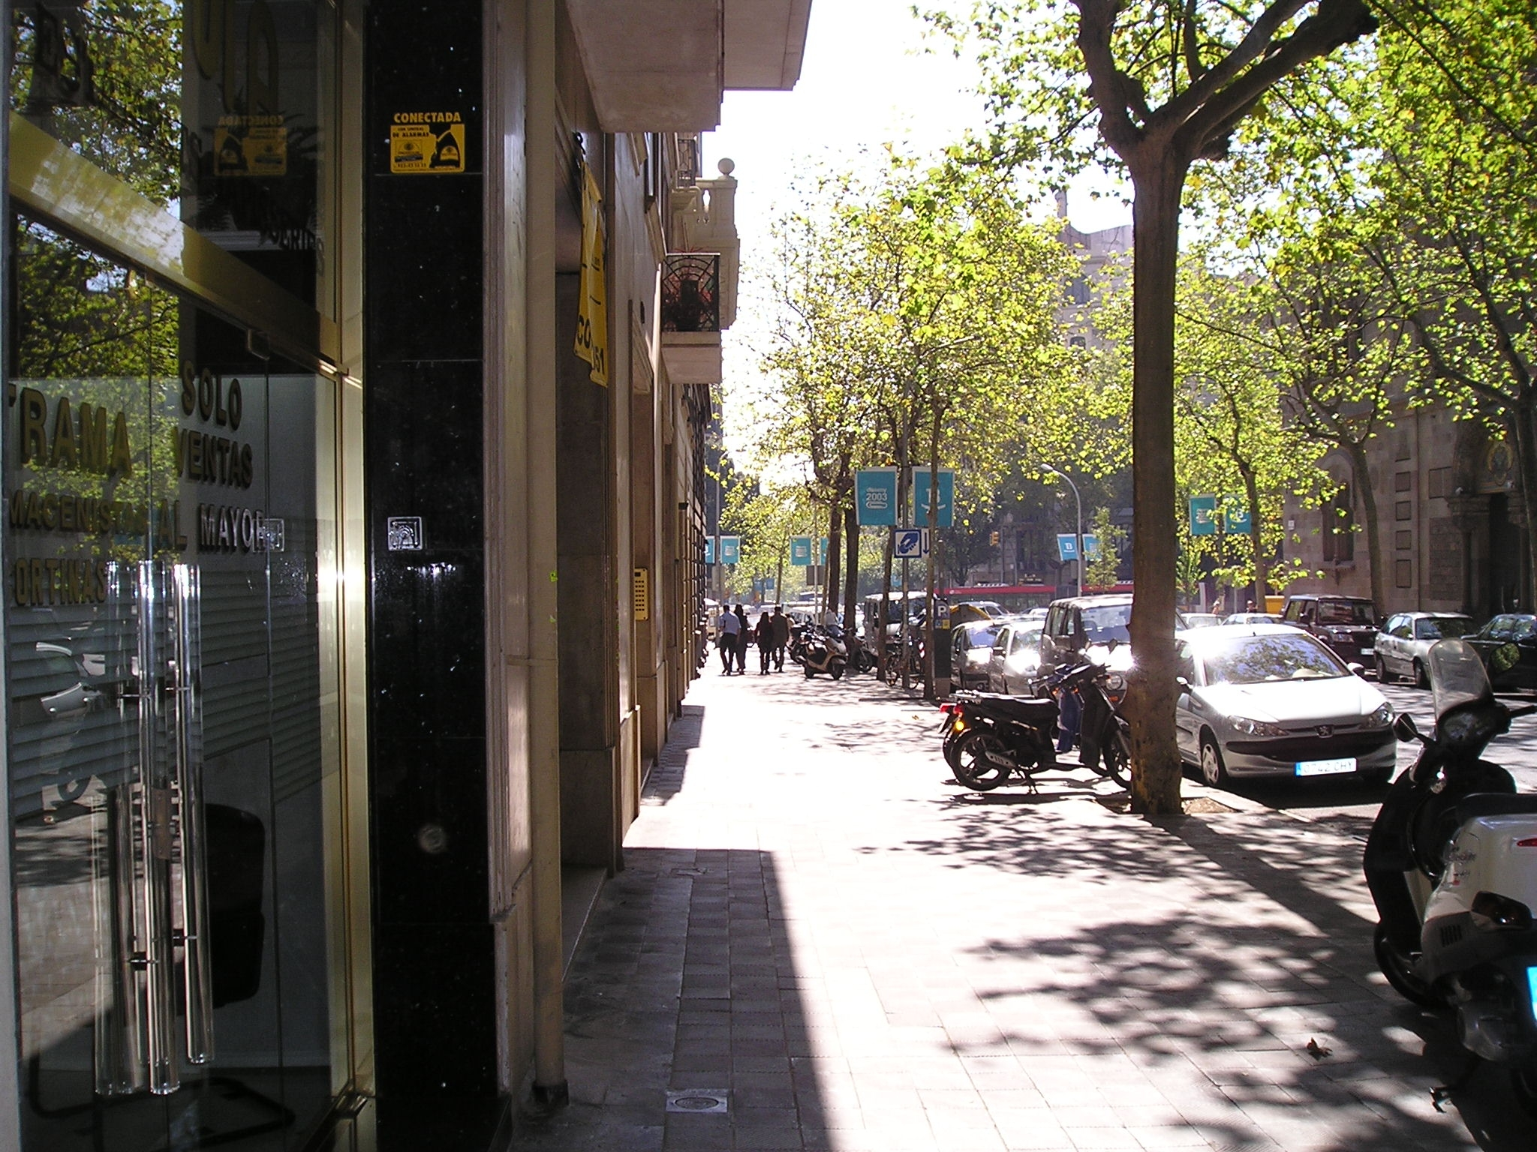
Spatial Context is Important
Roman Stanchak
CMSC828G Link Mining Poster Session 05/13/2008

Slide 3
Project Summary
Author-Topic Model
    Image -> Document
    Image Patch -> Word
    Image Annotation -> Author
Induce a graph on spatial distribution of visual words
    Relational-dictionary of all pairs of visual the dictionary
Bag of Words -> Bag of Neighbors
Roman Stanchak
CMSC828G Link Mining Poster Session 05/13/2008

