Slide 1
Creating, Deploying, & Running SSIS with Variables and Parameters
Robbie Staples, P.E., MCSE, MCSA

Slide 2
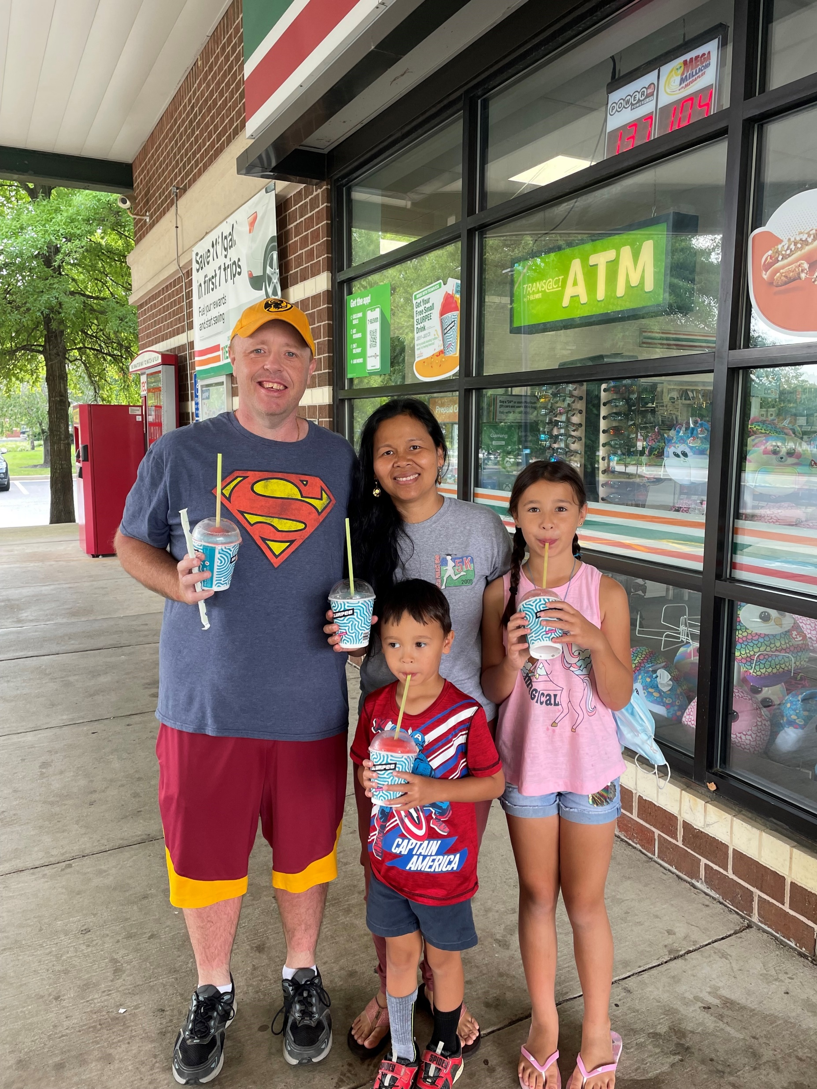
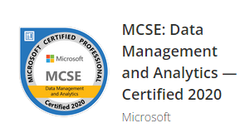
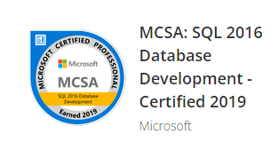
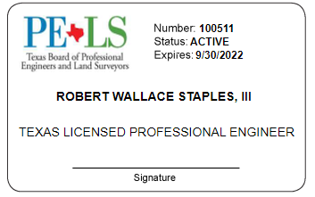


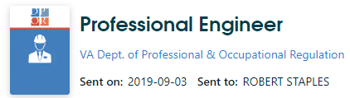


Robbie Staples
Senior Business Analyst/Developer
Old Dominion Electric Cooperative
He, His
rstaples@odec.com
@sqldietdrpepper
/robertwstaplesiii
Notes:
Interactive Poll
Do you use SSIS?
Do you use the SSIS Catalog?
Do your SSIS packages have variables?
Do your SSIS packages have parameters?
Do you use Environments & Environment variables in SSMS?
What brought you to this presentation today?

Slide 3
Outline
The SSIS Catalog
Variables
Parameters
Environment Variables in SSMS

Slide 4
The SSIS Catalog
Repository in SSMS for SSIS packages
Creates a database called “SSISDB”
SSMS has a nice interface
Creating the SSIS Catalog - Tim Mitchell
Project Vs. Package Deployment

Slide 5
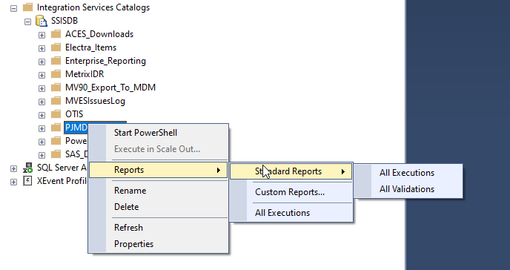
SSIS Catalog Report Options

Slide 6
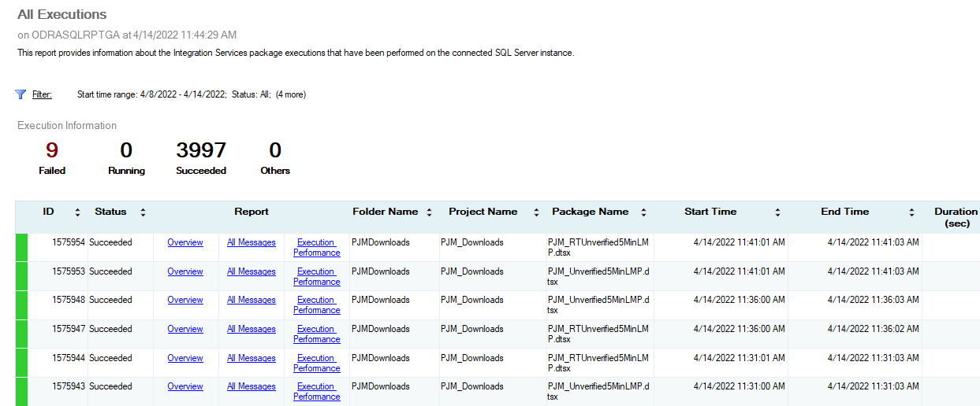
SSIS Catalog All Executions

Slide 7
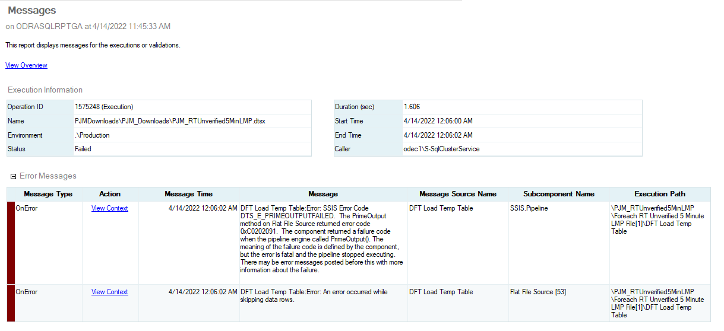
SSIS Catalog Failure Example

Slide 8
DEMO
Deploying to & Navigating the SSIS Catalog

Slide 9
Variables
Usually exist only inside an SSIS package
Can have a role in Env Variables
Can be passed to and from Stored Procs
Send emails when things are not right

Slide 10
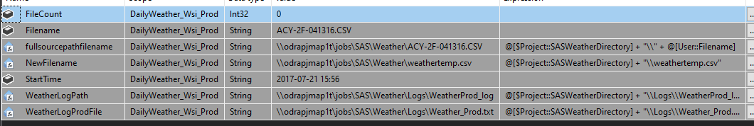
Static & Dynamic Variable Setup

Slide 11
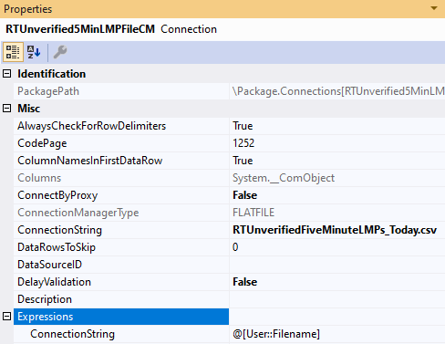
Automate Flat File Connection Manager

Slide 12
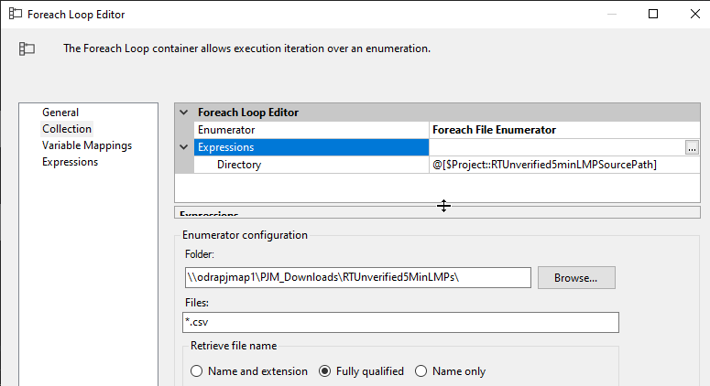
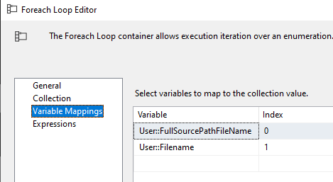
Automate For Each Loop Tasks
Parameterize the Directory
Tie to the Parameterized File Name

Slide 13

Automate with ??? using Variables
Expression Task as First Step
@[User::StartTime] = GetDate()
Execute SQL Task as Last Step
Insert into ETLStats
values(‘SAS_Hourly_Weather’, ?, getdate(), ?)
Tie back to the ? marks above

Slide 14


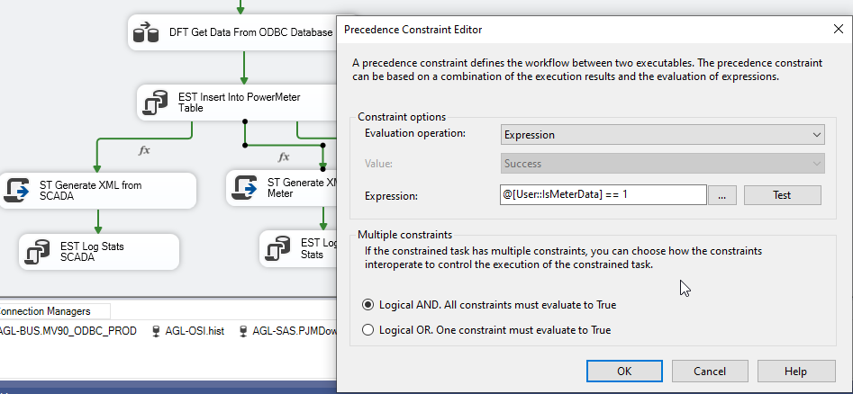
Automate Variables in a Stored Procedure
Execute SQL Task Setup
CREATE PROCEDURE [YourProcedureName]
@IsMeterData INT OUTPUT
Precedence Constraint with Expression

Slide 15
Sending Emails from Stored Procedure
IF @FileCount < 36
BEGIN
set @body = cast(@FileCountLocal as varchar(3)) + ' files were processed.'
EXEC msdb.dbo.sp_send_dbmail @profile_name=@profile,
@recipients=@recipients,
@subject='Less than 36 Weather Files Were Processed in SAS database',
@body= @body, @body_format = 'HTML'
END

Slide 16
Parameters
Accessible in SSIS and SSMS
Project Vs. Package
Can be used to set Variables
DB Connections at Project level

Slide 17


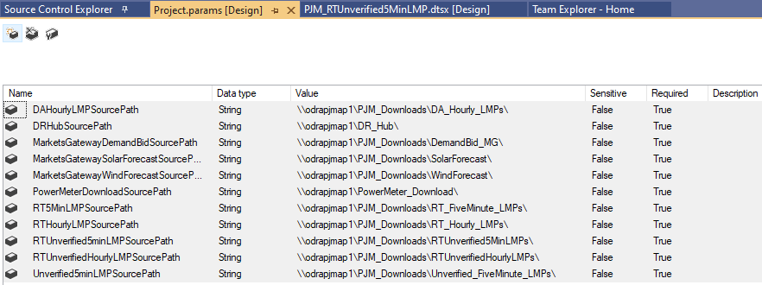
Parameters Setup & Examples
Project Parameter Location
Project DB Connection Manager

Slide 18
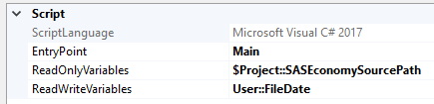
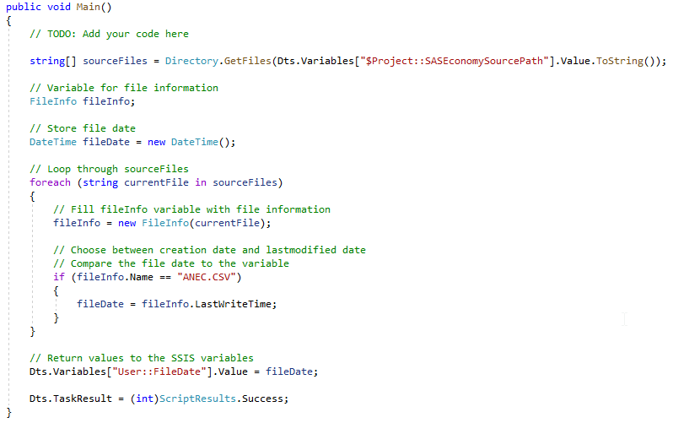
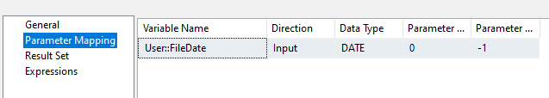
Automate Your Script Task
Script Task Setup & Code
Execute SQL Task Setup & Code
Declare @inputDate varchar(19);
Set @inputDate = convert(varchar(19), cast(? As datetime, 120);
Exec [YourProcedure] @inputDate;

Slide 19
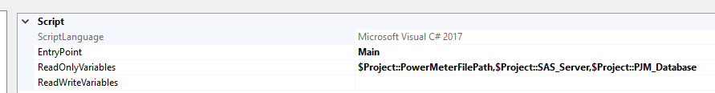
Automate Your Script Task
public void Main()
{
string FilePath = Dts.Variables["$Project::PowerMeterFilePath"].Value.ToString();
string SAS_Server = Dts.Variables["$Project::SAS_Server"].Value.ToString();
string PJM_Database = Dts.Variables["$Project::PJM_Database"].Value.ToString();
string connectionString = @"Server=" + SAS_Server + ";database=" + PJM_Database +
";Trusted_Connection=True"; //database connection info
System.IO.File.WriteAllText(FilePath + @"upload\FiveMinMeterValues.xml", strXML); //write
the xml file to the server

Slide 20
Environment Variables in SSMS
Set parameters from the package in SSMS
Setup for different environments (Dev, Test, Prod, etc.)
Parameters and DB connection strings
Saves time (File Paths, DB, Etc.)

Slide 21
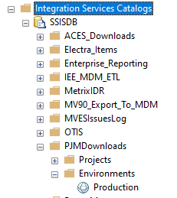
Environment Setup in SSMS

Slide 22
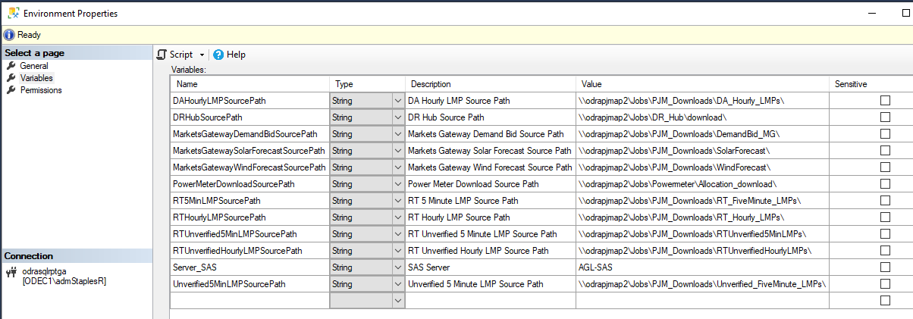
Environment Variables Setup in SSMS

Slide 23
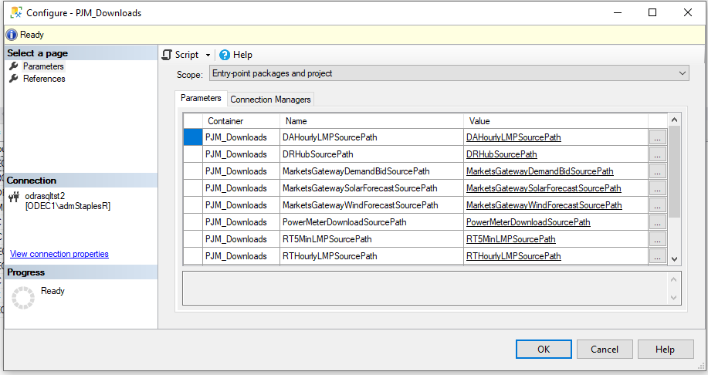
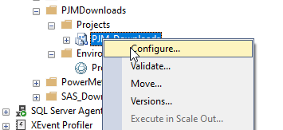
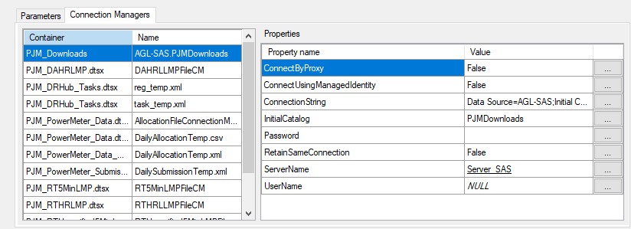
Environment Variables tied to SSIS Packages
Right Click SSIS
Env Var to SSIS Proj Param
Connection Manager Server Parameterized

Slide 24
DEMO
Seeing it all in action
Notes:
1. Establish one path locally within Visual Studio and then, have the Environment variable point to a different path to prove it works.
2. Set up a job that results in failure (such as Excel 64-bit versus 32-bit for Demo purposes or pointing to a directory while files do not exist). Fix it and see it work.

Slide 25
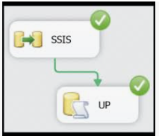
Where can SSIS take you now?
Robbie Staples
rstaples@odec.com
@sqldietdrpepper
/robertwstaplesiii
Notes:
Interactive Poll
Do you use SSIS?
Do you use the SSIS Catalog?
Do your SSIS packages have variables?
Do your SSIS packages have parameters?
Do you use Environments & Environment variables in SSMS?
What brought you to this presentation today?

