Slide 1
Temporal Tables from A to Z
Robbie Staples, P.E., MCSE, MCSA

Slide 2
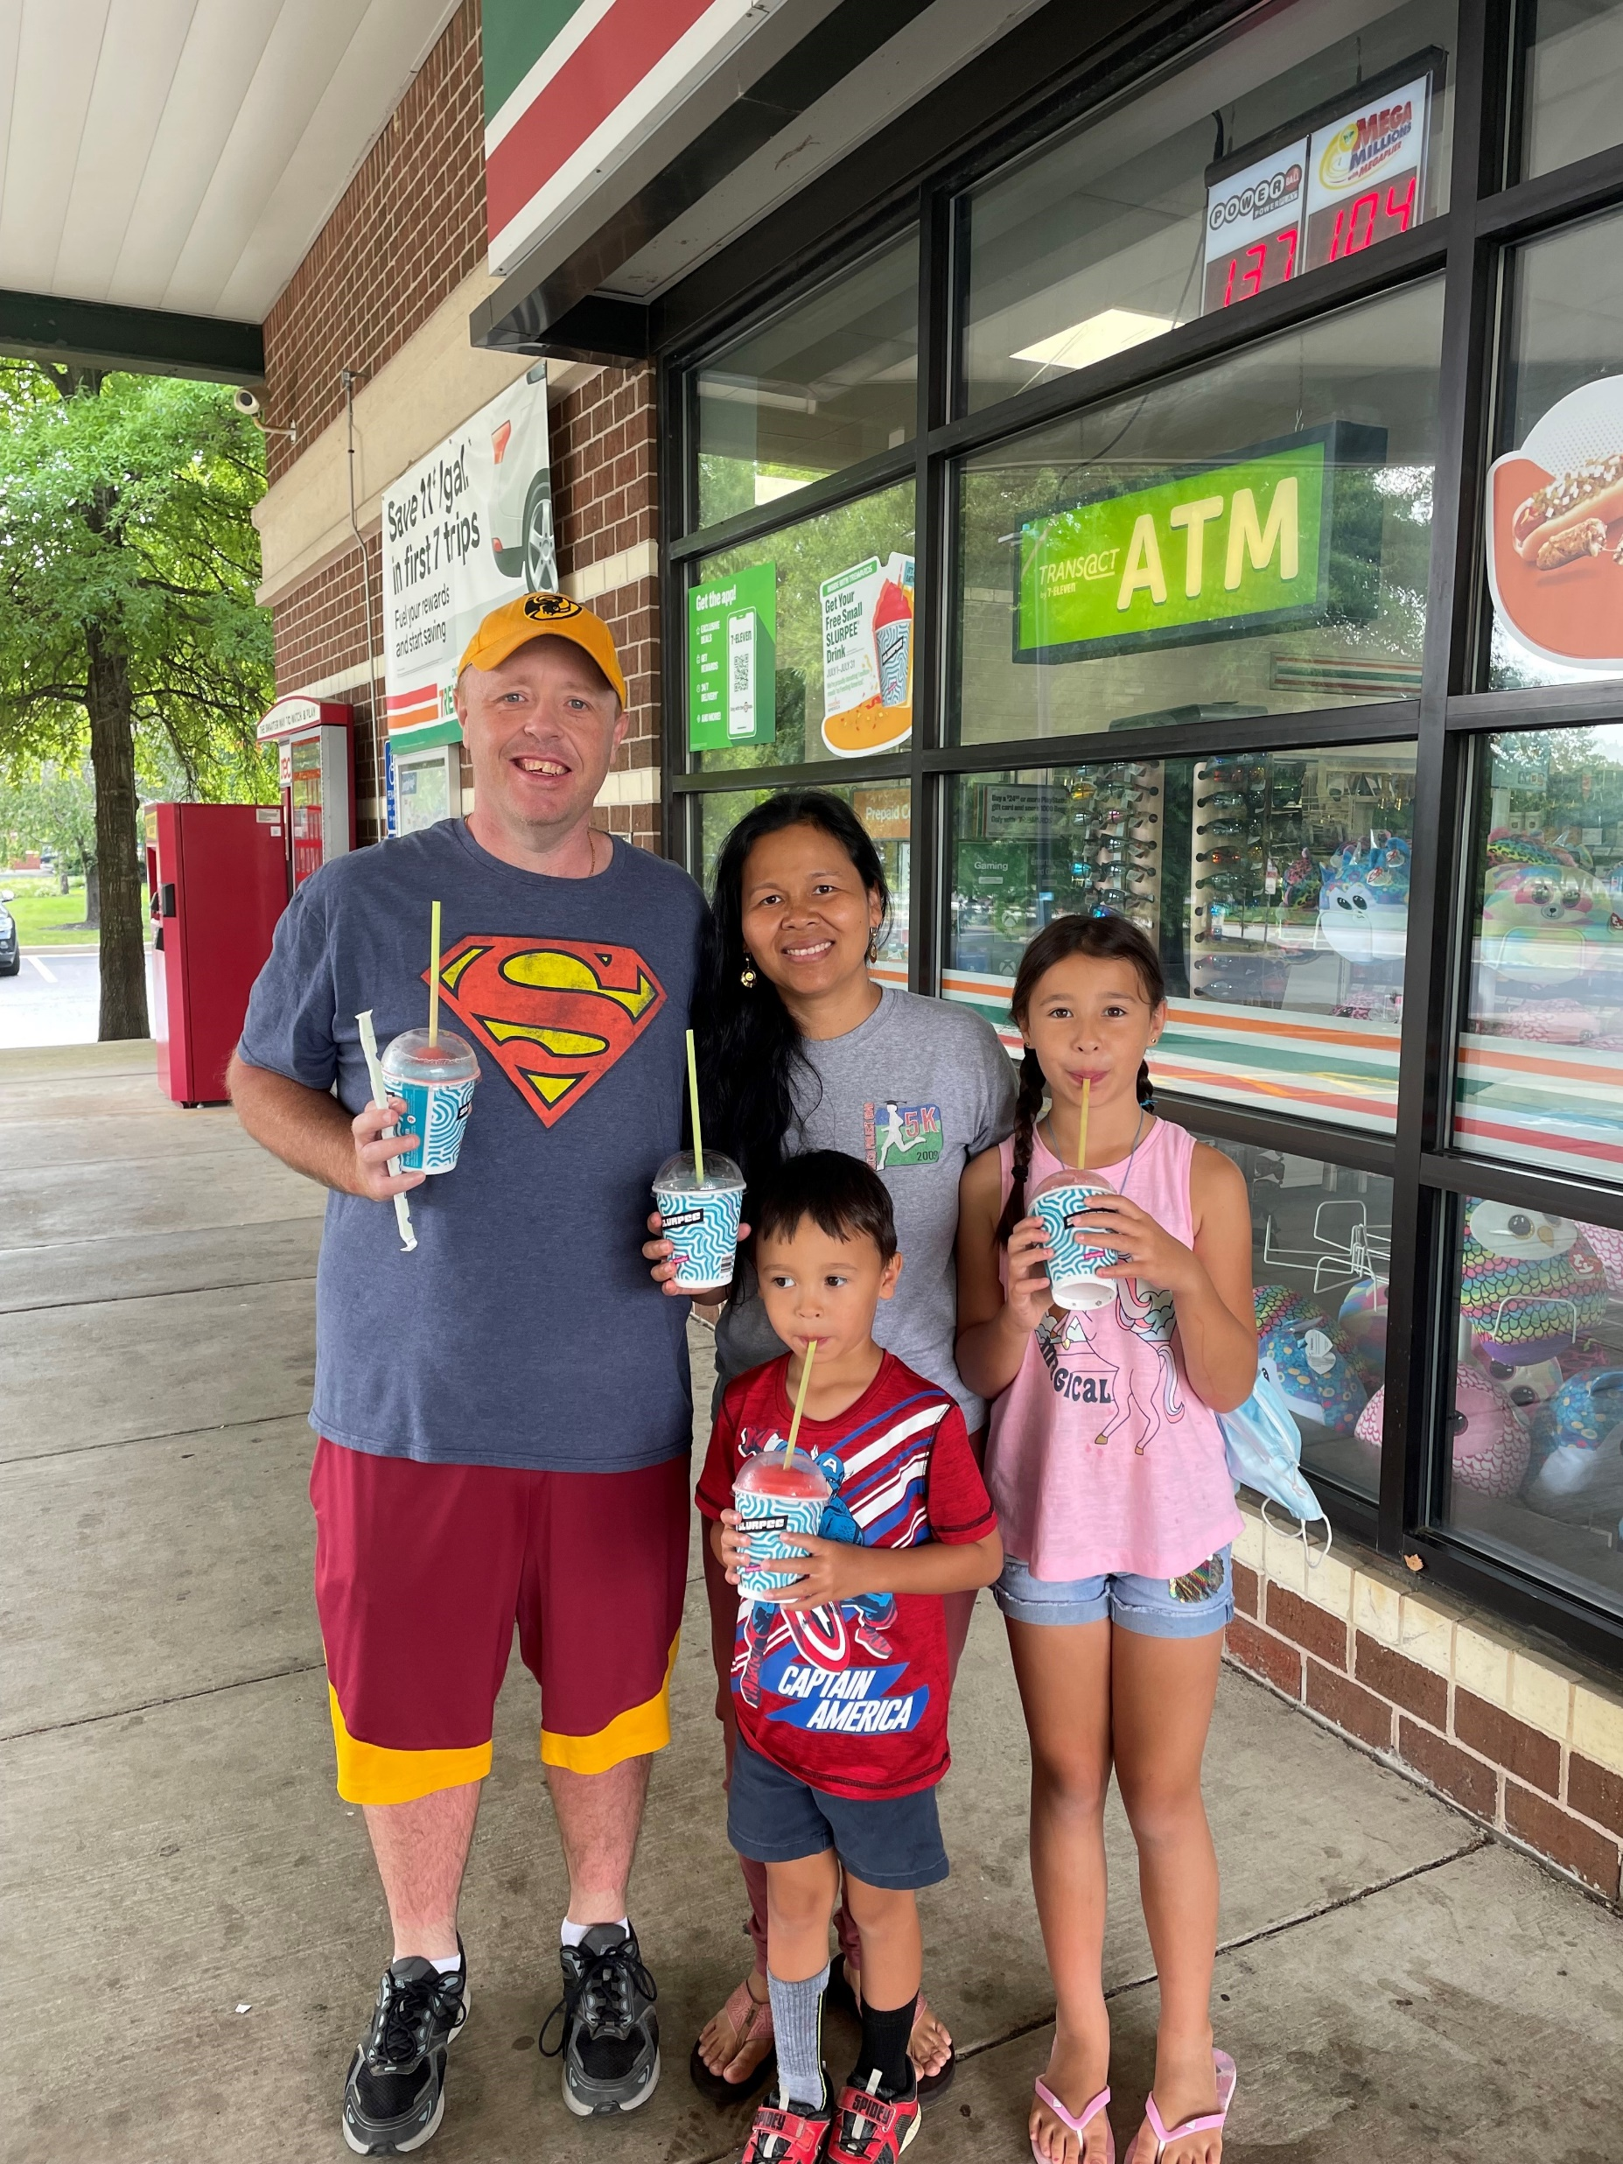
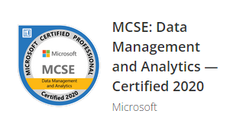

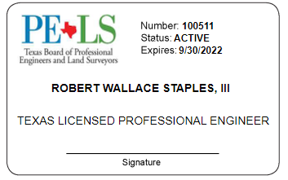





Robbie Staples
Senior Business Analyst/Developer
Old Dominion Electric Cooperative
He, His
rstaples@odec.com
@sqldietdrpepper
/robertwstaplesiii
Notes:
Interactive Poll
Do you use SSIS?
Do you use the SSIS Catalog?
Do your SSIS packages have variables?
Do your SSIS packages have parameters?
Do you use Environments & Environment variables in SSMS?
What brought you to this presentation today?

Slide 3
What are Temporal Tables?
Available in SQL Server 2016 and later
Provide info about data stored in the table at any point in time
Another table that allows for auditing and viewing history
Came about in part due to GDPR (General Data Protection Regulation)

Slide 4
When should you use Temporal Tables?
When you have audit requirements
Point-in-time analysis which could involve multiple tables
Projecting and reporting for historical trend analysis
For anomaly detection
To track slowly-changing dimensions
Repairing row-level data corruption

Slide 5
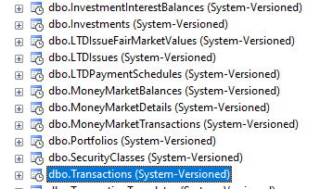
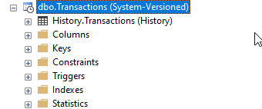
How to set up a Temporal Table
Preferred method is at table creation. Requires primary key constraint.
If added to existing table, history will only be good going forward
Create custom schema if desired

Slide 6
What if you have a change?
Changes for tables that have temporal tables can be more difficult than typical tables
No change in method for adding or removing columns to the table
If you want to drop a table, there are more steps due to the temporal table

Slide 7
DEMO
Create a Temporal Table
1
Drop a column
2
Add a column
3
Rename a column
4
Drop the entire table
5
Go from NULL to NOT NULL

Slide 8
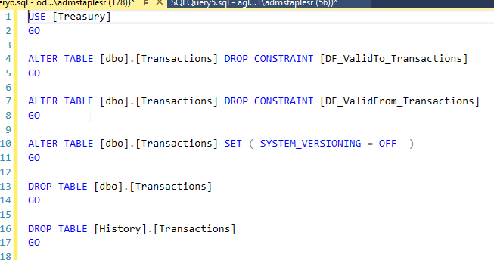
Dropping a Table with a Temporal Table

Slide 9
Mistakes I made
Set default constraint for ValidFrom as getdate() instead of sysutcdatetime()
Didn’t understand that SysEndTime (ValidFrom) defaults to 9999-12-31 23:59:59 only in main table

Slide 10
How to Query a Temporal Table
All times are stored in UTC
SQL Server has time zone conversion functions
Full list of TZs is available at https://dzone.com/articles/dates-and-times-in-sql-server-at-time-zone
For your system, run SELECT * FROM sys.time_zone_info;

Slide 11
Querying Temporal Table Continued
Query both main table & temporal table to get “Complete” picture
FOR SYSTEM_TIME
ALL
AS OF <DT>
FROM <start_dt> TO <end_dt>
BETWEEN <start_dt> AND <end_dt>
CONTAINED IN (<start_dt> , <end_dt>)

Slide 12
DEMO
Show
various time zones
Query
“complete” picture
Query
points in time
Query
deleted records

Slide 13
Add Temporal Table to Existing Table
Add columns for Start & End Time
Set defaults on how to fill columns
Turn on System Versioning
NOTE: Only works going forward

Slide 14
DEMO
Add Temporal Table to Existing Table

Slide 15
Resources
https://docs.microsoft.com/en-us/sql/relational-databases/tables/temporal-table-usage-scenarios?view=sql-server-ver15
https://www.sqlshack.com/temporal-tables-in-sql-server/
https://docs.microsoft.com/en-us/sql/relational-databases/tables/querying-data-in-a-system-versioned-temporal-table?view=sql-server-ver15

Slide 16

What can you do with temporal tables?
Robbie Staples
He, His
rstaples@odec.com
@sqldietdrpepper
/robertwstaplesiii
Notes:
Interactive Poll
Do you use SSIS?
Do you use the SSIS Catalog?
Do your SSIS packages have variables?
Do your SSIS packages have parameters?
Do you use Environments & Environment variables in SSMS?
What brought you to this presentation today?

