Slide 1
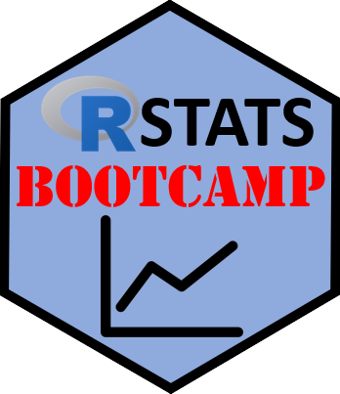

Data Objects
https://RStatsBootcamp.com/

Slide 2
Learning Objectives
Describe basic data types in R
Use str() to inspect data objects effectively
Describe data with factors for categorical variables
Use class() and convert between variable types

Slide 3
Data Objects in R Space
Imagine floating in R Global Environment
Any visible data object can be called by name
Fundamental way to analyze data through code manipulation
System of containers to store data effectively

Slide 4
Basic Data Types
Numeric: numbers with decimal points
Integer: whole numbers without decimals
Character: text strings enclosed in quotes
Logical: TRUE/FALSE boolean values

Slide 5
The Global Environment
More abstract than visual spreadsheet representation
Create variables in code script files
Bring data from external files or web
Use class() function to check variable types

Slide 6
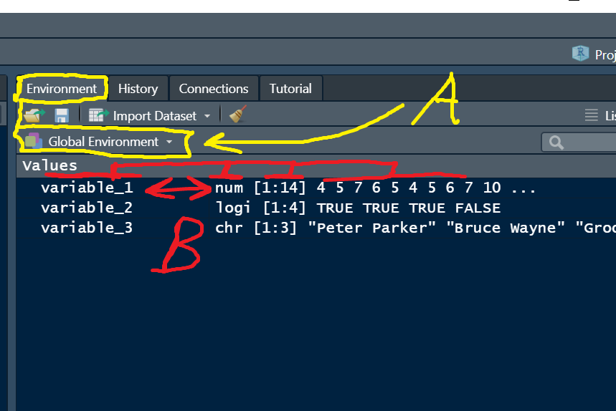

Slide 7
Vector Fundamentals
Most basic data structure in R
Collection of elements of same type
Created using c() function
Operations applied element-wise automatically

Slide 8
Creating Different Vector Types
Numeric vectors: c(1, 2, 3, 4)
Character vectors: c(“apple”, “banana”, “cherry”)
Logical vectors: c(TRUE, FALSE, TRUE)
Sequences: 1:10 or seq() function
<demonstration>

Slide 9
Variable Naming Rules
Must begin with letter, can contain numbers
Cannot contain spaces or forbidden characters
Should be human-readable and consistent
Case sensitive throughout R

Slide 10
Working with Factors
Used for categorical data with limited categories
Non-ordered factors: simple category names
Ordered factors: specific sequence matters
Must specify order explicitly when needed

Slide 11
Data Conversion
Use class() to check current data type
Convert with as.numeric(), as.character(), as.factor()
R usually guesses correctly but check when unsure
Sometimes manual conversion necessary
<demonstration>

Slide 12
Vector and Matrix Operations
Vectors: single dimension storage (1 to i)
Matrices: two dimensions (i rows, j columns)
Arrays: three or more dimensions
All must store same data type

Slide 13
Matrix Creation and Manipulation
Use matrix() function with data, nrow, ncol
Can name rows and columns with rownames(), colnames()
Access elements using bracket notation [i,j]
Useful for mathematical operations and data organization
<demonstration>

Slide 14

Practice Exercises

