Slide 1
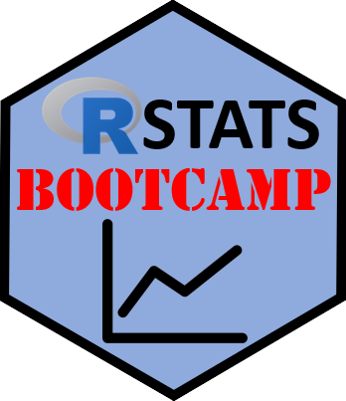

Data Frames
https://RStatsBootcamp.com/

Slide 2
Learning Objectives
Describe and use common data file types
Use Excel for data setup and create Data Dictionary
Read data from Excel and CSV files effectively
Manipulate variables within data frames

Slide 3
Getting Data into R
First step: making your data tidy and organized
Excel or CSV files recommended for most users
Avoid proprietary formats (SPSS, Genstat, Minitab)
Take responsibility for your own data management

Slide 4
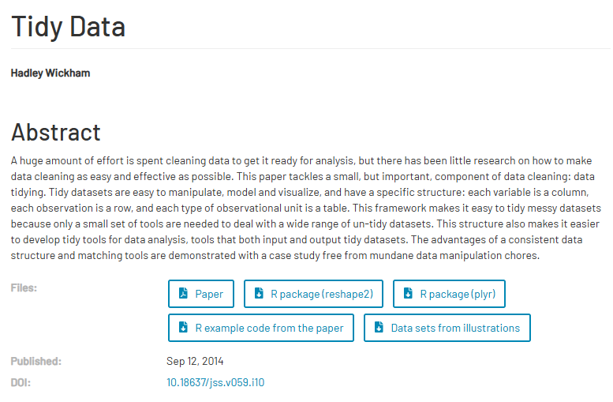
Tidy Data Concept
Each variable should be in a column
Each independent observation should be in a row
Data dictionary should accompany dataset
Facilitates complete reproducibility of analysis

Slide 5
Common Data File Types
CSV (Comma Separated Values) - plain text format
Excel spreadsheets - widely compatible and resilient
Avoid proprietary formats for archiving purposes
Stick to CSV or Excel unless very good reason

Slide 6
Excel Data Setup Best Practices
One table for actual data in Tidy format
Second tab for Data Dictionary with variable descriptions
No formatting or results embedded in spreadsheet
Clean separation of data and documentation

Slide 7
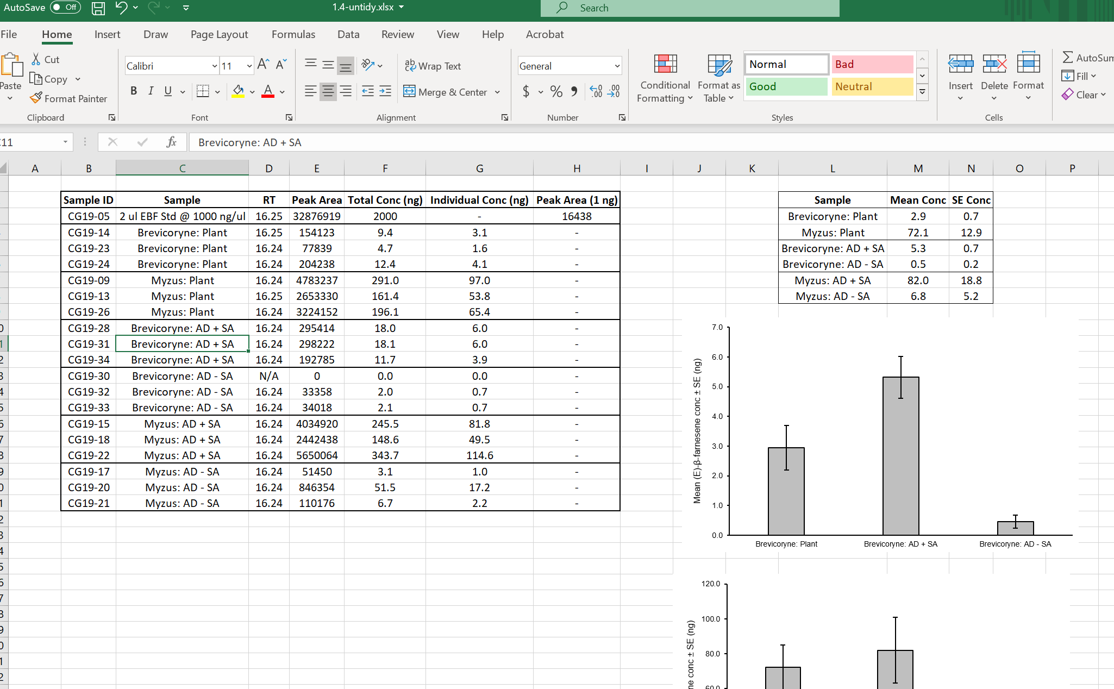
Untidy

Slide 8
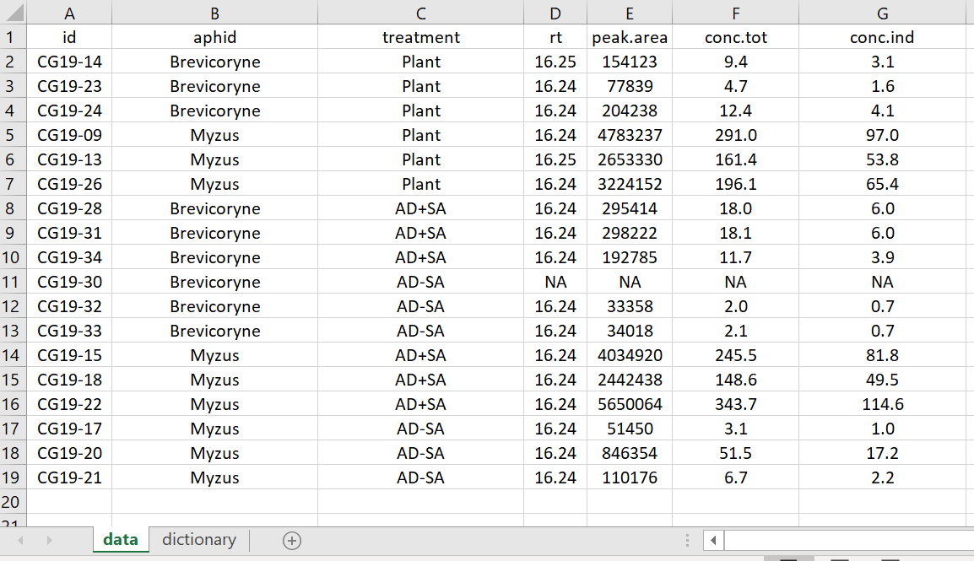
Tidy

Slide 9
Data Dictionary Importance
Describes each variable in enough detail
Enables complete reproduction of any analysis
Essential component of reproducible research
Should accompany every dataset

Slide 10
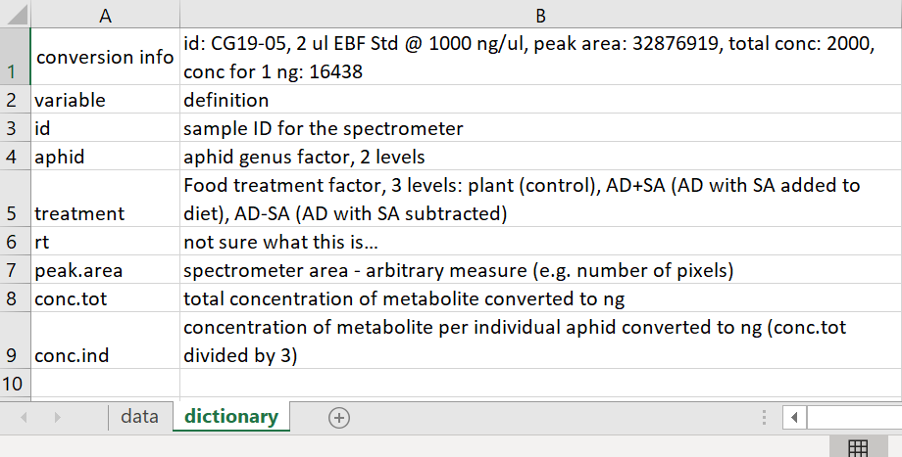

Slide 11
Reading Data into R
Use read.xlsx() from openxlsx package for Excel
Use read.csv() for CSV files
Set working directory with setwd() first
Ensure file paths use forward slashes
<demonstration>

Slide 12
Working Directory Management
Formally set working directory for file operations
Use getwd() to check current directory
Use setwd() to change to desired location
Essential for organizing input and output files
<demonstration>

Slide 13
Data Frame Manipulation
Use names() to see variable names
Use $ operator to access variables: data$variable
Use str() to examine data frame structure
Use [ , ] indexing for rows and columns
<demonstration>

Slide 14
Key Data Frame Functions
names(): returns variable names
str(): shows structure and first few values
attach(): makes variables directly accessible
detach(): undoes attach() operation

Slide 15
Index Operator Usage
[rows, columns] format for precise selection
Leave blank for all: [ , ] returns everything
Use variable names in quotes: [“variable_name”]
Combine with c() for multiple selections
<demonstration>

Slide 16

Practice Exercises

