Slide 1


Distributions
https://RStatsBootcamp.com/

Slide 2
Learning Objectives
Create and use histograms to evaluate data distribution
Identify Gaussian data and understand it’s not “normal”
Identify Poisson and Binomial data distributions
Diagnose common data distributions effectively

Slide 3
Sampling and Statistical Inference
Sampling underpins traditional statistics fundamentals
Population of interest cannot be directly measured
Sample to estimate real measures of population
Error depends on population variation and sample size

Slide 4
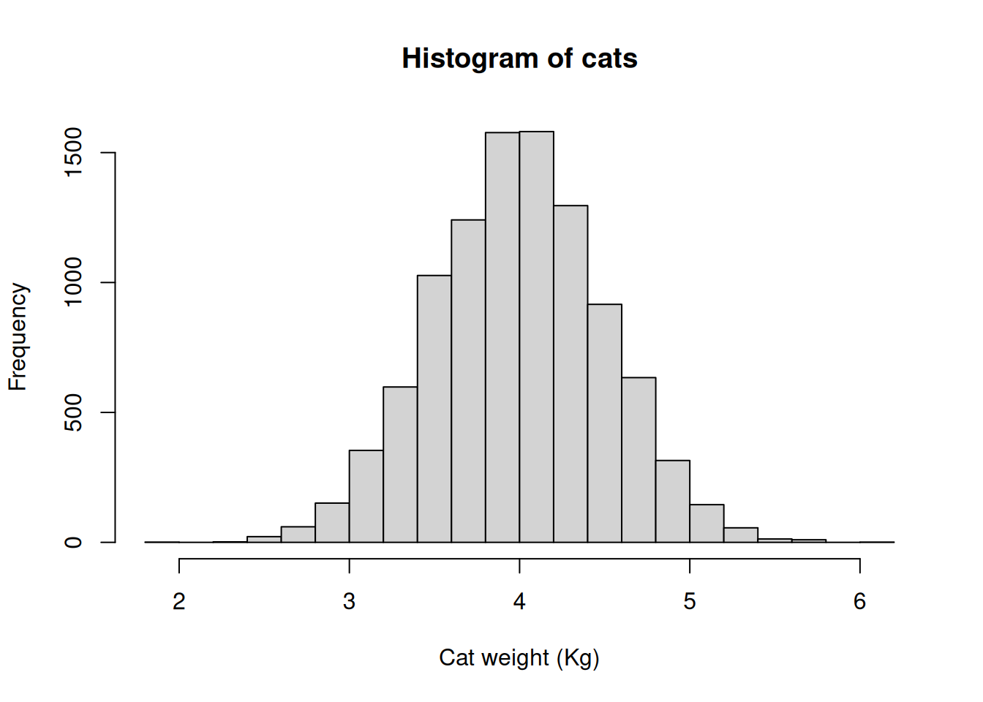

Histogram Usage
Plots numeric variable on x-axis (continuous or integers)
Frequency or proportion of observations on y-axis
Bars represent counts in ranges called “bins”
Shape reveals distribution of data

Slide 5
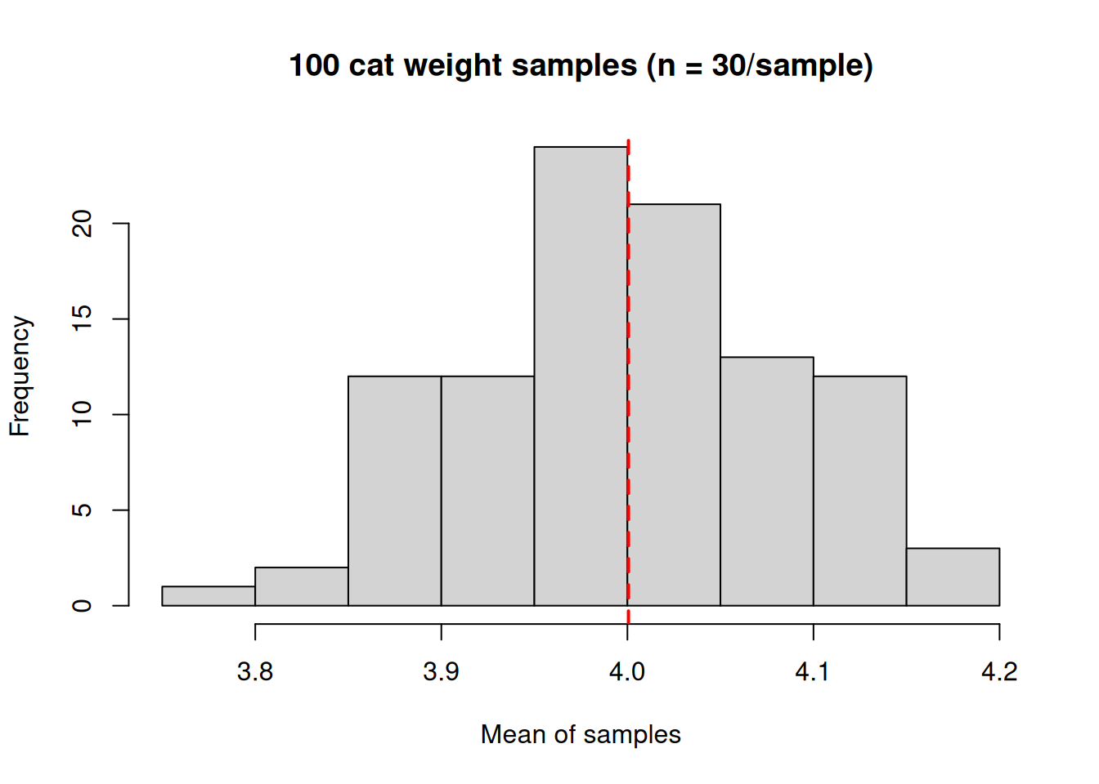
Simulation of Samples
Compare sample means to true population mean
Sample means vary randomly around true mean
Most samples close to true mean, fewer farther away
Demonstrates sampling distribution concept

Slide 6
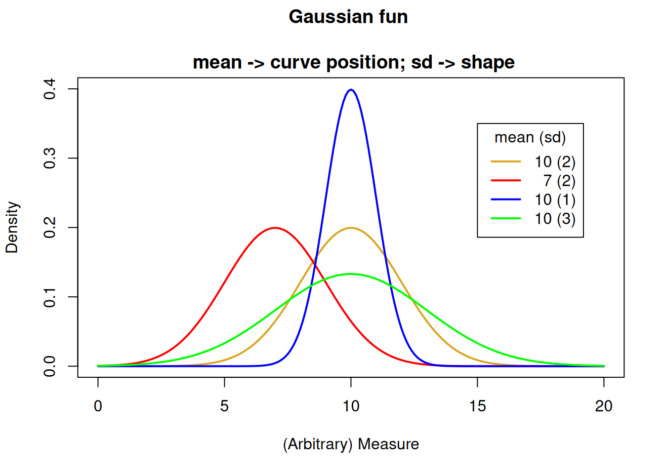
Gaussian Distribution
Classic “bell curve” shaped distribution
Most important for continuous numeric variables
Expected for measurements like height, weight, length
Described by mean and variance parameters

Slide 7
Gaussian Assumptions in Analysis
Linear models assume Gaussian residuals (not raw data)
Must test assumption for regression and ANOVA
Two parameters: mean and variance control shape
Different means shift curve position, different variances change spread

Slide 8
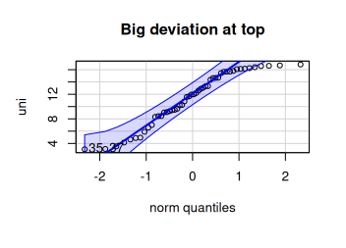
Quartile-Quartile (Q-Q) Plots
Compare data to theoretical Gaussian expectation
Straight diagonal line indicates perfect Gaussian fit
Systematic deviation indicates non-Gaussian distribution
Useful diagnostic for model assumptions

Slide 9
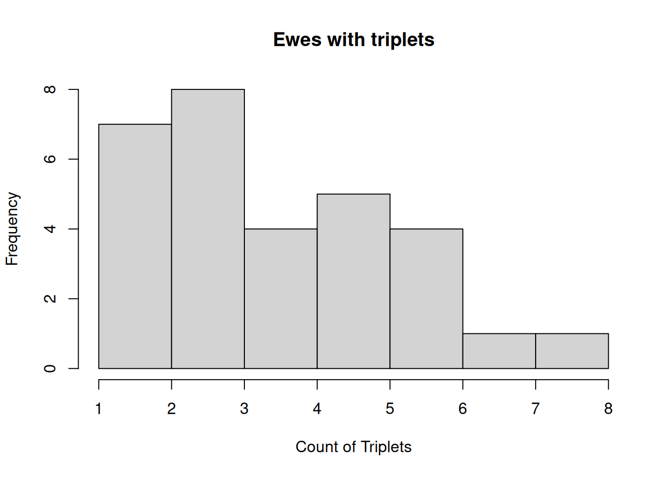
Poisson Distribution
Used for count data of discrete events
Classic example: events occurring over time/space
Data typically skewed to the right
Single parameter λ (lambda) describes mean and variance

Slide 10
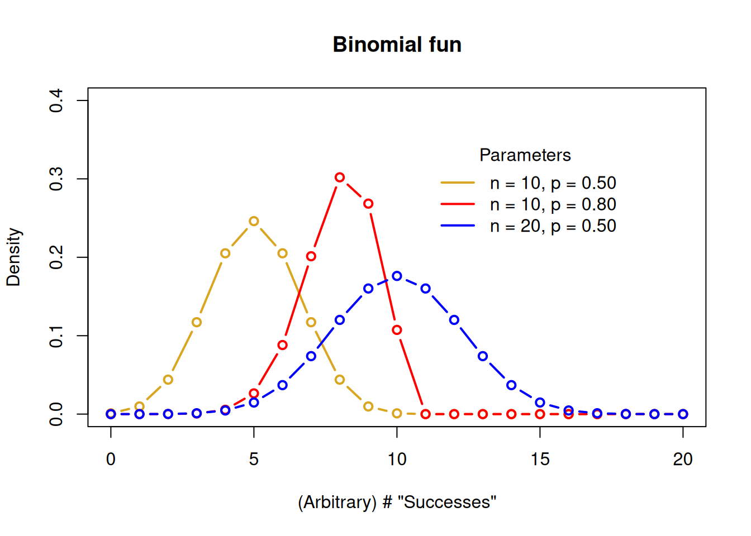
Binomial Distribution
Describes data with exactly two outcomes (0/1, yes/no)
Count of “successes” in series of independent trials
Examples: coin flips, germination success, presence/absence
Two parameters: number of trials (n) and probability (p)

Slide 11
Distribution Diagnosis Process
Develop expectation based on data type
Graph data with histogram and q-q plot
Compare q-q plots with different theoretical distributions
Try transformations if assumptions violated

Slide 12
Diagnostic Best Practices
Subjective endeavor requiring experience
First examine type of data for expected distribution
Use both graphical and statistical tests
Consider transformations to meet assumptions

Slide 13

Practice Exercises

