Slide 1
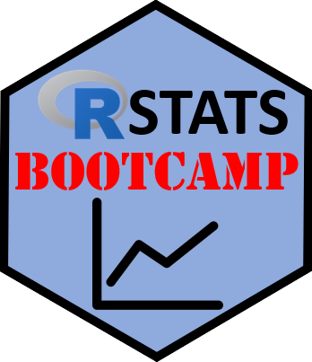

Regression
https://RStatsBootcamp.com/

Slide 2
Learning Objectives
Evaluate the question of simple regression
Discuss data and assumptions of simple regression
Graph simple regression effectively
Perform tests and alternatives for simple regression

Slide 3
Regression to the Mean
One of most common and powerful statistical tools
Created by Francis Galton for studying heritable traits
Concept: whenever correlation imperfect, regression to mean occurs
Foundation tool shared for greater scientific good

Slide 4
The Question of Simple Regression
Relate value of numeric variable to another variable
Predict variable value based on another
Quantify variation attributable to predictor
Test significance of relationships

Slide 5

Regression Model Components
α (alpha): intercept parameter
β (beta): slope parameter
y: dependent variable, x: predictor variable
ε (epsilon): residual error term

Slide 6
Data and Assumptions
Linear relationship between variables
Numeric continuous data for dependent variable
Independence of observations
Gaussian distribution of residuals (not raw data!)

Slide 7
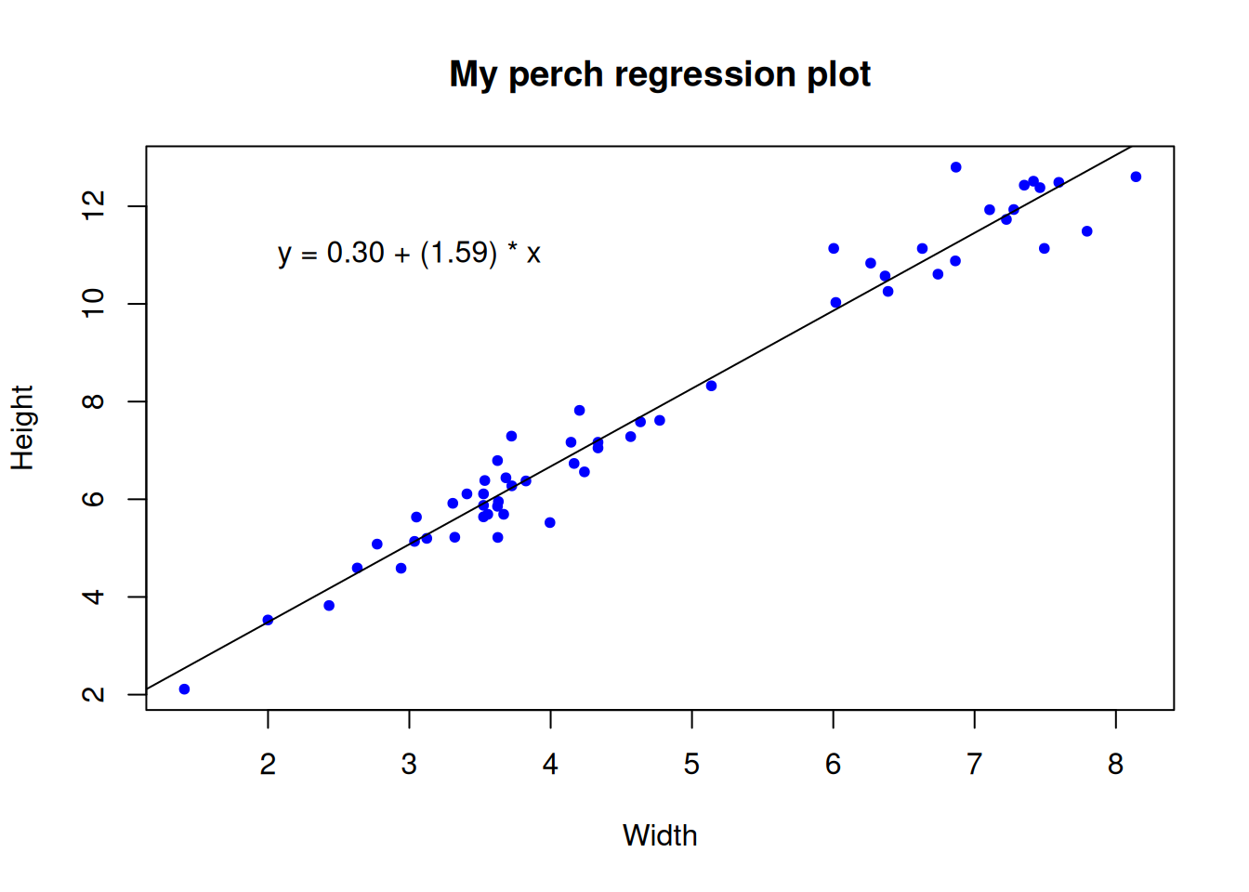
Graphing Regression
Scatterplot with dependent variable on y-axis
Predictor variable on x-axis
Regression line shows line of best fit
Line used for prediction of y given x values

Slide 8
Testing Assumptions
Data scientist responsible for validating model
Test Gaussian residuals graphically and statistically
Check homoscedasticity with residuals vs fitted plot
Use diagnostic plots and formal tests

Slide 9
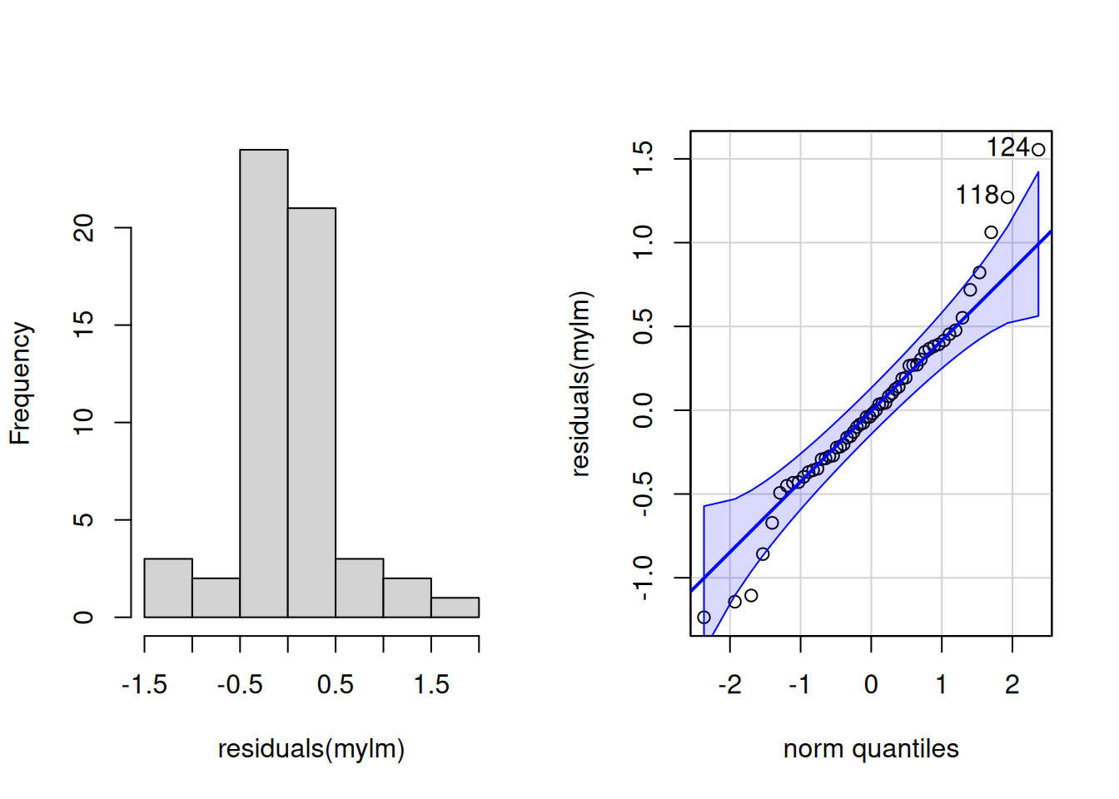
Residual Analysis
Residuals represent deviation from predicted values
Should be Gaussian distributed with mean zero
Use histogram and q-q plots for visual assessment
Shapiro-Wilk test for formal normality testing

Slide 10
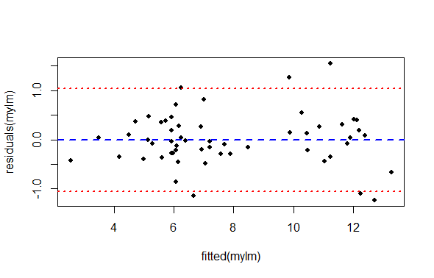
Homoscedasticity Assessment
Variance of residuals should be constant
Plot residuals vs fitted values
Look for even spread across x-axis
Absence of systematic patterns indicates independence

Slide 11
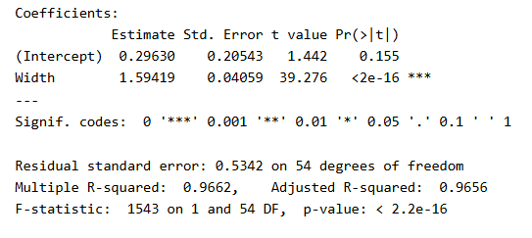
Regression Results Interpretation
F-statistic tests overall model significance
R-squared shows proportion of variance explained
Coefficient estimates show intercept and slope
P-values test whether parameters differ from zero

Slide 12
Reporting Regression Results
Include R-squared, degrees of freedom, and p-value
Example: “significant linear relationship (R-squared = 0.97, df = 1,54, P < 0.0001)”
Never copy-paste raw statistical output
Summarize appropriately for intended audience

Slide 13
Alternatives to Regression
Data transformation when assumptions violated
Spearman rank correlation for relationship demonstration
Nonparametric regression (Kendal-Theil-Siegel)
Consider these when assumptions cannot be met

Slide 14

Practice Exercises

