Slide 1


T-test
https://RStatsBootcamp.com/

Slide 2
Learning Objectives
Articulate the question of the t-test
Evaluate data and assumptions for t-test
Graph t-test data appropriately
Perform tests and alternatives for t-test

Slide 3

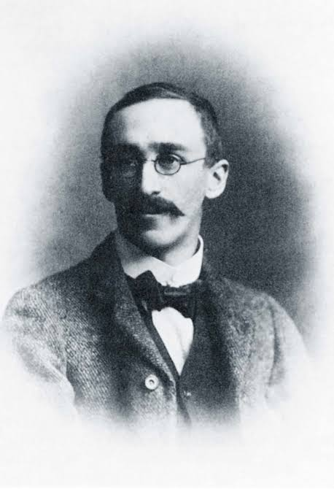
Student’s T-test Origins
Foundation of modern statistical science
Invented by William Sealy Gosset at Guinness brewery
Published anonymously as “Student” for commercial protection
Refined and supported by R.A. Fisher

Slide 4
The Question of the T-test
Compare populations using independent samples
Three common versions: 2 independent samples, 1 sample vs known mean, paired samples
Basic question: are means different between groups?
Used to test if samples came from different populations

Slide 5
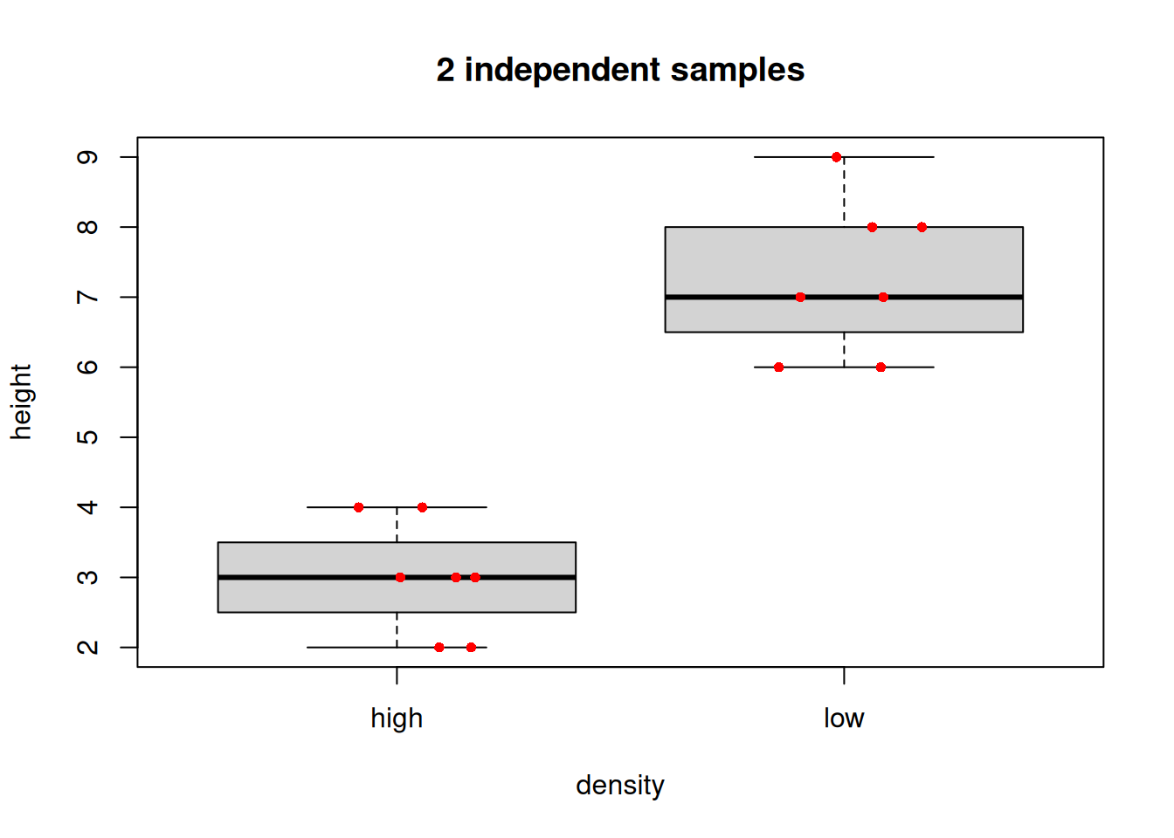
Two Independent Samples
Numeric variable measured in two samples
Question: are sample means different?
Data in “long format” (one numeric, one factor) or “wide format” (two numeric vectors)
Traditional visualization: boxplot with optional raw data points

Slide 6
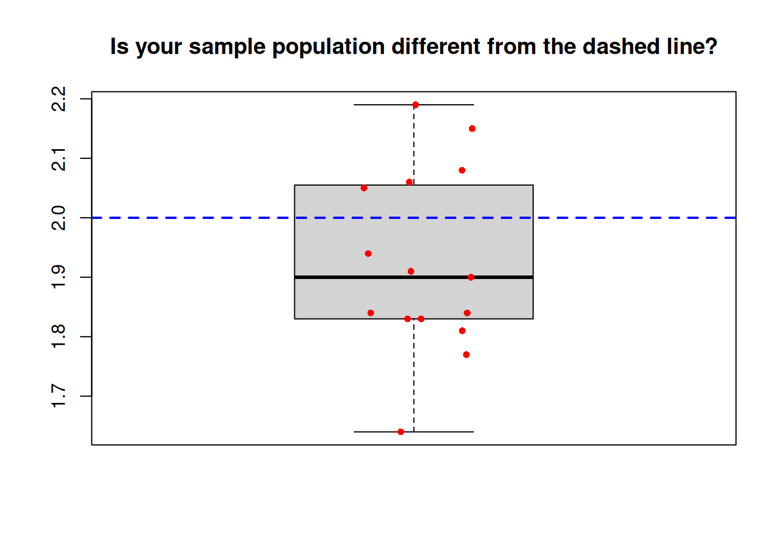
One Sample vs Known Mean
One sample compared to known population mean
Question: did sample come from population with known mean?
Data: single numeric vector and population mean value
Visualization: boxplot with reference line for known mean

Slide 7
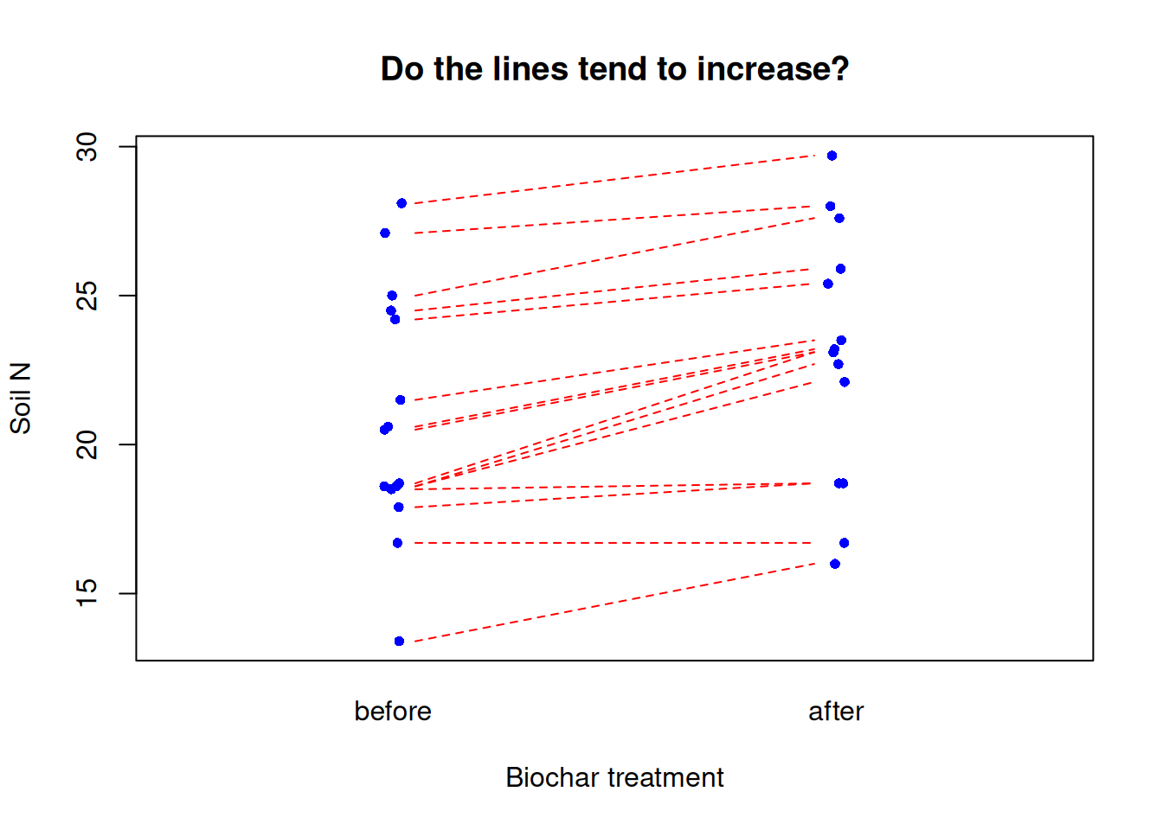
Paired Samples
Individual observations in samples are not independent
Examples: before/after treatment, spatially paired plots
Each pair represents relationship between measurements
Visualization shows tendency for change between paired observations

Slide 8
T-test Assumptions
Gaussian distribution within each sample (not combined)
Homoscedasticity (equal variance between samples)
Independence of observations
T-test somewhat robust to assumption violations

Slide 9
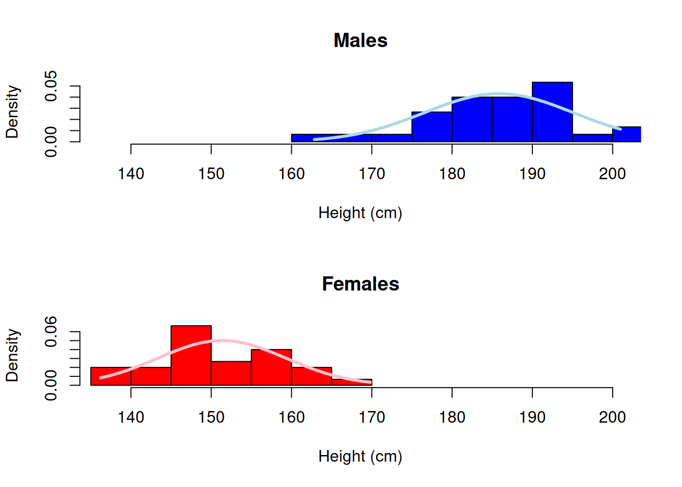
Assumption Testing
Test Gaussian distribution separately for each group
Use histograms, q-q plots, and Shapiro-Wilk test
Check variance equality with Bartlett test or visual comparison
Independence assumption critical and related to study design

Slide 10
Graphical Assessment
Histogram and q-q plot for each sample separately
Compare to expected Gaussian distribution
Look for systematic deviations from normality
Consider sample size in interpretation

Slide 11
Mann-Whitney U-test Alternative
Non-parametric alternative when assumptions not met
Uses wilcox.test() function in R
Good choice for small samples or skewed distributions
Less statistical power but no distributional assumptions

Slide 12
Results Reporting
Report test statistic, degrees of freedom, p-value
Example: “significant difference (2-sample t-test: t = -8.63, df = 11.9, P < 0.0001)”
Always include all three key quantities
Format p-values appropriately (P < 0.0001 for small values)

Slide 13

Practice Exercises

