Slide 1


ANOVA
https://RStatsBootcamp.com/

Slide 2
Learning Objectives
Articulate the question of 1-way ANOVA
Evaluate data and assumptions for 1-way ANOVA
Graph 1-way ANOVA data effectively
Perform tests and alternatives for 1-way ANOVA

Slide 3
Analysis of Variance (ANOVA)
Revolutionized objectivity in experimental data analysis
Invented by R.A. Fisher at Rothamsted Research
“Convenient method of arranging the arithmetic”
Foundation of basic statistical practice today

Slide 4
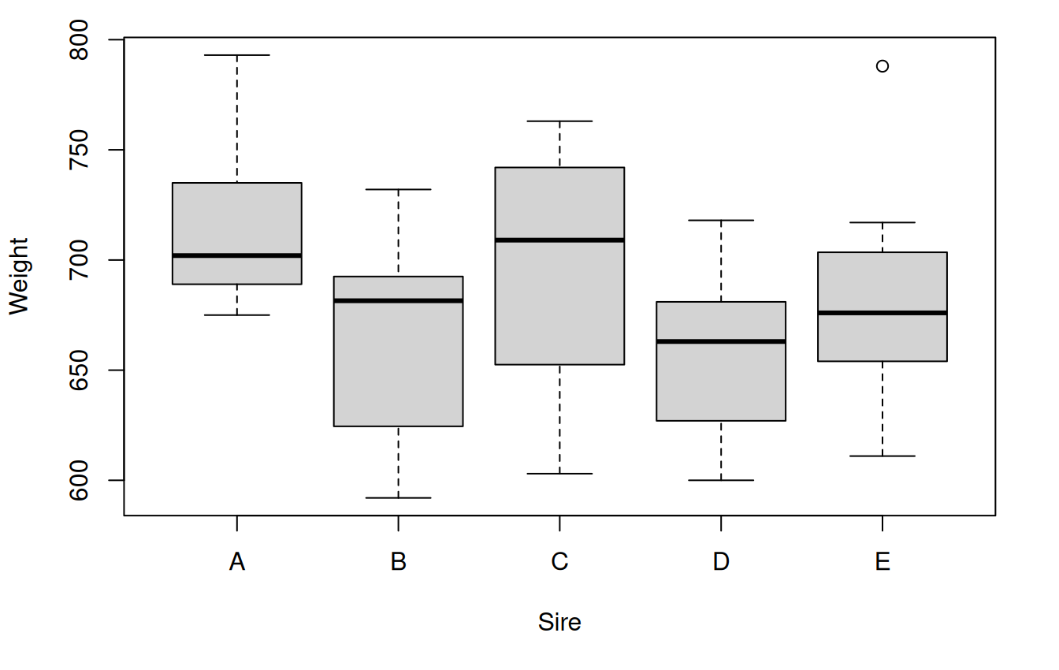
The Question of 1-way ANOVA
One numeric continuous dependent variable
Factor with 2 or more levels (often with control)
When two levels: conceptually equivalent to t-test
Test overall difference in means between factor levels

Slide 5
ANOVA Applications
Overall difference test between factor means
Comparison of each level with control/reference
Post hoc tests between specific factor levels
Examination of sources of variation in dependent variable

Slide 6
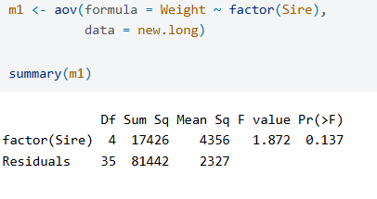
F Ratio Test Statistic
Proportion of variance between groups relative to within groups
Higher F values suggest greater likelihood of real differences
Based on comparison of mean squares
Foundation for significance testing in ANOVA

Slide 7
Data Format Requirements
Wide format: separate vectors for each factor level
Long format (preferred): single numeric vector with factor vector
Each row corresponds to single independent case
Tidy Data standard preferred for analysis

Slide 8
ANOVA Assumptions
Gaussian residuals (test graphically and with NHST)
Homoscedasticity (residuals vs fitted values plot)
Equality of variance (residual vs factor plot and NHST)
Independent observations (assumed based on study design)

Slide 9
Assumption Testing Process
Use aov() to create model object
Test Gaussian residuals with histogram and qqPlot()
Shapiro-Wilk test for formal normality assessment
Bartlett test for equality of variance across groups

Slide 10
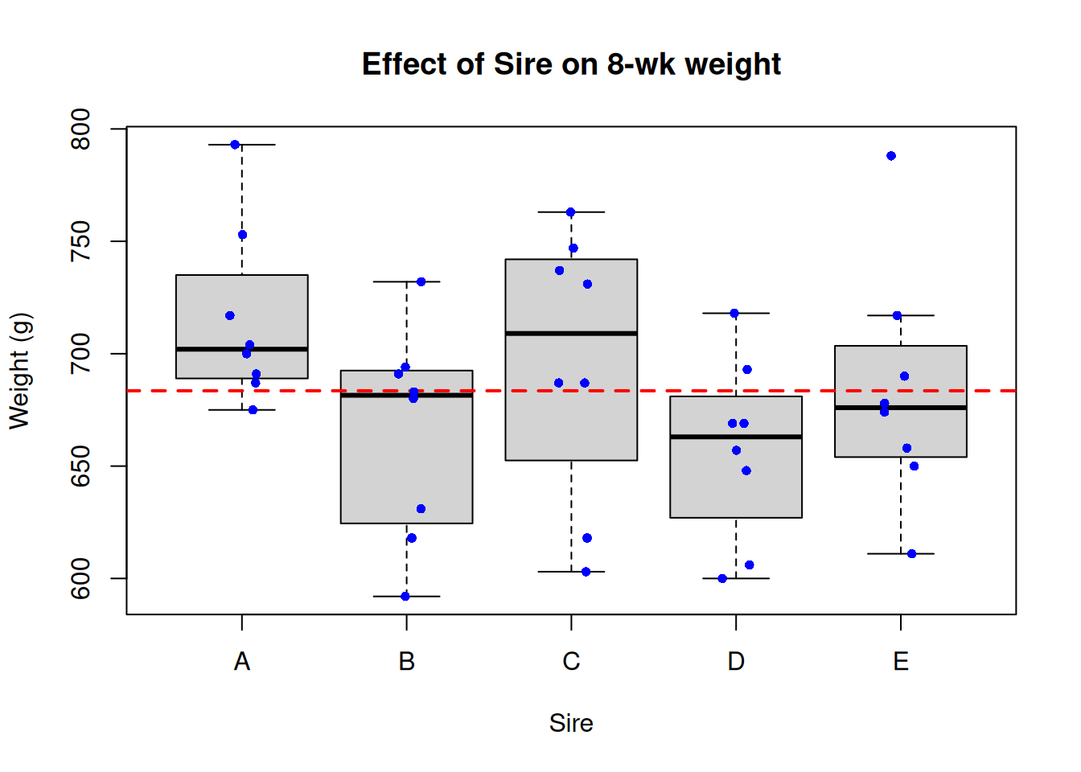
Graphing ANOVA Data
Classic visualization: boxplot by factor levels
Show central tendency separately for each group
Add raw data points over box summaries
Include reference line for grand mean

Slide 11
ANOVA F Test and Alternatives
Use aov() function for basic ANOVA
Alternative: lm() for contrasts and linear model approach
Output in classic ANOVA table format
F statistic, degrees of freedom, and p-value reported

Slide 12
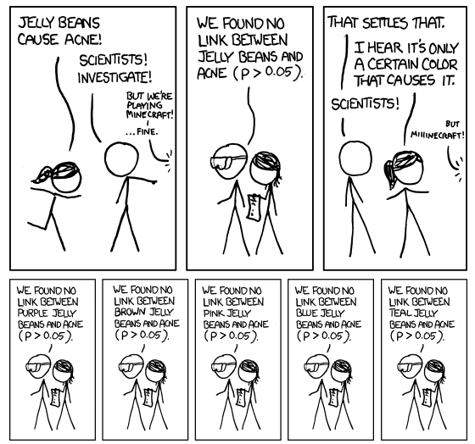
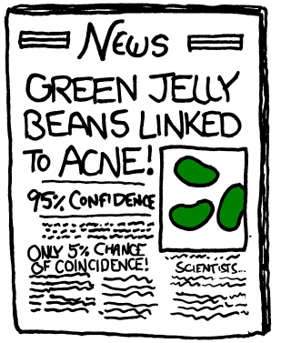
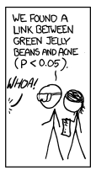

Slide 13
Contrasts and Post Hoc Testing
Set reference level with relevel() function
Compare each factor level to reference
Post hoc tests for all pairwise comparisons
Bonferroni adjustment for multiple testing

Slide 14
Multiple Comparison Methods
Bonferroni adjustment: conservative, divides alpha by comparisons
Tukey HSD: less conservative, ideal for 1-way ANOVA
Both control Type I error rate across tests
Choose based on research questions and context

Slide 15
Non-parametric Alternative
Kruskal-Wallis test when assumptions not met
Less statistical power but no distributional requirements
Use kruskal.test() function in R
Qualitatively similar interpretation to ANOVA

Slide 16

Practice Exercises

