Slide 1

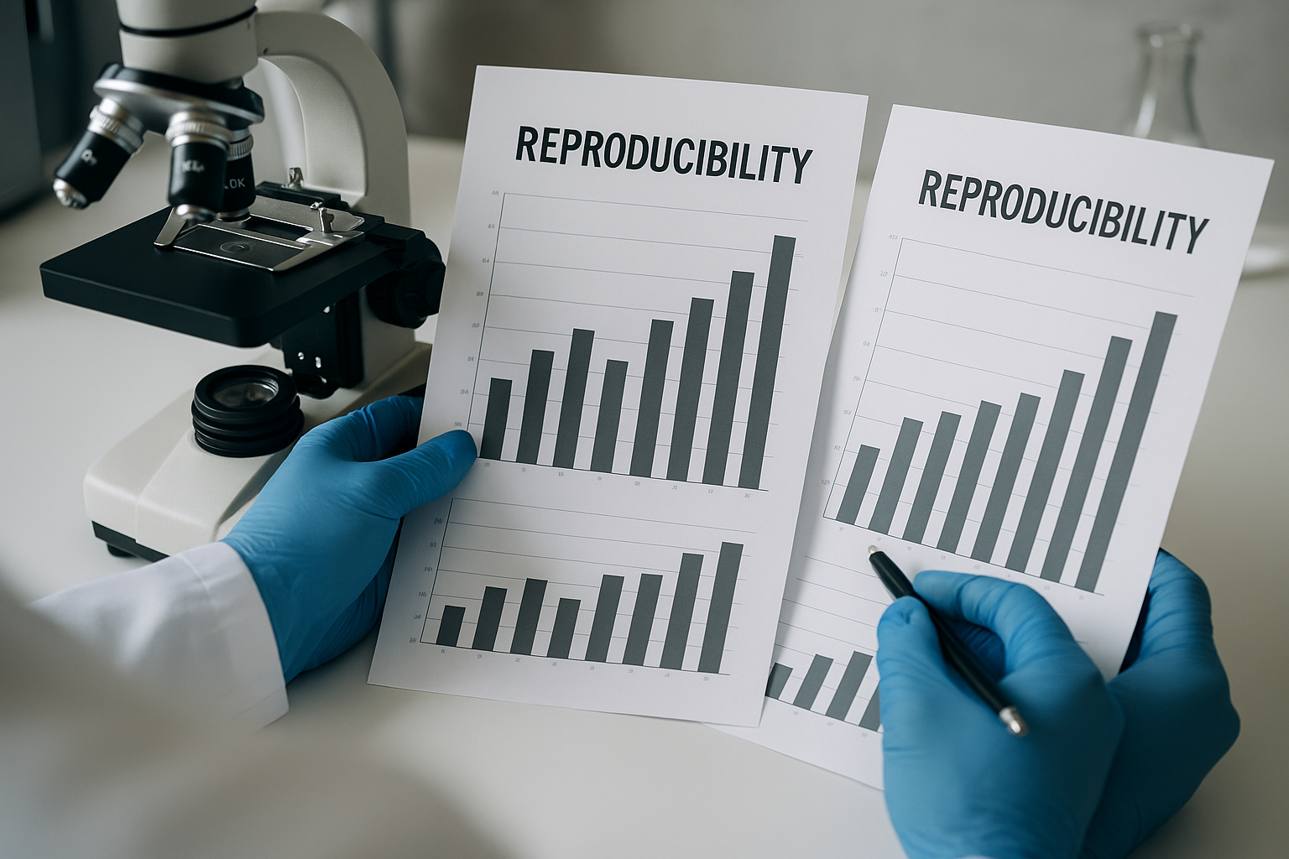
Reproducibility
https://RStatsBootcamp.com/

Slide 2
Learning Objectives
Explain why reproducibility matters in data science
Identify key components of reproducible workflow
Implement best practices for documentation
Organize project files effectively

Slide 3
Why Reproducibility Matters
Cornerstone of scientific research and data analysis
Ensures findings can be verified and methods understood
Work can be built upon by others (including future self)
Provides verification, collaboration, efficiency, impact, and trust

Slide 4
Components of Reproducible Workflows
Documented code with clear comments and structure
Version control systems like Git for tracking changes
Environment management for consistent software conditions
Proper data management with preserved raw data

Slide 5
Code Documentation Standards
Clear purpose statements and input/output descriptions
Parameter explanations and usage examples
Error checking and validation within functions
Comments explaining why, not just what code does

Slide 6
Environment Management
Document software environment for recreation
Use sessionInfo() to capture package versions
Consider renv package for project-specific environments
Ensure others can recreate same conditions
<demonstration>

Slide 7
Data Management Principles
Raw data preservation (never modify originals)
Data cleaning scripts documenting all transformations
Clear data documentation and metadata
Transparent pipeline from raw to analysis-ready data

Slide 8
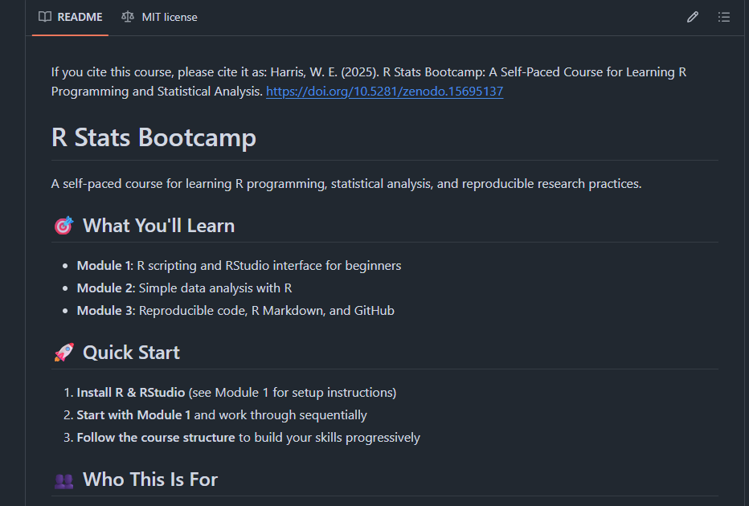
File Organization Strategies
Clear directory structure with logical separation
Numbered scripts indicating workflow order
Separate folders for data, code, results, documentation
README files explaining project structure and usage

Slide 9
Documentation Best Practices
Comprehensive information including all necessary details
Clear language avoiding jargon when possible
Current documentation updated as project evolves
Accessible storage with project files

Slide 10
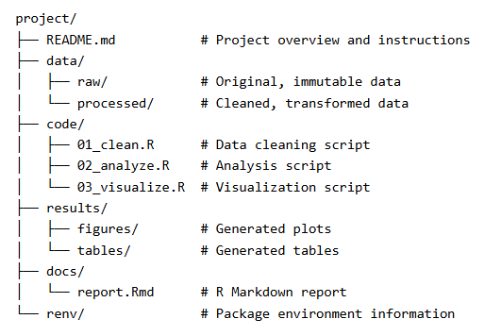
Project Structure Template
README.md with project overview and instructions
data/ folder with raw/ and processed/ subfolders
code/ folder with numbered analysis scripts
results/ folder for figures/ and tables/

Slide 11
Version Control Integration
Track changes to code and documentation over time
Enable collaboration without file conflicts
Ability to revert to previous versions if needed
Essential component of modern reproducible research

Slide 12

Practice Exercises

