Slide 1
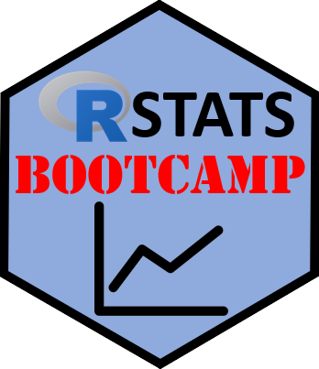
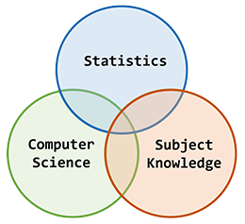
About the Bootcamp
https://RStatsBootcamp.com/

Slide 2


What is the R Stats Bootcamp?
Comprehensive, self-paced course for researchers and students
Develops practical data science skills in R programming
Focuses on statistical analysis and reproducible research practices
Mission to provide accessible, high-quality training

Slide 3
Our Philosophy
Accessible to researchers at all levels
Practical with focus on real-world applications
Reproducible to advance scientific integrity
Collaborative to encourage knowledge sharing
Free to promote open science

Slide 4
Target Audience
Research students beginning their data analysis journey
Academic staff looking to update quantitative skills
Professionals transitioning to data-driven roles
Self-learners interested in R programming and statistics

Slide 5
Module 1: R Foundations
Master fundamentals of R programming and RStudio environment
Learn to manipulate data and create functions
Work with different data structures
Build essential programming skills

Slide 6
Module 2: Statistical Analysis
Apply R skills to statistical analysis and data visualization
Explore hypothesis testing, correlation, and regression
Learn techniques for data exploration and analysis
Master essential statistical concepts

Slide 7
Module 3: Reproducible Research
Discover tools and practices for reproducible science
Learn R Markdown for dynamic documents
Master Git for version control
Develop collaborative workflow skills

Slide 8
Learning Approach
Self-paced lessons that fit your schedule
Hands-on exercises to reinforce concepts
Real-world examples relevant to research contexts
Progressive difficulty building on previous knowledge

Slide 9
Course Development
Based on current best practices in data science education
Incorporates feedback from learners and instructors
Reflects advances in R packages and statistical methods
Grounded in research on effective teaching and learning

Slide 10

Getting Support
Discord community support coming soon
Additional resources linked throughout the course
Self-assessment tools and practice exercises
Learning-by-doing methodology with practical focus

Slide 11


