Slide 1
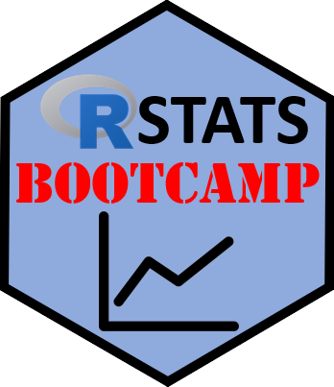
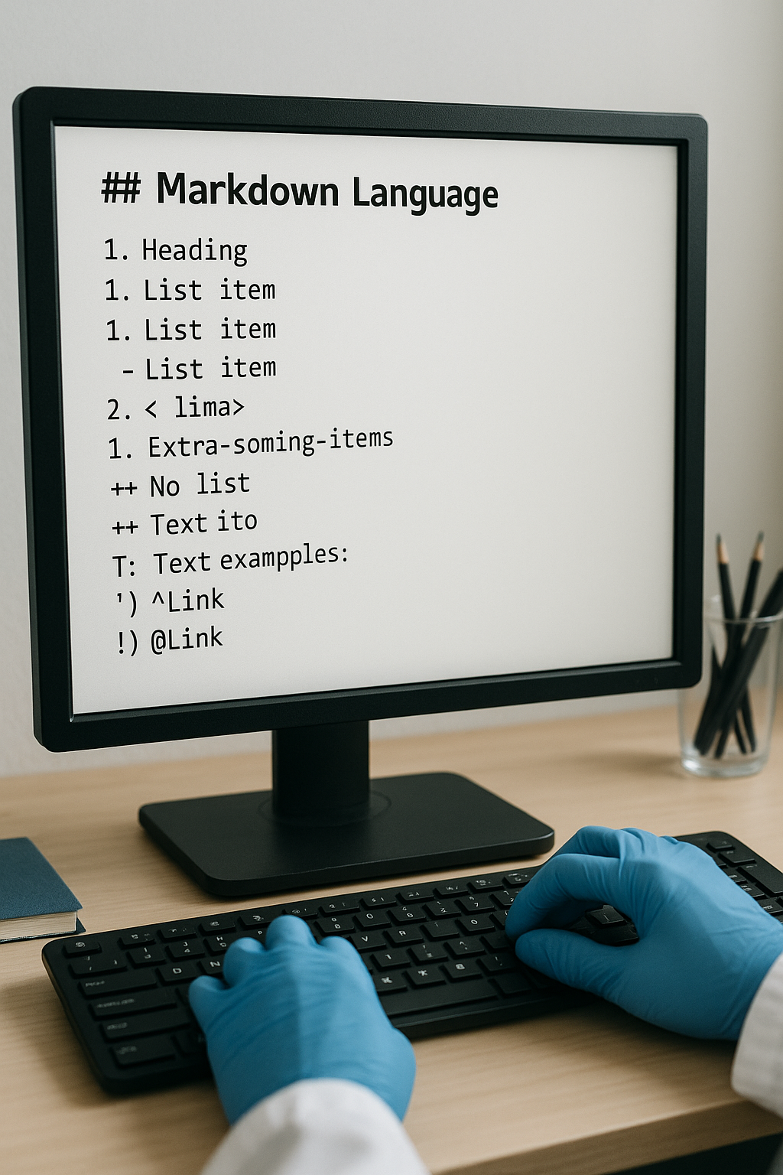
R Markdown
https://RStatsBootcamp.com/

Slide 2
Learning Objectives
Understand the basics of R Markdown
Create documents combining code, output, and narrative text
Format text using Markdown syntax
Generate reports in multiple formats (HTML, PDF, Word)

Slide 3
What is R Markdown?
File format combining R code, output, and narrative text
Powerful tool for reproducible reports, presentations, dashboards
Three key elements: YAML header, Markdown text, Code chunks
Plain text files with special formatting syntax

Slide 4
Getting Started
Create new R Markdown in RStudio: File → New File → R Markdown
Choose document type (HTML, PDF, Word)
Provide title and author information
Template generated for modification
<demonstration>

Slide 5
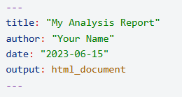
YAML Header Structure
Appears at top between triple dashes (---)
Contains document metadata and formatting options
Customize output format, table of contents, themes
Can include dynamic dates and advanced formatting

Slide 6
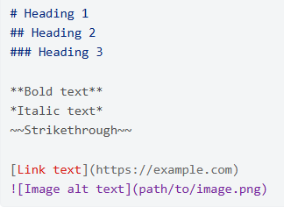
Markdown Text Formatting
Lightweight markup language for text formatting
Headers using # symbols (# Header 1, ## Header 2)
Bold text with text, italic with text
Links, images, lists, and tables with simple syntax

Slide 7

Code Chunks
Execute R code and display results in document
Enclosed in triple backticks with {r} designation
Control behavior with chunk options
Include chunk names for organization and referencing

Slide 8
Chunk Options Control
eval: whether to evaluate code (TRUE/FALSE)
echo: whether to show code (TRUE/FALSE)
include: whether to include chunk in output
message/warning: control display of messages and warnings

Slide 9
Inline Code
Include R code directly within text using backticks
Format: r code_here within sentences
Calculates results and inserts into text
Useful for dynamic reporting of values

Slide 10
Output Formats
HTML: interactive, customizable, web-friendly
PDF: formal appearance, requires LaTeX installation
Word: familiar format for collaboration and editing
Multiple formats can be specified in single document

Slide 11
Document Generation Process
Click Knit button in RStudio
R Markdown runs all code chunks
Generates outputs (tables, plots, etc.)
Formats text according to Markdown syntax
<demonstration>

Slide 12
Advanced Features
Table of contents with toc: true
Code folding for interactive documents
Custom themes and syntax highlighting
Floating TOC and section numbering

Slide 13

Practice Exercises

