Slide 1

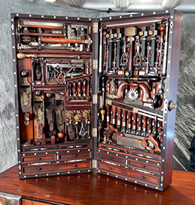
R Functions
https://RStatsBootcamp.com/

Slide 2
Learning Objectives
Describe what functions do and how they work
Use functions effectively with the help system
Understand what packages are and their purpose
Find, download, and use R packages

Slide 3
The Garage and Toolbox Metaphor
R functions are tools that do work for you
Packages are toolboxes containing related functions
R comes with many packages, thousands more available
Functions grouped by task focus and functionality

Slide 4
Function Basics
Generic format: function_name()
Function name with required bracket notation
R is case sensitive for function names
Details like capitalization matter significantly

Slide 5
Using Functions
Input information or data into function brackets
Function output is the work being done
Arguments have unique names and values
Use equals sign for argument assignment

Slide 6
Common Function Names
Often easy to guess: mean(), log(), sd()
plot(), boxplot(), help() for common tasks
Names usually reflect their purpose clearly
Help pages essential for learning usage
<demonstration>

Slide 7
Function Arguments
Each argument has unique name
Values assigned using equals sign
Arguments separated by commas
Optional arguments indicated by “…”

Slide 8
Getting Help with Functions
Use help() function as reference for arguments
Essential until you memorize common functions
Check Usage and Arguments sections carefully
Key to learning R in easiest way

Slide 9
R Packages
Toolboxes built to solve specific problems
Open source and freely available
Download when you identify need for functions
Over 22,000 packages currently available
https://cran.r-project.org/web/packages/

Slide 10
Installing and Loading Packages
Step 1: install.packages(“package_name”)
Step 2: library(“package_name”)
Installing downloads from remote repository
Loading makes functions available for use
<demonstration>

Slide 11
RStudio Package Management
Use Packages tab in lower right pane
Click radio button to load packages
Click Install button to install new packages
Search official CRAN repository by default
<demonstration>

Slide 12
Best Practices
Always get help page up as reference
Learn arguments and customization options
Practice with common functions regularly
Understand before memorizing function usage

Slide 13

Practice Exercises

