Slide 1
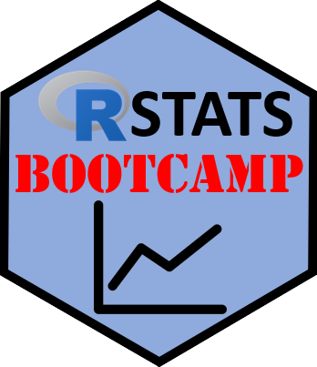

Data Subsetting
https://RStatsBootcamp.com/

Slide 2
Learning Objectives
Describe indexing concept for vectors and matrices
Use which() function to subset data effectively
Select specific parts of data frames
Use aggregate() function to summarize data

Slide 3
Data Sumo Philosophy
Subsetting and manipulating data is core activity
Essential for exploratory data analysis
Used extensively in data acquisition and analysis
Foundation for database queries and data manipulation

Slide 4
Indexing Concept Basics
Data objects store values accessible by “address”
Vectors (1D), matrices (2D), arrays (3D+) have indices
Index values correspond to position of data
Essential for slicing and dicing data

Slide 5
Vector Indexing
Vector indices run from 1 to length of vector
Use [1:i] notation to access elements
R displays index in console output [1]
Access single elements or ranges with brackets

Slide 6
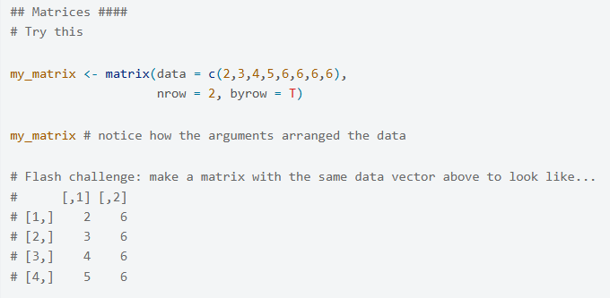
Matrix Indexing
Two dimensions: [rows, columns] or [i, j]
Slice out entire rows or columns with blank space
Can name rows and columns for easier access
Use names in quotes for selection by name

Slide 7
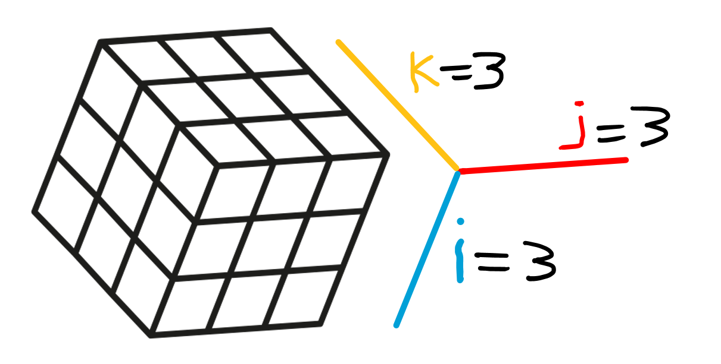
Array Indexing
Three or more dimensions: [i, j, k, …]
Each dimension represents different data organization
More complex but follows same principles
Useful for multi-dimensional data analysis

Slide 8
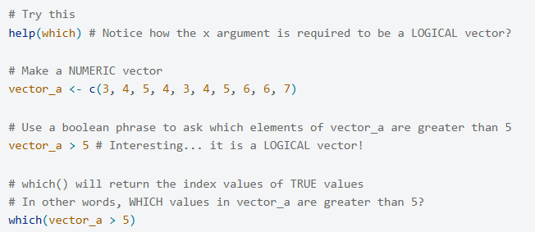
The which() Function
Returns index values where logical expression is TRUE
Requires logical vector as input argument
Powerful for constructing data queries
Essential tool for conditional data selection

Slide 9
Boolean Selection Strategies
Create logical expressions to identify data subsets
Use which() to get index positions of TRUE values
Apply indices to extract desired data values
Alternative to creating multiple dataset versions

Slide 10
Data Frame Selection
Select rows based on values in one or more variables
Combine multiple conditions with & (and) and | (or)
Use which() with complex boolean expressions
Powerful method for data filtering and analysis

Slide 11
Compound Boolean Operations
Chain multiple conditions with logical operators
Use parentheses to control evaluation order
Build complex selection rules step by step
Essential for sophisticated data manipulation

Slide 12
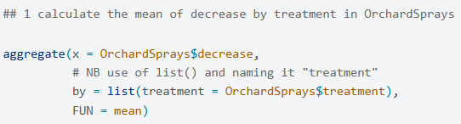
The aggregate() Function
Summarize data by groups using specified functions
x argument: numeric data to summarize
by argument: list of grouping variables
FUN argument: function to apply (mean, sd, etc.)

Slide 13
Custom Functions in aggregate()
Create custom summary functions with function()
Apply multiple statistics simultaneously
Name output elements for clarity
Powerful tool for grouped data analysis

Slide 14

Practice Exercises

