Slide 1
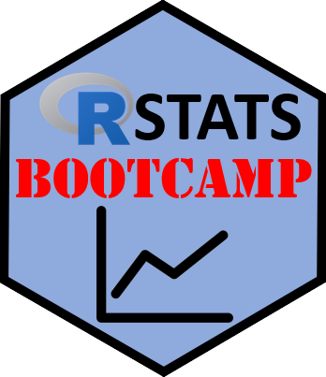

Explore Data
https://RStatsBootcamp.com/

Slide 2
Learning Objectives
Formulate appropriate statistical questions
Perform hypothesis testing using NHST framework
Summarize what “Weighing the Pig” means
Distinguish between Analysis versus EDA

Slide 3
Question, Explore, Analyze Workflow
Dataset often comes in imperfect state
First task is to “weigh the pig” - understand data
Order: Question, Explore, Analyze
Choose analysis prior to collecting first data point

Slide 4
Weighing the Pig Concept
Term for creating summary-at-a-glance of dataset
Includes graphics, statistical summary, and data amount
Key consideration: specification of variables
Best way to gain skill: practice with data

Slide 5
Exploratory Data Analysis (EDA)
Examine variables: are they as expected?
Graph data and examine numerical summaries
Look for errors both trivial and serious
May take large proportion of analysis time

Slide 6
Question Formulation and NHST
Null Hypothesis Significance Testing framework
Population of interest cannot be directly measured
Experimental samples drawn randomly from population
Test statistics compared to expected under null hypothesis

Slide 7
NHST Core Components
Null hypothesis: consistent with no effect
P-value: probability observed effect due to chance
Alpha value: maximum acceptable probability of error (0.05)
Alternative hypothesis: effect we predict to be true

Slide 8
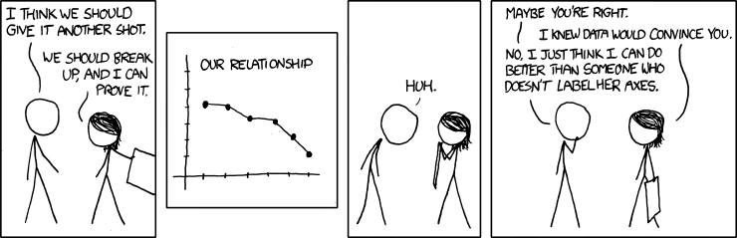
Variables and Graphing Principles
Good graph tells whole story
Bad graph worse than no graph at all
Distinction between EDA graphs and evidence graphs
Must convey relevant information and be self-contained

Slide 9
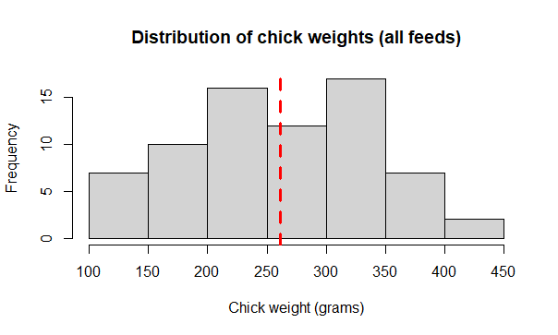
Scientific Graph Requirements
Reflect hypothesis or statistical concept
Appropriate to the data being analyzed
Consistent in aesthetics throughout
Build up information in layers

Slide 10
Analysis versus EDA Distinction
Analysis: generates evidence, fits specific question
EDA: informal exploration and assumptions testing
Analysis designed for others, EDA usually private
Essential parts of complete data analysis process

Slide 11
Statistical Analysis Plan Concept
Formal document connecting hypothesis to analysis method
Created before any data collection begins
Specifies hypotheses, statistical models, and data collection
Effect size and sample size justification included

Slide 12
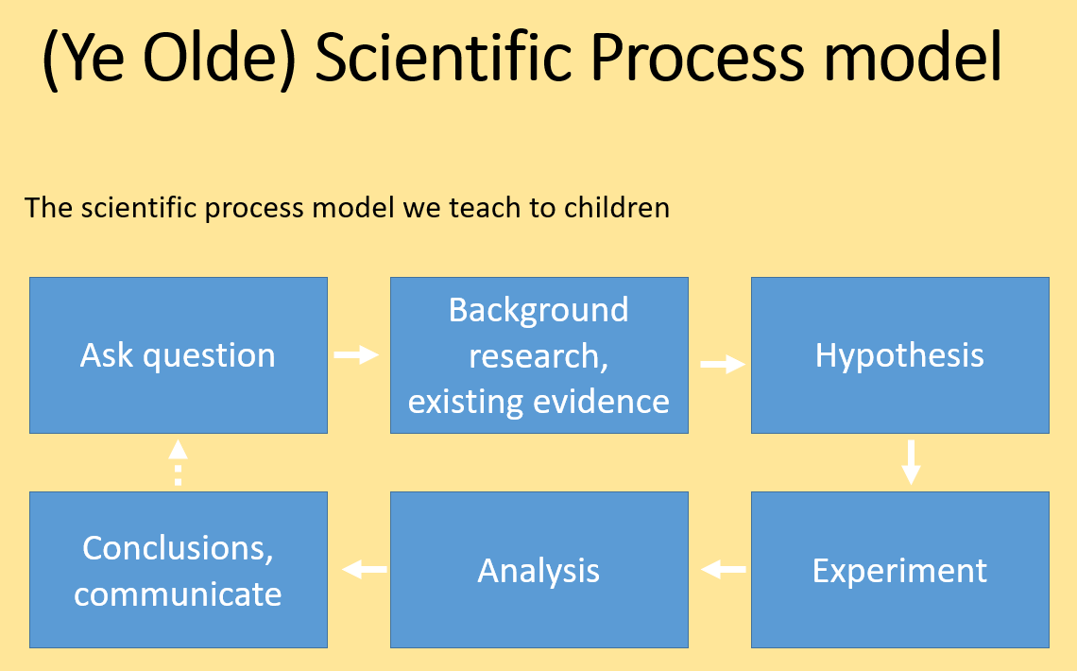

Slide 13
Modern Scientific Method
Traditional cycle inadequate for best practice
Analysis planning must occur with hypothesis formulation
Experimental design phase with power analysis
Statistical analysis plan produced prior to data collection

Slide 14
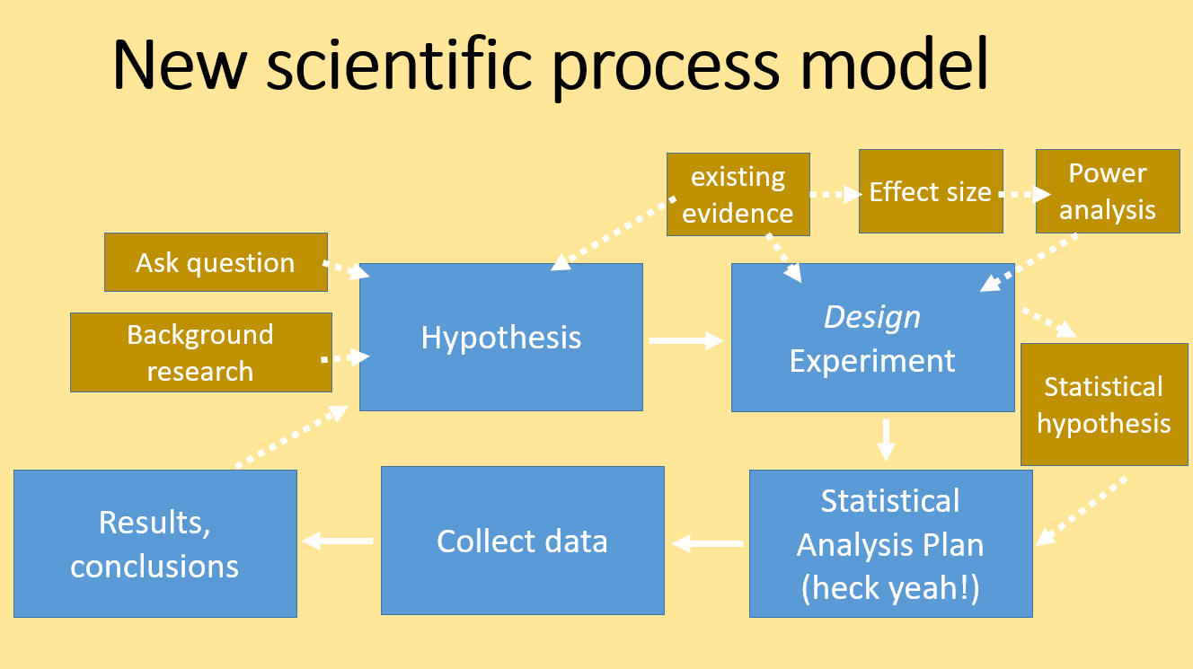

Slide 15

Practice Exercises

