Slide 1
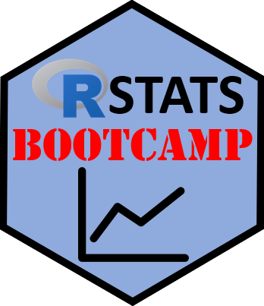

Correlation
https://RStatsBootcamp.com/

Slide 2
Learning Objectives
Analyze correlation between two variables
Evaluate correlation data and assumptions
Graph correlated variables effectively
Perform correlation statistical tests and alternatives

Slide 3
Statistical Relationships
Correlation does not imply causation (fundamental principle)
Statistical relationship doesn’t mean one causes the other
Example: ice cream sales and forest fires correlate via summer heat
Basic tool in data science toolbox for relationships

Slide 4
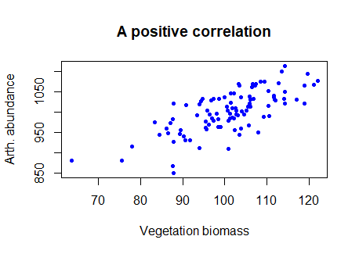
The Question of Correlation
Whether demonstrable association exists between numeric variables
Interested in how variables may “co-vary” (exhibit covariance)
Covariance quantified as positive or negative
Strength varies from zero to perfect correlation (+1 or -1)

Slide 5
Data and Assumptions
Pearson correlation for linear relationships
Requires Gaussian distributed numeric values
Calculated as covariance divided by product of standard deviations
Use cor() function in R for calculation

Slide 6
Graphing Correlation
Traditionally visualized with scatterplot
Degree of “scatter” relates to correlation strength
Can examine specific pairs or correlation matrices
Use pairs() and cor() for multiple variables

Slide 7
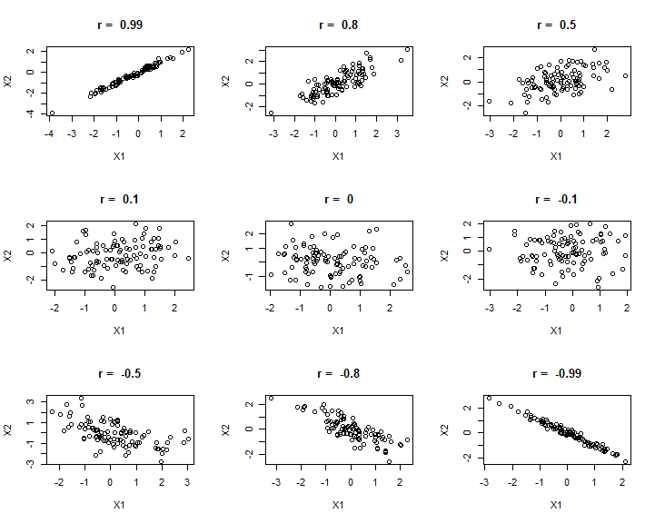

Slide 8
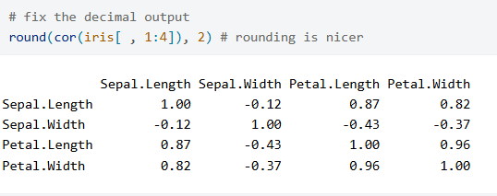
Correlation Matrices
Quickly assess correlation between many variables
Powerful combination of statistical summary and graphing
Can reveal influence of grouping variables (like species)
Essential for multivariate data exploration

Slide 9
Testing Correlation
Use cor.test() for statistical significance
Pearson correlation is default method
Spearman rank correlation when assumptions not met
Follow order: Question, Graph, Test, Validate

Slide 10
Pearson Correlation Assumptions
Linear relationship between variables
Bivariate Gaussian distribution
Homoscedasticity (similar variance across range)
Independence of observations and absence of outliers

Slide 11
Spearman Rank Correlation
Alternative when Pearson assumptions not met
Relaxed assumptions: ranked data and independence
Appropriate for non-linear relationships
Correlation coefficient noted as “rho” (ρ)

Slide 12
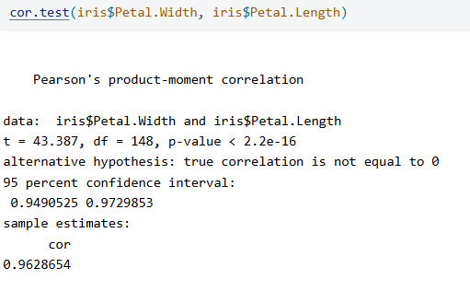
Results and Reporting
Report test statistic, sample size/df, and p-value
Example: “significant correlation (Pearson’s r = 0.96, df = 148, P < 0.0001)”
Round to two decimal places consistently
Never use scientific notation for p-values < 0.0001

Slide 13
Validation Process
Check assumptions before interpreting results
Use diagnostic plots and formal tests
Consider alternative methods if assumptions violated
Document assumption testing in methods section

Slide 14

Practice Exercises

