Slide 1


Collaboration
https://RStatsBootcamp.com/

Slide 2
Learning Objectives
Organize data science projects for effective collaboration
Implement best practices for code sharing and documentation
Use Git and GitHub for team-based workflows
Maintain reproducibility in collaborative environments

Slide 3
Why Collaborative Workflows Matter
Data science increasingly a team effort
Requires more than technical skills - thoughtful organization
Increases productivity through division of labor
Improves quality through peer review and diverse perspectives

Slide 4
Key Collaboration Benefits
Enhanced creativity through diverse perspectives
Continuity when team members change
Systematic approach maximizing productivity
Maintained reproducibility and quality standards

Slide 5
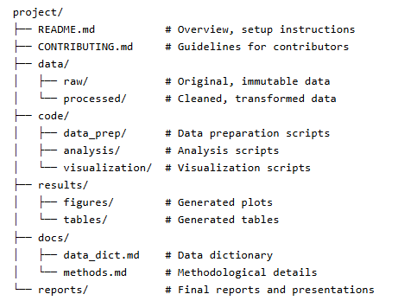
Project Organization for Teams
Well-organized structure helps team navigation
Separate folders for data, code, results, documentation
README.md with overview and setup instructions
CONTRIBUTING.md with guidelines for contributors

Slide 6
Essential Documentation Components
Project overview with setup instructions and usage examples
Code comments explaining why, not just what
Function documentation with purpose, parameters, examples
Data dictionary describing variables and sources

Slide 7
Code Sharing Best Practices
Follow consistent style guides (e.g., tidyverse style guide)
Use consistent naming conventions throughout
Format code for readability and understanding
Consider linters and formatters for consistency

Slide 8
Modular Code Development
Break long scripts into functions
Write code others can understand and reuse
Clear function definitions with inputs and outputs
Main workflow calling individual functions

Slide 9
Package Management
Ensure consistent package versions across team
Use renv for project-specific package management
Document package dependencies clearly
Initialize and snapshot package environments

Slide 10
Git Workflows for Teams
Centralized workflow: simple approach for small teams
Feature branch workflow: better for larger teams
Forking workflow: common for open-source projects
Choose appropriate workflow for team size and complexity

Slide 11
Code Review Process
Guidelines for reviewers: respectful, constructive, focus on code
Guidelines for authors: explain changes, respond positively
Keep pull requests focused and manageable
Acknowledge good practices and thank reviewers

Slide 12
Maintaining Reproducibility
Environment management with renv or conda
Document system requirements and dependencies
Establish protocols for data access and sharing
Implement continuous integration for automated testing

Slide 13

Practice Exercises

