Slide 1
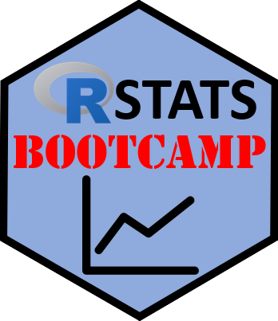

Setup & Introduction
https://RStatsBootcamp.com/

Slide 2


Learning Objectives
Understand how the R Stats Bootcamp works
Describe the motivation for using R
Install R and RStudio or set up RStudio Cloud
Navigate RStudio components and interface

Slide 3
How the R Stats Bootcamp Works
Provides practical, open instructional materials for learning R
Reviews simple statistics in R
Introduces reproducibility and collaboration tools
Blend of practical material with videos and self-assessment

Slide 4
R Motivation
Designed for non-programmers to perform statistical analysis
Growing popularity in universities, companies, and research
Large community of users and high demand for R skills
Free, open source, and cross-platform compatible

Slide 5
Installation Options
Option 1: Download R from CRAN and RStudio Desktop
Option 2: Use RStudio Cloud for browser-based work
Install R first, then RStudio for best results
Consider your computer setup and preferences
https://cran.r-project.org/
https://posit.co/downloads/

Slide 6
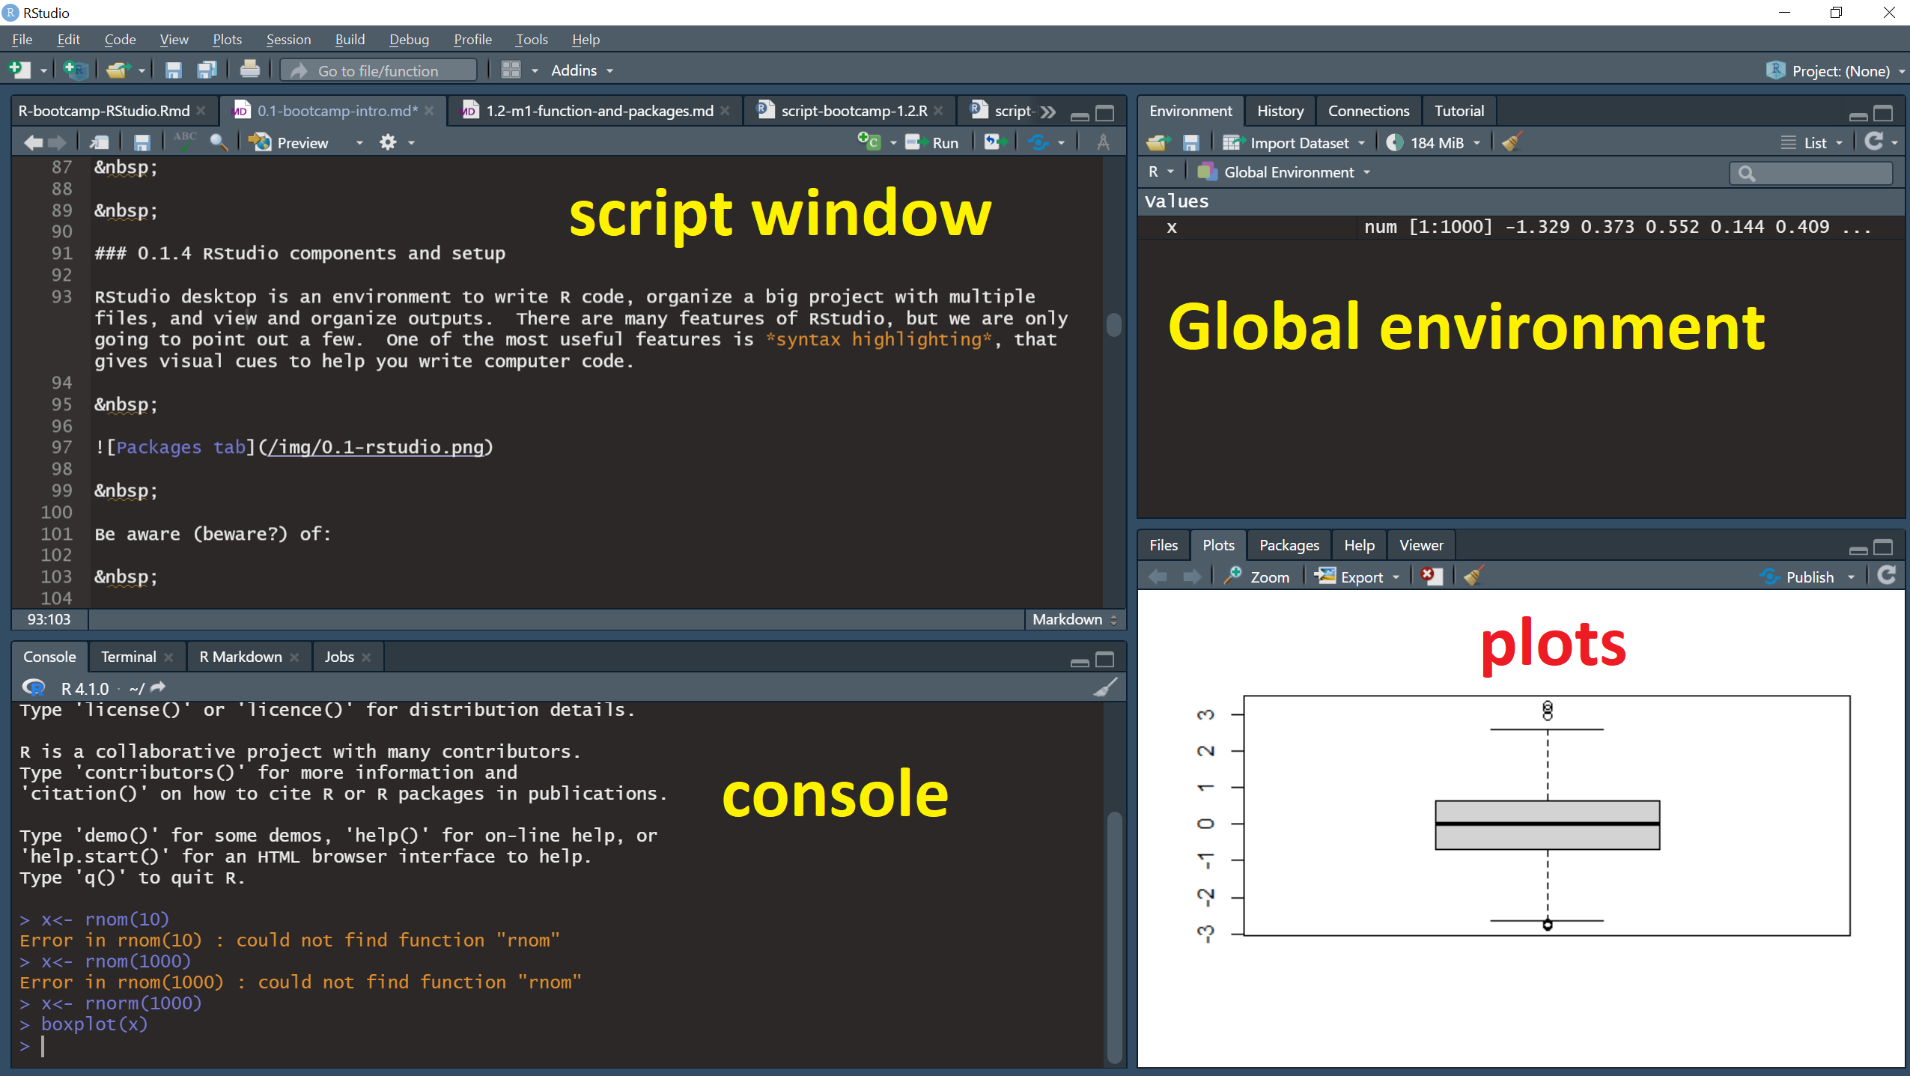
RStudio Interface Components

Slide 7
R Script Organization
Documents analysis for exact reproducibility
Interface between your commands and R software
Should be clear for future collaborators
Think of future self as respected colleague

Slide 8
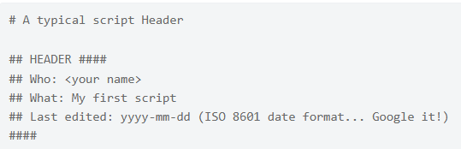
Script Structure Best Practices
Header with name, date, and purpose
Contents section as roadmap for analysis
Code chunks with descriptive titles
Consistent numbering and logical organization

Slide 9
Code Execution Methods
Ctrl+Enter (Cmd+Return on Mac) for current line
Select code and Ctrl+Enter for specific sections
Use Run button in Script window
Access through Code menu for additional options
<demonstration>

Slide 10
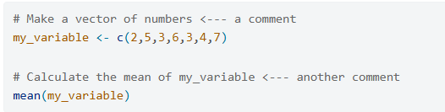
Comments and Documentation
Use # character for comment lines
Explain code like methods section of scientific paper
Provide enough detail for exact replication
Balance thoroughness with conciseness

Slide 11

Practice Exercises

