Slide 1
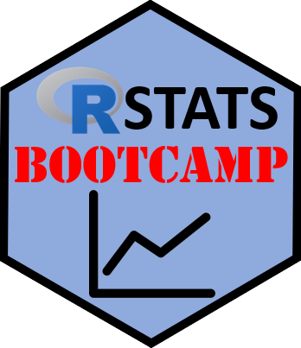

R Language
https://RStatsBootcamp.com/

Slide 2
Learning Objectives
Navigate example scripts, comments, help, and pseudocode
Use math operators effectively in R
Apply logical Boolean operators for data manipulation
Distinguish between base R and Tidyverse approaches

Slide 3
R as a Passive-Aggressive Butler
R is popular statistical programming language and open source software
Designed to help non-programmers perform statistical analyses
Sometimes requires careful language to avoid unexpected outcomes
Essential to view scripts as documentation of work

Slide 4
Script Organization Importance
Write scripts as documentation for respected colleagues
Work through instructions using R and RStudio actively
Type your own code rather than copy-pasting
Document all code with clear, concise comments

Slide 5
Help System in R
Use help() function with tool name in brackets
Help pages organized consistently across all functions
Function name, description, usage, and argument definitions
Essential to understand for effective R use

Slide 6
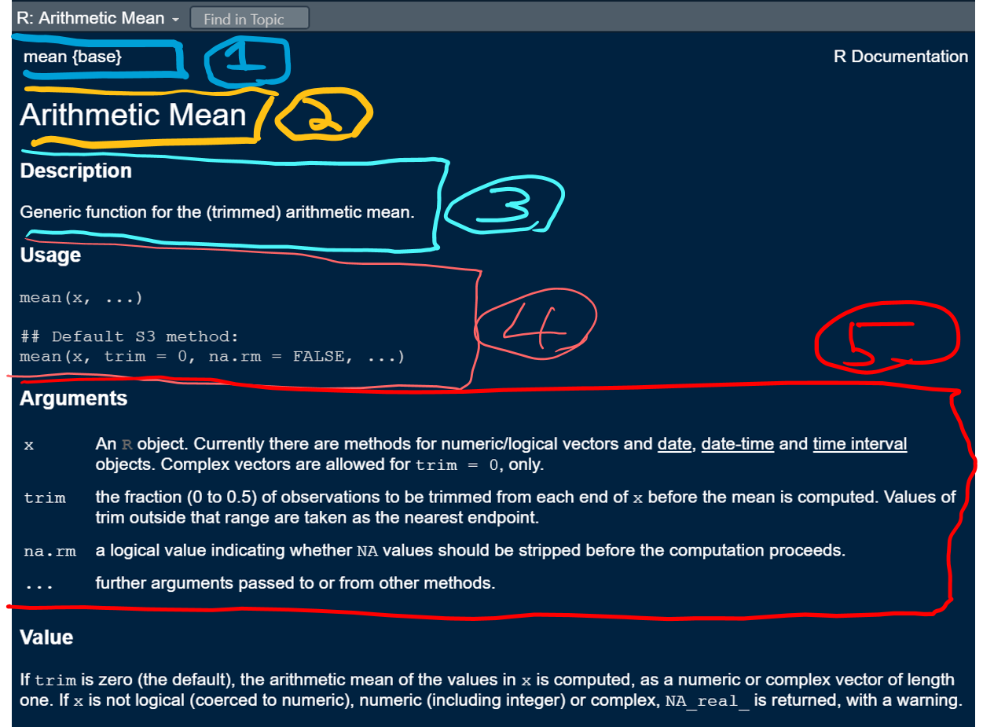

Slide 7
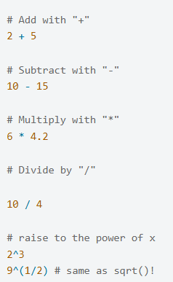
Math Operators
Basic arithmetic: +, -, *, /, ^ (power)
Order of operations follows standard mathematical rules
Use parentheses to control calculation order
Spacing improves readability (use single spaces)

Slide 8
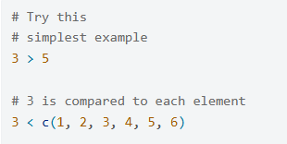
Logical Boolean Operators
Boolean expressions resolve to TRUE or FALSE
Common operators: >, <, ==, !=, &, |, !
Used for selecting groups of data effectively
Powerful alternative to creating different datasets

Slide 9
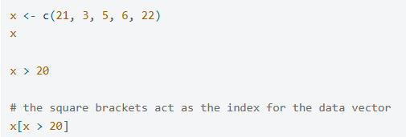
Selecting with Booleans
Use Boolean expressions to select data subsets
Square brackets act as index for data vectors
Combine with logical operators for complex selections
Essential skill for data manipulation

Slide 10
Base R versus Tidyverse
Base R: Traditional, powerful form of R language
Tidyverse: Alternative approach with different conventions
Both have benefits and philosophical differences
Bootcamp focuses exclusively on base R first

Slide 11
Script Section Requirements
Header: Contains name, date, and purpose
Contents: Roadmap listing all major sections
Both sections essential for every R script
Foundation for reproducible research practices

Slide 12

Practice Exercises

