Slide 1
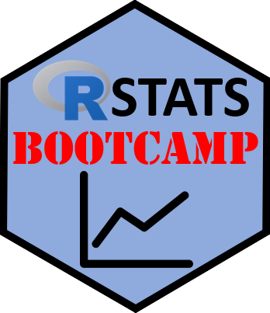
R Markdown
https://RStatsBootcamp.com/

Slide 2
Learning Objectives
Understand the basics of R Markdown
Create documents combining code, output, and narrative text
Format text using Markdown syntax
Generate reports in multiple formats (HTML, PDF, Word)

Slide 3
What is R Markdown?
File format combining R code, output, and narrative text
Powerful tool for reproducible reports, presentations, dashboards
Three key elements: YAML header, Markdown text, Code chunks
Plain text files with special formatting syntax

Slide 4
Getting Started
Create new R Markdown in RStudio: File → New File → R Markdown
Choose document type (HTML, PDF, Word)
Provide title and author information
Template generated for modification

Slide 5
YAML Header Structure
Appears at top between triple dashes (—)
Contains document metadata and formatting options
Customize output format, table of contents, themes
Can include dynamic dates and advanced formatting

Slide 6
Markdown Text Formatting
Lightweight markup language for text formatting
Headers using # symbols (# Header 1, ## Header 2)
Bold text with text, italic with text
Links, images, lists, and tables with simple syntax

Slide 7
Code Chunks
Execute R code and display results in document
Enclosed in triple backticks with {r} designation
Control behavior with chunk options
Include chunk names for organization and referencing

Slide 8
Chunk Options Control
eval: whether to evaluate code (TRUE/FALSE)
echo: whether to show code (TRUE/FALSE)
include: whether to include chunk in output
message/warning: control display of messages and warnings

Slide 9
Inline Code
Include R code directly within text using backticks
Format: r code_here within sentences
Calculates results and inserts into text
Useful for dynamic reporting of values

Slide 10
Output Formats
HTML: interactive, customizable, web-friendly
PDF: formal appearance, requires LaTeX installation
Word: familiar format for collaboration and editing
Multiple formats can be specified in single document

Slide 11
Document Generation Process
Click Knit button in RStudio
R Markdown runs all code chunks
Generates outputs (tables, plots, etc.)
Formats text according to Markdown syntax

Slide 12
Advanced Features
Table of contents with toc: true
Code folding for interactive documents
Custom themes and syntax highlighting
Floating TOC and section numbering

